Slide 1

Mental health Research for Justice and Belonging. Family, community and country.
Goals for Our Studies
Family, community and country.

Slide 2

COVID-19 stressors and mental health problems amongst women who arrived as refugees and those born in Australia
The overall aim of the present study was to examine associations of COVID-19 related material hardship and COVID-19 related fear and stress with a range of CMDs amongst refugee women resettled in Australia. We included data from a sample of Australian-born women who were assessed in parallel with the refugee women to examine areas of commonality and difference between the two groups in relation to the associations between the two COVID-19 stressor domains (material and fear and stress) and key mental disorder outcomes.

Slide 3

Cohort profile: intimate partner violence and mental health among women from refugee background and a comparison group of Australian-born – the WATCH cohort study
The Women Aware with Their Children study was created because prospective data are required to accurately guide prevention programmes for intimate partner violence (IPV) and to improve the mental health and resettlement trajectories of women from refugee backgrounds in Australia.

Slide 4
Attitudes towards gender roles and prevalence of intimate partner violence perpetrated against pregnant and postnatal women: Differences between women immigrants from conflict-affected countries and women born in Australia
The aim was to compare, for the first time in a large systematic study, women born in conflict-affected countries who immigrated to Australia with women born in Australia for attitudes towards gender roles and men’s use of IPV and the actual prevalence of IPV. The study also examined if any associations remained across the two timepoints of pregnancy and postpartum.

Slide 5

Enabling Dads and Improving First Nations Adolescent Mental Health: A Pragmatic Randomised, Controlled Study.
Our pragmatic community-based research intervention “Enabling Dads and Improving First Nations Adolescent Mental Health” is designed to improve the mental health of First Nations adolescents living in communities in the Far North of Australia. The study also aims to strengthen parenting knowledge and empowerment amongst the participating male fathers. The study aims to address a dire need to reduce the burden and risk of mental illness and suicide in our First Nations adolescents and to improve the social and emotional wellbeing of their fathers. 15 This project draws on existing cultural knowledge and strengths and aims to be sustainable, replicated and rolled out by First Nations communities if it achieves its anticipated outcomes

Slide 6
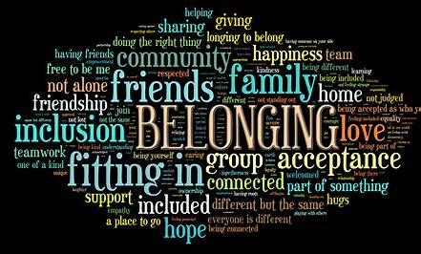
Forced migration, trauma, and the risk of mental health disorders among women in the perinatal period
provides an updated global prevalence estimate of perinatal depressive disorders among women who are migrants, and the first global estimates for anxiety and post-traumatic stress disorder (PTSD) among women who are migrants in the perinatal period.
This quality systematic review and meta-analysis offers the migrant and refugee mental health field a comprehensive assessment of current knowledge to inform new studies, policies, and interventions, and to identify dissonance and gaps in knowledge. The review's inclusion of studies examining all common mental health disorders confirmed a predominant focus on depression.

