Slide 1

STAFF PD · LEARNING SUPPORT · FIVE MINUTES
There's a genius baby driving your forklift.
How to get real work out of Copilot Chat — without putting a student, a report, or your professional judgement in the path of it.
The genius · The forklift · The crash · The brakes
Notes:
Open with the picture, not the theory. The joke is the whole model: what we've been handed is something with an enormous amount of knowledge and no life experience, no stake in the outcome, and no idea which of the things in this room is a legal document. Fifteen minutes, four stages, and everyone leaves with one thing to try.

Slide 2
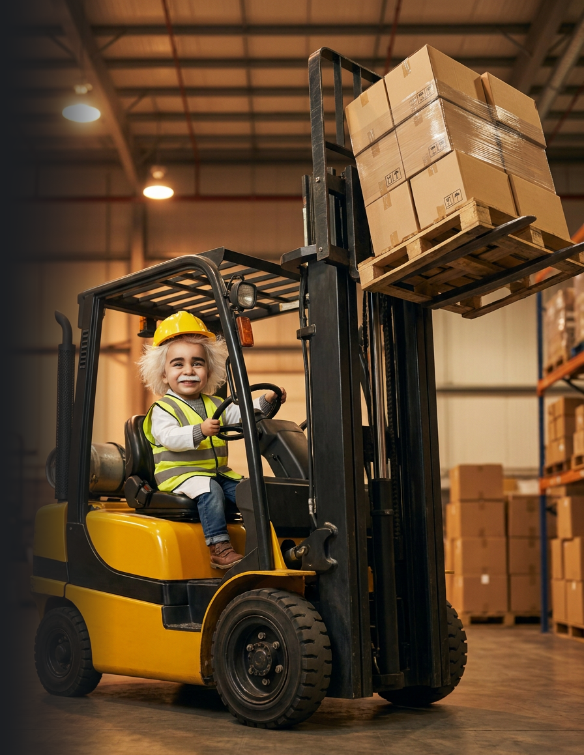

THE WHOLE IDEA, IN ONE SLIDE
It is brilliant, it is fast, and it has no idea what it's carrying.
THE GENIUS
THE FORKLIFT
THE CRASH
Read more than you ever will. Understood none of your students.
A chatbox doesn't make it smarter. It gives it reach.
Nobody crashes on purpose. They crash faster than their brakes.
0%
of its confidence comes from knowing it's right. That is the whole problem.
Notes:
Twenty seconds per picture, no more. Genius, reach, consequence — then say: 'which is why the rest of this is about brakes.' The 0% is the line to land: it is not confident because it checked, it is confident because that is how it writes.

Slide 3
THE RED LINES
No prompt is good enough to make these okay.
Real names, dates of birth, addresses, photos or student ID numbers.
Anything touching a child protection or safeguarding matter. Ever. Not even de-identified.
✕
✕
Psychology, OT, speech, paediatric or medical reports — no excerpts, no screenshots, no “just this one bit”.
Letting the model make the call on a diagnosis, an adjustment, a placement or a funding claim.
✕
✕
A diagnosis attached to anything that could identify the child.
Report comments or assessment judgements submitted as your own. NESA and the IB both require the judgement to be yours.
✕
✕
Full ILPs, PLPs, NCCD evidence, case-meeting minutes or parent emails pasted in verbatim.
Pasting AI text into a formal document without rewriting it as your own professional judgement.
✕
✕
If you catch yourself typing “is it okay if I just…”, the answer is no.
Your school account protects where data travels — not whether you're allowed to send it. That's the Privacy Act and our own policy. Ask the privacy or IT lead before, not after.
Notes:
Read these out. Don't paraphrase. This is the slide people photograph, so make sure it matches your school's own policy wording before you present it.

Slide 4
BRAKE TWO
Check the C.O.R.E. before you lift.
“I'm a learning support teacher. Year 8 student, decoding at roughly Year 3 level, mainstream science, one TA.”
C
CONTEXT
Who you are, who the learner is, the setting. Never a name.
“Rewrite the passage so they can access it independently. Give it to me as a two-column table.”
O
OBJECTIVE & OUTPUT
What you want — and the exact shape it comes back in.
“You're an experienced LS teacher. Keep all six key terms, max 200 words, don't simplify the science.”
R
ROLE & RULES
Who it's being, and the limits it has to hold.
“Match the tone of this line: […]. Then flag any term that still needs pre-teaching.”
E
EVALUATION & EXAMPLES
One example of good — and how you'll judge what comes back.
Four lines, about forty seconds. Role and examples are the two people skip — and they're the two that move the answer most.
Notes:
Get them to say C.O.R.E. out loud once — the mnemonic is doing the work here, not the detail. If you only have time to labour two letters, do R and E: assigning a role and giving one worked example are the two techniques that move the answer most, and they're the two everyone skips. C is where the privacy discipline lives — 'never a name' is part of the scaffold itself, not a separate rule to remember later.

Slide 5
WHEN THE BRAKES DIDN'T WORK
You typed a real name. Here's the next ten minutes.
1
Stop. Don't send another prompt in that thread trying to talk your way out of it.
2
Screenshot the thread, then write down what you entered and roughly when.
3
Do not quietly delete it and hope. Deleting destroys your evidence, not the record.
4
Tell your principal or the school's privacy contact today. Whether it's a notifiable breach is their call to make, not yours.
Reporting it the same day is a small conversation. Finding out six weeks later is not.
Notes:
Say plainly that this slide exists because it will happen to someone in this room. The goal is to make same-day reporting feel routine rather than career-ending — the cover-up is always worse than the paste. Do not improvise the reporting chain: name your actual principal and privacy contact here before you present.

Slide 6
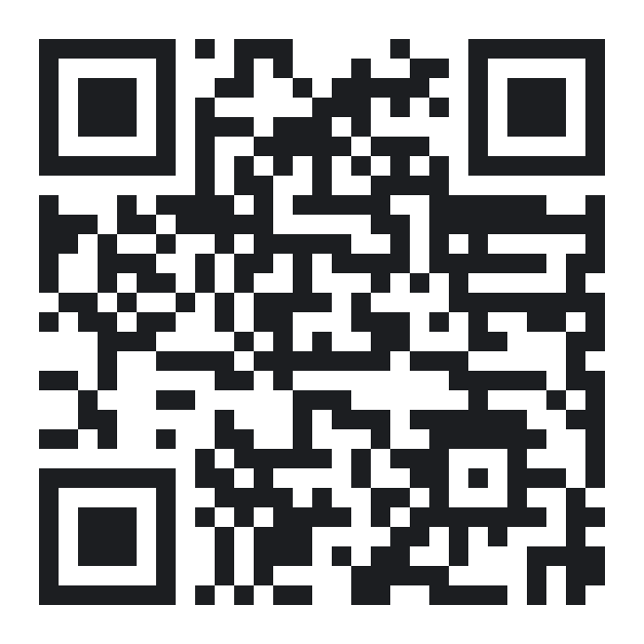
BEFORE YOU LEAVE
One thing. Before Friday.
1
Take a task you're already setting. Retype it with no names.
TAKE-HOME
2
Run it through the C.O.R.E. — four lines, forty seconds.
The C.O.R.E. scaffold
The de-identify swap list
The three-point brake check
The red lines
3
Check the output: is it true, is it mine, is anyone identifiable?
4
Scan the code for the one-pager. It has everything this deck skipped.
SCAN FOR THE ONE-PAGER
myaitutor.au/resources
The baby is a genius. The forklift is genuinely powerful. You are the only qualified adult in the warehouse.
Notes:
Land the last line and stop. Do not run a Q&A off the front — take questions one to one, or you will overrun a five-minute slot. Point at the QR: everything you skipped is on that one page. Say the privacy contact's name out loud here rather than putting it on the slide.

