Slide 1

STAFF PD · LEARNING SUPPORT · ABOUT 15 MINUTES
There's a genius baby driving your forklift.
How to get real work out of Copilot Chat — without putting a student, a report, or your professional judgement in the path of it.
The baby · The forklift · The crash · The brakes
Notes:
Open with the picture, not the theory. The joke is the whole model: what we've been handed is something with an enormous amount of knowledge and no life experience, no stake in the outcome, and no idea which of the things in this room is a legal document. Fifteen minutes, four stages, and everyone leaves with one thing to try.

Slide 2
THE RUN SHEET
Four stages. Fifteen minutes. One thing to try.
01
02
03
04
THE BABY
THE FORKLIFT
THE CRASH
THE BRAKES
What this thing actually is — and why it sounds so certain about everything.
What a chatbox lets it lift for you, and the loads actually worth lifting.
The three ways it goes wrong specifically in a learning support context.
De-identify · the C.O.R.E. scaffold · the three-point check · and the recovery plan.
3 min
4 min
3 min
5 min
You'll leave with one prompt scaffold, one red-line list, and one thing to try before Friday.
Notes:
Set expectations: this is not a tools demo, it's a judgement session. Nobody is being asked to use AI. People who never open Copilot again should still leave knowing what their colleagues are pasting into it.

Slide 3
01
THE GENIUS BABY
It has read more than you ever will. It has understood none of your students.
Both halves of that sentence matter. Underrate the first half and you waste it. Underrate the second half and you hurt someone.
Notes:
Hold on this slide. The single biggest misconception in staffrooms is that the thing is either magic or rubbish. It is neither: it is extraordinarily capable at language and completely empty of context.

Slide 4
WHAT YOU'RE ACTUALLY WORKING WITH
Genius at the words. Clueless about the child.
GENIUS AT
CLUELESS ABOUT
Language — Rewriting, simplifying, restructuring, changing tone.
Your student — It has never met them and never will.
Volume — Thirty variations while you make a coffee.
Your context — The class, the TA, the timetable, the 2pm trigger.
Shape — Turning your messy notes into a clean structure.
What's true — It predicts plausible. Plausible is not correct.
Formats — Tables, sentence starters, step sequences, cloze.
What matters — It can't tell a warm-up from a legal document.
Patience — It will never sigh at the ninth rewrite.
Stakes — An ILP and a shopping list look identical to it.
0%
of its confidence comes from knowing it's right. It predicts plausible — and plausible is not correct.
Notes:
Ask the room for one thing from the left column they'd want back this term — that buys you the attention for the right column. Then land the right column hard: fluency is not a quality signal. Teachers read confident prose as competent prose, and this thing has no mechanism for sounding unsure. Pause on the 0% — it's the single line most likely to change how someone reads an output this week.

Slide 5
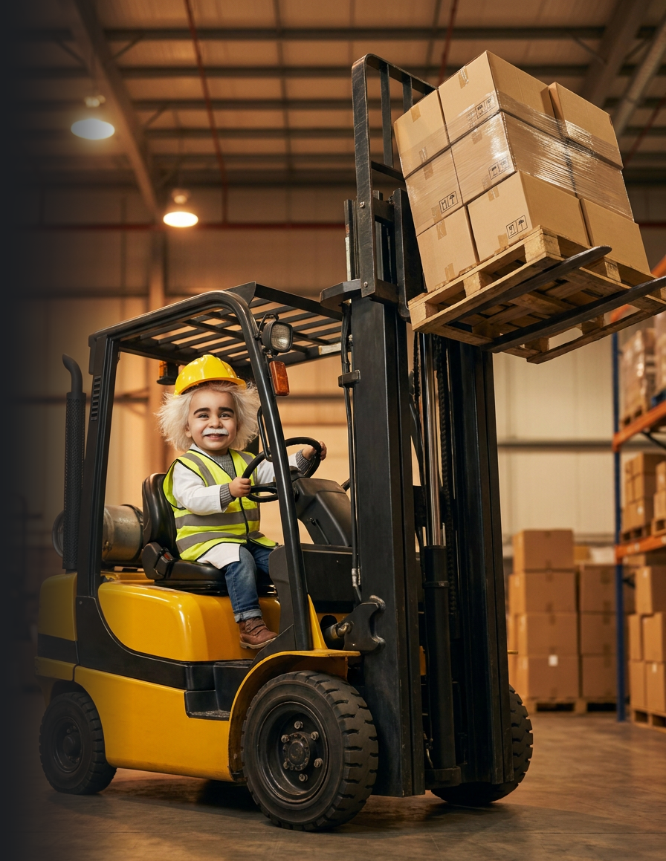
02
THE FORKLIFT
A chatbox doesn't make it smarter. It gives it reach.
Copilot Chat is the forklift: it shifts loads you'd otherwise spend a free period on. Whether that's useful depends entirely on where you point it.
Notes:
Distinction worth making out loud: the chatbox didn't add intelligence, it added leverage and speed. Leverage amplifies whatever you bring to it — including bad judgement.

Slide 6
WHERE TO POINT IT
Six loads worth lifting.
1
Reading-age rewrites
2
Tiered tasks
3
Scaffolds on demand
Same content, lower reading age, subject vocabulary kept intact. Any subject, any year.
One worksheet becomes three levels. Extension, core and entry, in about a minute.
Sentence starters, cloze, word banks, step sequences, checklists, glossaries.
4
ILP and PLP drafting
5
Plain-language comms
6
Long-document triage
Your bullet points into SMART wording. Goals, adjustments, review notes. You set the goal.
Parent emails, newsletter blurbs, a dense report paragraph turned into something a parent can actually read.
A 40-page policy, research paper or set of meeting minutes cut down to what touches your caseload.
Every one of these starts with your professional thinking and ends with your professional edit. The forklift carries the load. It does not decide where the load goes.
Notes:
Notice what is NOT on this list: deciding an adjustment, writing an assessment judgement, or anything that involves a real child's records. Those come up in the crash section.

Slide 7
THE BEST TRICK ON THIS SLIDE DECK
Crash-test the task before the student does.
The highest-value prompt in learning support isn't "make me a worksheet". It's asking the model to fail at your task on purpose.
STEP 1 — MAKE IT BREAK
STEP 2 — ONLY THEN, FIX
“You're a Year 7 student with weak working memory and slow processing. Below is a task I've written. Work through it step by step as that student and tell me the exact points where you'd get stuck, give up, or need to re-read. Don't fix it yet — just show me where it breaks.”
“Now suggest three adjustments, ranked by how little they change the task for everyone else.”
It stress-tests your design — not replaces it. You still wrote the task.
No student data needed — the profile is generic by construction.
You keep the decision — it hands you options; you pick and adapt.
You are still the one who decides what the fix is. It just found the potholes faster than a read-through would.
Notes:
This is the slide to slow down on. It reframes the tool from content generator to thinking partner, and it's the safest possible use because there's no real student in it.

Slide 8
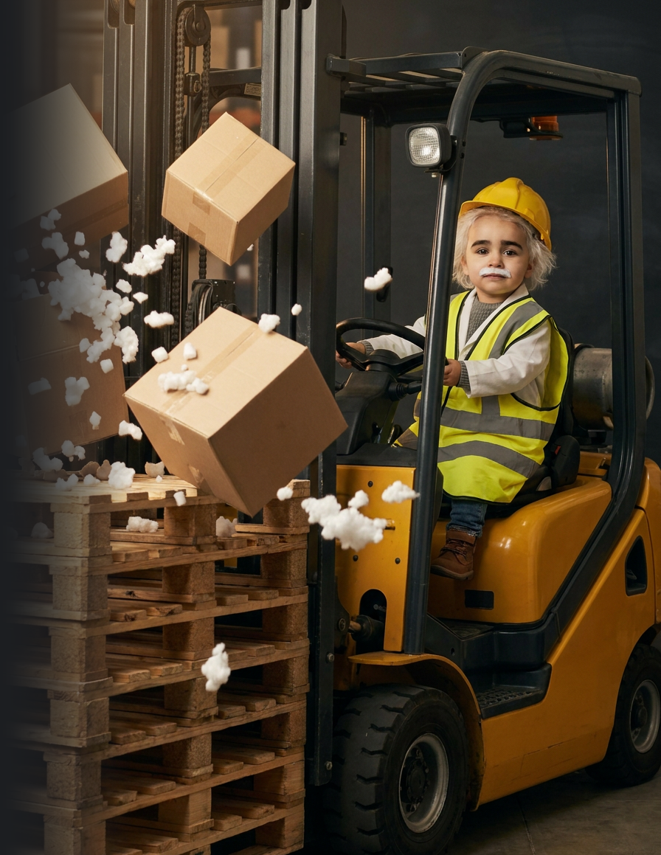
03
THE CRASH
Nobody crashes on purpose. They crash going faster than their brakes.
Three crashes matter in our work. One is loud and obvious. One is embarrassing. The third one is quiet, and it's the one that actually costs a kid something.
Notes:
Keep the tone light here — the humour buys you the attention for the privacy content. Nobody in the room is a villain; everyone is busy.

Slide 9
FAILURE MODES
Three ways this goes wrong in learning support.
THE PRIVACY CRASH
THE ACCURACY CRASH
THE JUDGEMENT CRASH
LOUD
EMBARRASSING
QUIET
You paste the real thing — a name, a report excerpt, case-meeting notes, a screenshot with a face in the corner. It leaves your control the moment you press enter, and there is no un-sending it.
It invents a strategy, a diagnostic criterion, a percentile, a policy clause, a reference. It will sound exactly like the textbook. It will not be in the textbook.
It writes an adjustment that reads professionally. It's 4:40pm. You're tired. You keep it. A decision about a child has now been made by autocomplete, in your name.
Biggest risk. Easiest to avoid.
Costs you credibility in a meeting.
The one that actually costs a student.
All three have the same fix, and it isn't "use AI less". It's brakes.
Notes:
Ask: which of these three have you already seen happen — here or anywhere? Usually someone volunteers an accuracy crash. That opens the door to the judgement one.

Slide 10
BEFORE YOU TYPE ANYTHING
Which Copilot are you actually in?
SIGNED IN WITH YOUR SCHOOL ACCOUNT
PERSONAL ACCOUNT, OR LOGGED OUT
Work accounts get enterprise data protection: your prompts stay inside your organisation's tenant and aren't used to train the model. Look for the protection indicator next to the prompt box. Necessary, but not sufficient — see below.
Treat every word you type as public. Same standard as posting it to the school's Facebook page. This includes the free consumer app on your own phone during a free period — the account is what matters, not the device.
PROTECTED IS NOT THE SAME AS PERMITTED
Enterprise protection governs where your data travels. It does not grant permission to put student information into it. As a non-government school we sit under the federal Privacy Act and the Australian Privacy Principles — and anything from a psychologist, OT, speech pathologist or paediatrician is health information, which carries a higher bar again. None of that changed when Copilot arrived.
CHECK THIS AGAINST YOUR SCHOOL'S CURRENT AI-USE POLICY AND APPROVED-TOOL LIST — BOTH OF THEM CHANGE
Notes:
Before you present: confirm the school's current AI-use policy and approved-tool list — that guidance moves, so verify it rather than trusting this slide. The legal point to land is that non-government schools sit under the federal Privacy Act and the Australian Privacy Principles. NSW public schools are the other way round — PPIPA, plus HRIPA for allied-health reports — so if anyone in the room has come from the public system, say that out loud so they don't apply the wrong instrument. Allied-health reports are health information either way, which is the highest bar of all. Don't improvise beyond this: if you're asked something you can't answer, say you'll check with the privacy lead.

Slide 11
04
THE BRAKES
Brakes aren't what slow you down. They're what let you drive fast.
Three of them. About thirty seconds each. Learn them once and you can use this thing at speed without thinking about it.
De-identify · Check the C.O.R.E. · The three-point check
Notes:
Reframe: guardrails are not compliance theatre, they're what makes fast use defensible.

Slide 12
BRAKE ONE
De-identify before you type, not after.
INSTEAD OF
TYPE THIS
“Jayden really struggles with…”
“A Year 5 student who struggles with…”
“His psych report says working memory 4th percentile”
“Assessed with significant working memory difficulty”
Pasting the ILP straight in
Typing the three goals in your own words, no name
“Room 12, in Ms Patel's class”
“A mainstream Year 5 class with one TA”
A photo of the worksheet with a name in the header
Retyping the task text on its own
The train test: print the prompt, leave it on a train — is anyone identifiable? Year level, condition, class and suburb together are enough. De-identification is a combination test, not a name test.
Notes:
The combination point is the one people miss. Removing the name is not de-identification in a small school where there's exactly one Year 5 student with that profile.

Slide 13
BRAKE TWO
Check the C.O.R.E. before you lift.
“I'm a learning support teacher. Year 8 student, decoding at roughly Year 3 level, mainstream science, one TA.”
C
CONTEXT
Who you are, who the learner is, the setting. Never a name.
“Rewrite the passage so they can access it independently. Give it to me as a two-column table.”
O
OBJECTIVE & OUTPUT
What you want — and the exact shape it comes back in.
“You're an experienced LS teacher. Keep all six key terms, max 200 words, don't simplify the science.”
R
ROLE & RULES
Who it's being, and the limits it has to hold.
“Match the tone of this line: […]. Then flag any term that still needs pre-teaching.”
E
EVALUATION & EXAMPLES
One example of good — and how you'll judge what comes back.
Four lines, about forty seconds. Role and examples are the two people skip — and they're the two that move the answer most.
Notes:
Get them to say C.O.R.E. out loud once — the mnemonic is doing the work here, not the detail. If you only have time to labour two letters, do R and E: assigning a role and giving one worked example are the two techniques that move the answer most, and they're the two everyone skips. C is where the privacy discipline lives — 'never a name' is part of the scaffold itself, not a separate rule to remember later.

Slide 14
SAME TOOL, SAME MINUTE
What the C.O.R.E. actually buys you.
NO SCAFFOLD
WITH THE C.O.R.E.
“Make a worksheet for a struggling student.”
“You're an experienced learning support teacher. Year 8 student, mainstream science, decoding at roughly Year 3 level, one TA. Rewrite the passage below so they can access it independently — two-column table, original and simplified. Keep all six key terms bold, max 200 words, don't simplify the science. Match the tone of: 'Water moves from a weak solution to a strong one.' Then flag any term still needing pre-teaching.”
What comes back:
Generic content, wrong reading level, no link to your curriculum, no scaffolds, an invented context. You rewrite the lot.
Net time saved: negative.
What comes back: something you edit for five minutes and use.
Notice there isn't a single student detail in the good prompt. Specific about the barrier, anonymous about the child.
Notes:
Read the good prompt aloud — it sounds like how you'd brief a new TA. That's the mental model: brief it like a capable stranger who has never met your class.

Slide 15
BRAKE THREE
The three-point check, on the way out.
Run this on the output, before it goes anywhere near a student, a parent, or a file.
1
2
3
IS IT TRUE?
IS IT MINE?
IS ANYONE IDENTIFIABLE?
Every strategy, statistic, criterion or citation gets checked against something you'd be willing to cite in a meeting. If you can't verify it, cut it. Don't soften it — cut it.
Would I have written this? If it isn't the call you'd have made, it doesn't go in. Rewrite it in your own voice, especially for anything formal or anything a parent will read.
Check the output, not just what you typed. It will cheerfully invent a student name and you will paste it straight into a real document at 4:40pm.
Thirty seconds, every single time — and hardest when you're tired. Tired is exactly when the judgement crash happens.
Notes:
Point three surprises people. Models routinely fill in a plausible name when you've de-identified, and that name then travels into a real ILP.

Slide 16
THE RED LINES
No prompt is good enough to make these okay.
Real names, dates of birth, addresses, photos or student ID numbers.
Anything touching a child protection or safeguarding matter. Ever. Not even de-identified.
✕
✕
Psychology, OT, speech, paediatric or medical reports — no excerpts, no screenshots, no “just this one bit”.
Letting the model make the call on a diagnosis, an adjustment, a placement or a funding claim.
✕
✕
A diagnosis attached to anything that could identify the child.
Report comments or assessment judgements submitted as your own. NESA and the IB both require the judgement to be yours.
✕
✕
Full ILPs, PLPs, NCCD evidence, case-meeting minutes or parent emails pasted in verbatim.
Pasting AI text into a formal document without rewriting it as your own professional judgement.
✕
✕
If you catch yourself typing “is it okay if I just…”, the answer is no.
Close the tab and ask your privacy or IT lead. That conversation takes two minutes. The other one takes a term.
Notes:
Read these out. Don't paraphrase. This is the slide people photograph, so make sure it matches your school's own policy wording before you present it.

Slide 17
WHEN THE BRAKES DIDN'T WORK
You typed a real name. Here's the next ten minutes.
1
Stop. Don't send another prompt in that thread trying to talk your way out of it.
2
Screenshot the thread, then write down what you entered and roughly when.
3
Do not quietly delete it and hope. Deleting destroys your evidence, not the record.
4
Tell your principal or the school's privacy contact today. Whether it's a notifiable breach is their call to make, not yours.
Reporting it the same day is a small conversation. Finding out six weeks later is not.
Notes:
Say plainly that this slide exists because it will happen to someone in this room. The goal is to make same-day reporting feel routine rather than career-ending — the cover-up is always worse than the paste. Do not improvise the reporting chain: name your actual principal and privacy contact here before you present.

Slide 18
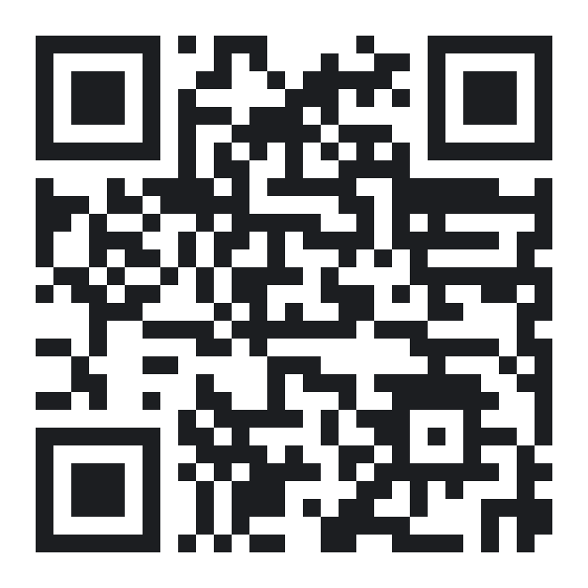
BEFORE YOU LEAVE
Five minutes. Right now.
1
Open Copilot Chat. Check you're on your school account.
TAKE-HOME
2
Take a task you're already setting next week. Retype it, no names.
The C.O.R.E. scaffold
The de-identify swap list
The three-point brake check
The red lines
3
Run the crash-test prompt: make it fail as the student, before it fixes anything.
4
Ask for three adjustments, ranked by least disruption.
SCAN FOR THE ONE-PAGER
myaitutor.au/resources
5
Bin two. Keep one. Make it yours.
The baby is a genius. The forklift is genuinely powerful. You are the only qualified adult in the warehouse.
Notes:
Land the last line and stop. Don't add a Q&A slide — take questions on this one so the sentence stays on the screen the whole time.

