Slide 1
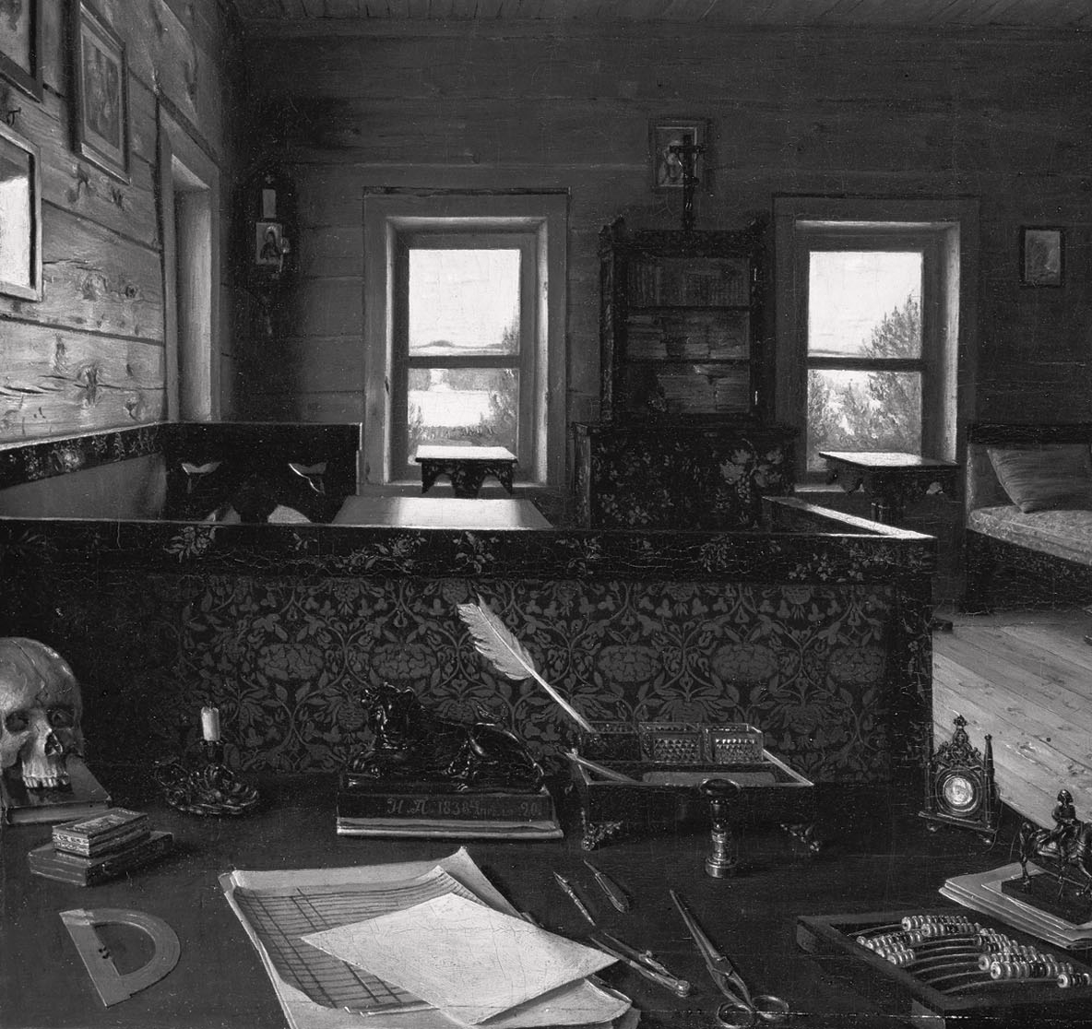
Where the mind things are

Slide 2
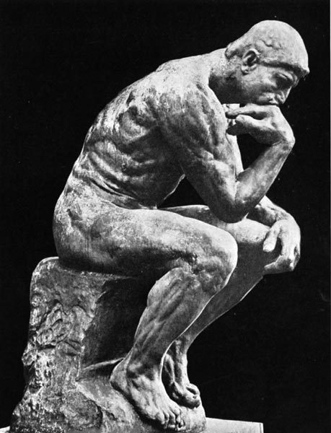
Mental work
stage
Semantic, ideas,
case studies
Expertise,
Expirience
Theory
Estimations, Resource plans
Time sheets, billings
Method
Templates, samples
Evidence
Content
MENTALWARE

Slide 3
Mental work layers
Concept1 Concept2 Concept3
Thesaurus
Workflow
Time1
Time2
Time3
MENTALWARE
Log files
Content1
Content2
Content3

Slide 4
Induction of hypothesis
Start
Reconstruction
Collection
Organize output
Revise
Design
Deduction of
Predictable consequences
Continue
Time-loop
Observation
Search for input
Selection
Test and evaluate

Slide 5
Development of
layered representations
DESIGN
Inner
representation
Next revisions
VISION
CHANGES
perspective
Outside perspective
here & now
Current version
retrospective
History

Slide 6
What do you think about it
Expression
Select
Iterate
Arithmetic
ADD
SUB
MUL
DIV
..
IF
THEN
ELSE
WHILE
DO
OPERAND
OPERAND
OPERAND

Slide 7
Step by step
Step 1
Step 2
Step 3
Sequence
Result
REC 1
REC 2
REC 3
END
Keep order
Save state and log results
Time planning — critical, ribbon, adaptive

Slide 8
Take a choice
Selection
DEFAULT CHOICE
CASE 4
CHOICE 4
CASE 3
CHOICE 3
CASE 2
CHOICE 2
ELSE
CASE 1
CHOICE 1
IF
THEN
CASES
CHOICE

Slide 9
Operate with operands to get results
Operand 1
OP1
Operand 2
OP2
Antecedent
ANT
Add | Sub | Mul | Div
Operator
FILE
Arithmetic
Total

