Slide 1
TEAM 13
Online Store
Cart & Order Pipeline
A Java-based e-commerce simulation covering CO1 – CO6
ALLU SHARAN TEJ
ABBARAJU SHANMUKHA SRIRAM
2620030461
2620030507
Developer
Developer
Problem Solving Using Programming (Java) · 26SC1101E

Slide 2
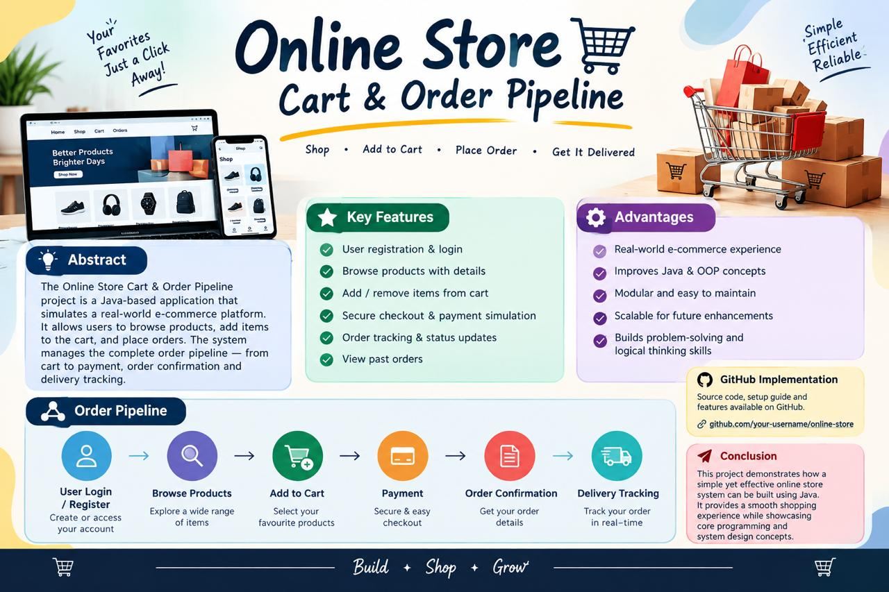

Slide 3
ABSTRACT
Project Overview
The Online Store Cart & Order Pipeline is a Java-based application that simulates a real-world e-commerce platform. It allows users to register, browse products, add items to a shopping cart, place orders, complete a secure checkout, and track order status in real time.
The system manages the complete order pipeline — from cart to payment confirmation and delivery tracking. Built using core Java programming concepts across CO1 to CO6, the project demonstrates computational thinking, object-oriented design, collections, streams, and file persistence in a practical shopping domain.
Online Store Cart & Order Pipeline · Team 13 · 26SC1101E
2

Slide 4
PROBLEM STATEMENT
Understanding the Challenge
01
02
Seamless Shopping
Full Pipeline
Users need an easy way to browse products, manage a cart and complete purchases online.
System must handle registration, catalog, cart, payment simulation and order tracking.
03
04
Data Integrity
Skill Coverage
All operations must be reliable, maintain correct state and give clear status feedback.
Solution must demonstrate progressive Java skills from basic I/O to collections & streams.
Online Store Cart & Order Pipeline · Team 13 · 26SC1101E
3

Slide 5
COURSE OUTCOME 1
Foundations — Problem to Program
1
Computational Thinking & IPO analysis for Online Store (User, Product, Cart, Order)
2
Problem charter: clear inputs, processing rules, expected outputs and edge cases
3
Algorithms, pseudocode and flowcharts for registration, browse and add-to-cart
4
Variables, identifiers, literals, constants and primitive data types
5
Operators, expressions, precedence and decision logic for price calculations
6
Type conversion and casting (int ↔ double for totals)
7
Scanner and formatted console I/O for menu-driven interaction
8
CO1 completion: sequential program — register → browse → add to cart
Online Store Cart & Order Pipeline · Team 13 · 26SC1101E
4

Slide 6
COURSE OUTCOME 2
Decisions & Loops
if / if-else / nested
for loops
Login validation, stock checks & discount eligibility
Iterate product catalog and display cart items
if-else-if ladder
while loops
Order status: Placed → Confirmed → Shipped → Delivered
Continuous processing until user exits
switch statement
break / continue
Main menu: Browse / Cart / Checkout / Track
Skip out-of-stock, stop on payment failure
Boolean logic
Policy → Path
Decision tables for payment & coupon rules
E-commerce rules become runnable decisions
Online Store Cart & Order Pipeline · Team 13 · 26SC1101E
5

Slide 7
COURSE OUTCOME 3
Methods, Arrays & Algorithms
01
02
03
Reusable Methods
Data Movement
Overloading
displayMenu(), calculateTotal(), applyDiscount(), printInvoice()
Parameters, pass-by-value, return values for price & quantity
Search by name, category or price range
04
05
06
1D Arrays
Search & Sort
2D Arrays
Product catalog and current cart items
Linear search, bubble & selection sort for ranking
Order history as rows × columns matrix
Online Store Cart & Order Pipeline · Team 13 · 26SC1101E
6

Slide 8
COURSE OUTCOME 4
Object-Oriented Design
Encapsulation
static members
Private state + getters/setters + toString() for User, Product, Cart, Order
Store-wide counters: totalOrders, nextOrderId
Association & Composition
Inheritance
Cart has Products • Order has User and CartItems
Customer & Admin roles extending common User base class
Polymorphism
Abstract & Interfaces
Method overriding for different customer vs admin views
Payable, Trackable, Searchable contracts + Packages
Exception Handling
Clean Architecture
try-catch-finally for invalid login, empty cart, payment failure
Modular classes ready for payment gateway & admin dashboard
Online Store Cart & Order Pipeline · Team 13 · 26SC1101E
7

Slide 9
COURSE OUTCOMES 5 & 6
Strings, Files, Collections & Streams
CO5 · Strings & File Persistence
CO6 · Collections & Modern Java
• String handling for names, IDs, status messages
• ArrayList for dynamic cart & product catalog
• equals() / compareTo() for correct comparison
• HashSet for unique IDs, HashMap for fast lookup
• StringBuilder for invoices & order summaries
• Queue for order processing pipeline (FIFO)
• Parsing & validating records (split, trim, parse)
• Generics & safe collection traversal
• Library sorting & binary search
• Lambdas & method references for rules
• File Persistence with Path, Files, Buffered I/O
• Stream pipelines + Collectors for reports
• Load → Validate → Process → Persist workflow
• Optional for safe product / order lookup
Online Store Cart & Order Pipeline · Team 13 · 26SC1101E
8

Slide 10
WRAP-UP
Conclusion & Resources
Key Takeaways
● Successfully implemented a complete Online Store Cart & Order Pipeline covering all CO1–CO6 concepts.
● Demonstrated computational thinking, OOP, collections, streams and file persistence in e-commerce.
● Supports registration, browsing, cart, checkout simulation and order tracking with modular design.
● Ready for future enhancements: real payment gateway, recommendation engine and admin analytics.
GitHub Repository
Screenshots & Geo Tag
PSPJ-PROJECT/photo_2026-09-21 10.08.10.jpeg at main · mentalzerox5-jpg/PSPJ-PROJECT
mentalzerox5-jpg/PSPJ-PROJECT: ONLINE STORE CART & ORDER PIPELINE
Source code · setup guide · features
Online Store Cart & Order Pipeline · Team 13 · 26SC1101E
9

Slide 11


