Slide 1
An Empirical Study of Parameterized Unit Test Generalization in xUnit Framework
Xusheng Xiao
Department of Computer Science
North Carolina State University
Raleigh, NC 27695-8206
xxiao2@ncsu.edu
Di Lu
Department of Computer Science
North Carolina State University
Raleigh, NC 27695-8206
dlu@ncsu.edu

Slide 2
Outlines
xUnit Framework
Examples
Test Patterns Distribution
Mock Objects
Benefits
  Defect
  Test Generalization
  New PUTs

Slide 3
xUnit Framework
xUnit is a open source unit testing framework, which includes many features that can help programmer write clearer tests.
Attribute | Value
Total LOC | 24809
xUnit LOC | 4789
xUnit.extensions LOC | 1295
#Total Tests | 549
#xUnit Tests | 310
#xUnit.extensions Tests | 50

Slide 4
Test Generalization Example
01: public void CanSearchForNullInContainer()
02: {
03: List<object> list = new List<object> { 16, "Hi there" };
04: Assert.DoesNotContain(null, list);
05: }
Conventional
Unit Test
00: [PexMethod]
01: public void TestDoesNotContainPUT (List<object> list)
02: {
03: Assert.DoesNotContain(null, list);
04: }
Simple PUT
00: [PexMethod]
01: public void TestDoesNotContainPUT (List<object> list)
02: {
03: PexAssume.IsTrue(list != null);
04: PexAssume.IsFalse(list.Contains(null) );
05: Assert.DoesNotContain(null, list);
06: }
Complete
PUT

Slide 5
Factory Method
00: [PexMethod]
01: public void TestAssertExceptionPUT(AssertException ex)
02: {
03: PexAssume.IsTrue(ex != null)
04: PexAssert.AreEqual(ex.UserMessage, ex.Message);
05: }
At the first glance, we thought Pex can easily generate
AssertException automatically.
But when we actually run Pex on this PUT, it failed.

Slide 6
Factory Method (Cont)
00: [PexFactoryMethod(typeof(AssertException))]
01: public static AssertException Create(string userMessage
/*,SerializationInfo info_serializationInfo,
StreamingContext context_streamingContext*/
02: )
03: {
04: var assertException = new AssertException(userMessage);
05: /*assertException.GetObjectData(info_serializationInfo, context_streamingContext);*/
06: return assertException;
07: }
In our example, Pex fail to create an instance of AssertException. In fact, an instance of AssertException has several more properties to set, such as the properties of SerializationInfo and StreamingContext. These properties are again non-primitive objects, which explain why Pex cannot figure out how to create an instance for it.

Slide 7
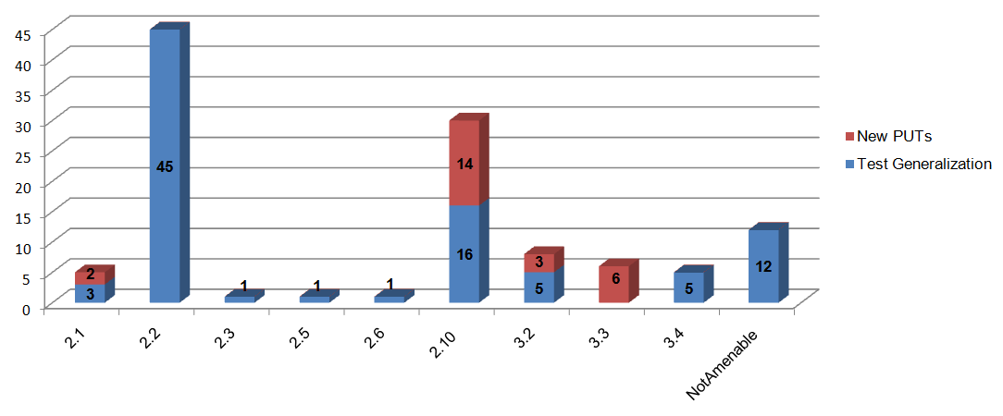
Test Patterns Distribution

Slide 8
Parameterized Mock Objects
00: [PexFactoryMethod(typeof(TheoryCommand))]
01: public static TheoryCommand Create(IMethodInfo testMethod, string displayName,
object[] parameters)
02: {
03: var theoryCommand = new TheoryCommand(testMethod, displayName, parameters);
04: return theoryCommand;
05: }

Slide 9
Parameterized Mock Objects
00: public class MMethodInfo : IMethodInfo
01: {
…… // other methods
02: public bool HasAttribute(Type attributeType)
03: {
04: PexAssert.IsNotNull(attributeType);
05: var call = PexChoose.FromCall(this);
06: return call.ChooseResult<bool>();
07: }
08: public void Invoke(object testClass, params object[] parameters)
09: {
10: PexAssert.IsNotNull(testClass);
11: PexAssert.IsNotNull(parameters);
12: var call = PexChoose.FromCall(this);
13: if (call.ChooseThrowException())
14: throw call.ChooseException(false, new[] {typeof (TargetInvocationException)});
15: Type.GetType(TypeName).GetMethod(Name).
Invoke(testClass, parameters);
16: }
17: } // end of class

Slide 10
Benefits of Test Generalization
Test Class | Unit Tests |  |  | CUT Block Coverage |  | PUT Block Coverage |  | New Block
 | CUT | NA | PUT | C/T | % Cov | C/T | % Cov
EqualTests | 45 | 6 | 34 | 74/77 | 96.10 | 76/77 | 98.70 | 2
AssertExceptionTests | 2 | 0 | 2 | 3/3 | 100 | 3/3 | 100.00 | 0
ContainsTests | 9 | 0 | 9 | 52/84 | 61.90 | 52/84 | 61.90 | 0
DoesNotContainTest | 9 | 0 | 9 | 51/84 | 60.71 | 51/84 | 60.71 | 0
EmptyTests | 5 | 2 | 3 | 22/26 | 84.62 | 22/26 | 84.62 | 0
FalseTests | 2 | 2 | 0 | 6/6 | 100 | N/A | N/A | N/A
InRangeTests | 7 | 0 | 3 | 31/72 | 43.06 | 31/72 | 43.06 | 0
TrueTests | 2 | 2 | 0 | 6/6 | 100 | N/A | N/A | N/A
TheoryCommandTests | 9 | 0 | 7 | 44/48 | 91.67 | 46/48 | 93.75 | 2
Total of xUnit | 81 | 12 | 60 | 166/172 | 96.51 | 167/172 | 97.09 | 1
Total of xUnit.extension | 9 | 0 | 7 | 44/48 | 91.67 | 46/48 | 93.75 | 2
Total of both projects | 90 | 12 | 67 | 210/220 | 95.45 | 213/220 | 96.81 | 3

Slide 11
Benefits - Defect
Lack of Null Checking
In one of the PUTs of Equaltests class, Pex generated an empty string array and a string array containing a null object for the equal test. Since these string arrays differ in the length, the test is expected to throw an EqualException. Instead of receiving the EqualException, the test reports a NullReferenceException. This is because the null object in the second string array is used to construct the error string for the EqualException, which shows that it lacks of a null check before the error string construction.

Slide 12
Benefits of New PUTs
Test Class | #New PUT | C/T | % Cov | New Block | % Orig | % Gen | % Increase
ContainsTests.cs | 5 | 77/84 | 91.67 | 25 | 61.90 | 61.90 | 29.76
DoesNotContainTest.cs | 5 | 77/84 | 91.67 | 26 | 60.71 | 60.71 | 30.95
EmptyTests.cs | 1 | 26/26 | 100 | 4 | 84.62 | 84.62 | 15.38
InRangeTests.cs | 5 | 65/72 | 90.28 | 34 | 43.06 | 43.06 | 47.22
Average of xUnit | 4 | 61/67 | 92.11 | 22.25 | 62.57 | 62.57 | 30.83
Total of xUnit | 16 | 177/177 | 100 | 10 | 96.51 | 97.09 | 2.91

Slide 13
Thank you!

