Slide 1


Programas en red
Chapter 12
Python for Everybody
www.py4e.com
Notes:
Note from Chuck. If you are using these materials, you can remove the UM logo and replace it with your own, but please retain the CC-BY logo on the first page as well as the acknowledgement page(s) at the end.

Slide 2
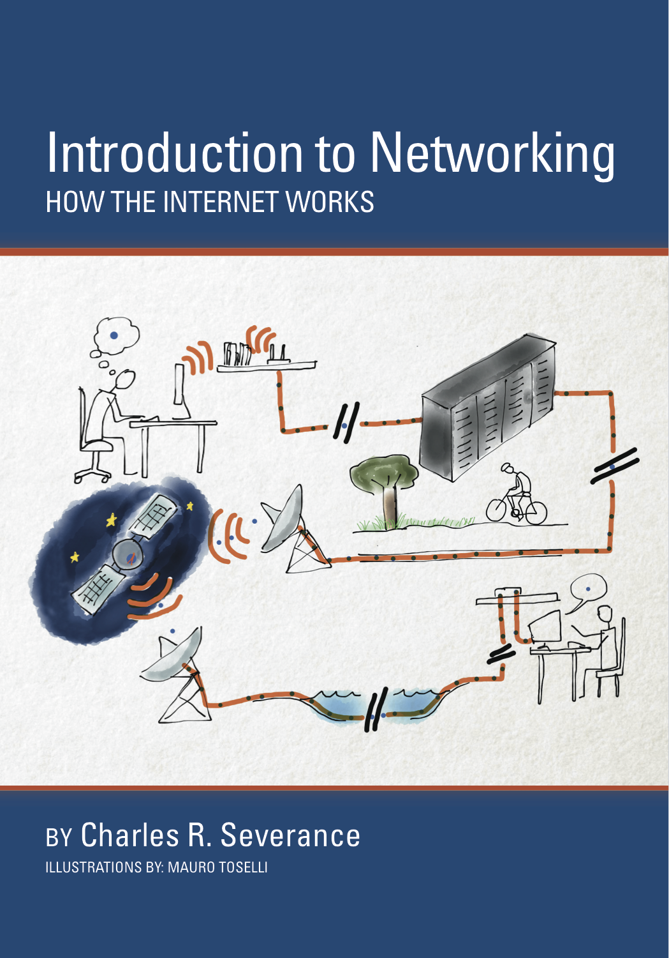
Un libro gratuito sobre Arquitecturas de Red
Si se encuentra esta área interesante y/o se precisan más detalles
www.net-intro.com

Slide 3
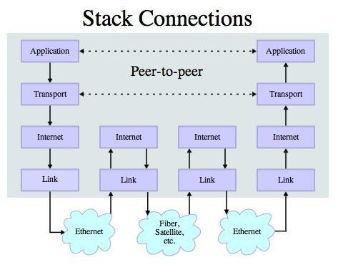
Transport Control Protocol (TCP)
Construido sobre IP (Internet Protocol)
Asume que IP puede perder algunos datos – almacena y restransmite los datos si parece que se han perdido
Maneja el “control de flujo” usando una ventana de transmisión
Provee de una tubería confiable
Source: http://en.wikipedia.org/wiki/Internet_Protocol_Suite

Slide 4
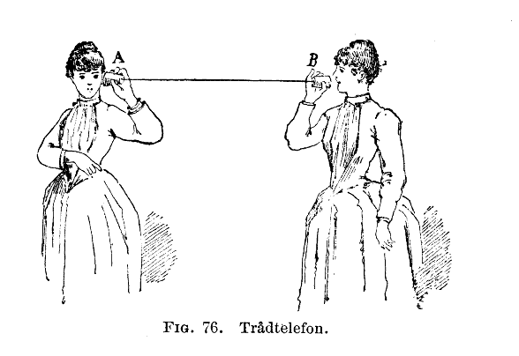
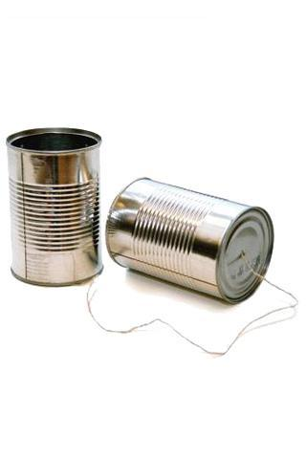
http://en.wikipedia.org/wiki/Tin_can_telephone
http://www.flickr.com/photos/kitcowan/2103850699/

Slide 5

Conexciones TCP / Sockets
“En las redes de computadoras, un socket de internet o un socket de red es un punto final (endpoint) de un inter-proceso bidireccional de flujo de comunicación a través de una red de computadoras basadas en protocolos de Intered, como Internet.”
Proceso
Proceso
Internet
http://en.wikipedia.org/wiki/Internet_socket

Slide 6
Números de puerto TCP
Un puerto es un punto final (endpoint) específico de una aplicación o proceso del software de comunicaciones
Permita que múltiples aplicaciones de red coexistan en el mismo servidor
Existe una nlista de números de puerto TCP bien conocidos
http://en.wikipedia.org/wiki/TCP_and_UDP_port

Slide 7
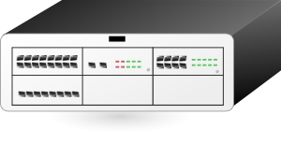

www.umich.edu
E-Mail entrante
25
blah blah blah blah
Login
23
74.208.28.177
Servidor
Web
80
443
Buzón de correo personal
109
110
Clipart: http://www.clker.com/search/networksym/1

Slide 8
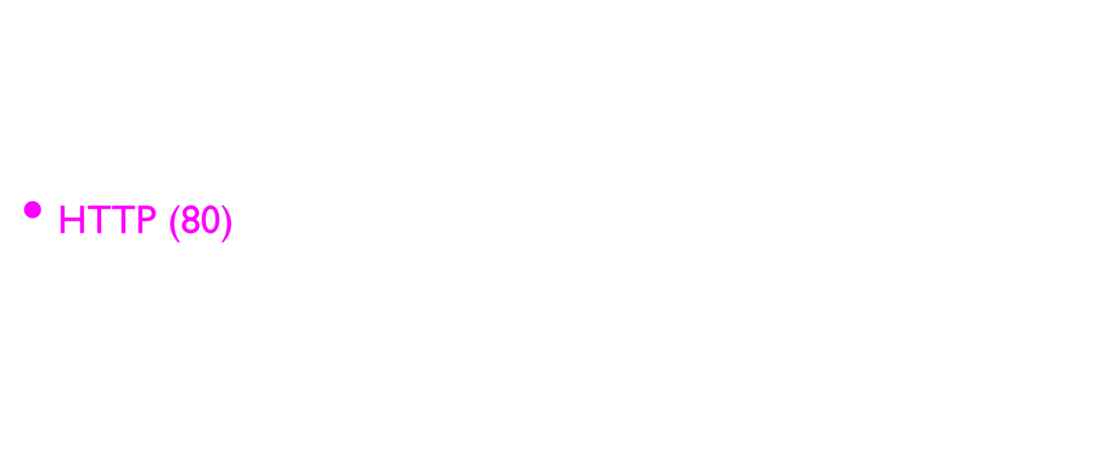
Pueros TCP comunes
http://en.wikipedia.org/wiki/List_of_TCP_and_UDP_port_numbers

Slide 9
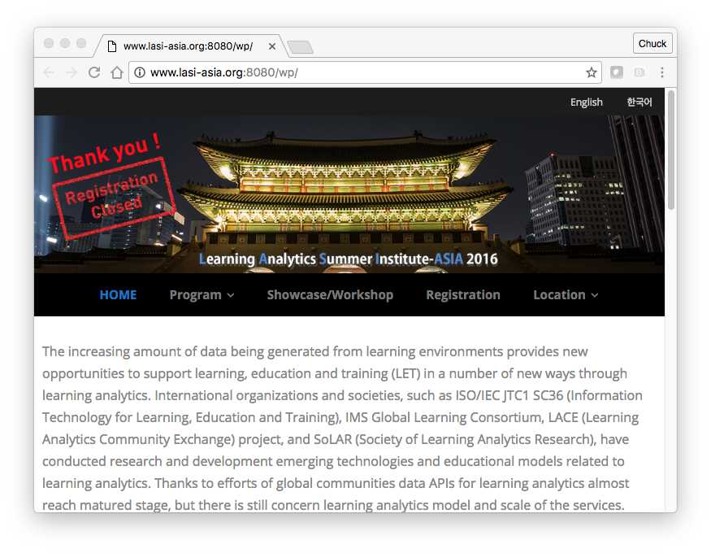
A veces vemos un puerto en la URL si el servidor web corre en un puerto “no estándar

Slide 10
Sockets en Python
Python tiene soporte intrínseco para los sockets TCP
import socket
mysock = socket.socket(socket.AF_INET, socket.SOCK_STREAM)
mysock.connect( ('data.pr4e.org', 80) )
Host
Puerto
http://docs.python.org/library/socket.html

Slide 11
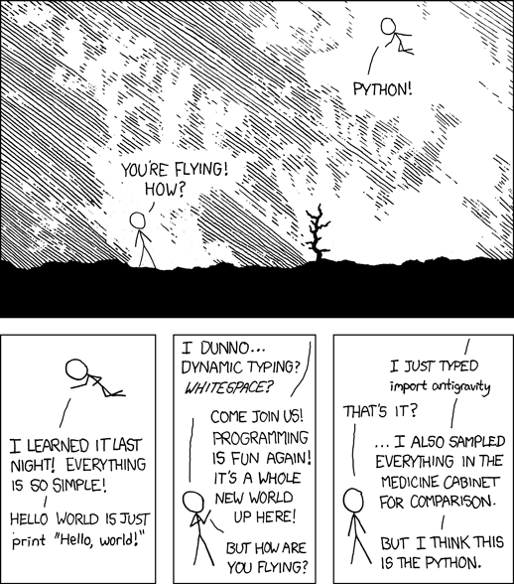
http://xkcd.com/353/

Slide 12
Protocolos de Aplicación

Slide 13
Protocolos de aplicación
Como TCP (y Python) proporciona un socket confiable, ¿qué se puede hacer con él? ¿Qué problemas puede solucionar?
Protocolos de aplicación
- Mail
- World Wide Web
Source: http://en.wikipedia.org/wiki/Internet_Protocol_Suite

Slide 14
HTTP - Hypertext Transfer Protocol
Es el Protocolo de Capa de Aplicación dominante en Internet
Inventado para la Web – para recoger HTML, Imágenes, Documentos, etc.
Extendido para datos además de para documentos - RSS, Web Services, etc. Coneptos básicos – Crear una conexión – Requerir un documento (request) – Recoger el documento (retrive) – Cerrar la conexión
http://en.wikipedia.org/wiki/Http

Slide 15
HTTP
El HyperText Transfer Protocol es el conjunto de reglas que permite a los navegadores recoger documentos web de los servidores a través de internet

Slide 16
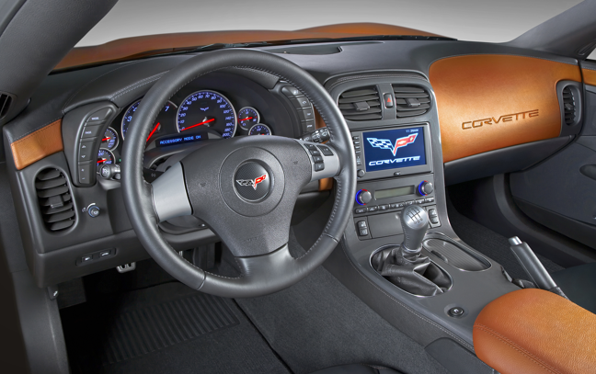
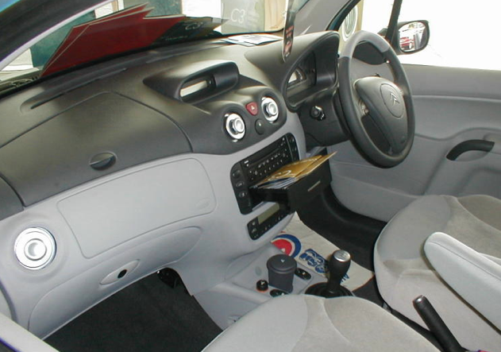
¿Qué es un Protocolo?
Conjunto de reglas que todas las partes sigues para predecir el comportamiento de cada uno
Y no chocar entre sí
  En carreteras de doble sentido en España, conduzca por el lado derecho de la carretera
  En carreteras de doble sentido en el Reino Unido, conduzca por el lado izquierdo de la carretera.

Slide 17
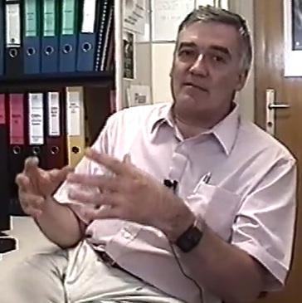
http://www.dr-chuck.com/page1.htm
protocol
host
document
http://www.youtube.com/watch?v=x2GylLq59rI
Robert Cailliau
CERN
1:17 - 2:19

Slide 18
Obteniendo datos del servidor
Cada vez que el usuario hace clic en una etiqueta de anclaje (anchor tag) con un valor href = para cambiar a una nueva página, el navegador se conecta al servidor web y emite una solicitud "GET" para obtener el contenido de la página en la URL especificada
El servidor devuelve el documento HTML al navegador, que formatea y muestra el documento al usuario

Slide 19
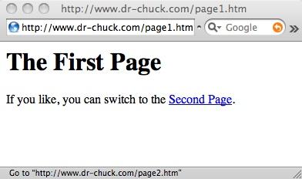
Servidor Web
80
Navegador

Slide 20
Servidor Web
80
Navegador
Click

Slide 21
Request
Servidor web
80
GET http://www.dr-chuck.com/page2.htm
Navegador
Click

Slide 22
Request
Servidor Web
80
GET http://www.dr-chuck.com/page2.htm
Navegador
Click

Slide 23
Request
Servidor Web
Response
80
<h1>The Second Page</h1><p>If you like, you can switch back to the <a href="page1.htm">First Page</a>.</p>
GET http://www.dr-chuck.com/page2.htm
Navegador
Click

Slide 24
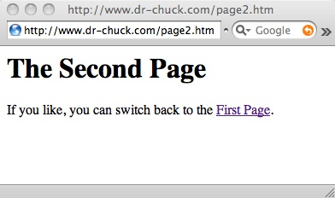
Request
Servidor Web
Response
80
<h1>The Second Page</h1><p>If you like, you can switch back to the <a href="page1.htm">First Page</a>.</p>
GET http://www.dr-chuck.com/page2.htm
Navegador
Click
Análisis/
Renderizado

Slide 25
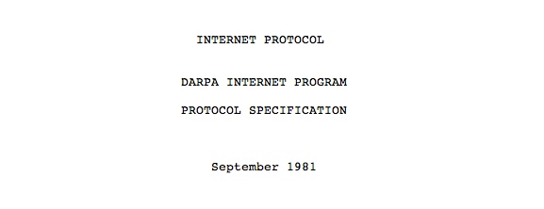
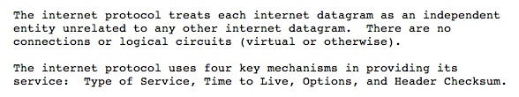
Internet Standards
The standards for all of the Internet protocols (inner workings) are developed by an organization
Internet Engineering Task Force (IETF)
www.ietf.org
Standards are called “RFCs” - “Request for Comments”
Source: http://tools.ietf.org/html/rfc791

Slide 26
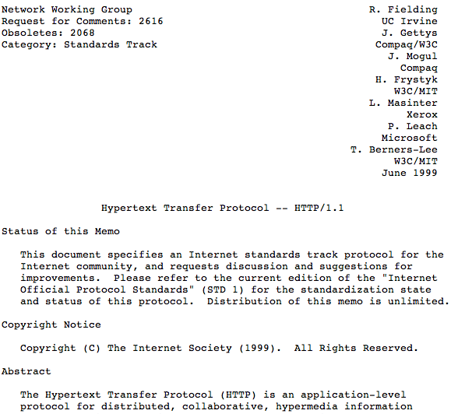
http://www.w3.org/Protocols/rfc2616/rfc2616.txt

Slide 27
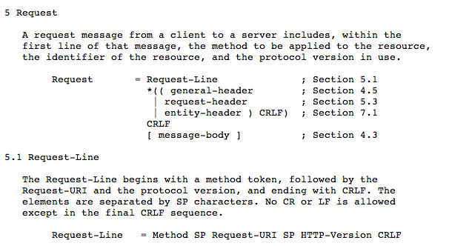

Slide 28
Making an HTTP request
Connect to the server like www.dr-chuck.com"
Request a document (or the default document)
GET http://www.dr-chuck.com/page1.htm HTTP/1.0
GET http://www.mlive.com/ann-arbor/ HTTP/1.0
GET http://www.facebook.com HTTP/1.0

Slide 29
$ telnet www.dr-chuck.com 80
Trying 74.208.28.177...
Connected to www.dr-chuck.com.Escape character is '^]'.
GET http://www.dr-chuck.com/page1.htm HTTP/1.0
HTTP/1.1 200 OK
Date: Thu, 08 Jan 2015 01:57:52 GMT
Last-Modified: Sun, 19 Jan 2014 14:25:43 GMT
Connection: close
Content-Type: text/html
<h1>The First Page</h1>
<p>If you like, you can switch to
the <a href="http://www.dr-chuck.com/page2.htm">Second
Page</a>.</p>
Connection closed by foreign host.
Web Server
Browser

Slide 30

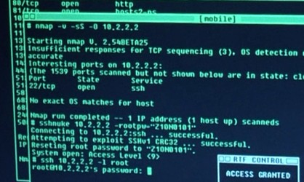
Accurate Hacking in the Movies
Matrix Reloaded
Bourne Ultimatum
Die Hard 4
...
http://nmap.org/movies.html

Slide 31
Let’s Write a Web Browser!

Slide 32
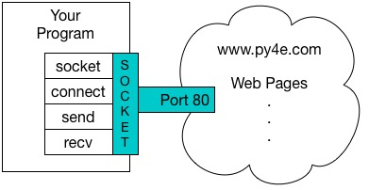
An HTTP Request in Python
import socket
mysock = socket.socket(socket.AF_INET, socket.SOCK_STREAM)
mysock.connect(('data.pr4e.org', 80))
cmd = 'GET http://data.pr4e.org/romeo.txt HTTP/1.0\r\n\r\n'.encode()
mysock.send(cmd)
while True:
data = mysock.recv(512)
if (len(data) < 1):
break
print(data.decode(),end='')
mysock.close()

Slide 33
HTTP/1.1 200 OK
Date: Sun, 14 Mar 2010 23:52:41 GMT
Server: Apache
Last-Modified: Tue, 29 Dec 2009 01:31:22 GMT
ETag: "143c1b33-a7-4b395bea"
Accept-Ranges: bytes
Content-Length: 167
Connection: close
Content-Type: text/plain
But soft what light through yonder window breaks
It is the east and Juliet is the sun
Arise fair sun and kill the envious moon
Who is already sick and pale with grief
HTTP Header
while True:
data = mysock.recv(512)
if ( len(data) < 1 ) :
break
print(data.decode())
HTTP Body

Slide 34
About Characters and Strings…

Slide 35
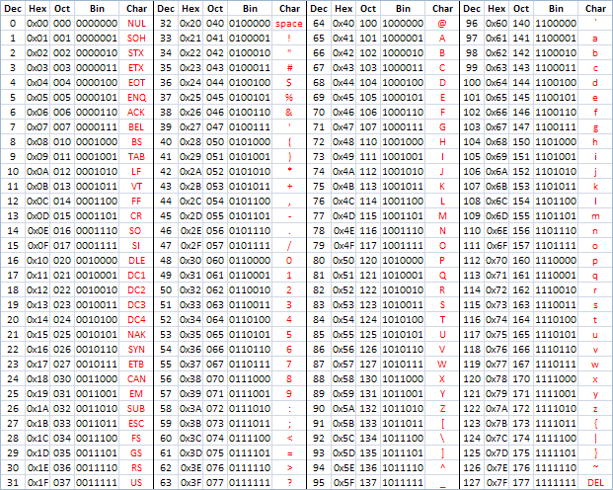
ASCII
American Standard Code for Information Interchange
https://en.wikipedia.org/wiki/ASCII
http://www.catonmat.net/download/ascii-cheat-sheet.png

Slide 36
Representing Simple Strings
Each character is represented by a number between 0 and 256 stored in 8 bits of memory
We refer to "8 bits of memory as a "byte" of memory – (i.e. my disk drive contains 3 Terabytes of memory)
The ord() function tells us the numeric value of a simple ASCII character
>>> print(ord('H'))
72
>>> print(ord('e'))
101
>>> print(ord('\n'))
10
>>>

Slide 37
ASCII
>>> print(ord('H'))
72
>>> print(ord('e'))
101
>>> print(ord('\n'))
10
>>>
In the 1960s and 1970s, we just assumed that one byte was one character

Slide 38
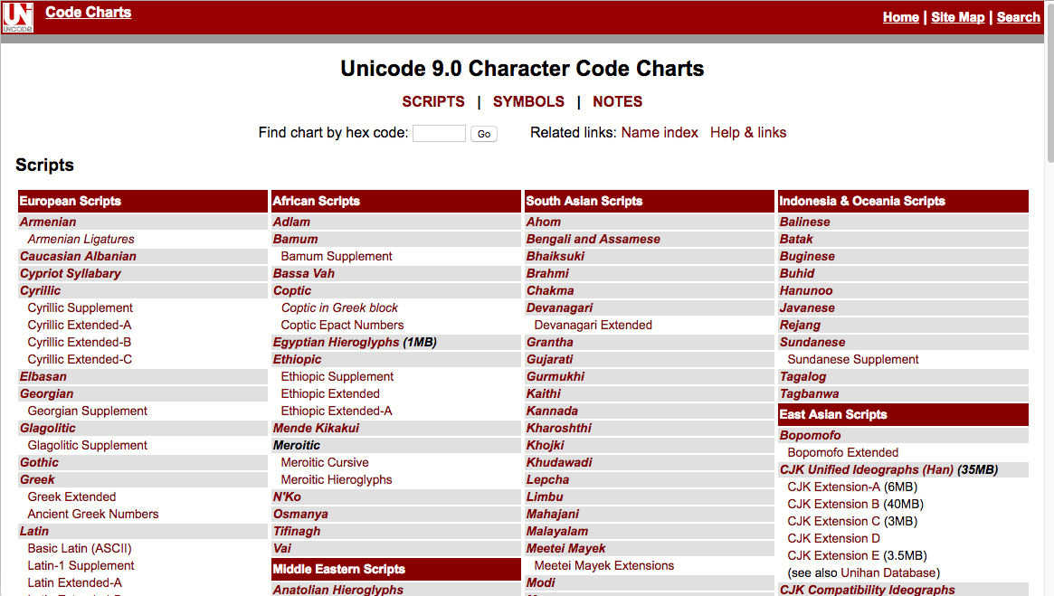
http://unicode.org/charts/

Slide 39
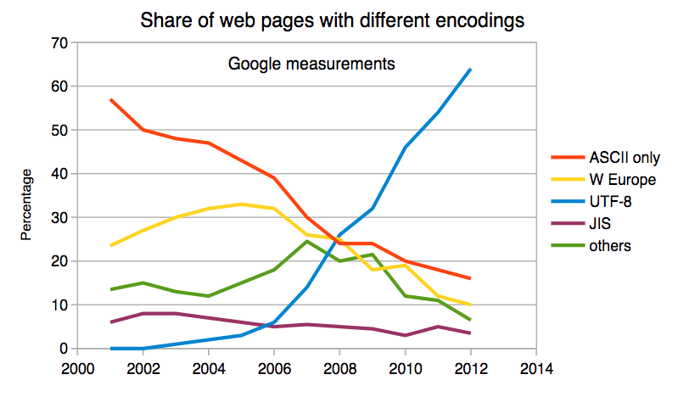
Multi-Byte Characters
To represent the wide range of characters computers must handle we represent characters with more than one byte
  UTF-16 – Fixed length - Two bytes
  UTF-32 – Fixed Length - Four Bytes
  UTF-8 – 1-4 bytes
- Upwards compatible with ASCII
- Automatic detection between ASCII and UTF-8
- UTF-8 is recommended practice for encoding
data to be exchanged between systems
https://en.wikipedia.org/wiki/UTF-8

Slide 40
Two Kinds of Strings in Python
Python 2.7.10
>>> x = '이광춘'
>>> type(x)
<type 'str'>
>>> x = u'이광춘'
>>> type(x)
<type 'unicode'>
>>>
Python 3.5.1
>>> x = '이광춘'
>>> type(x)
<class 'str'>
>>> x = u'이광춘'
>>> type(x)
<class 'str'>
>>>
In Python 3, all strings are Unicode

Slide 41
Python 2 versus Python 3
Python 2.7.10
>>> x = b'abc'
>>> type(x)
<type 'str'>
>>> x = '이광춘'
>>> type(x)
<type 'str'>
>>> x = u'이광춘'
>>> type(x)
<type 'unicode'>
Python 3.5.1
>>> x = b'abc'
>>> type(x)
<class 'bytes'>
>>> x = '이광춘'
>>> type(x)
<class 'str'>
>>> x = u'이광춘'
>>> type(x)
<class 'str'>

Slide 42
Python 3 and Unicode
In Python 3, all strings internally are UNICODE
Working with string variables in Python programs and reading data from files usually "just works"
When we talk to a network resource using sockets or talk to a database we have to encode and decode data (usually to UTF-8)
Python 3.5.1
>>> x = b'abc'
>>> type(x)
<class 'bytes'>
>>> x = '이광춘'
>>> type(x)
<class 'str'>
>>> x = u'이광춘'
>>> type(x)
<class 'str'>

Slide 43
Python Strings to Bytes
When we talk to an external resource like a network socket we send bytes, so we need to encode Python 3 strings into a given character encoding
When we read data from an external resource, we must decode it based on the character set so it is properly represented in Python 3 as a string
while True:
data = mysock.recv(512)
if ( len(data) < 1 ) :
break
mystring = data.decode()
print(mystring)

Slide 44
An HTTP Request in Python
import socket
mysock = socket.socket(socket.AF_INET, socket.SOCK_STREAM)
mysock.connect(('data.pr4e.org', 80))
cmd = 'GET http://data.pr4e.org/romeo.txt HTTP/1.0\n\n'.encode()
mysock.send(cmd)
while True:
data = mysock.recv(512)
if (len(data) < 1):
break
print(data.decode())
mysock.close()

Slide 45
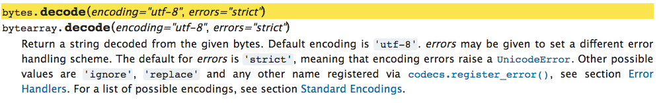
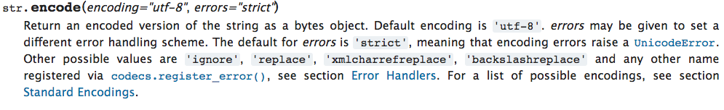
https://docs.python.org/3/library/stdtypes.html#bytes.decode
https://docs.python.org/3/library/stdtypes.html#str.encode

Slide 46
Network
decode()
Bytes
UTF-8
recv()
Socket
String
Unicode
Bytes
UTF-8
encode()
send()
import socket
mysock = socket.socket(socket.AF_INET, socket.SOCK_STREAM)
mysock.connect(('data.pr4e.org', 80))
cmd = 'GET http://data.pr4e.org/romeo.txt HTTP/1.0\n\n'.encode()
mysock.send(cmd)
while True:
data = mysock.recv(512)
if (len(data) < 1):
break
print(data.decode())
mysock.close()

Slide 47
Making HTTP Easier With urllib

Slide 48
Using urllib in Python
Since HTTP is so common, we have a library that does all the socket work for us and makes web pages look like a file
import urllib.request, urllib.parse, urllib.error
fhand = urllib.request.urlopen('http://data.pr4e.org/romeo.txt')
for line in fhand:
print(line.decode().strip())
urllib1.py

Slide 49
import urllib.request, urllib.parse, urllib.error
fhand = urllib.request.urlopen('http://data.pr4e.org/romeo.txt')
for line in fhand:
print(line.decode().strip())
But soft what light through yonder window breaks
It is the east and Juliet is the sun
Arise fair sun and kill the envious moon
Who is already sick and pale with grief
urllib1.py

Slide 50
Like a File...
import urllib.request, urllib.parse, urllib.error
fhand = urllib.request.urlopen('http://data.pr4e.org/romeo.txt')
counts = dict()
for line in fhand:
words = line.decode().split()
for word in words:
counts[word] = counts.get(word, 0) + 1
print(counts)
urlwords.py

Slide 51
Reading Web Pages
import urllib.request, urllib.parse, urllib.error
fhand = urllib.request.urlopen('http://www.dr-chuck.com/page1.htm')
for line in fhand:
print(line.decode().strip())
<h1>The First Page</h1>
<p>If you like, you can switch to the <a href="http://www.dr-chuck.com/page2.htm">Second Page</a>.
</p>
urllib2.py

Slide 52
Following Links
import urllib.request, urllib.parse, urllib.error
fhand = urllib.request.urlopen('http://www.dr-chuck.com/page1.htm')
for line in fhand:
print(line.decode().strip())
<h1>The First Page</h1>
<p>If you like, you can switch to the <a href="http://www.dr-chuck.com/page2.htm">Second Page</a>.
</p>
urllib2.py

Slide 53
The First Lines of Code @ Google?
import urllib.request, urllib.parse, urllib.error
fhand = urllib.request.urlopen('http://www.dr-chuck.com/page1.htm')
for line in fhand:
print(line.decode().strip())

Slide 54
Parsing HTML
(a.k.a. Web Scraping)

Slide 55
What is Web Scraping?
When a program or script pretends to be a browser and retrieves web pages, looks at those web pages, extracts information, and then looks at more web pages
Search engines scrape web pages - we call this “spidering the web” or “web crawling”
http://en.wikipedia.org/wiki/Web_scraping
http://en.wikipedia.org/wiki/Web_crawler

Slide 56
Why Scrape?
Pull data - particularly social data - who links to who?
Get your own data back out of some system that has no “export capability”
Monitor a site for new information
Spider the web to make a database for a search engine

Slide 57
Scraping Web Pages
There is some controversy about web page scraping and some sites are a bit snippy about it.
Republishing copyrighted information is not allowed
Violating terms of service is not allowed

Slide 58
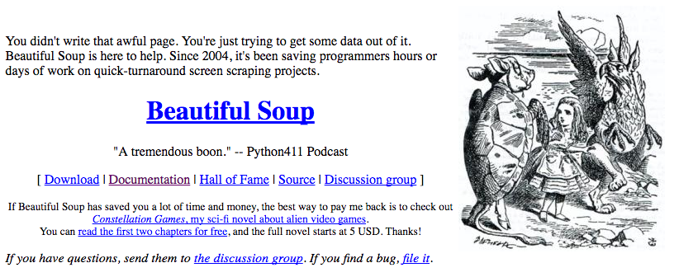
The Easy Way - Beautiful Soup
You could do string searches the hard way
Or use the free software library called BeautifulSoup from www.crummy.com
https://www.crummy.com/software/BeautifulSoup/

Slide 59
BeautifulSoup Installation
# To run this, you can install BeautifulSoup
# https://pypi.python.org/pypi/beautifulsoup4
# Or download the file
# http://www.py4e.com/code3/bs4.zip
# and unzip it in the same directory as this file
import urllib.request, urllib.parse, urllib.error
from bs4 import BeautifulSoup
...
urllinks.py

Slide 60
import urllib.request, urllib.parse, urllib.error
from bs4 import BeautifulSoup
url = input('Enter - ')
html = urllib.request.urlopen(url).read()
soup = BeautifulSoup(html, 'html.parser')
# Retrieve all of the anchor tags
tags = soup('a')
for tag in tags:
print(tag.get('href', None))
python urllinks.py
Enter - http://www.dr-chuck.com/page1.htm
http://www.dr-chuck.com/page2.htm

Slide 61
Summary
The TCP/IP gives us pipes / sockets between applications
We designed application protocols to make use of these pipes
HyperText Transfer Protocol (HTTP) is a simple yet powerful protocol
Python has good support for sockets, HTTP, and HTML parsing

Slide 62
Acknowledgements / Contributions
Thes slide are Copyright 2010- Charles R. Severance (www.dr-chuck.com) of the University of Michigan School of Information and open.umich.edu and made available under a Creative Commons Attribution 4.0 License. Please maintain this last slide in all copies of the document to comply with the attribution requirements of the license. If you make a change, feel free to add your name and organization to the list of contributors on this page as you republish the materials.
Initial Development: Charles Severance, University of Michigan School of Information
… Insert new Contributors here
...

