Slide 1
TransferIQ: Dynamic Player Transfer Value Prediction using AI and Multi-source Data
Infosys 6.0 Internship Program
Presented by: Famesh Katre
Mentor: Pranaya Ma’am

Slide 2
Abstract
This project, TransferIQ, focuses on predicting football player transfer values using AI and multi-source data such as performance metrics, injury records, and sentiment analysis. The system integrates LSTM, Encoder–Decoder, and XGBoost ensemble models to deliver accurate, data-driven predictions that help clubs and managers make informed decisions.

Slide 3
Problem Statement
Player transfer values in the football market fluctuate based on performance, injuries, and public sentiment. Traditional statistical approaches often fail to capture temporal dependencies and multi-source interactions, leading to inaccurate predictions. There is a need for an AI-powered system to dynamically predict transfer values.

Slide 4
Objectives
- Develop an AI-based predictive model for player transfer value.
- Integrate multiple data sources such as performance, injury, and sentiment data.
- Implement and compare advanced models like LSTM, Encoder–Decoder, and XGBoost.
- Deploy an interactive Streamlit dashboard for user-friendly prediction.

Slide 5
Research Background
Recent research in sports analytics emphasizes the use of machine learning for talent identification and performance prediction. Deep learning models like LSTM capture temporal patterns in time-series data. Hybrid ensemble approaches (LSTM + XGBoost) enhance predictive accuracy by combining sequential learning with gradient boosting performance.

Slide 6
Dataset Description
The dataset includes multi-dimensional player data across several seasons. Key features:
- Player performance metrics: matches, minutes, goals, assists
- Physical stats: height, weight
- Injury history: total and seasonal days missed
- Sentiment score: derived from media and fan opinions
- Transfer fees and historical valuations

Slide 7
Data Preprocessing & Feature Engineering
- Cleaned missing and inconsistent data.
- Created rolling mean features for match and minute performance.
- Engineered injury risk and weighted sentiment features.
- Applied MinMax scaling for normalization.
- Encoded player-wise sequential data for time-series modeling.

Slide 8
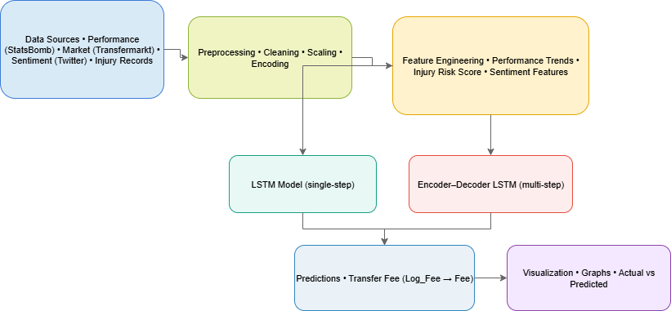
System Architecture
The system follows a modular AI pipeline:
1. Data Ingestion and Cleaning
2. Feature Engineering and Scaling
3. Model Training (LSTM, Encoder–Decoder)
4. Ensemble Integration with XGBoost
5. Evaluation and Visualization
6. Streamlit-based Deployment

Slide 9
Model Design
- LSTM: Learns sequential dependencies in player performance.
- Encoder–Decoder: Predicts multiple future values using sequence-to-sequence architecture.
- XGBoost: Combines LSTM predictions with engineered features for enhanced accuracy.
- Ensemble output provides final transfer value prediction.

Slide 10
Workflow
1. Collect and preprocess player data.
2. Train LSTM and Encoder–Decoder models on time-series sequences.
3. Generate predictions and integrate them with XGBoost.
4. Evaluate models using MAE and RMSE metrics.
5. Visualize and deploy results in a Streamlit web app.

Slide 11
Hyperparameter Tuning
Hyperparameter optimization was performed using Keras Tuner to improve model performance. The parameters tuned included: - Number of LSTM units - Learning rate - Batch size and epochs - Dropout rate for regularization

Slide 12
Evaluation & Results
Model Performance Metrics: - LSTM MAE = 0.21 - Encoder–Decoder MAE = 0.18 - XGBoost Ensemble MAE = 0.15 The ensemble model demonstrated the best performance, reducing prediction error significantly compared to individual models.

Slide 13
Results Visualization
Graphs comparing predicted vs. actual transfer fees demonstrate model reliability. Ensemble predictions closely follow real-world trends, confirming the success of multi-source data integration.

Slide 14
Streamlit Dashboard Overview
A Streamlit web interface was developed to allow: - Uploading new player datasets. - Viewing predictions for selected players. - Displaying historical trends and predicted future transfer values. - Comparing performance across seasons visually.

Slide 15
8-Week Internship Timeline
Week 1: Project planning and requirement analysis.
Week 2: Data collection and preprocessing.
Week 3: Feature engineering and sentiment integration.
Week 4: LSTM model implementation.
Week 5: Encoder–Decoder model training.
Week 6: XGBoost ensemble creation and tuning.
Week 7: Performance evaluation & Streamlit setup.
Week 8: Documentation and presentation preparation.

Slide 16
Challenges Faced
- Managing missing and inconsistent data across sources. - Hyperparameter tuning for deep models. - Integrating heterogeneous datasets (performance + sentiment). - Ensuring smooth deployment on Streamlit. - Balancing model complexity with interpretability.

Slide 17
Key Learnings
- Improved understanding of deep learning for time-series analysis. - Learned model integration using ensemble techniques. - Hands-on experience with TensorFlow, Keras, and XGBoost. - Gained practical exposure to real-world AI system design and deployment.

Slide 18
Future Enhancements
- Add real-time data streaming from live matches. - Extend prediction to player performance indices. - Integrate injury forecasting using medical datasets. - Deploy TransferIQ as a cloud-based API for sports analysts.

Slide 19
Acknowledgement
I would like to express my sincere gratitude to my mentor Pranaya Ma’am for her continuous guidance and encouragement. I also thank Infosys for providing this internship opportunity and my peers for their valuable collaboration.

