Slide 1
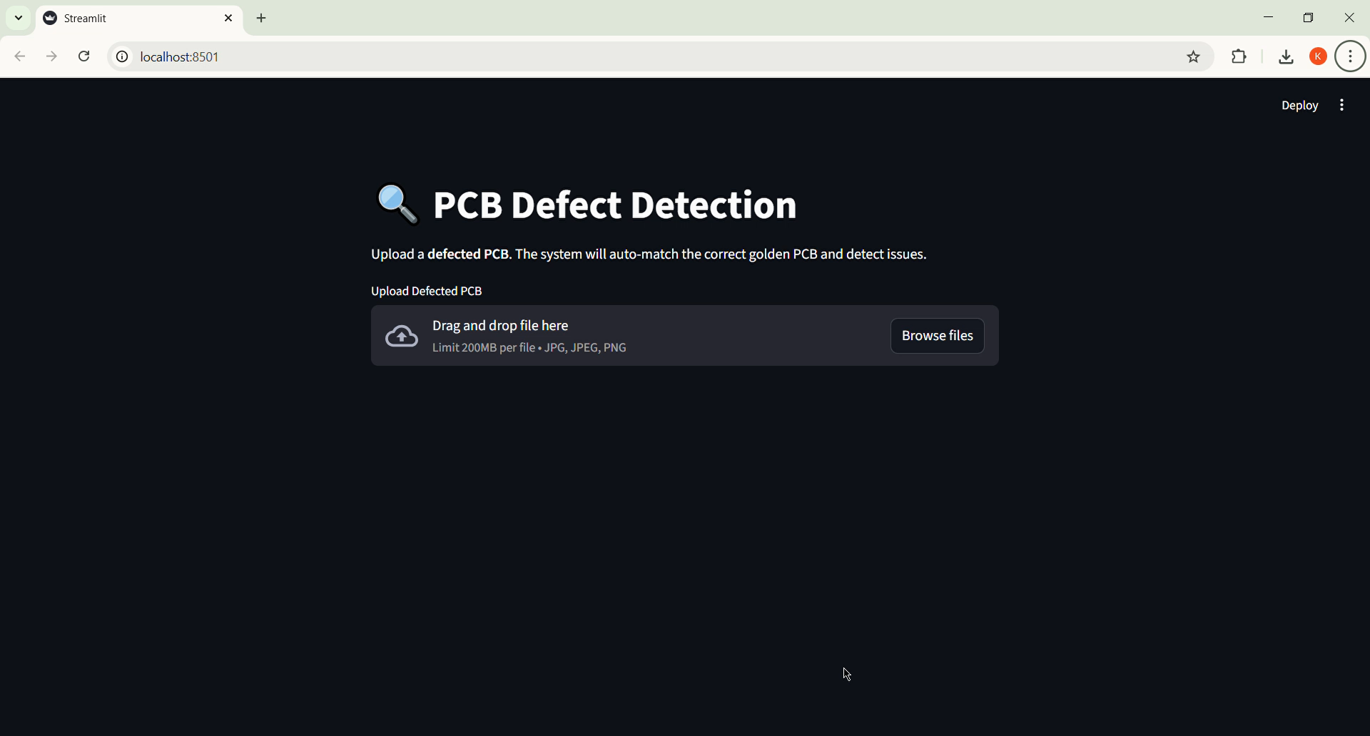
Demo

Slide 2
CircuitGuard: PCB Defect Detection and Classification
Developed by: Karan Panchal
Guided by: Pranaya Ma’am
Infosys Project

Slide 3
Problem Statement
In large-scale manufacturing environments managing production workflows, monitoring performance, and ensuring process efficiency pose significant challenges. Manual tracking of PCB data, component usage, and defect analysis often leads to inefficiencies, data inconsistencies, and delays in decision-making. The lack of an integrated system for real-time monitoring and automated analysis results in reduced productivity and increased operational costs. To address these issues, the Infosys PCB Project aims to develop a streamlined, automated solution that enhances process visibility, improves data accuracy, and supports faster, data-driven decisions in PCB manufacturing and management.

Slide 4
Objective
Develop a fully automated defect detection and classification system.
Use image subtraction, contour extraction, and CNN-based classification.
Provide a web interface for users to upload PCB images and get results with labeled defects.
Export annotated results for reporting or analysis.

Slide 5
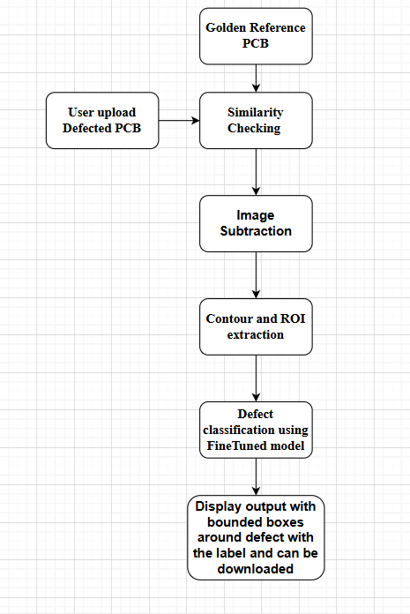
Flow Diagram

Slide 6
Project Modules (Overview)
Module 1: Image Subtraction
Compare defected PCB images with reference (clean) images using grayscale conversion.
Apply absolute difference (cv2.absdiff) and thresholding to highlight defect regions.
Save binary output images showing clearly detected defects for further processing.
Module 2:ROI & Contour Extraction
Detect defect regions from binary masks using OpenCV contours.
Crop bounding boxes around defects to create Regions of Interest (ROIs).
Save ROIs in class-wise folders for model training and classification.

Slide 7
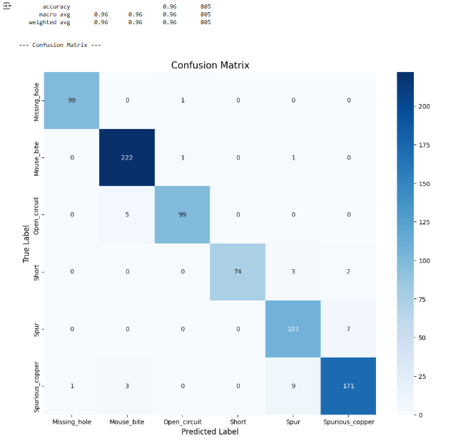
Project module (overview)
Module 3:Model Training & Fine-Tuning
Train EfficientNet-B4 on extracted ROIs with data augmentation and class balancing for accurate defect classification.
Validate model on unseen ROIs and save the best-performing model checkpoint.
Use the trained model to predict defect classes on new ROIs, showing top predictions with confidence scores.

Slide 8
Project Modules (Overview)
Module 4:Backend Pipeline
Complete pipeline integrates image subtraction, ROI extraction, and defect classification for single or batch PCB images.
ROIs are extracted from cleaned masks, saved class-wise, and fed into the trained EfficientNet-B4 model for prediction.
Displays top predictions with confidence and supports visualization and debugging of annotated defect outputs.
Module 5:Frontend Integration
Streamlit-based UI allows users to upload defected PCB images and automatically matches with the correct reference PCB using SSIM.
Performs image subtraction, ROI extraction, and classification, displaying annotated PCBs with detected defects and confidence scores.
Supports visualization and download of annotated images for further analysis or reporting.

Slide 9
Conclusion
The PCB defect detection system effectively automates the inspection of printed circuit boards by comparing defected images with reference PCBs. Using image subtraction, ROI extraction, and deep learning (EfficientNet-B4), it accurately identifies and classifies defects. The integration with Streamlit provides a user-friendly interface for uploading PCBs, visualizing annotated defects, and downloading results. This pipeline reduces manual inspection time, improves consistency, and allows scalable defect analysis. Overall, it demonstrates a robust combination of computer vision and AI for industrial quality control.

