Slide 1
CircuitGuard – PCB Defect Detection and Classification Application
By: V PRIYANKA

Slide 2
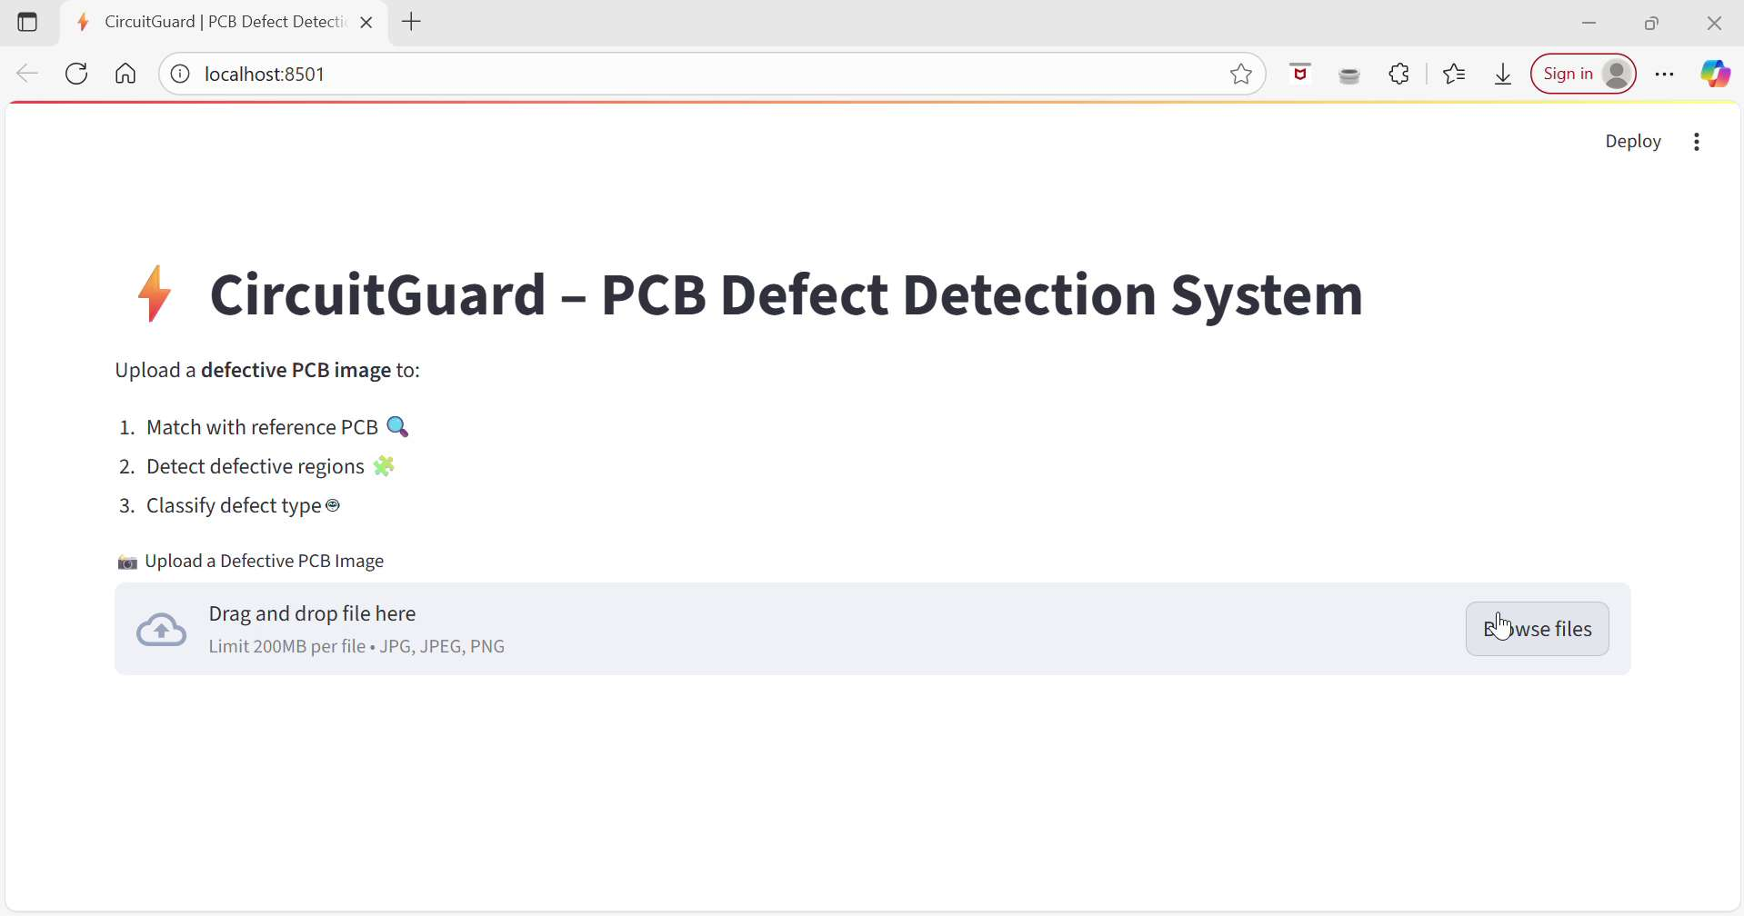
Output

Slide 3
Objectives
• To develop an automated defect detection and classification system for PCBs.
• Uses image processing and deep learning for precise defect identification.
• Employs reference-based image subtraction and CNN-based classification.
• Provides a web interface for uploading PCB images and viewing labeled results.

Slide 4
Problem Statement
Manual inspection of PCBs is time-consuming and prone to human error.
Need for an automated system to detect and classify defects efficiently.
Goal: Ensure high manufacturing accuracy and reduce faulty PCB production.

Slide 5
System Architecture Overview
Image preprocessing and subtraction using OpenCV.
Contour extraction and ROI segmentation.
EfficientNet-based classification using PyTorch.
Web frontend for image upload and visualization.
Backend inference pipeline for predictions.

Slide 6
Dataset Details
• Dataset: DeepPCB Dataset
• Contains defect-free templates and test PCB images.
• Used for training and validating the model.
• URL: https://www.dropbox.com/scl/fi/4vrtqn7t001yl41oucflu/PCB_DATASET.zip

Slide 7
Dataset Preparation & Image Processing
• Setup DeepPCB dataset, align and preprocess image pairs.
• Apply image subtraction and thresholding for defect highlighting.
• Deliverables: Clean dataset, subtraction scripts, defect masks.

Slide 8
Model Training and Evaluation
• Model: EfficientNet-B4 (PyTorch).
• Training: 128×128 images, Adam optimizer, cross-entropy loss.
• Deliverables: Trained model, metrics, and confusion matrix.
• Target: ≥97% classification accuracy on test set.

Slide 9
Frontend & Backend Integration
• Frontend: Built using Streamlit for real-time uploads.
• Backend: Modular pipeline for preprocessing and inference.
• Deliverables: Interactive web app with labeled outputs.

Slide 10
Finalization & Documentation
• Added export functionality for results and logs.
• Performed multi-image testing and performance optimization.
• Deliverables: Final web application, documentation, GitHub repo.
• Evaluation: Fully functional and presentation-ready system.

Slide 11
Evaluation Criteria
• Image Processing – Detect all key defect areas.
• Model Performance – ≥97% accuracy and stable results.
• UI Integration – ≤5 seconds per output image.
•System Finalization – Export and documentation completed.

Slide 12
Technology Stack
Deep Learning: PyTorch, timm, EfficientNet-B4
Dataset: DeepPCB
Frontend: Streamlit
Backend: Python (modular inference pipeline)
Evaluation: Accuracy, Loss, Confusion Matrix
Export: Annotated Images

Slide 13
Results & Outcomes
• Successfully detected and localized PCB defects.
• Classified defects using CNN with high precision.
• Achieved ≥94% test accuracy with EfficientNet-B4.
• Developed functional and user-friendly web app.

Slide 14
Conclusion & Future Work
• CircuitGuard offers an efficient automated PCB inspection tool.
• Reduces manual effort and improves reliability.
Future Enhancements:
• Expand to multi-layer PCB detection.
• Cloud-based deployment for industrial integration.
• Integrate real-time monitoring and analytics dashboard.

