Slide 1
Title: CircuitGuard-PCB Defect Detection and
Classification Application
Presented By:
K. Snehith Reddy

Slide 2
1. ABSTRACT
Problem Statement
Manual PCB inspection is time-consuming, error-prone, and inconsistent
Critical defects (open circuits, shorts, mouse bites) compromise reliability
Need for automated quality control system in manufacturing
Proposed Solution
Deep Learning-based automated defect detection using EfficientNet-B4
Computer Vision pipeline with reference-based image comparison
Web application for real-time processing and visualization
Modular design covering preprocessing, detection, classification, and export
System Modules
Dataset Processing - Image alignment & subtraction
ROI Extraction - Contour detection & bounding boxes
Model Training - EfficientNet-B4 with PyTorch
Evaluation - Performance testing & validation
Web UI - Streamlit interface for image upload
Backend Pipeline - Inference & processing engine
Export System - Results download & logging

Slide 3
2. Introduction
Printed Circuit Boards (PCBs) are the backbone of almost every electronic device we use today—from smartphones and laptops to medical equipment and automobiles. These familiar green boards with their intricate copper traces function as the nervous system of electronics, linking components so they can work together seamlessly. But as technology becomes smaller and more advanced, manufacturing flawless PCBs has grown increasingly difficult. Even the slightest error can cause a device to malfunction or fail in critical ways.
There are countless opportunities for defects during production: chemicals may not etch copper correctly, drills can deviate by fractions of a millimeter, or unwanted copper might remain behind—all of which can compromise the board. Traditionally, factories have relied on human inspectors to examine PCBs under magnifiers and identify issues. This process is slow, tedious, and inconsistent. Fatigue, differences in judgment, and human error mean that inspecting a single board can take 5–10 minutes, making manual inspection impractical when thousands of boards are produced each day.
This project solves the problem by creating an automated system capable of inspecting PCBs with speed and precision—essentially a tireless, super-focused digital inspector. Powered by advanced imaging and artificial intelligence, our system detects defects in mere seconds with over 97% accuracy. This enables manufacturers to catch issues early, reduce material waste, and ensure every device leaving the factory meets the highest quality standards.

Slide 4
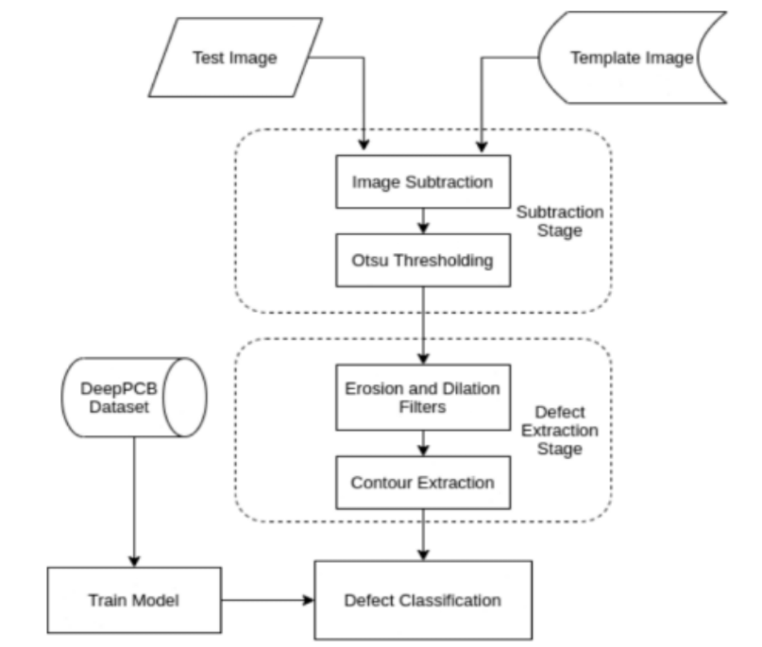
3. System Workflow
The system follows a structured pipeline to detect and classify PCB defects efficiently and accurately. The overall workflow is outlined below:
Upload
Load the test PCB image and its defect-free template.
Template Match & Alignment
Align both images to ensure accurate comparison.
Difference Map
Apply image subtraction and Otsu thresholding to highlight differences.
Defect Mask
Use erosion, dilation, and contour extraction to isolate defect regions.
ROI Extraction
Crop detected defect areas for analysis.
Classification
Classify each defect using a model trained on the DeepPCB dataset.
Visualization & Export
Display defects on the UI and export the final report.

Slide 5
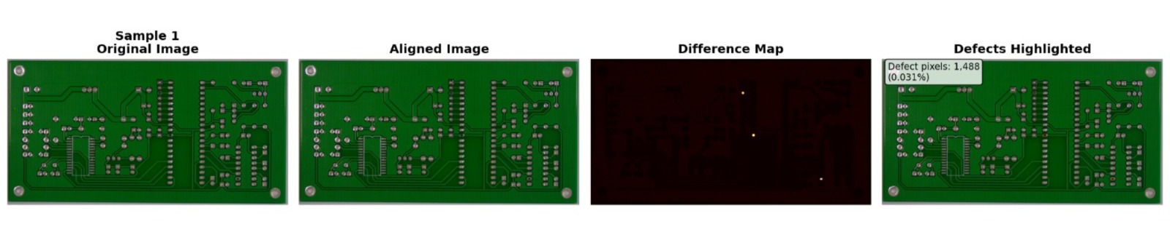
4. Method and Results
4.1 Module 1 — Dataset Setup & Image Subtraction
1. Dataset Preparation
Two primary folders are used:
  PCB_USED → defect-free template images
  images/ → defective PCB images categorized by defect type
Each test image is paired with the correct template by matching the first two digits of the filename.
2. Image Alignment
Keypoints are detected in both the template and test images using ORB.
A homography (RANSAC) aligns the test image to the template.
This makes sure both images line up correctly before comparison.
3. Image Subtraction & Thresholding
The aligned image is subtracted from the template to highlight differences.
Otsu’s thresholding turns these differences into a clear binary mask.
Erosion and dilation are applied to clean the mask and remove noise.
4. Output Results

Slide 6
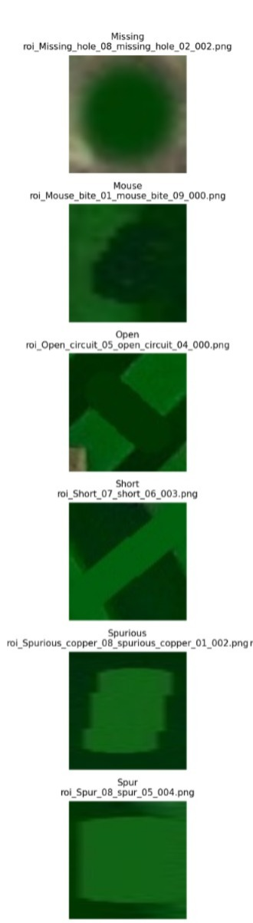
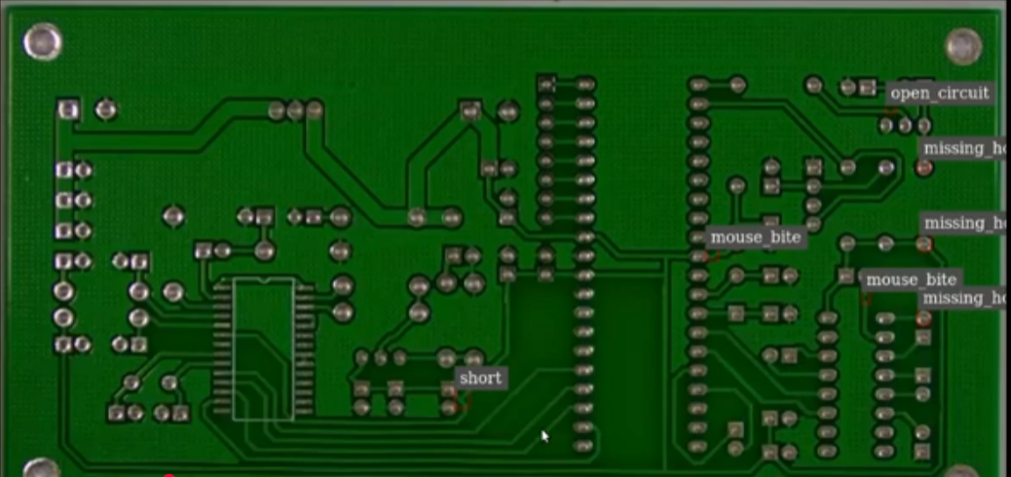
4.2 Module 2 — Contour Detection & ROI Extraction
1. Contour Detection
The binary masks from Module 1 are loaded.
External contours are detected to locate defect regions.
Very small contours are removed to avoid noise.
2. Bounding Box Extraction
For each valid contour, a bounding box is drawn around the defect area.
Padding is added so the ROI includes some surrounding PCB context.
3. ROI Cropping & Resizing
Each defect region is cropped from the original PCB image.
ROIs are resized to 128×128 to prepare them for classification models.
ROIs are saved into folders arranged by defect type.
4. Visualization Output
A sample visualization
shows bounding boxes
drawn on original image.

Slide 7
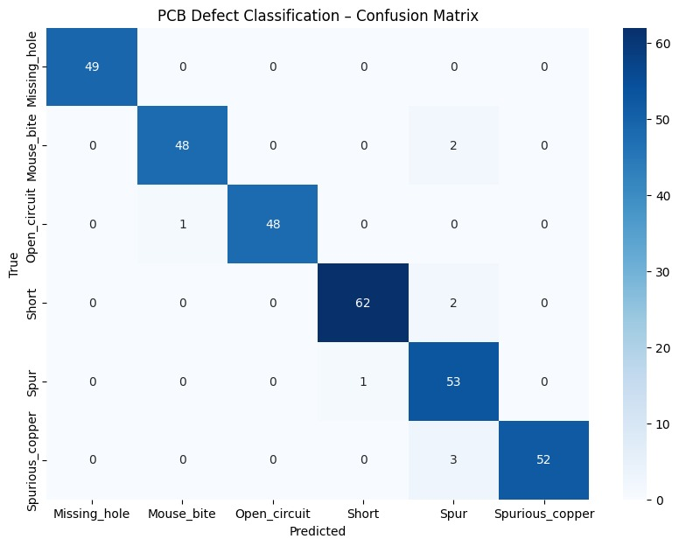
4.3 Module 3 — EfficientNet Model Training
1. Preprocessing
ROIs extracted from Module 2 are organized by defect type.
Images are resized to 128×128 and normalized.
Data augmentation (rotation, flips, color jitter) is applied to improve generalization.
The dataset is split into 80% train, 10% validation, and 10% test.
2. Model Setup & Training
EfficientNet-B4 is loaded with pretrained weights.
The final classifier layer is replaced to match the number of PCB defect classes.
Adam optimizer and cross-entropy loss are used for training.
The best model is saved based on highest validation accuracy.
3. Results & Evaluation
Training and validation loss curves are generated to show learning stability.
Final test accuracy is computed on the unseen test set.
A confusion matrix visualizes class-wise performance.
A full classification report (precision, recall, F1-score) summarizes model quality.
 | precision | recall | f1-score | support
Missing_hole | 1.00 | 1.00 | 1.00 | 49
Mouse_bite | 0.98 | 0.96 | 0.97 | 50
Open_circuit | 1.00 | 0.98 | 0.99 | 49
Short | 0.98 | 0.97 | 0.98 | 64
Spur | 0.88 | 0.98 | 0.93 | 54
Spurious_copper | 1.00 | 0.95 | 0.97 | 55
Accuracy | _ | _ | 0.97 | 321

Slide 8
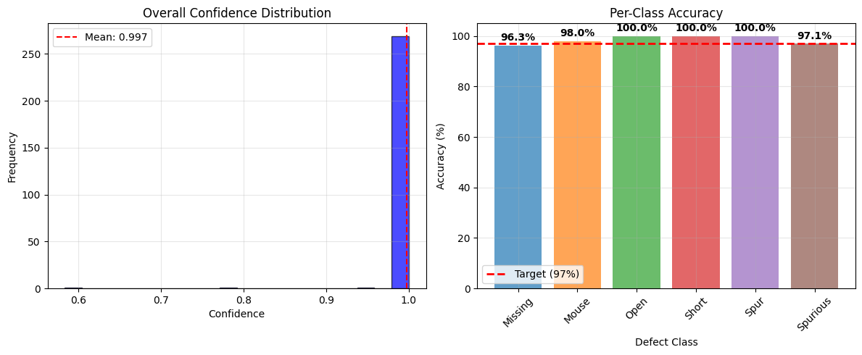
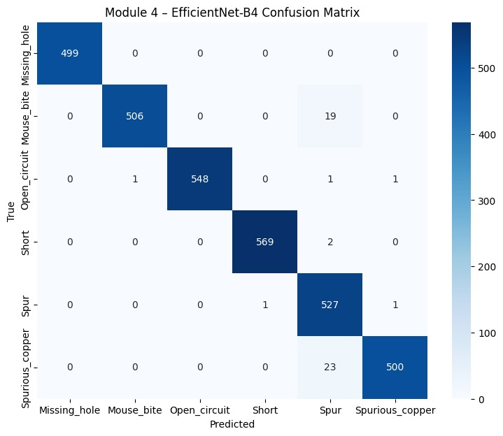
4.4 Module 4 — Model Evaluation & Inference Testing
1. Testing on Unseen Images
The model trained in Module 3 is evaluated on a separate test set consisting of ROIs not used in training or validation.
Each test image is preprocessed (resized, normalized) and passed through the EfficientNet-B4 model for prediction.
2. Prediction Accuracy
The predicted labels are compared to the true labels to calculate overall accuracy.
Class-wise metrics including precision, recall, and F1-score provide detailed insight into the model’s performance for each defect type.
3. Confusion Matrix Visualization
A confusion matrix is generated to visualize misclassifications and highlight which defect types are most often confused.
This helps identify weaknesses in the model and areas for potential improvement.

Slide 9
4.5 Module 5 — Web UI for Upload & Visualization
1. Uploading PCB Images
Users can upload defect PCB images in formats like PNG, JPG, or JPEG.
The interface immediately displays the uploaded image for confirmation.
2. Defect Detection Workflow
The uploaded image is aligned with the corresponding defect-free template.
A difference map is computed to highlight deviations.
A defect mask is generated using thresholding to isolate defective regions.
3. ROI Extraction & Classification
Detected defects are cropped into Regions of Interest (ROIs).
Each ROI is classified using the trained EfficientNet-B4 model.
Bounding boxes and predicted labels are drawn on the annotated PCB image.
4. Visualization & Logs
The web interface displays:
  Aligned grayscale PCB image, Difference map, Defect mask, Annotated PCB with bounding boxes and labels, Cropped ROI images with predicted defect type.
A defect detection log provides detailed information: label, confidence, and bounding box coordinates
5. User-Friendly Interaction
The interface is interactive, responsive, and requires no coding knowledge.
It allows real-time testing of new PCB images and visualization of defect analysis results.

Slide 10
4.6 Module 6 — Backend Pipeline Integration
Pipeline Steps:
Template Matching
  Uses Structural Similarity Index (SSIM) to find the closest defect-free PCB template.
  Ensures accurate reference for detecting anomalies.
Image Alignment
  Aligns the defect PCB to the template using ORB keypoints and homography transformation.
  Corrects scale, rotation, and perspective differences for precise comparison.
Difference Map & Defect Mask
  Computes pixel-wise differences between aligned defect and template images.
  Applies Otsu thresholding and morphological operations (erosion and dilation) to isolate defect regions.
ROI Extraction
  Detects contours of defect areas from the mask.
  Crops bounding boxes around each defect with padding for context.
  Prepares ROIs for classification.
Defect Classification
  Each ROI is processed by the trained EfficientNet-B4 model.
  Predicts defect type and confidence score for every detected region.
Annotation & Logging
  Annotates original PCB image with bounding boxes, predicted labels, and confidence.
  Maintains a structured defect log for all detected regions, including coordinates, labels, and confidence values.

Slide 11
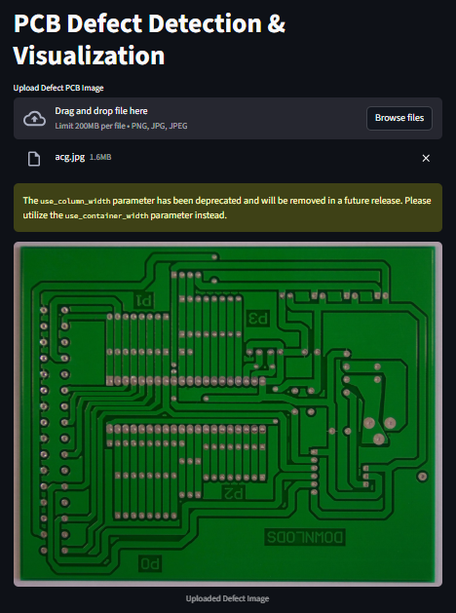
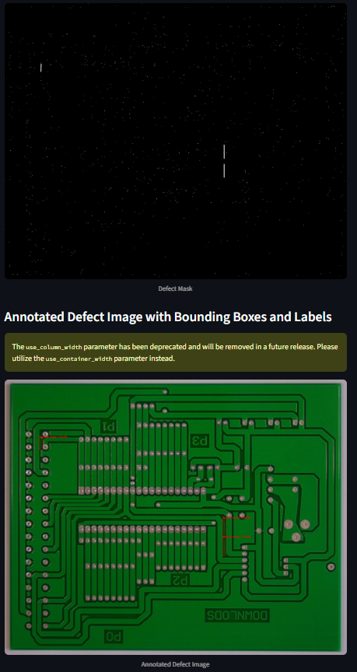
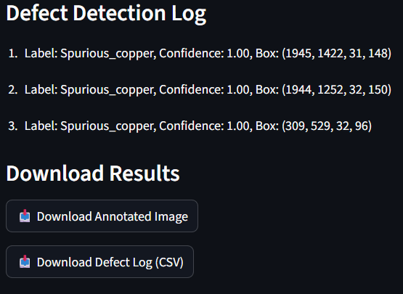
4.7 Module 7 — Testing, Evaluation & Export System
1. Annotated Image Output
Highlights detected PCB defects using bounding boxes and labels.
Provides visual verification of defect locations and types.
2. CSV Defect Log
Stores detailed information for each defect: type, confidence score, bounding box coordinates, timestamp, and matched template image.
Useful for documentation, analysis, and reporting.
3. Download Features
Users can download annotated images and the defect log.
Facilitates record-keeping, sharing results, and further analysis.

Slide 12
5. Advantages & Limitations
5.1 Advantages
High accuracy in detecting and marking PCB defects.
Fully automated, end-to-end pipeline from input to output.
User-friendly web interface using Streamlit for easy operation.
Provides exportable outputs: annotated images and CSV defect logs.
Fast processing with modular design for scalability and future upgrades.
Supports visualization of aligned defect images, difference maps, and ROIs.
5.2 Limitations
Performance drops with extreme rotation, skew, or distorted PCBs.
Requires clean, high-quality defect-free templates for alignment.
Can only detect defect types included in the training dataset.
ROI bounding boxes may vary or be imprecise for very complex PCB layouts.
Small or subtle defects may be missed if they do not appear clearly in difference maps.

Slide 13
6. Conclusion
A complete PCB defect detection system has been successfully developed by combining accurate template matching, image alignment, and efficient ROI extraction. The pixel-wise image subtraction method effectively highlights defect regions, allowing the system to detect various defect types with high reliability.
The integration of an EfficientNet classifier ensures precise recognition of defects, while the Streamlit-based user interface allows users to visualize annotated images, review defect logs, and download results. This end-to-end pipeline is fully automated, fast, and modular, making it suitable for practical industrial applications.
Despite its robustness, the system depends on high-quality template samples and can be sensitive to extreme rotations or distortions. Nevertheless, the design allows future enhancements, such as adding new defect categories or improving alignment techniques, making it flexible and scalable.

Slide 14
Thank You

