Slide 1



CRICKET PLAYER PERFORMANCE PREDICTION
BY:K V MAGESH
MENTOR--PRANAYA MAM

Slide 2
OBJECTIVE
Predict cricket player performance in upcoming matches (runs/wickets).
Enable data-driven decisions for player selection and team strategy.
Provide a user-friendly interface using Streamlit for real-time predictions.
Analyze past performance trends and match conditions.
Assist in evaluating player form against specific opponents and venues.

Slide 3
DATASET OVERVIEW
IPL historical match data
Player-wise performance records
Batting & bowling statistics
Venue and opponent information
Rolling performance metrics

Slide 4
DATA PREPROCESSING
Handle missing values:
Numeric columns → mean imputation.
Categorical columns → most frequent value.
Encode categorical variables: OneHotEncoder for team, venue, player.
Scale numeric features: StandardScaler ensures uniform range.
Preprocessing pipeline ensures consistency between training and prediction.
Helps model handle incomplete or inconsistent historical records.

Slide 5
FEATURE ENGINEERING
Extract numeric and categorical features separately.
Calculate advanced statistics:
Batting average, strike rate, consistency over last 5 matches.
Bowling economy rate, wickets per match.
Include match contextual features: venue, opposition, toss outcome.
Reduces dimensionality while keeping predictive power high.
Ensures model can capture trends over time and different conditions.

Slide 6
MODEL BUILDING
Algorithm used: RandomForest Regressor for regression prediction.
Pipeline approach: Preprocessing + Model combined for seamless training.
Models Tested:
Random Forest Regressor
XGBoost Regressor
LightGBM Regressor
Final Model: XGBoost
Reason:
Better accuracy
Handles non-linearity
Strong generalization

Slide 7
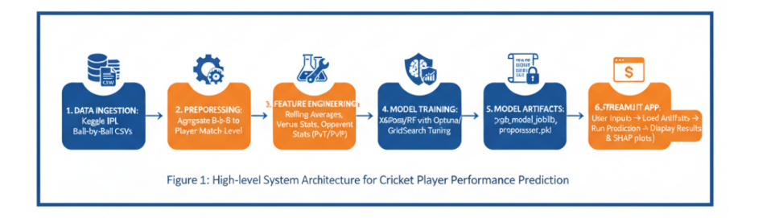
MODEL TRAINING WORKFLOW

Slide 8
MODEL EVALUATION
PREDICTIONS MADE ON TEST SET TO EVALUATE MODEL PERFORMANCE.
METRICS USED:
MEAN SQUARED ERROR (MSE) TO MEASURE PREDICTION ERROR.
R² SCORE TO MEASURE VARIANCE EXPLAINED BY THE MODEL.
EVALUATION ENSURES MODEL RELIABILITY BEFORE DEPLOYMENT.
CROSS-VALIDATION USED TO PREVENT OVERFITTING AND ASSESS GENERALIZATION.
HELPS IDENTIFY FEATURES WITH HIGHEST IMPACT ON PLAYER PERFORMANCE.

Slide 9
MORE FEATURES TO BEEN ADD
Add weather & pitch conditions
Integrate live cricket APIs
Add team-level prediction
Deploy on cloud platform
Use deep learning models (LSTM)

Slide 10
CHALLENGES
Large historical dataset leads to longer model training times.
Many categorical features increase feature dimensionality.
Version compatibility issues with scikit-learn pickles.
Handling missing or inconsistent match records.
Ensuring Streamlit app works across different platforms and Python environments.
Balancing model complexity and computation speed for real-time use.

Slide 11
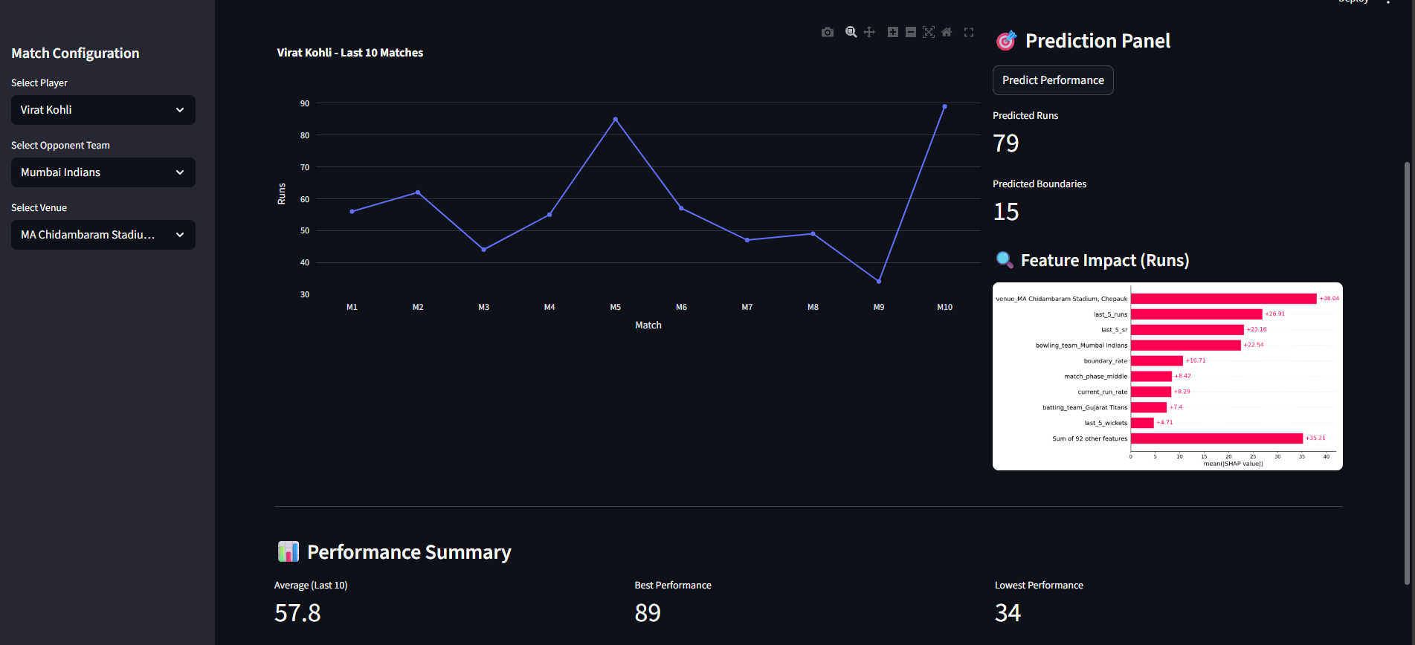
OUTPUT

Slide 12
THANK YOU

