Slide 1

IPL Player Performance Prediction Using Machine Learning
Student: Pooja S — B Tech AIML, RMD Engineering College. A data-driven system to predict individual IPL player performance for analysts and fantasy players.

Slide 2

Problem Statement
Predictions often rely on intuition. Individual IPL performance depends on opponent, match conditions, and recent form. A robust, data-driven predictive system is needed.

Slide 3



Objectives
Predict Runs
Predict Wickets
Actionable Insights
Estimate runs for batsmen in upcoming matches.
Forecast wickets for bowlers in upcoming matches.
Provide interactive dashboard insights for decision-making.

Slide 4
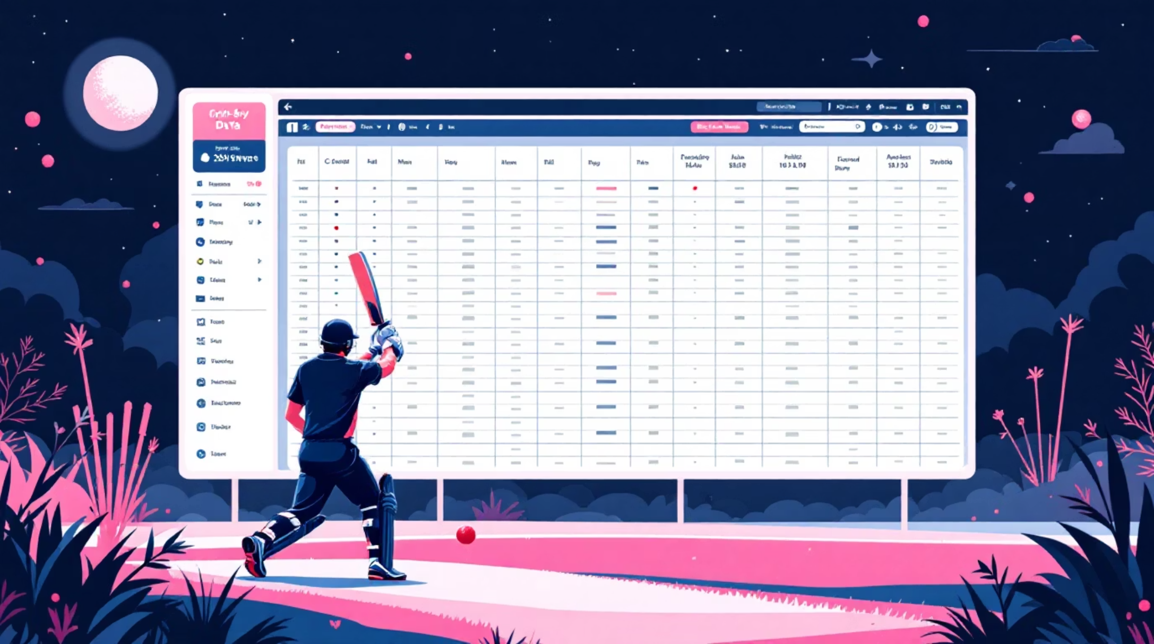
Dataset Description
Datasets: IPL Matches and Ball-by-Ball Deliveries. Key features include inning, balls, match_order, rolling_avg_10, batting_team, bowling_team, and runs_conceded.

Slide 5

Data Preprocessing
Handle Missing Values
Merge Datasets
Rolling Average
Combined match and delivery tables for context.
Computed last-10-matches rolling_avg_10 feature.
Cleaned data to ensure model-ready records.
One-Hot Encoding
Encoded categorical variables (teams, innings).

Slide 6
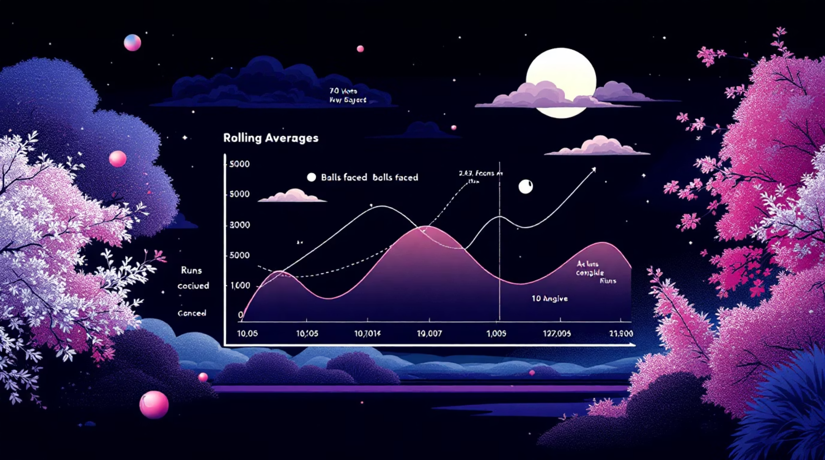
Feature Engineering
Rolling average captures recent player form.
Batting and bowling team encoding adds contextual matchups.
Match order and innings reflect game situation.
Runs conceded and balls faced quantify opportunity and risk.

Slide 7


Models Evaluated
Linear Regression
Baseline model for continuous predictions.
Random Forest
Ensemble method to capture non-linear patterns.
XGBoost (Selected)
Final model chosen for superior handling of non-linear relationships and best accuracy.

Slide 8
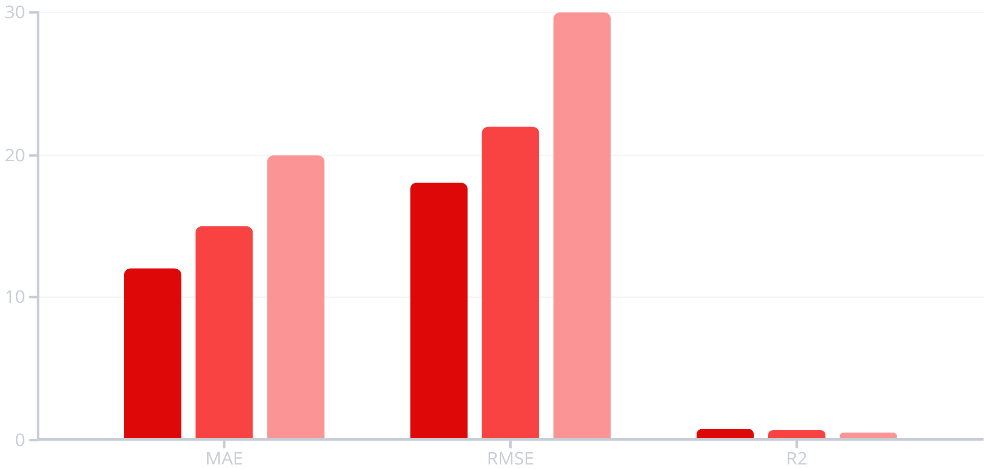
Model Evaluation
XGBoost achieved the best overall performance across MAE, RMSE, and R² and was selected as the final model.
XGBoost
RandomForest
Linear

Slide 9
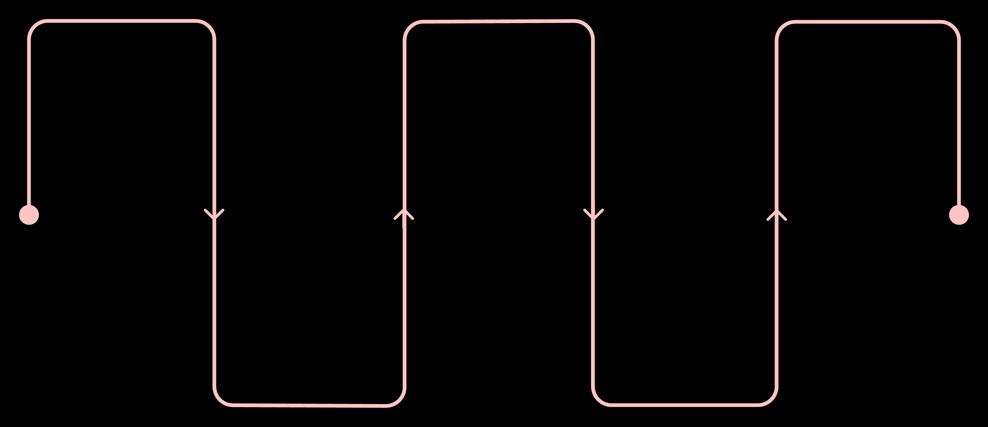
System Architecture & Deployment
Data Collection
Feature Engineering
Deployment
Serve model with Streamlit
Ingest raw data from sources
Create and select predictive features
Cleaning & Preprocessing
Model Training
Handle missing values and normalize
Train XGBoost models
The pipeline covers data collection, cleaning, feature engineering, XGBoost training and evaluation, and deployment via a Streamlit dashboard.

Slide 10
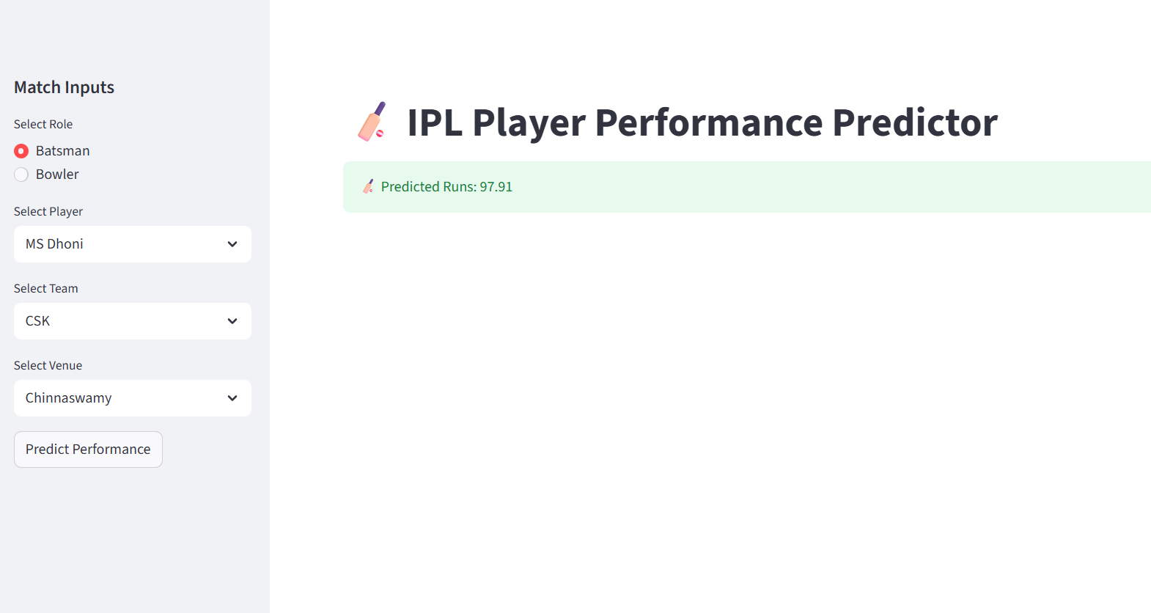
Dashboard
Implementation
Built with Streamlit; model serialized using Pickle; interactive inputs and prediction display.

Slide 11
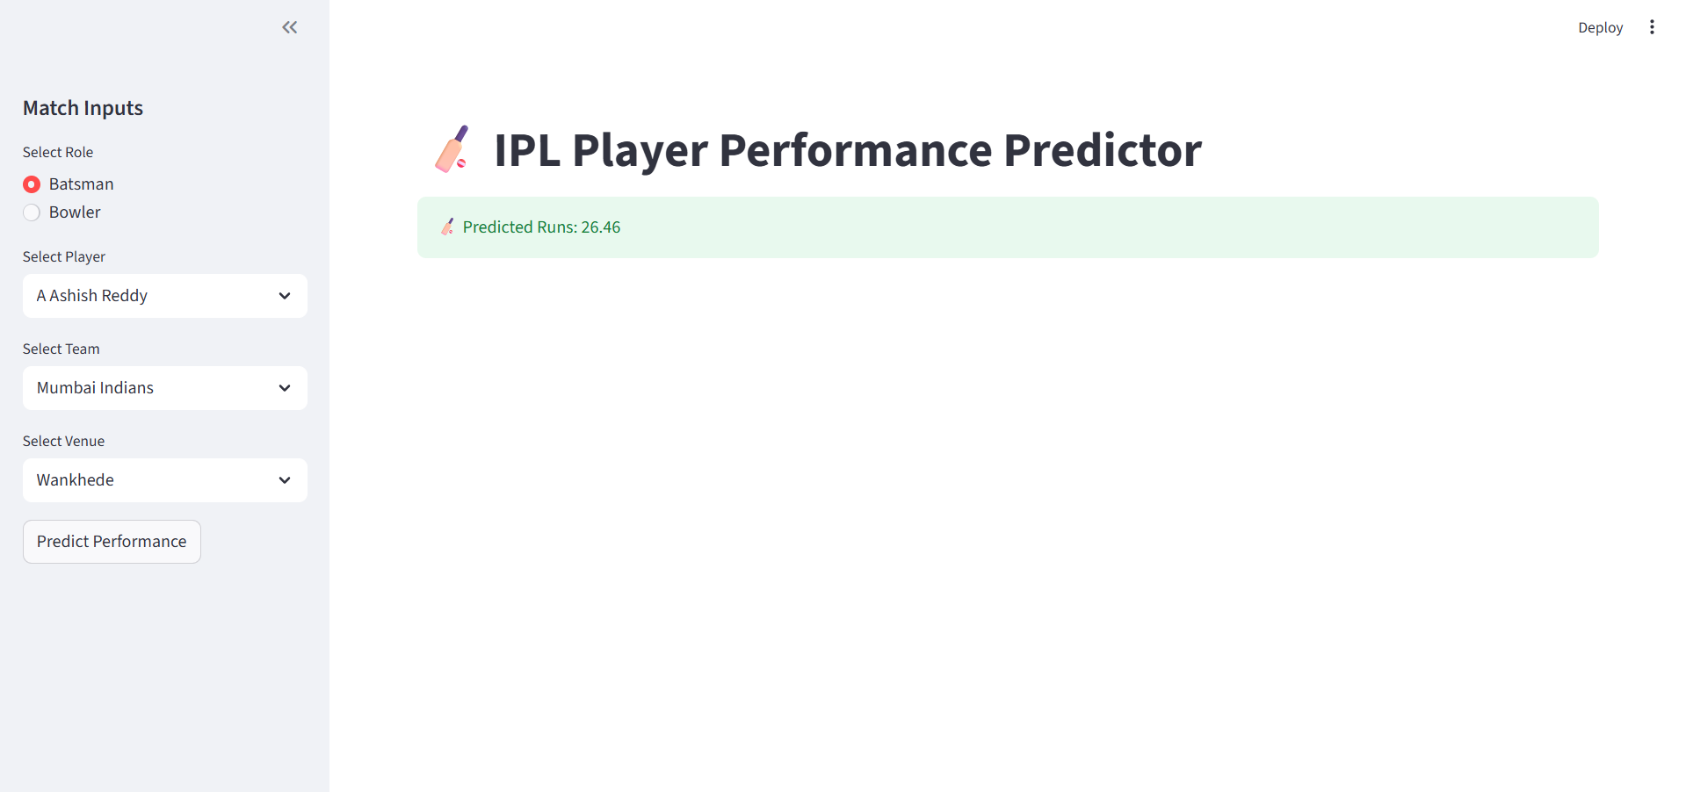
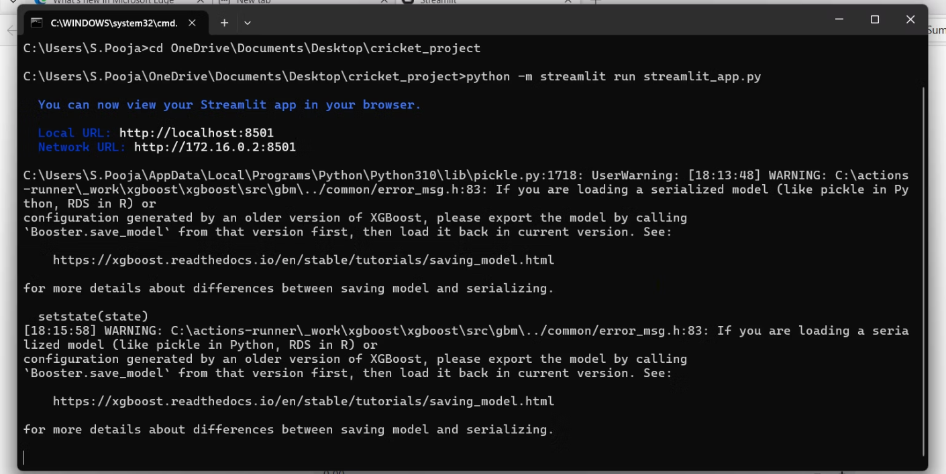

Slide 12
Conclusion
The developed machine learning system accurately predicts IPL player performance, offering data-driven insights for strategic planning and fantasy sports. Leveraging the robust XGBoost model, the system provides high-fidelity forecasts for runs and wickets, validated through rigorous evaluation and deployed via an interactive Streamlit dashboard.
Proven Accuracy
Strategic Advantage
Future Potential
XGBoost delivers reliable performance predictions.
Empowers data-driven decision-making for teams and enthusiasts.
Foundation for continuous learning and real-time data integration.

