Slide 1

Cricket Player Performance — ML for IPL
Predicting match-level runs (batsman) and wickets (bowler) using historical ball‑by‑ball data, feature engineering, XGBoost, SHAP and a Streamlit front end.

Slide 2

Data collection & preprocessing
Sources
Key fields
Cleaning
Multi‑season IPL deliveries + match summaries
Batsman, Bowler, Runs, Dismissals, Venue, Date
Standardise names, remove duplicates, impute missing
Aggregation
Compute legal deliveries, match‑level stats per player

Slide 3




Feature engineering — domain + temporal
Long‑term skill
Context
Recent form
Bowler signals
Venue averages, surface bias, opponent match‑ups
10‑match rolling averages (runs / wickets)
Career average, strike rate, boundary rate
Economy, wicket rate, venue/opponent splits
Features capture long‑term ability + short‑term form + match conditions.

Slide 4

Model development
01
Model
XGBoost regressor — handles nonlinearity, regularisation
02
Training
Chronological 80/20 split, early stopping on time‑aware val set
03
Tuning
Grid / random search for max_depth, eta, subsample, colsample
04
Baseline
10‑match rolling average
Outcome: XGBoost outperformed the rolling‑average baseline.

Slide 5
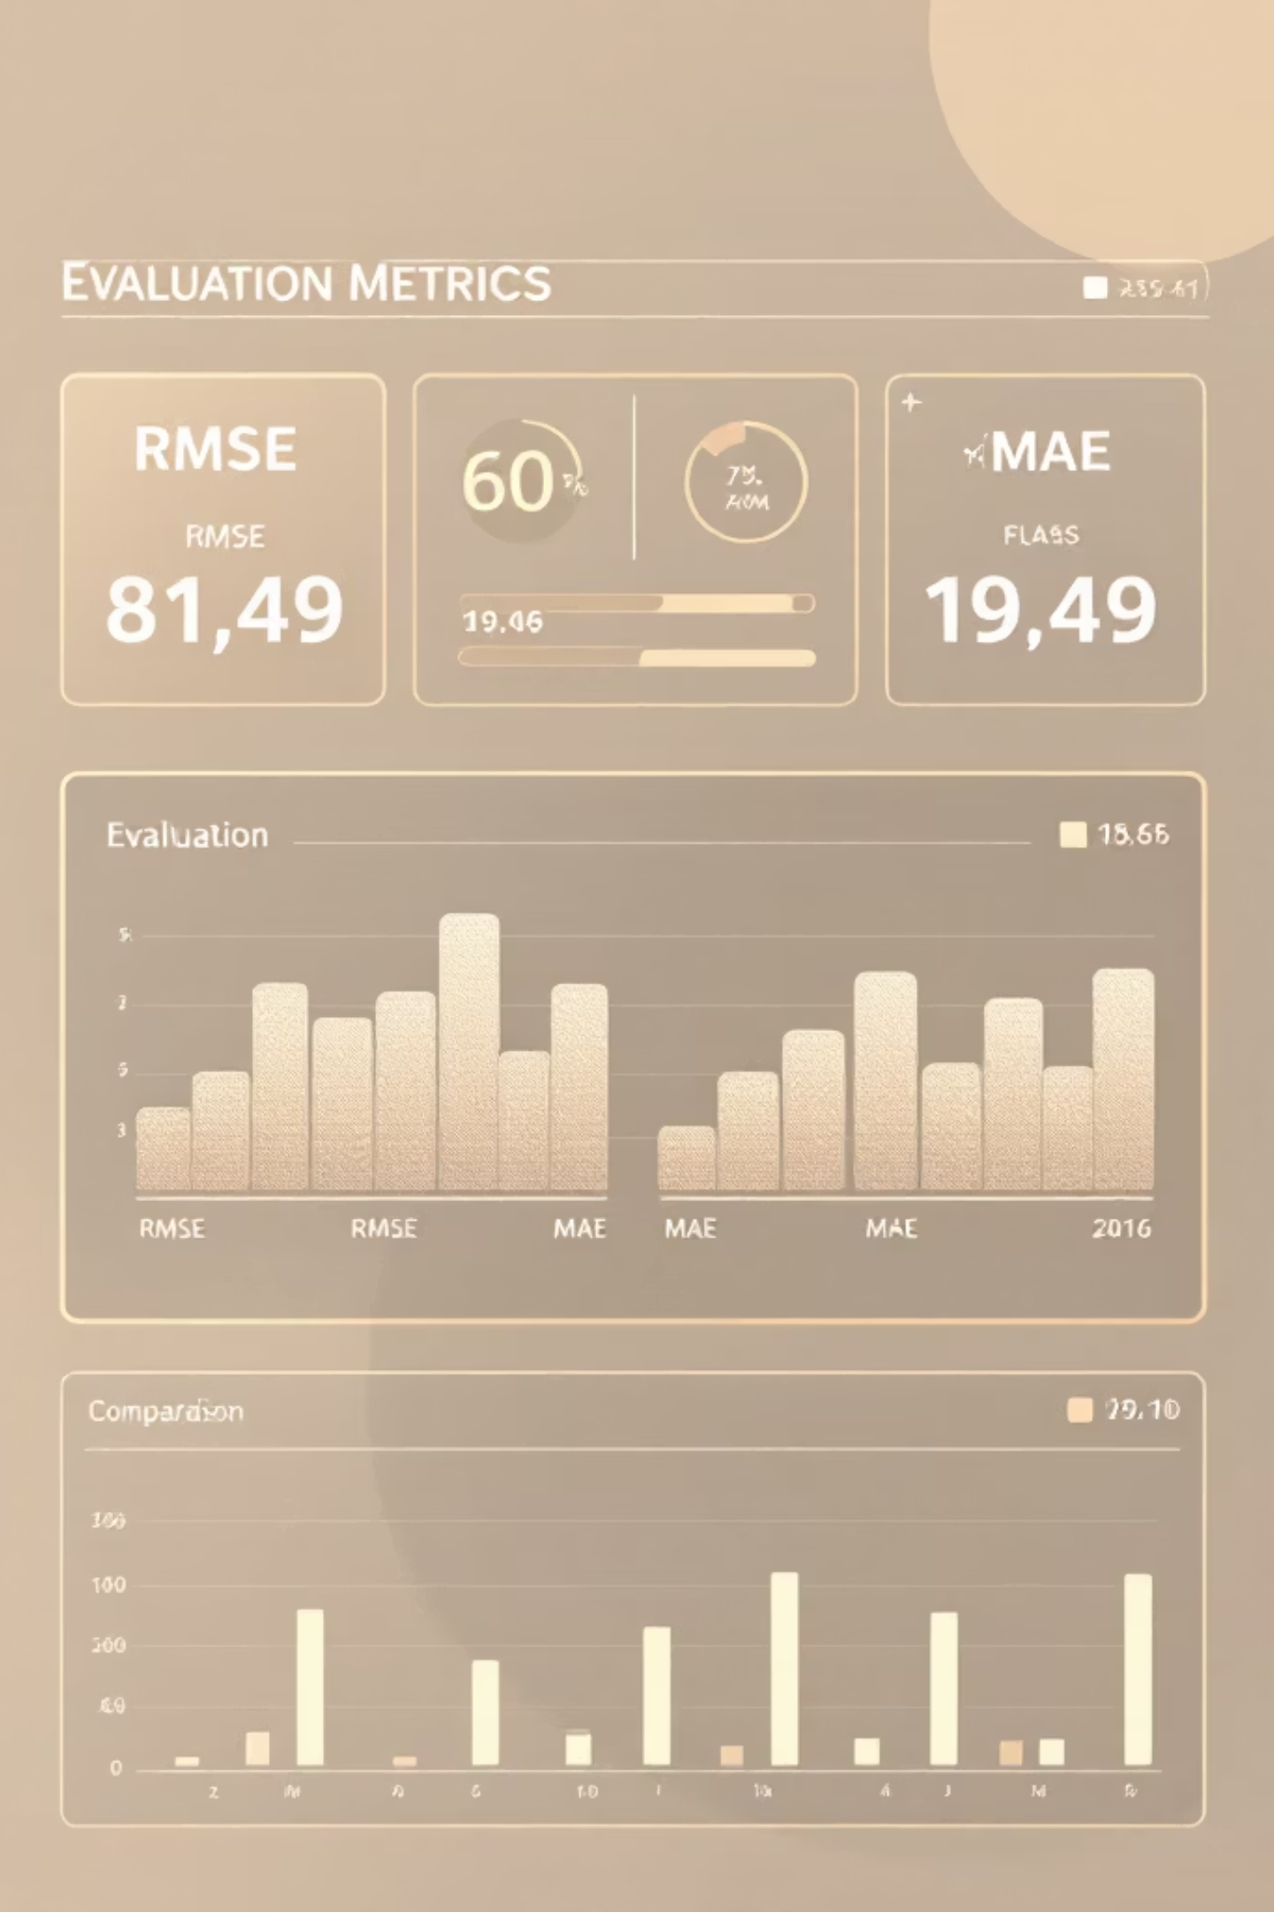
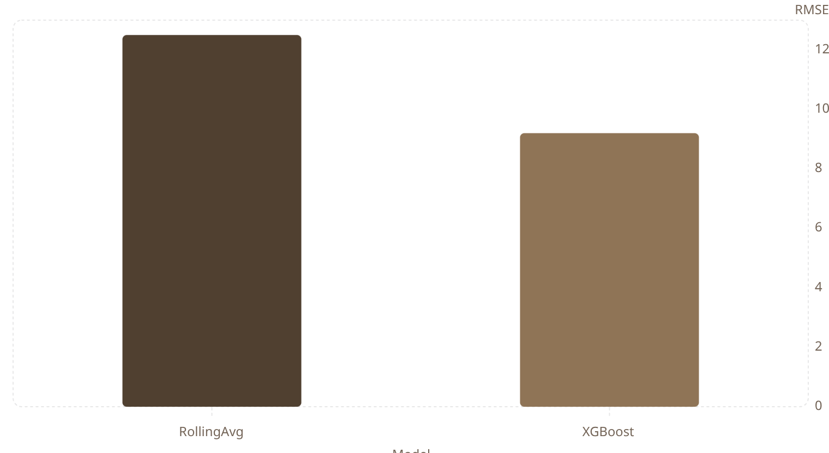
Evaluation & results
Metrics: RMSE, MAE (match‑level)
XGBoost: lower RMSE vs baseline
Better accuracy for runs and wickets
Feature engineering: primary gain

Slide 6

Explainability — SHAP
Value Colour Map
SHAP Impact
Top Features
SHAP reveals per‑prediction drivers. Recent form and venue frequently increase run predictions; economy and match context important for wickets.
Colour
Direction
Actionable
Red = high value; Blue = low value
Right = raises prediction; Left = lowers prediction
Use SHAP to validate features, detect bias, improve trust

Slide 7
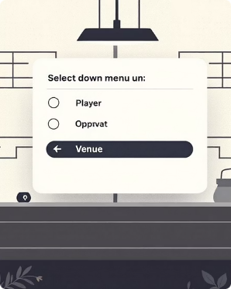
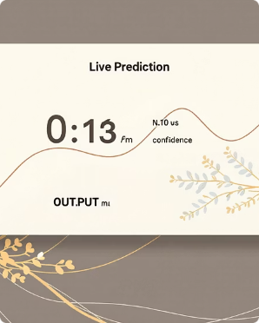
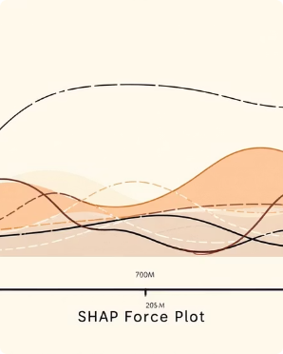

Streamlit dashboard — production
Stack
Streamlit front end
XGBoost model served via lightweight API
SHAP for interpretability
Pandas / NumPy for ETL
Controls
Live predictions
Explainability
Player, opponent, venue, match date
Runs / wickets with CI
SHAP feature breakdown per prediction
Deployable prototype for analysts and coaches — fast, explainable, and interactive.

