Slide 1
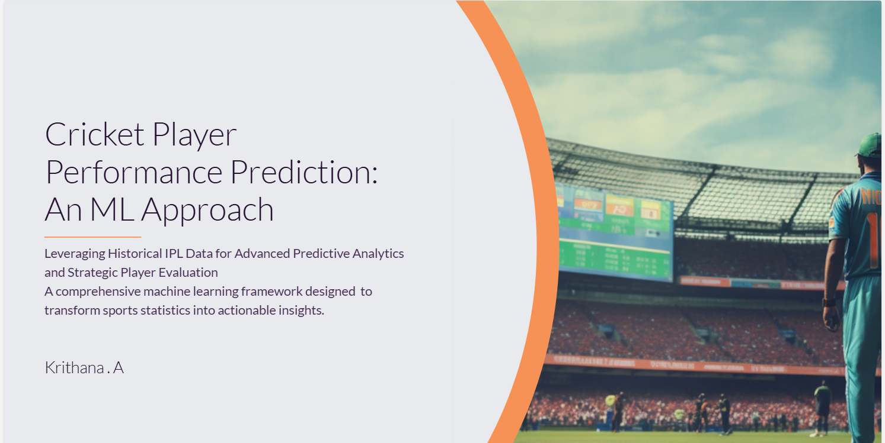

Slide 2
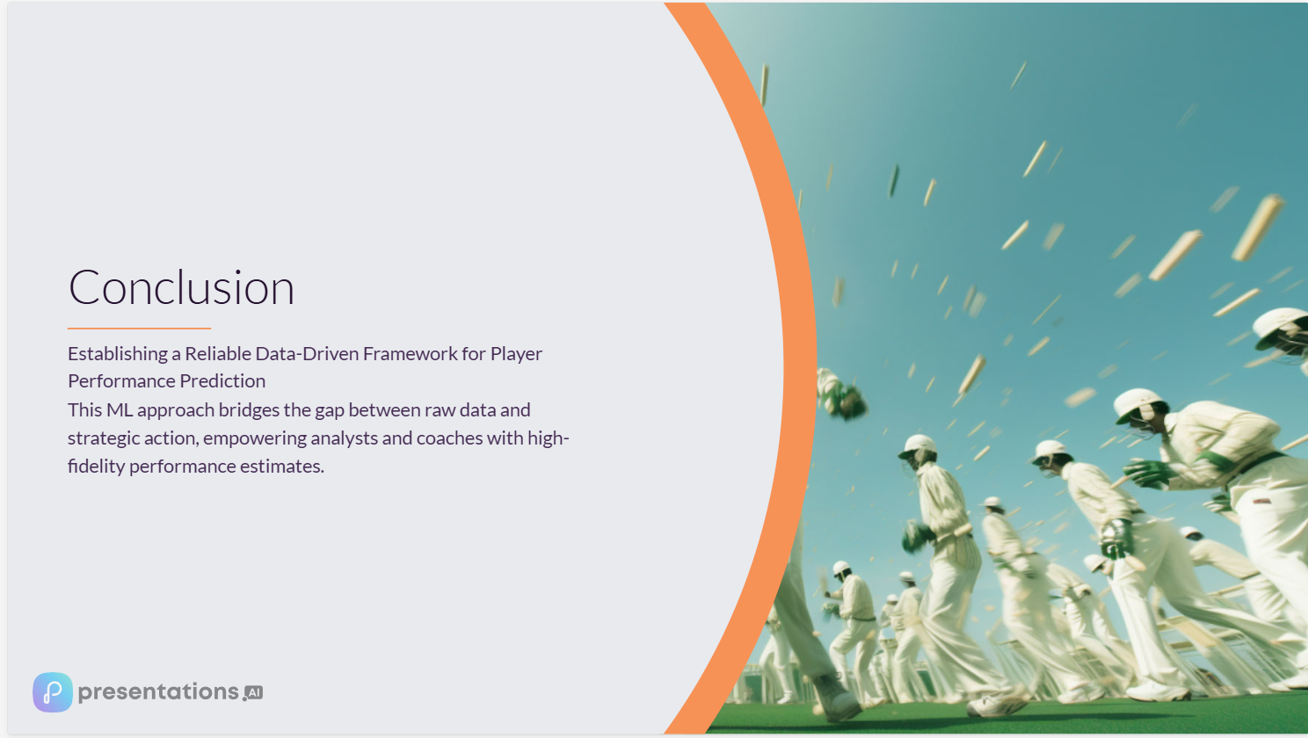
Abstract
This project develops a machine learning system to predict cricket player performance in upcoming IPL matches using historical ball-by-ball and match-level data. After data cleaning and exploratory analysis, advanced feature engineering techniques such as rolling averages, venue-based statistics, and opponent-specific metrics were applied. The problem was formulated as a supervised regression task with a time-series aware train-test split to prevent data leakage. Ensemble models including Random Forest, XGBoost, and LightGBM were trained and evaluated using RMSE, MAE, and R² metrics. The final model was deployed through a Streamlit dashboard for real-time predictions.

Slide 3
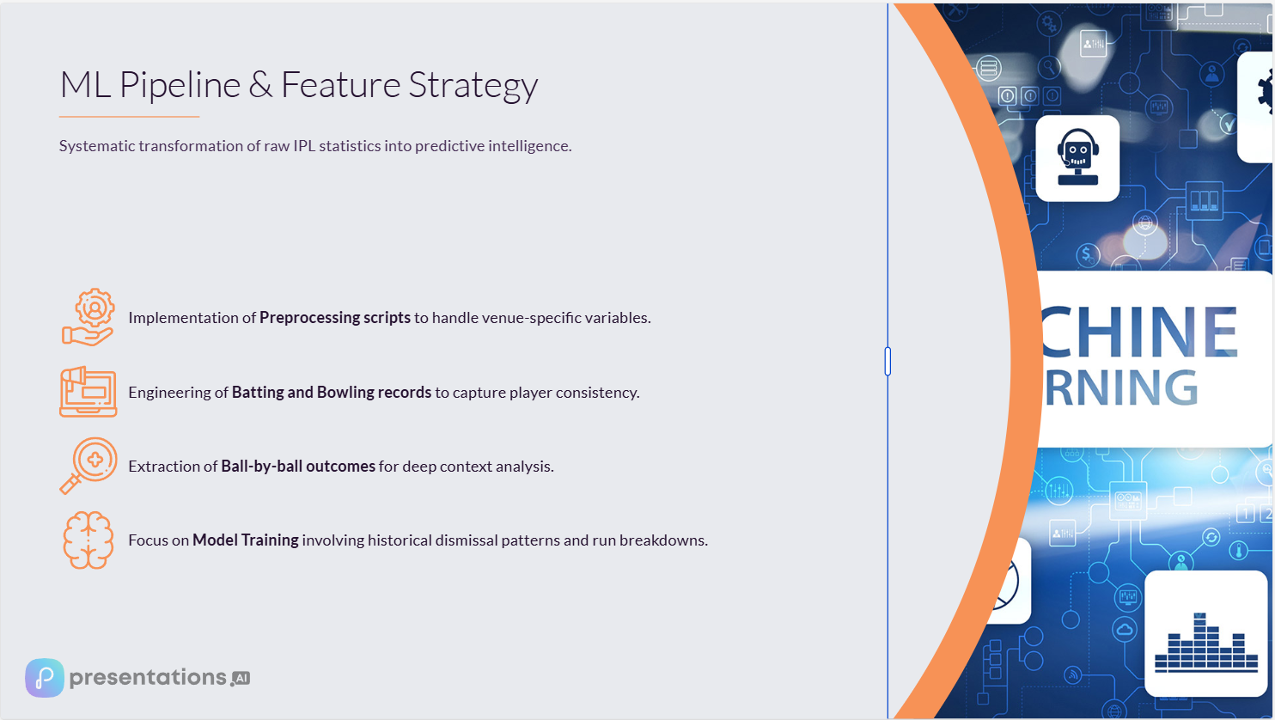
Problem Statement
Cricket generates abundant match and player statistics, yet many selection and strategy decisions rely heavily on intuition and basic averages. This gap presents a significant opportunity to apply machine learning to historical player and match data to predict individual player performance (e.g., runs for batsmen, wickets for bowlers) for upcoming matches. The goal of this project is to build an ML-driven system that produces reliable performance estimates to assist analysts, coaches, fantasy league players, and enthusiasts with data-driven insights.

Slide 4
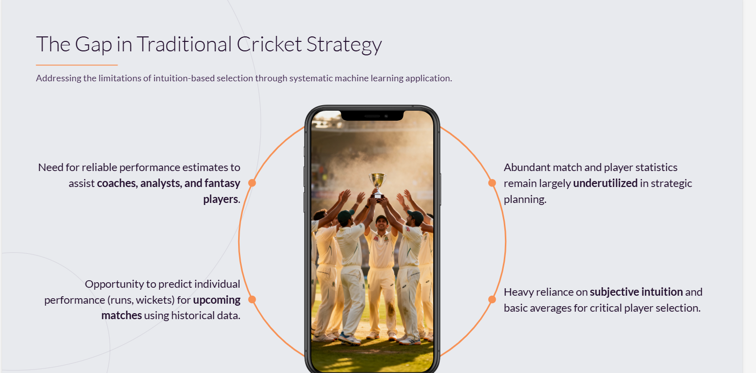

Slide 5
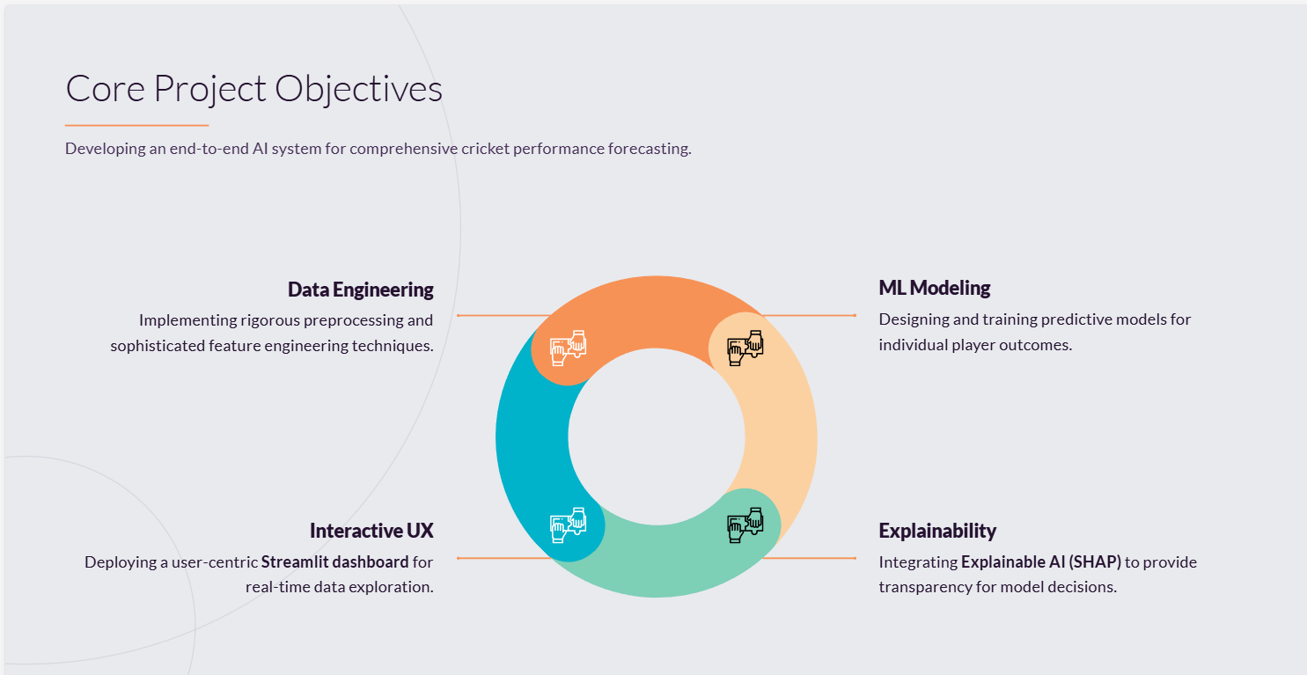

Slide 6
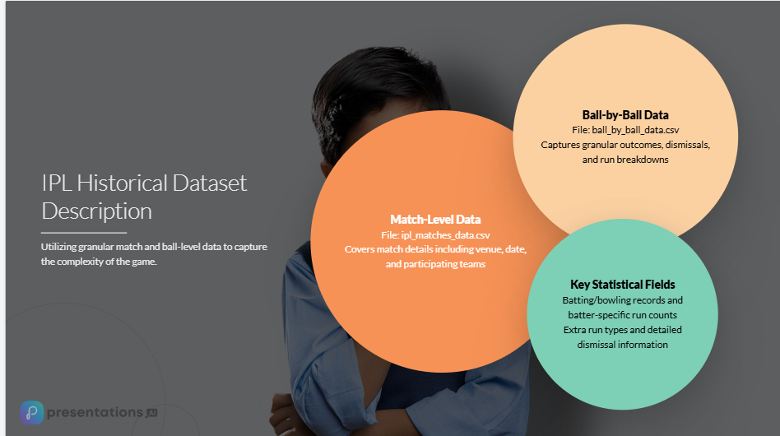

Slide 7
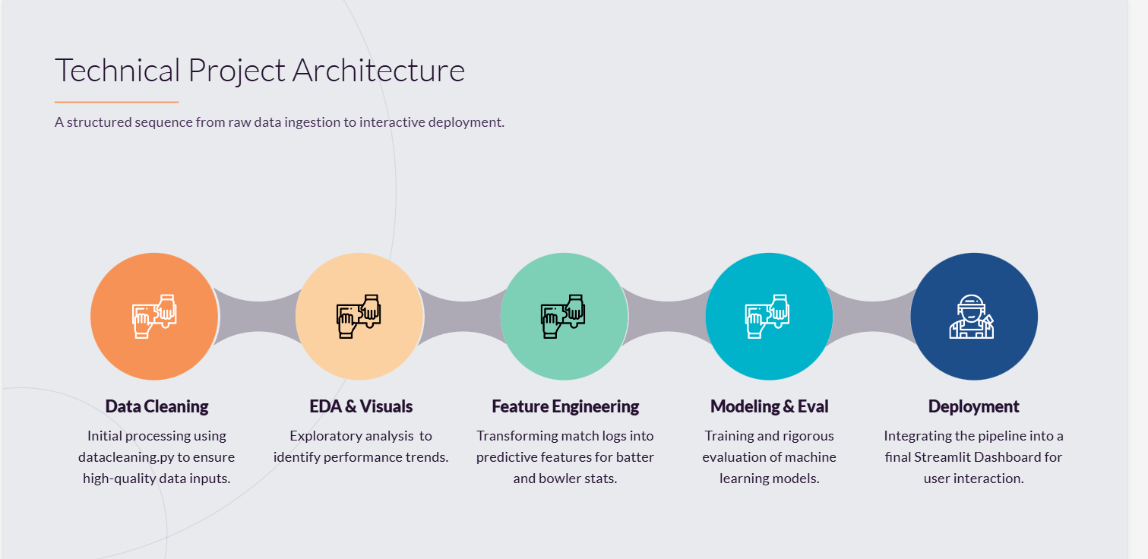

Slide 8
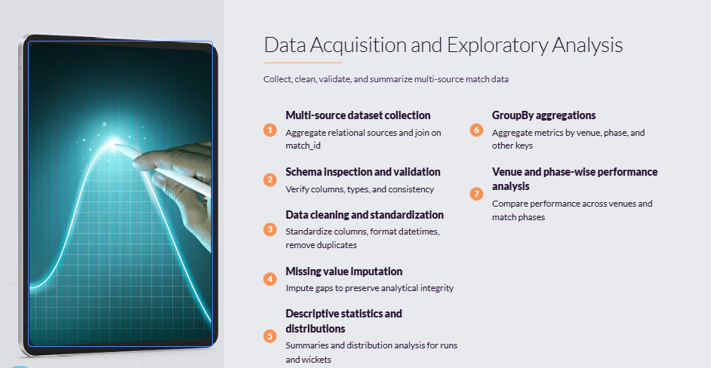
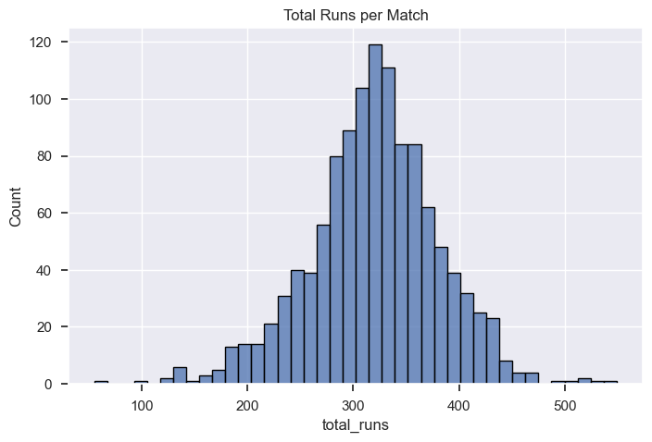
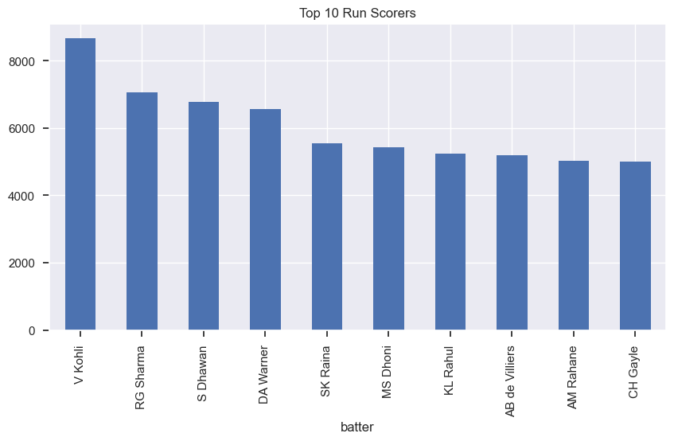
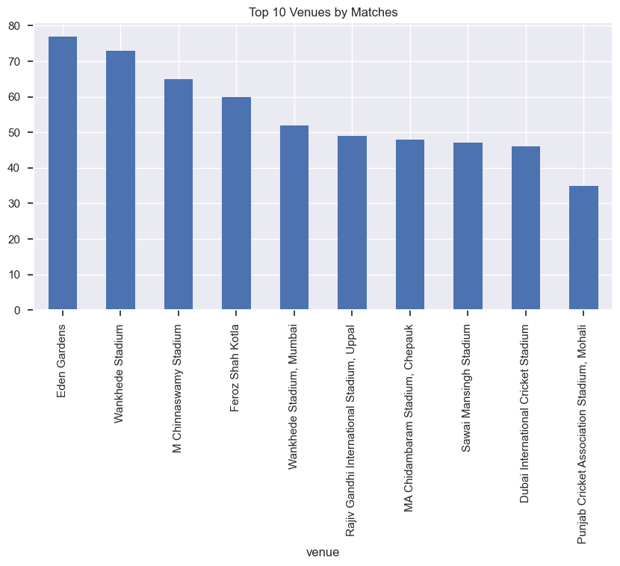
Data Acquisition & Exploratory Analysis
🔹 Techniques Used
Data Acquisition
Multi-Source Dataset Collection
Relational Data Integration (match_id Join)
Schema Inspection & Validation
Data Cleaning
Column Standardization
Datetime Formatting
Duplicate Removal
Missing Value Imputation
Exploratory Data Analysis
Descriptive Statistics
Distribution Analysis (Runs & Wickets)
GroupBy Aggregations
Venue & Phase-wise Performance Analysis

Slide 9
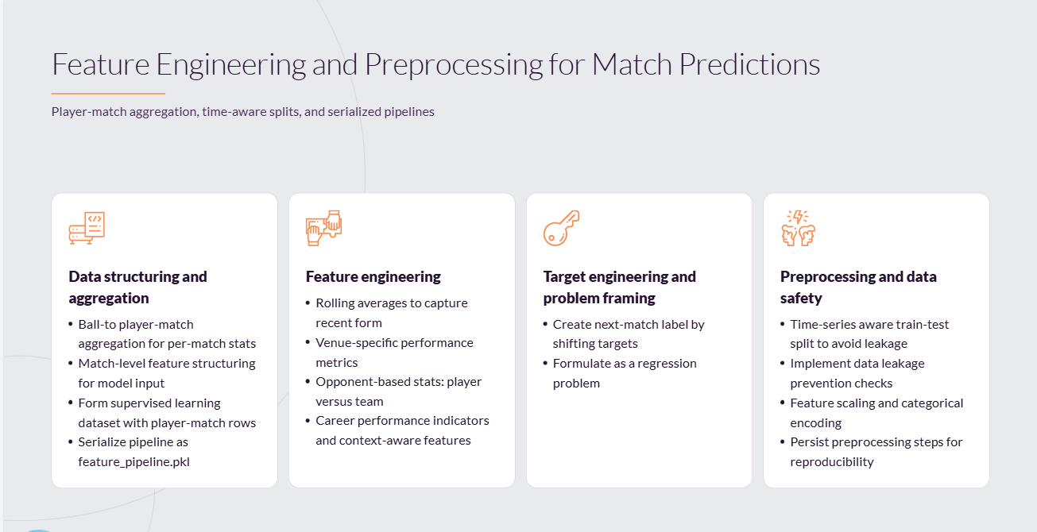

Slide 10
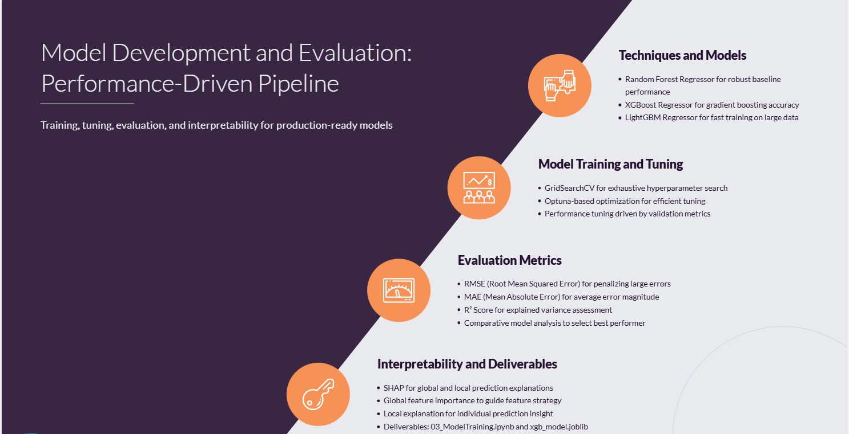

Slide 11
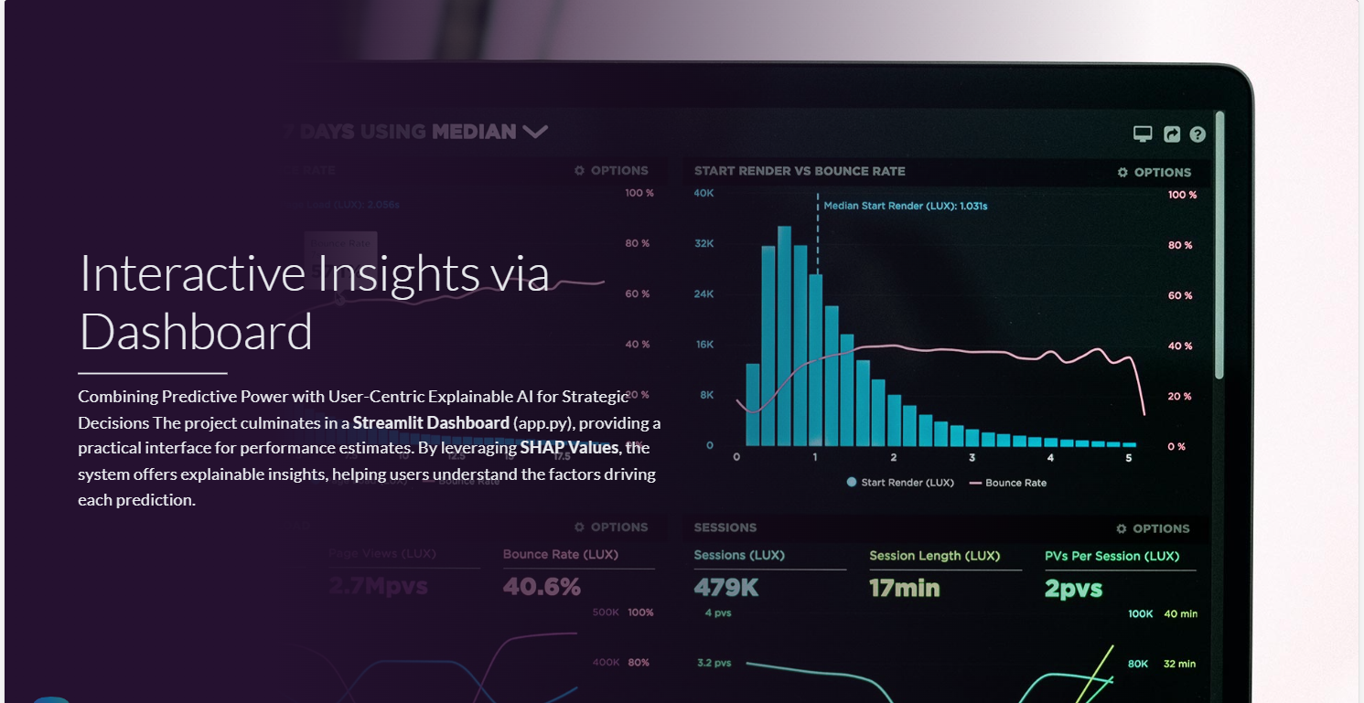

Slide 12
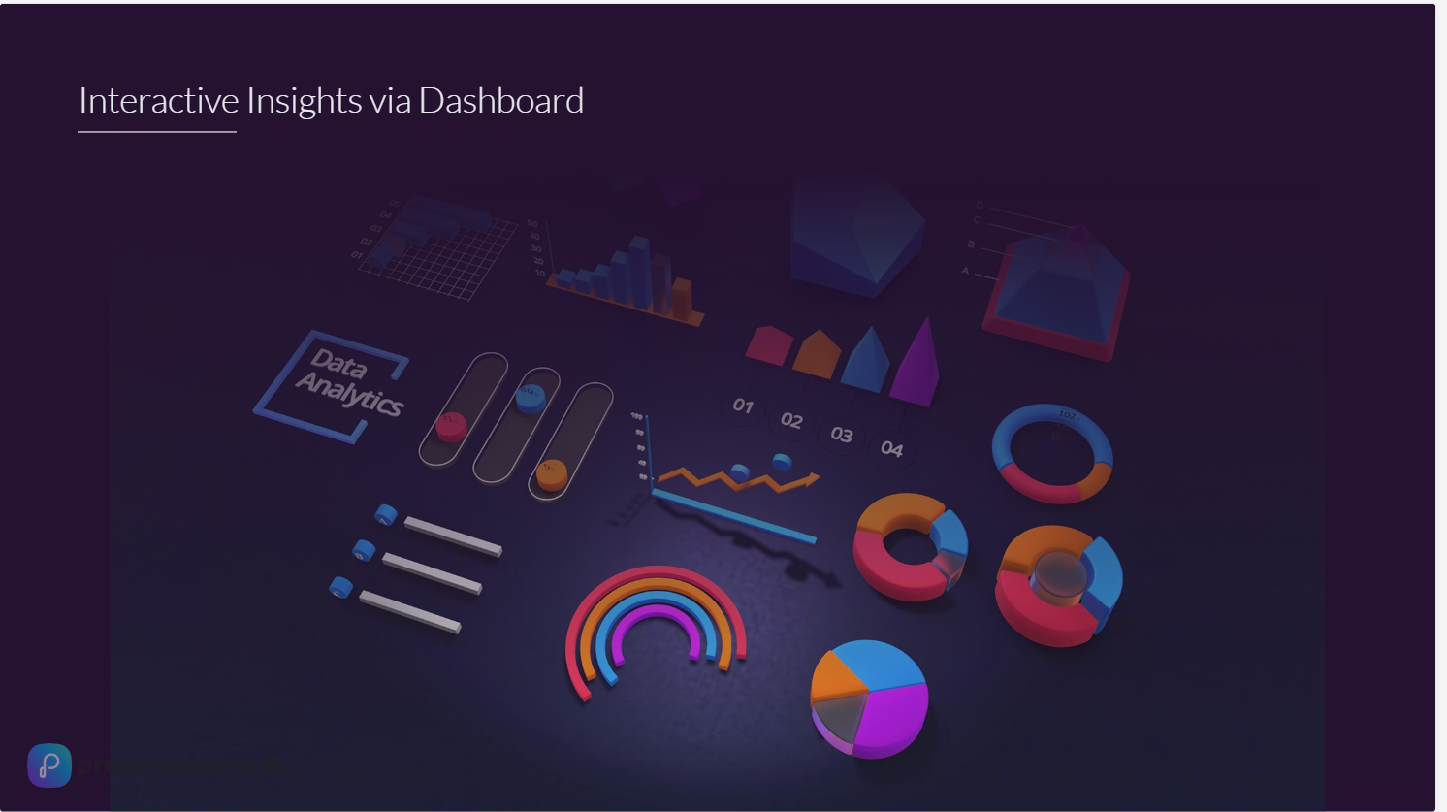
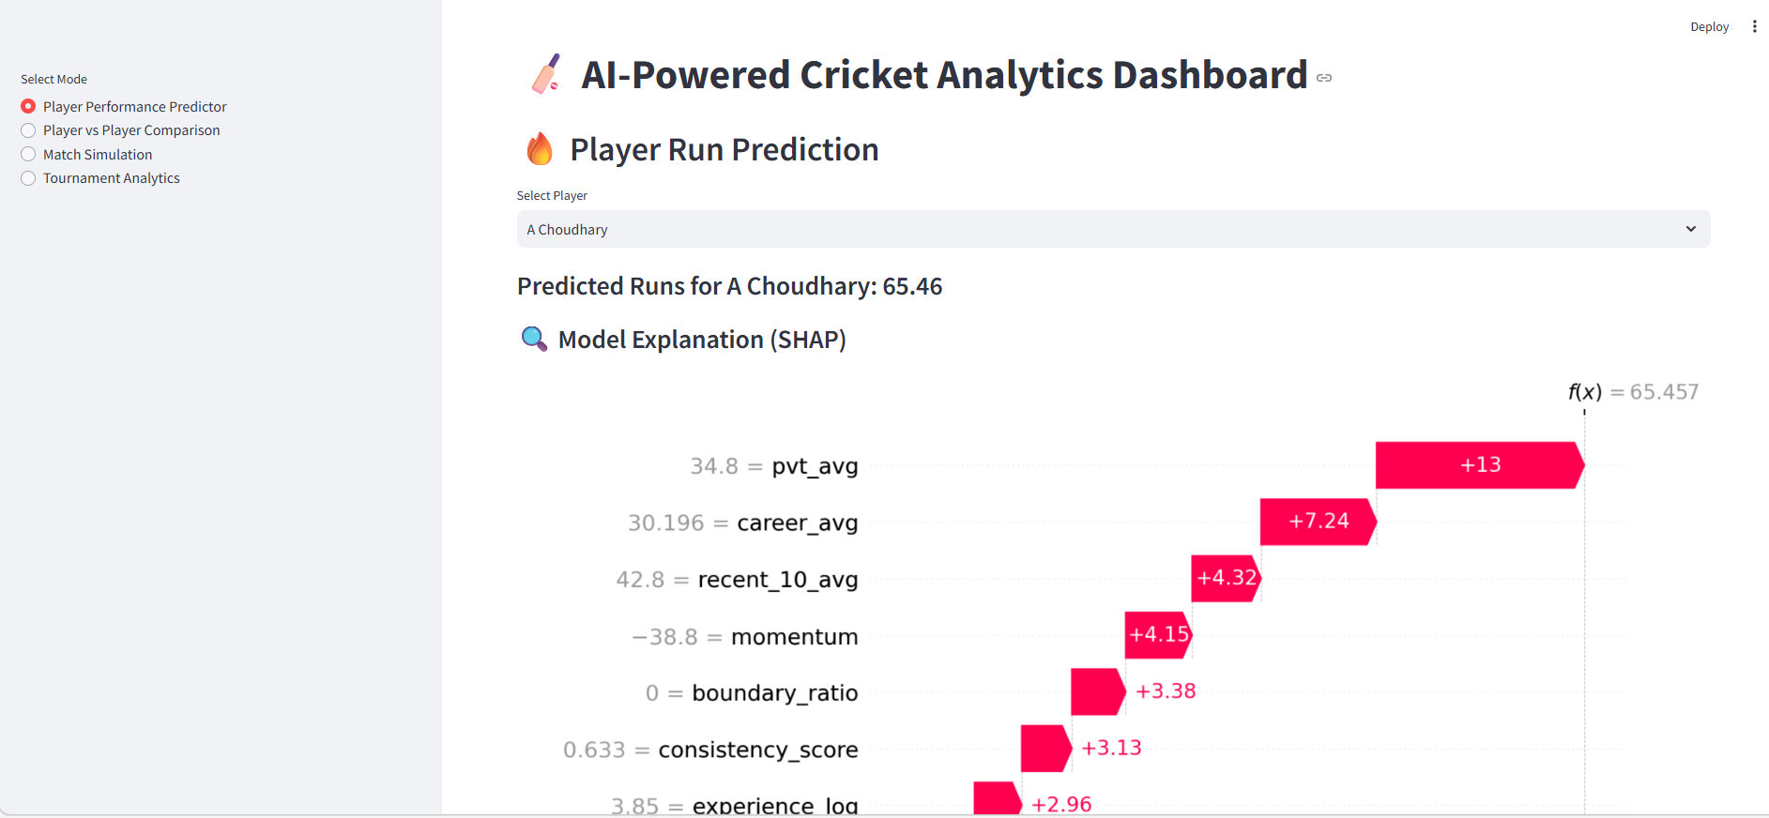
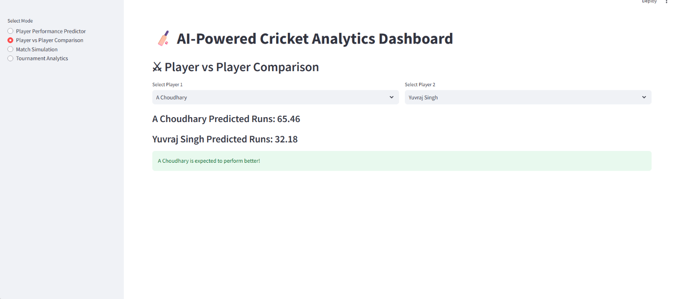
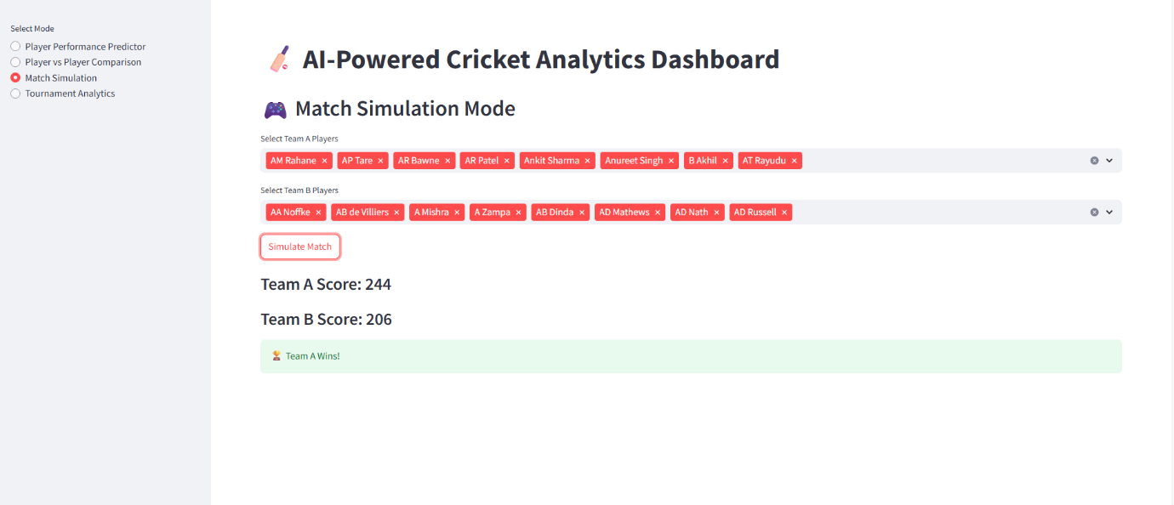

Slide 13
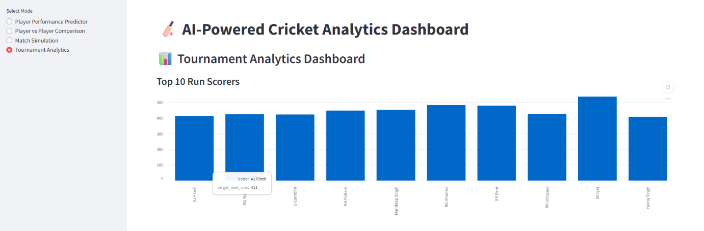
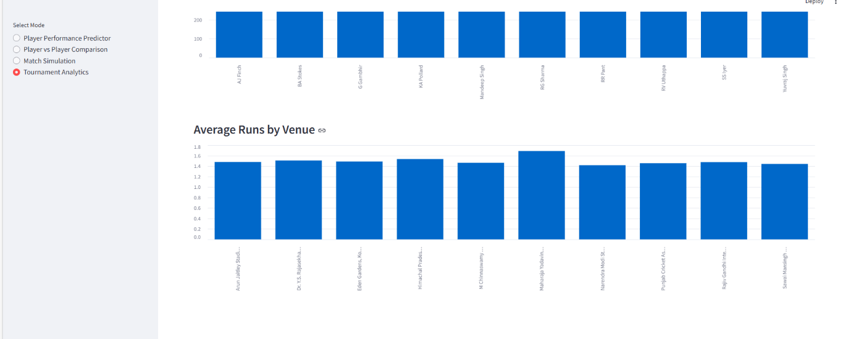

Slide 15


