Slide 1
Multi-Model AI Agent for Automated Health Diagnostics
A Modular AI System for Automated Blood Report Interpretation
Presented by: Vansh Siddhpura
Infosys Springboard Internship Program
Notes:
1

Slide 2
Problem Statement & Objective
Problem
Objective
Blood reports are hard to interpret for non-clinical users; reports arrive in heterogeneous formats (PDF, image scans, JSON). Manual review requires medical expertise and is time-consuming.
Build an automated pipeline to interpret blood reports, detect clinical patterns, quantify risk, and produce structured, evidence-aligned recommendations for users and clinicians.
Notes:
2

Slide 3
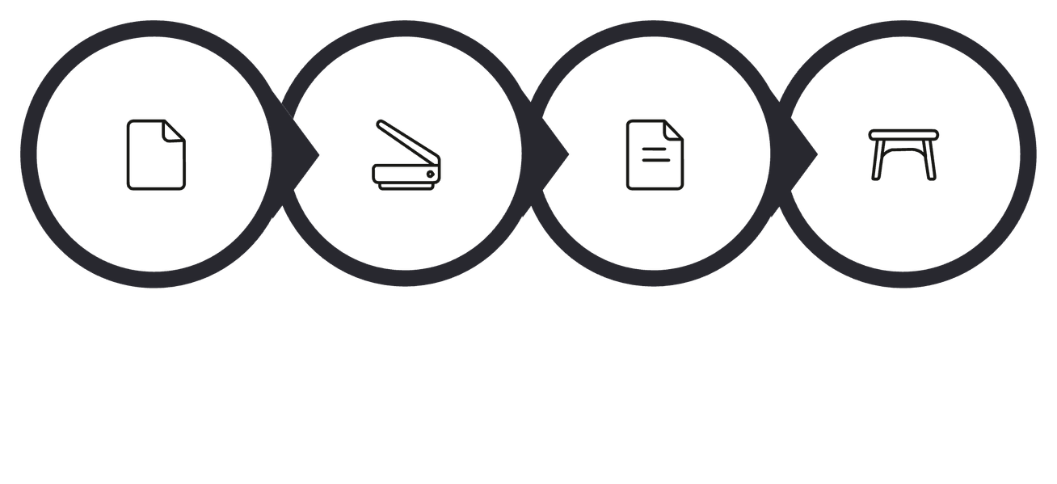




Data Sources & OCR
OCR: Role & Value
Optical Character Recognition converts image/PDF text to machine-readable text, enabling downstream parsing, normalization, and structured extraction.
Input Sources
Laboratory reports (sample development corpus)
Formats: JSON exports, machine PDFs, scanned images
Ensuring broad coverage of real-world report formats improves model robustness.
Report
OCR
Extracted Text
Structured Data
OCR accuracy is a gating factor; preprocessing (de-skew, enhance) improves extraction rates.
Notes:
3

Slide 4
Data Extraction & Processing
01
02
03
Regex-Based Extraction
Parameter Identification
Validation & Standardization
Pattern-driven extraction locates parameter names, numeric values, and units across noisy layouts.
Assign canonical parameter IDs (e.g., Hemoglobin → HGB) to support downstream logic and mapping across lab vocabularies.
Unit normalization, value sanity checks, and handling of formatting variants (commas, ranges, flags) ensure consistent structured data.
Notes:
4

Slide 5
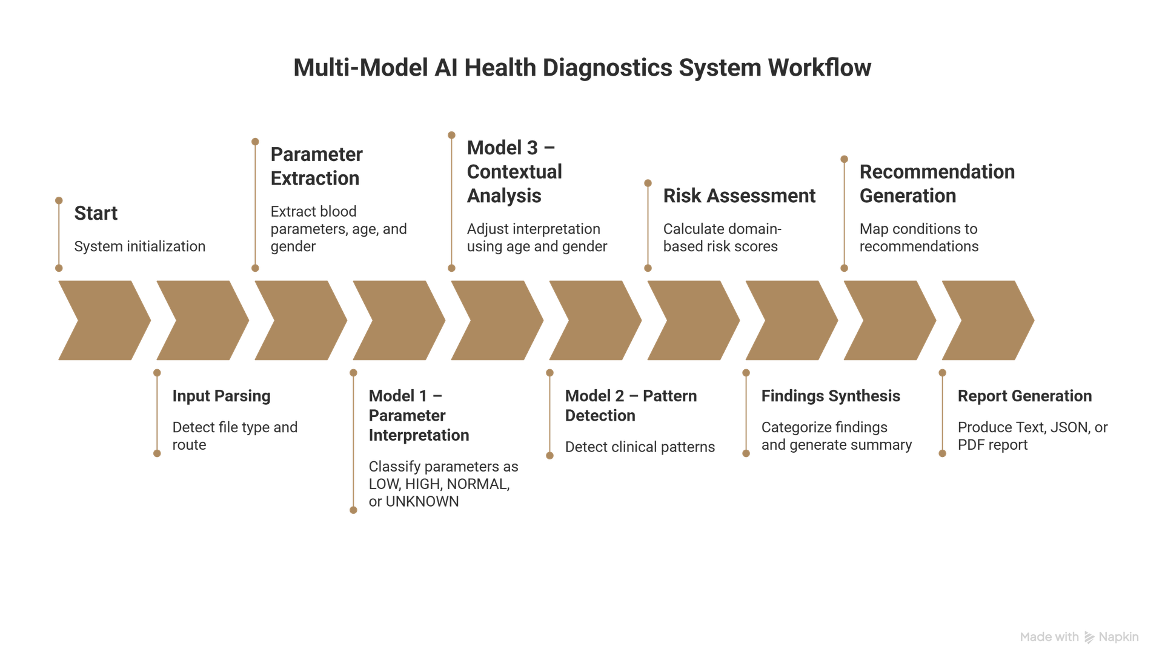
Overall System Workflow
End-to-end pipeline: Ingestion → Extraction & Validation → Interpretation models → Pattern detection → Contextual analysis → Risk scoring → Recommendation generation → Final structured report.
Modular orchestration enables independent testing, versioning, and failover for each stage.
Notes:
5

Slide 6
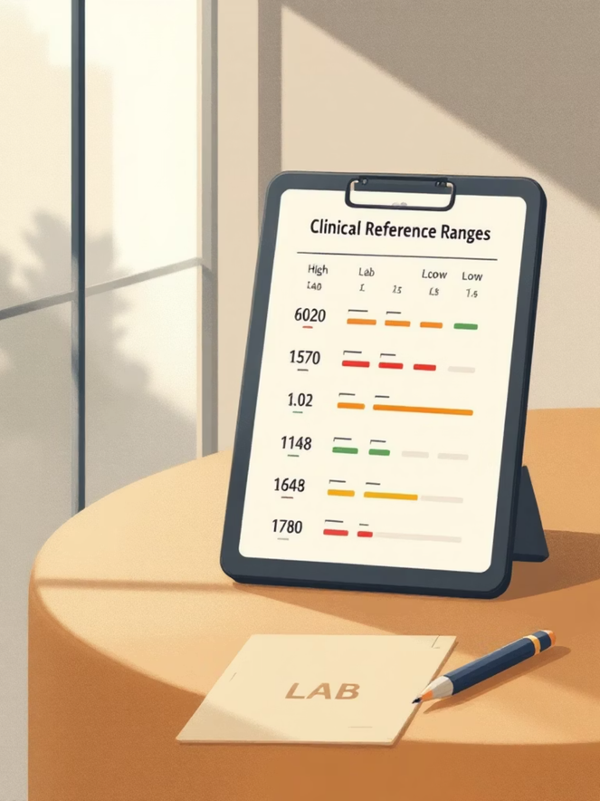
Model 1 — Parameter Interpretation
Model 1 maps each extracted value to medical reference ranges and classifies results as Low, Normal, High, or Borderline using rule-based thresholds informed by source lab metadata.
Reference-range lookup (lab-specific when available)
Age- and sex-aware baseline selection
Deterministic rule logic forms the interpretation foundation
Notes:
6

Slide 7
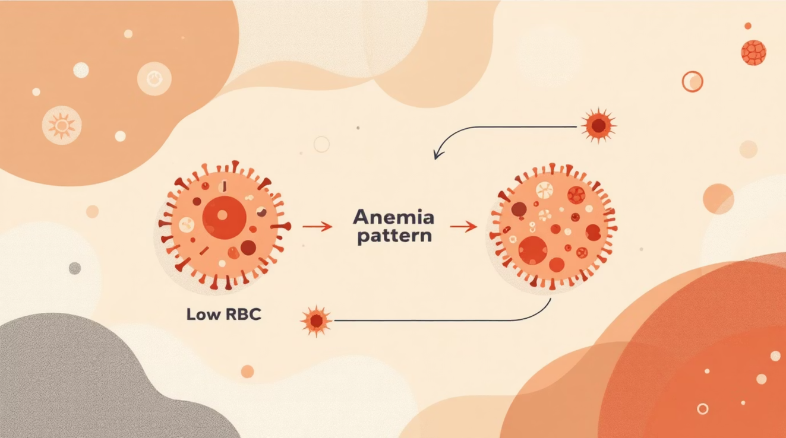
Model 2 & Model 3 — Pattern Detection and Contextual Analysis
Combined outputs feed a synthesis layer that balances per-parameter flags with multi-parameter patterns.
Pattern Detection
Contextual Analysis
Identifies co-occurring abnormalities (e.g., Low HGB + Low RBC → anemia pattern) and assigns confidence scores to pattern matches.
Adjusts interpretation using demographic context (age, sex) and historical values, refining thresholds and reducing false positives.
Notes:
7

Slide 8
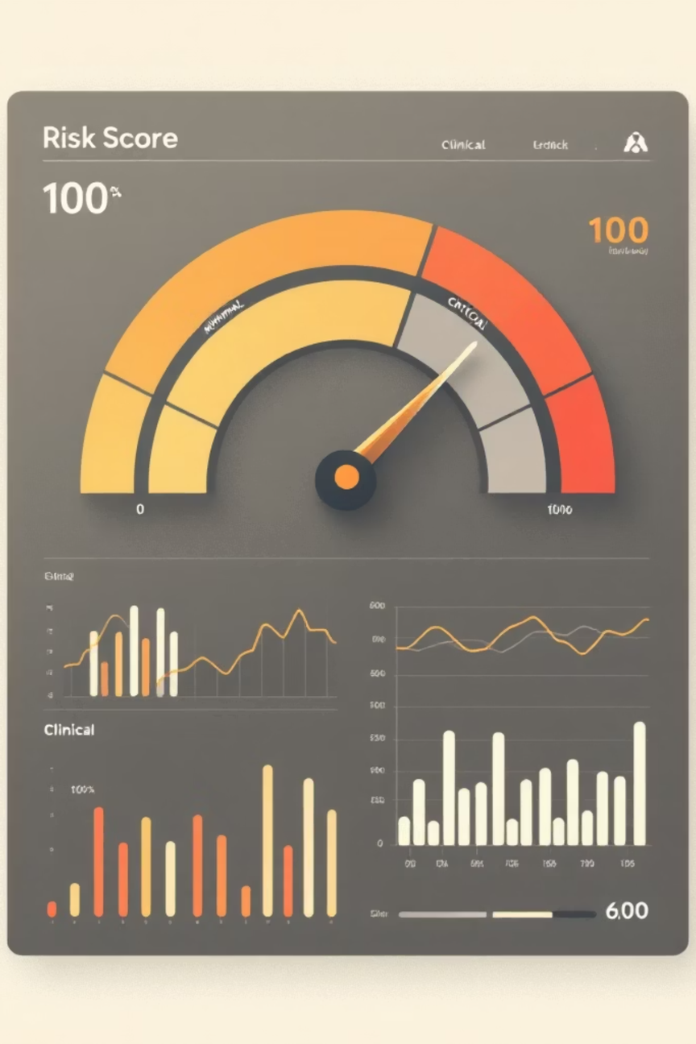
Risk Assessment & Synthesis
Scoring Mechanism
Risk Categories
Weighted aggregation of model outputs produces a normalized 0–100 risk score representing clinical concern magnitude.
Five-tier labels: Minimal, Low, Moderate, High, Critical — calibrated to clinical thresholds and configurable per deployment.
Synthesis Engine
Combines individual parameter interpretation, detected patterns, and contextual modifiers to produce a concise clinical summary.
Summary outputs include supporting evidence (which parameters contributed most) and confidence metrics for reviewer transparency.
Notes:
8

Slide 9



Recommendation Engine & Orchestrator
Personalized Recommendations
Follow-up Guidance
Orchestration & Reliability
Suggested timelines for repeat testing, urgent referral flags, and red-flag escalation when risk is High/Critical.
Dietary and lifestyle advice mapped directly to detected abnormalities (e.g., iron-rich diet for iron-deficiency pattern).
Multi-model orchestrator sequences model execution, manages retries, logs errors, and guarantees end-to-end reliability.
Notes:
9

Slide 10

Technical Highlights & Conclusion
Core Components
Architecture
Interface & Deployment
OCR-based extraction • Regex-driven parsing • Context-aware medical logic • Confidence-based pattern detection
Modular, testable pipelines with orchestrator and clear interfaces for model updates and clinical governance.
Streamlit-based prototype UI; designed for scalability and integration with EHRs or telehealth portals.
Conclusion: An end-to-end, extensible system that converts raw lab reports into actionable clinical insights — improving accessibility, reproducibility, and timely decision support.
Notes:
10

Slide 11
Thank You!!!
Notes:
10

