Slide 1
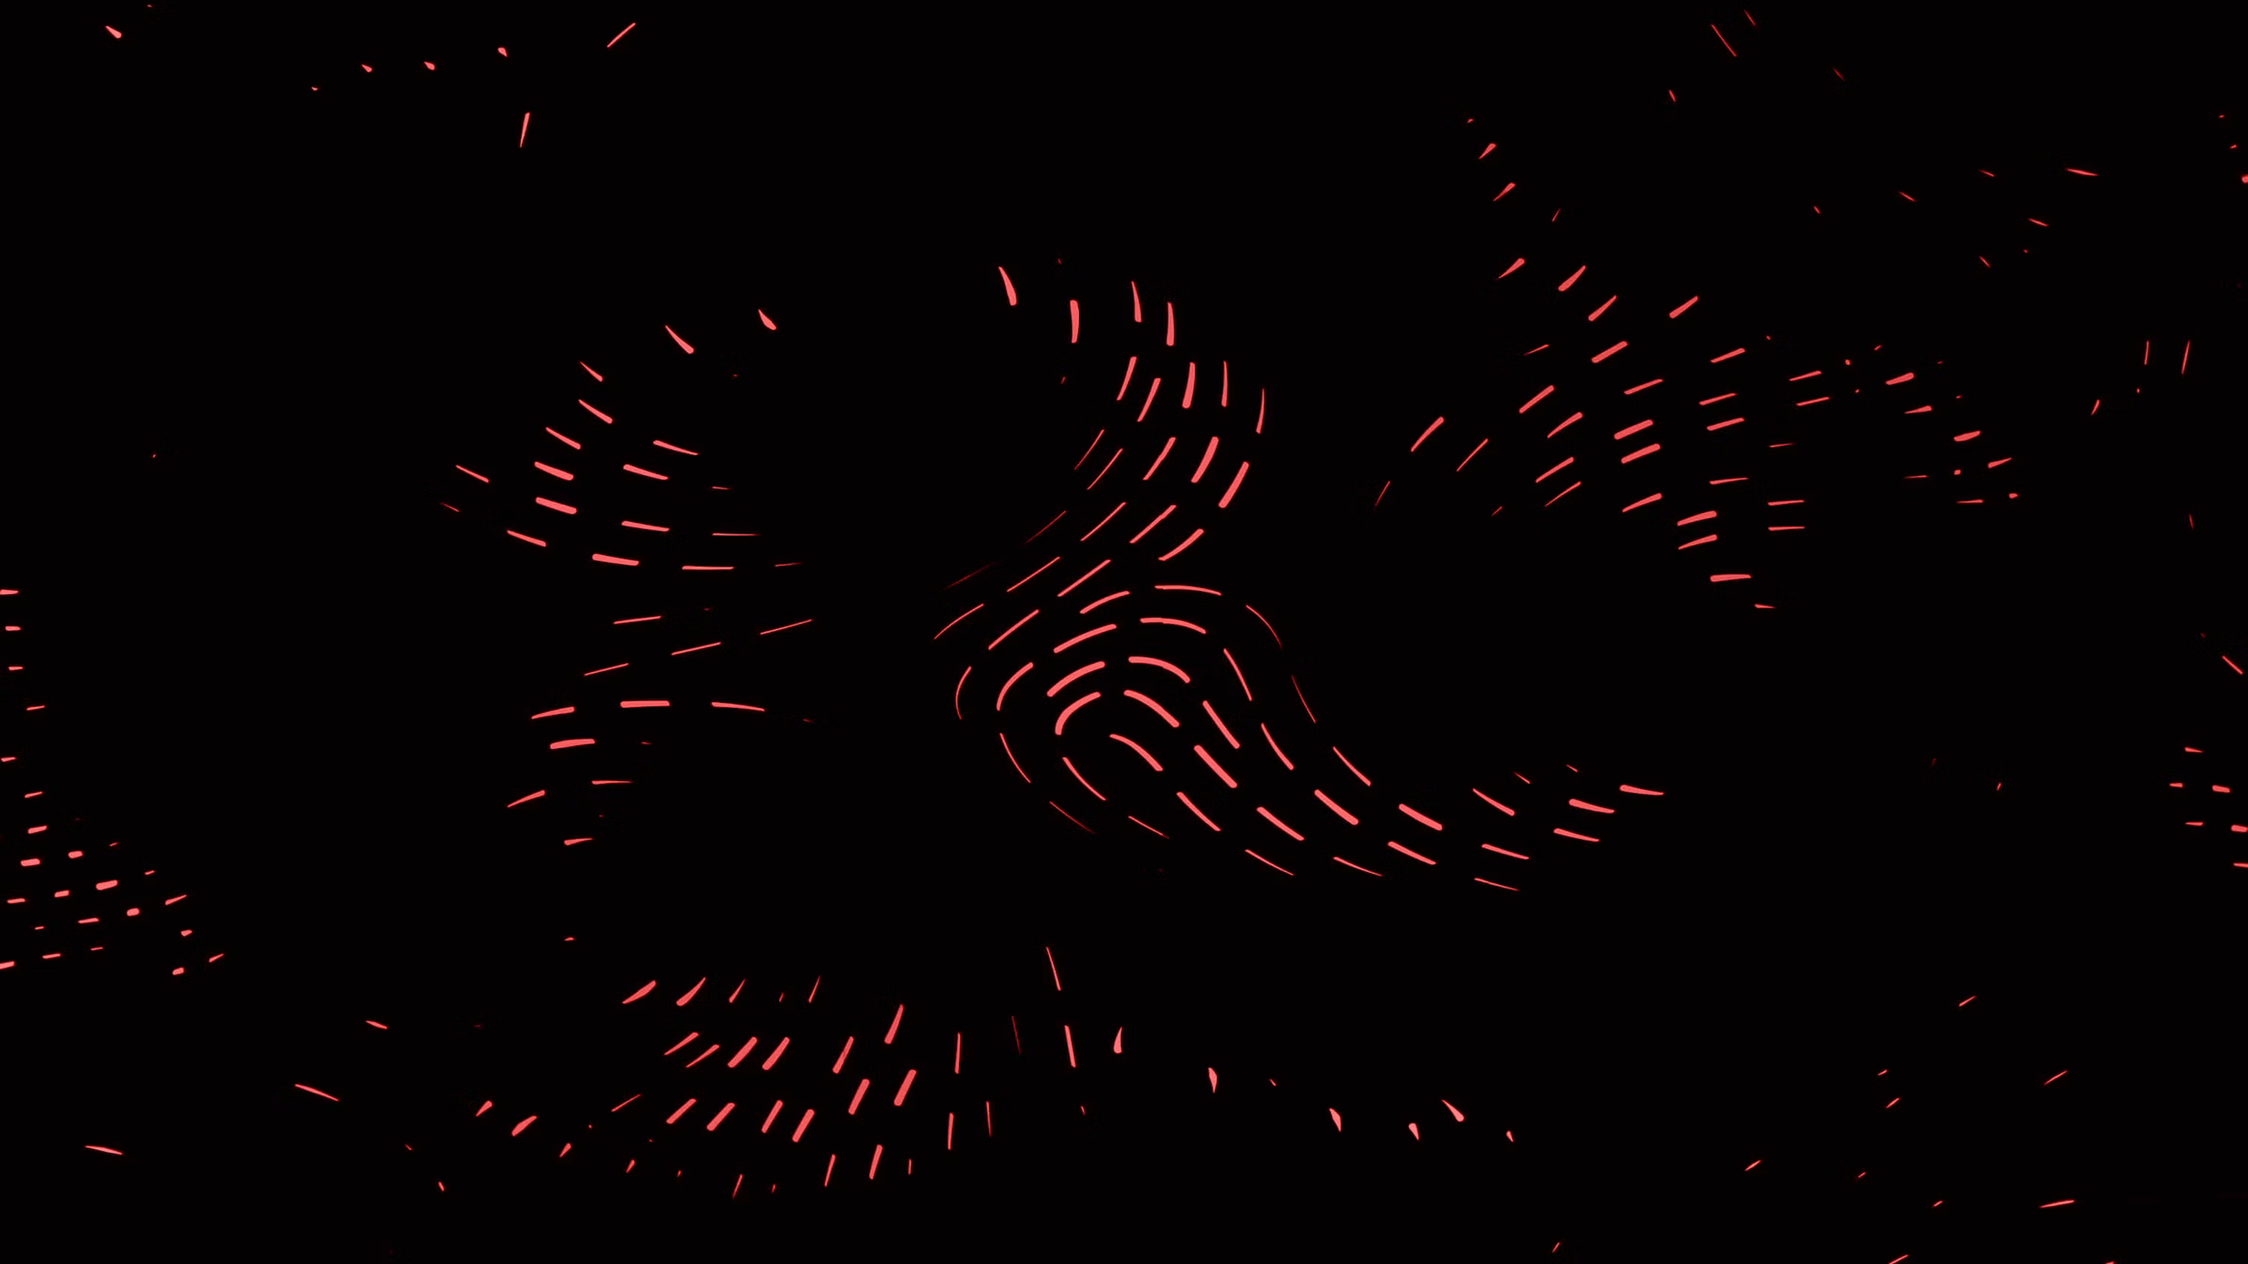
Multi-Model AI Agent for Automated Health Diagnostics
Transforming Unstructured Medical Reports into Actionable Intelligence using OCR, Regex, and Hybrid Rule Engines

Slide 2
An Intelligent Diagnostic Assistant
Universal Ingestion: A robust ingestion pipeline that accurately digitized high-fidelity digital PDFs alongside low-quality, blurry physical smartphone scans.
Absolute Privacy (Local-First): The system processes all highly sensitive Protected Health Information (PHI) 100% locally on the device.
Intelligent Analysis: It doesn't just read numbers; an expert rule engine correlates multiple biomarkers simultaneously to flag complex health risks (e.g., Metabolic Syndrome).
Actionable Advice: The Agent translates clinical data into personalized, easy-to-read lifestyle, fitness, and dietary recommendations tailored to the patient's specific demographics.

Slide 3
Local-First Monolithic Architecture
The Approach: We deliberately bypassed external cloud databases (like Supabase) and external REST APIs (like FastAPI).
Zero Network Latency: The entire "Intelligence Core" runs natively in a single Python runtime via Streamlit. This guarantees instant, real-time analysis without server downtime.
Imperative Data Security: By avoiding cloud transmission, we guarantee 100% HIPAA-compliant data privacy—patient data never leaves the local machine.
Dynamic Storage: Instead of a heavy SQL database, clinical logic is securely stored in a lightweight, lightning-fast knowledge_base.json file.

Slide 4
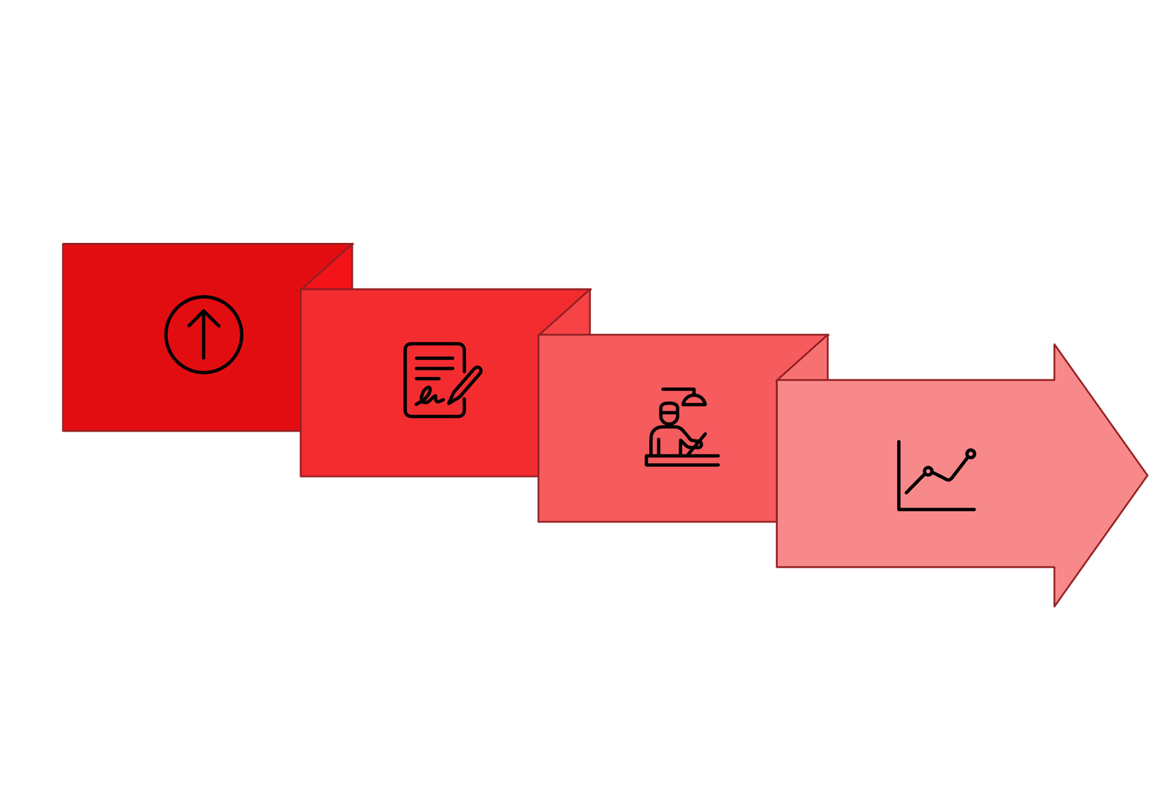




Local OCR
Generate Insights
Upload Report
Rule Engine

Slide 5
Reading the Unreadable with Tesseract
Core Vision: Utilizes Tesseract v5 OCR augmented with Python Imaging Library (PIL) to instantly grayscale and enhance the contrast of uploaded photos.
Adaptive Fallback Engine: If an image is too corrupted for standard reading, the system auto-triggers "Page Segmentation Mode 6 (PSM-6)", forcing the OCR to scan scattered data as a single continuous block, preventing data loss.
Adaptive Unit Scaling: Solves the massive challenge of unit disparity across clinics. If a lab reports Platelets as "1.75 Lakhs", the math engine autonomously scales it to standard scientific SI units ("175,000 /cumm") for accurate clinical evaluation.

Slide 6
Forgiving the OCR & Securing the Data
The Glued Text Solver: Automatically recovers data when letters merge in bad scans (e.g., successfully parsing AgeGender:20 to deduce the patient is 20 years old).
Strict Word Boundaries (\b): Isolates chemical symbols using strict regex boundaries so that the element "Na" (Sodium) never accidentally triggers a false critical alert on common words like "Name".
Negative Lookahead Disambiguation: Uses advanced Regex to separate physically identical strings. It strictly differentiates Hb (Hemoglobin) from HbA1c (Glucose), preventing the system from falsely diagnosing Anemia.

Slide 7
Milestone 1 – Data Ingestion & "Format Chaos" handling
Universal Input Support: Processes PDFs, scanned images, CSVs, and JSON files.
Handling "Format Chaos": Standardizes hundreds of erratic clinic formats and abbreviations (e.g., mapping "TLC" to "WBC").
Tesseract OCR Integration: Lightweight, CPU-friendly optical character recognition.
Adaptive Fallback Engine: Auto-triggers Page Segmentation Mode 6 (PSM-6) on corrupted/messy scans to force uniform text block reading and prevent data loss.

Slide 8
Milestone 2 – The Biomarker Risk Engine
Risk Scoring & Abnormality Detection
Data Normalization: Converts extracted raw text into structured numerical data.
Intelligent Range Mapping: Applies medical standard reference ranges to each identified biomarker.
Individual Biomarker Alerts: Automatically flags out-of-bounds metrics (Low, Normal, High, Critical).
Deterministic Validation: Ensures that the AI has hard, mathematical facts before it attempts to generate health insights.

Slide 9
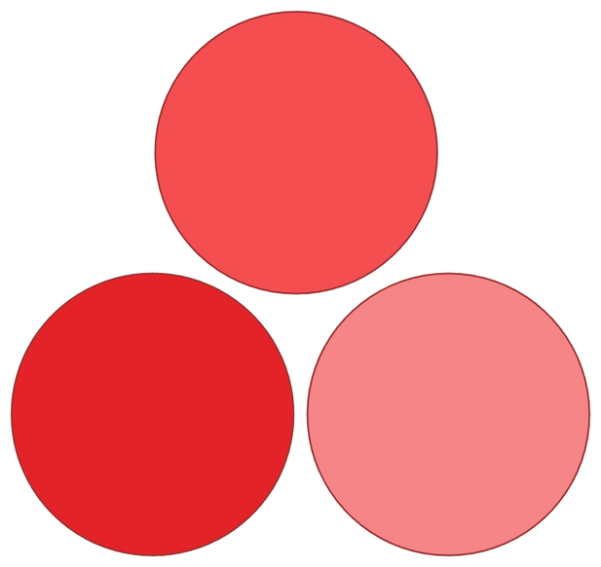
Milestones 3 & 4 – Multi-Model AI Agent Approach
Instead of one massive, monolithic AI, we employ a distributed intelligence approach, splitting complex tasks across specialized models for enhanced accuracy and efficiency.
Medical Synthesis
Integrate findings and generate clinical conclusions.
Context Extraction
Report Formatting
Pull relevant patient and chart details for synthesis.
Structure results into a clear, shareable document.
Model 1 (M1) - Context Extraction: Scans the document to deduce patient demographics (Age, Gender) required for accurate baseline comparisons.
Model 2 (M2) - Medical Synthesis: Analyzes structured abnormalities from the Risk Engine against the patient's medical history.
Model 3 (M3) - Report Formatting: Translates complex clinical findings into accessible, human-readable insights with automated medical disclaimers.

Slide 10
Dual-Tier Risk Assessment Engine
Context-Aware Ranges: The engine actively adjusts "Normal" physiological baselines on the fly depending on whether the extracted patient demographics signal Male, Female, or Elderly parameters.
Comprehensive Patient Context: The AI maps directly against 14 selectable chronic conditions (e.g., Asthma, Liver Disease, Diabetes) to generate hyper-specific warnings.
Micro & Macro Assessment: The engine simultaneously flags complex, multi-biomarker diseases (like Metabolic Syndrome) and instantly generates granular, specific dietary alerts for any single abnormal biomarker (e.g., Low WBC).
Critical Threshold Monitoring: A secondary layer instantly triggers "Severe Risk" warnings if values breach immediate life-threatening boundaries.

Slide 11
Safe Autonomous Learning
Autonomous Discovery: The system scans the physician's "Clinical Impressions" text on the uploaded report. If it finds a disease it has never seen before, it actively learns the condition and catalogues it into the knowledge base automatically.
The "Safety Lock": While the AI discovers the disease, it securely leaves the numerical diagnostic boundary parameters blank.
Human-In-The-Loop: To prevent AI hallucination, a licensed medical professional must manually approve and strictly code the exact numeric boundaries in the JSON file before the system is allowed to diagnose patients with the newly learned condition.

Slide 12
Results & Real-World Validation
Digital PDFs: Achieved 100% Extraction Accuracy instantaneously.
Glued Text Scans (AgeGender:20): Handled entirely without error via Regex non-digit skipping.
Localized Nomenclature (Lakhs vs Thousands): Successfully normalized by the mathematical Adaptive Unit Scalar.
Confusing Syntax (HbA1c / Name): False positives successfully eliminated by Negative Lookahead and Strict Word Boundaries.
Speed: Attained sub-2-second processing times per report, completely offline.

Slide 13
Interaction Layer & Clinical Output
The Streamlit Hub: A beautifully crafted, sleek dark-mode metric dashboard featuring intelligent color-coding for rapid triage (Green for Normal, Yellow for Alerts, Red for Critical).
Professional PDF Generation: The entire analysis is cleanly compiled into a structured, tabular PDF document. Unstructured data is mathematically formatted into neat clinical rows, ready to be immediately handed to a physician for review.
Future scope: Simulated Chat Agent that imitates an LLM experience using deterministic rules. Patients can type queries like "Is my report normal?" or "What should my diet be based on these risks?" and receive dynamic, mathematically-backed conversational answers.

Slide 14
THANK YOU

