Slide 1
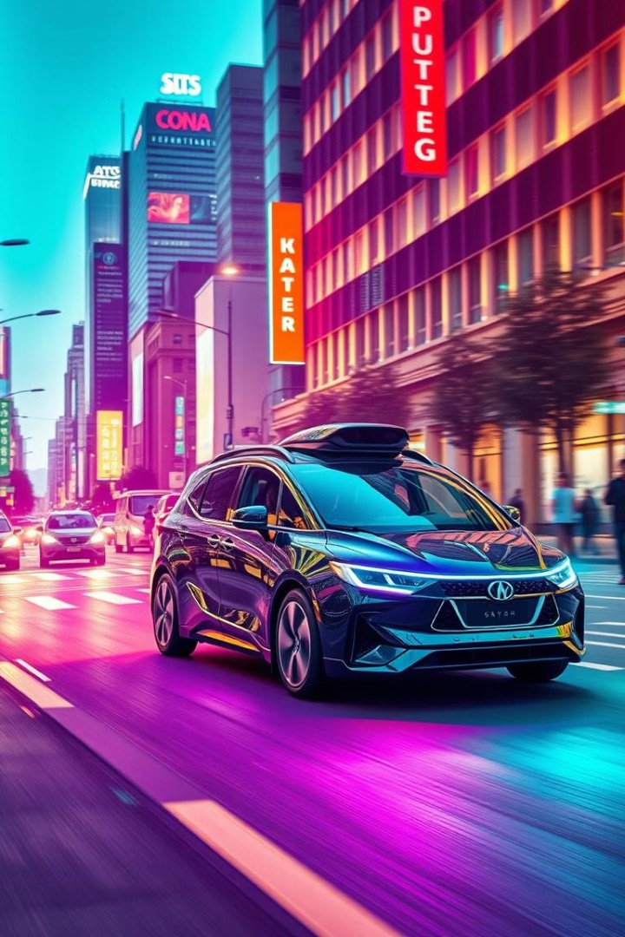
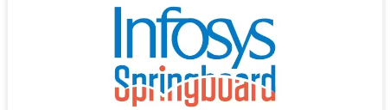
Autonomous Vehicle Driving System
Group 3
Mentor: Mr. Nitig Singh
Team Leader: Rameshwari Vadhvani
Co-lead: Raju Kumar
Team members: Deekshitha Nakkanaboyina, Yaswa Anirwin

Slide 2

Table of Contents :
Contents
Cityscapes Dataset Overview
Preprocessing Techniques
Model Selection
Architecture of U-net Model
Deep lab v3+ architecture
Challenging Scenario’s
Difficulty in Model Selection for Semantic Segmentation
RGB Channel Misinterpretation
Inapplicability of FFT
Difficulty in Testing Model
Misrepresentation of Metrics
Challenge in U-Net model semantic segmentation images
Discrepancy Between Validation and Testing Results with DeepLabV3+ model
Results
Acknowledgements
Thank you
1
.

Slide 3
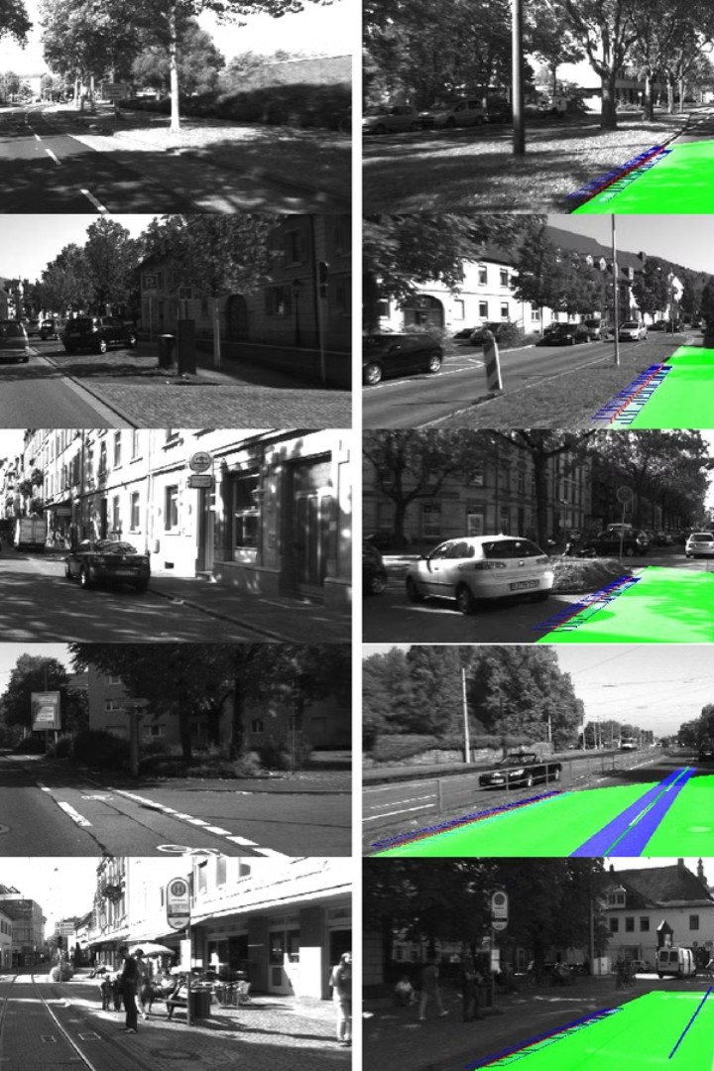
Cityscape Dataset Overview
1
Urban Scene Segmentation: The dataset focuses on high-resolution images of urban street scenes, aimed at advancing autonomous driving and urban scene understanding.
2
Fine-Grained Annotations: It provides 5,000 images with pixel-level fine annotations and an additional 20,000 with coarser labels, organized into 19 classes commonly used for semantic segmentation tasks.
3
Dataset Splits and Variety: Images are captured across 50 cities, divided into training, validation, and test sets, making it diverse and comprehensive for segmentation model training and evaluation.
2

Slide 4
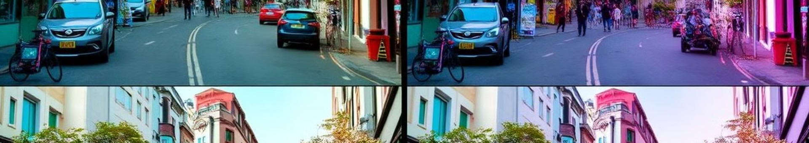

Preprocessing Techniques
Resizing Images
All images are resized to a consistent target size for uniformity.
1
2
Normalization
Pixel values are normalized to the range [0, 1] for improved model convergence.
Contrast Enhancement
Image contrast is adjusted to highlight key features and reduce noise.
3
3

Slide 5
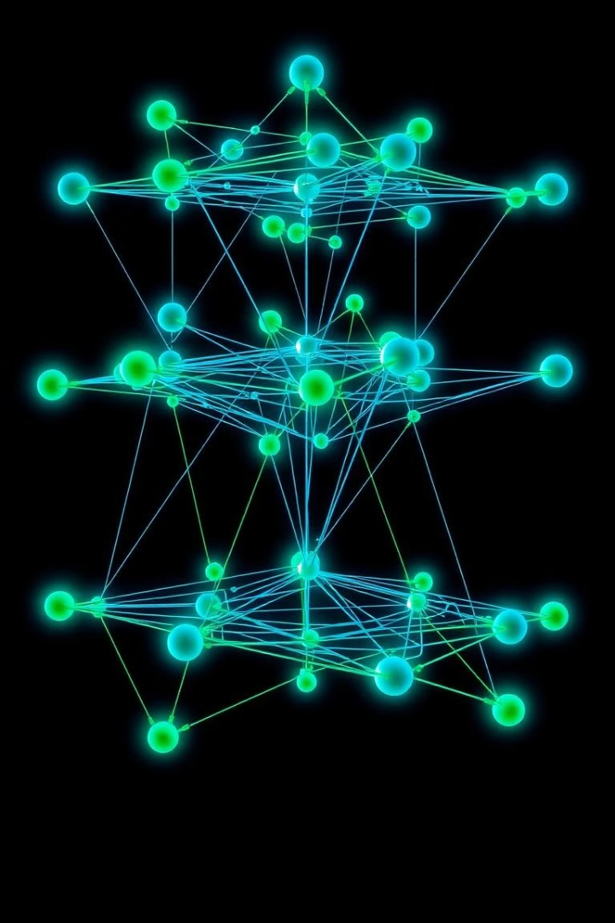

Model Selection
U-Net:
U-Net’s encoder-decoder architecture will allow us to capture detailed spatial information and context, making it suitable for precise pixel-level segmentation.
DeepLab (V3+ Variant) :
This model will utilize atrous convolutions for multi-scale context and an encoder-decoder structure to enhance edge details, improving performance on complex urban scenes.
Fourier Transformation-Based Model :
Leveraging spatial frequencies, this approach will help detect textures and patterns, complementing segmentation by capturing both global context and fine details.
4

Slide 6
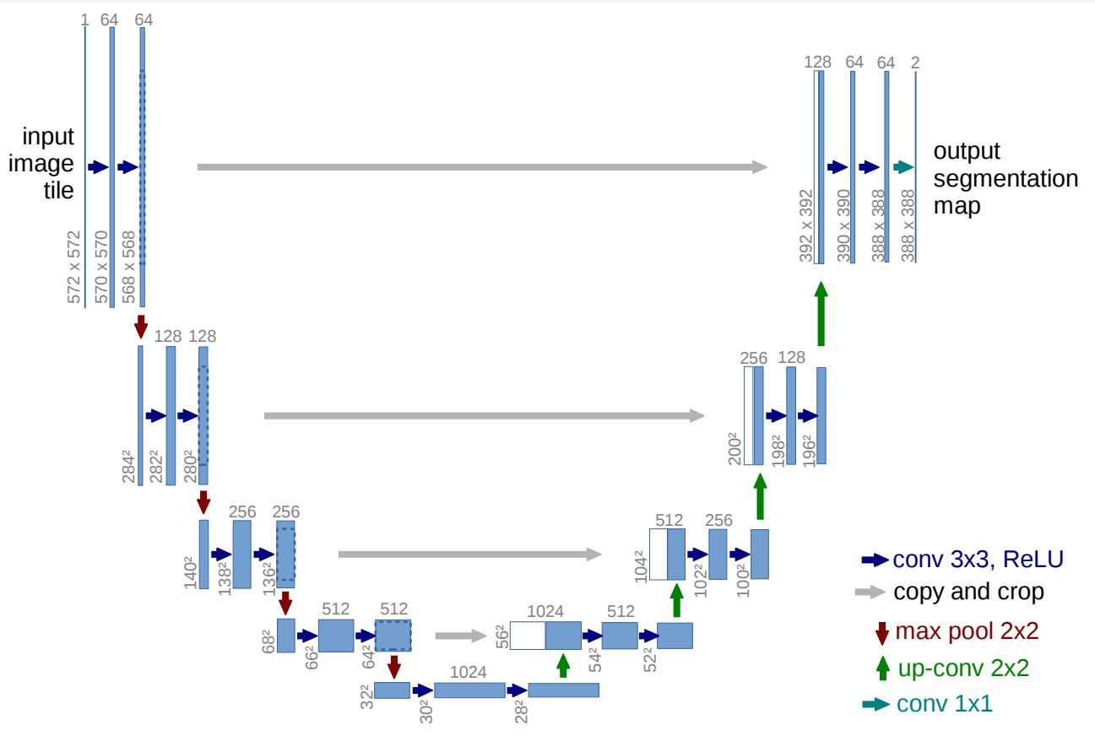
Architecture of U-net Model
Symmetrical Encoder-Decoder Structure:
U-Net has a "U" shape with an encoder (downsampling path) and a decoder
(upsampling path). The encoder extracts features and reduces spatial
spatial
dimensions, while the decoder upsamples and reconstructs the resolution to provide detailed segmentation maps.
Skip Connections:
U-Net includes skip connections between corresponding layers of the encoder and decoder paths. These connections preserve high-resolution features from earlier layers, which improves detail and localization, crucial for precise segmentation.
Fully Convolutional:
U-Net is entirely convolutional, without fully connected layers, making it efficient for processing images of various sizes and yielding pixel-wise classifications across the image.
Why U-Net is Good for Semantic Segmentation:
Preserves Spatial Information
Efficient and Accurate
Versatile for Different Tasks
5

Slide 7

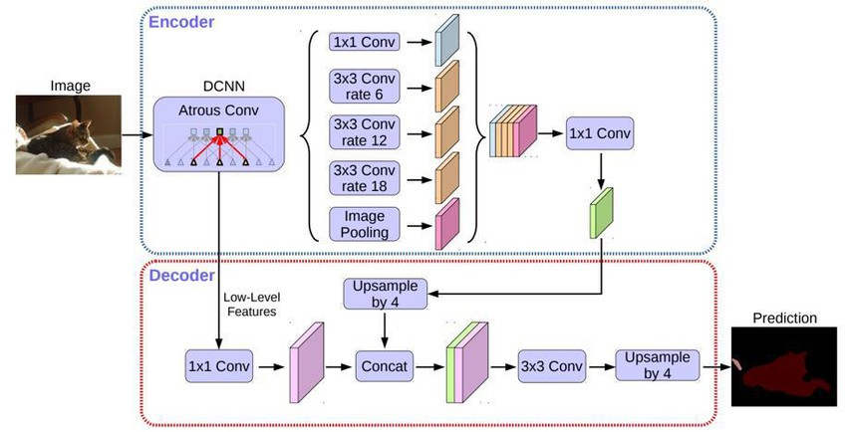


Deep Lab v3+ Architecture
Atrous Convolutions:
Enables capturing features at multiple scales downsampling, preserving
without detail.
This allows the model to “see” a wider context while maintaining high resolution.
ASPP Module:
The Atrous Spatial Pyramid Pooling captures multi-scale context effectively.
It enhances the model's ability to understand both fine details and broader scene structures.
Efficient Decoder:
The decoder refines details using convolutions,
depthwise
separable
reducing
computation. and suitable for fast, high-
This keeps the model lightweight resolution segmentation tasks.
Why DeepLabv3+ is Good for Semantic Segmentation:
Multi-Scale Context
High Resolution
Efficient Computation
6

Slide 8
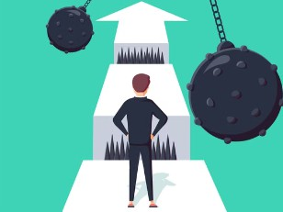
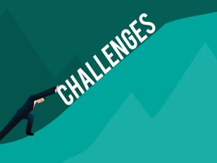


Challenging Scenarios:-
7

Slide 9
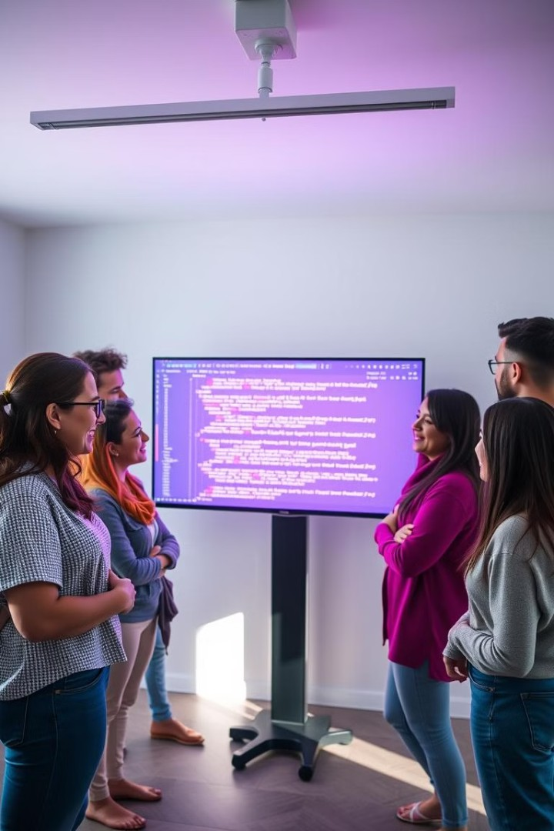
1)Difficulty in Model Selection for Semantic Segmentation
CHALLENGE:
SOLUTIONS:
Facilitated Communication Daily meetings were implemented to enhance open communication among team members.
Adoption and Comparison of Models These meetings allowed team members to effectively adopt and compare different models.
Selecting the right model for semantic segmentation can be challenging due to the vast number of available options.
Each model has its strengths and weaknesses, making it difficult to determine which will perform best for a specific task.
8

Slide 10
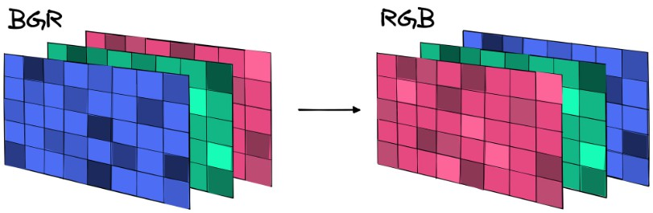
2)RGB Channel Misinterpretation
CHALLENGE:
Semantic segmentation models rely on accurate color interpretation.
If the RGB channels are misinterpreted as BGR, the model's performance will suffer.
SOLUTION:
We addressed this challenge by validating input data formats before feeding them into the models.
This ensured that the correct channel order was used, leading to improved accuracy.
9

Slide 11
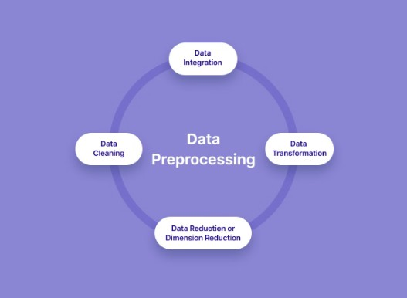
3)Inapplicability of FFT
Challenges :
Solution :
To address this, we replaced FFT with standard preprocessing techniques like resizing and normalization.
1. The Fast Fourier Transform (FFT) is a technique commonly used for image processing. However, it is not suitable for all models, particularly those like DeepLabV3+ and U-Net.
These methods are more general and adaptable, ensuring optimal performance across a wider range of images and models.
2. While FFT can be effective for high- noise images, like those in medical segmentation, it can actually degrade the performance of models dealing with clearer images.
3. Grey scaled images are not accepted by the models . to do semantic segmentation. it is exclusively used for medical image segmentation
10

Slide 12
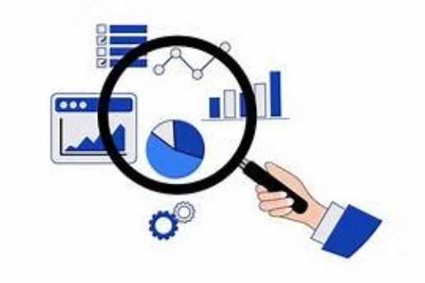
4)Difficulty in Testing Model
Challenge
We are unable to test the model with whole testing images in the cityscapes dataset .
Solution
We addressed this challenge by considering standardized data sample for testing
This enabled us to conduct more comprehensive and robust testing, improving the reliability and accuracy of our model evaluations.
11

Slide 13
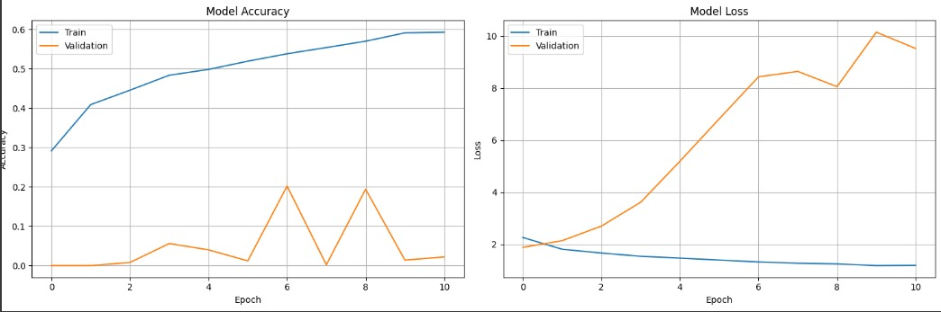
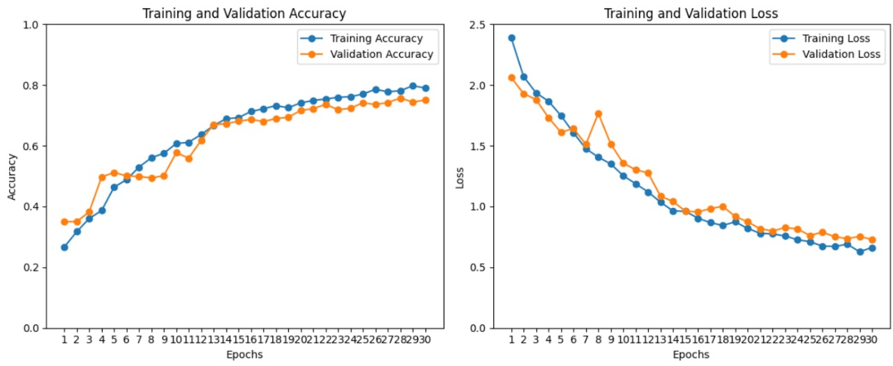
5)Misrepresentation of Metrics
CHALLENGE:
Semantic segmentation models rely heavily on accurate evaluation metrics to assess their performance.
SOLUTION:
Misrepresented metrics can lead to misleading conclusions about the model's effectiveness.
We addressed this by re-validating our metrics, ensuring they accurately reflect the model's performance.
12

Slide 14
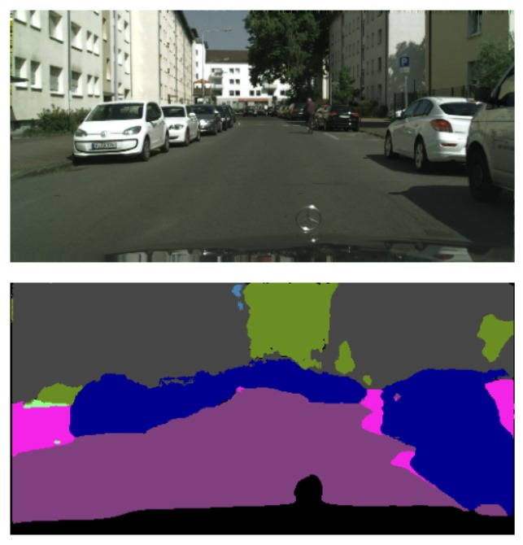
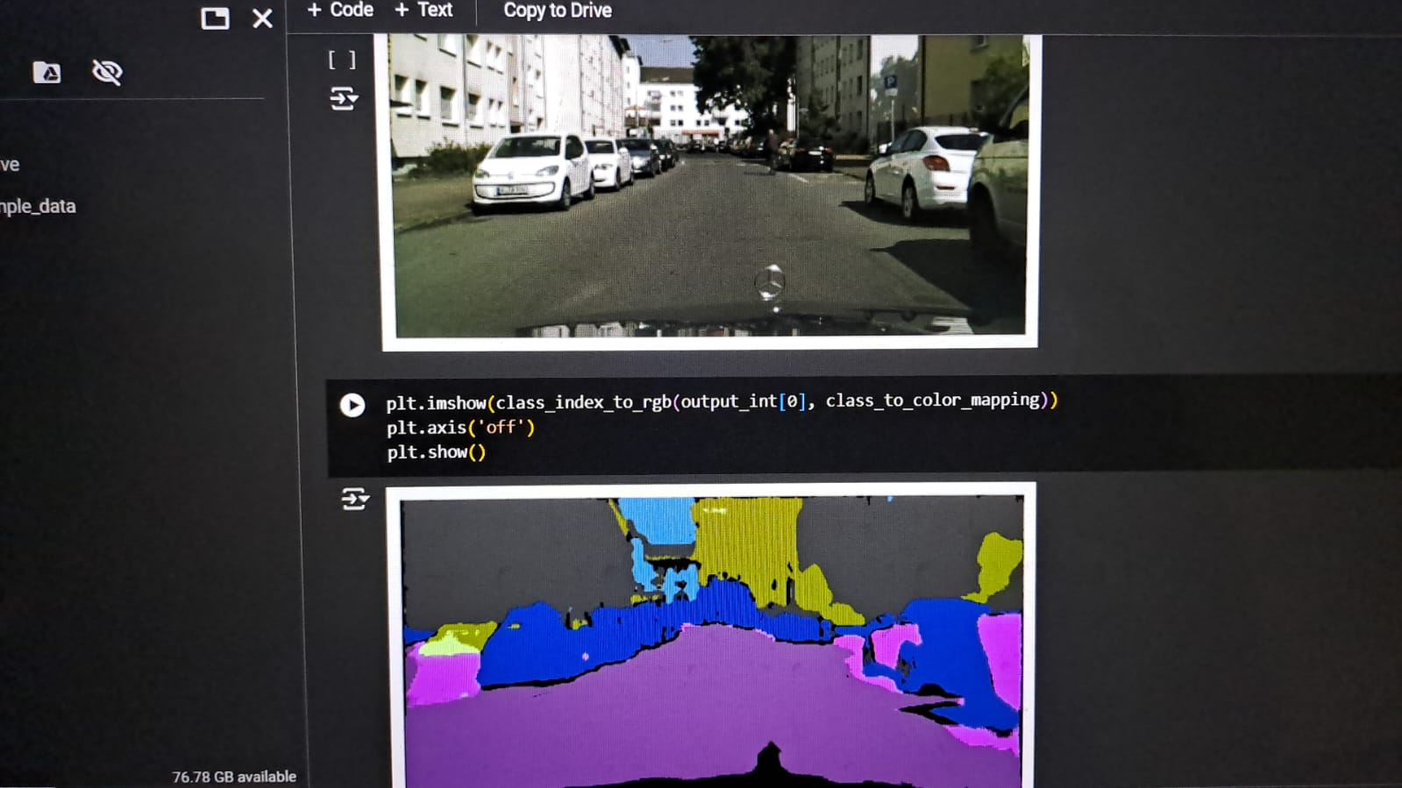
6)Challenge in U-Net model semantic segmentation images
Initially we got poor results for semantic segmentation as shown in the picture .
We overcame this challenge by changing the model architecture .
Key Changes Made:
- Modified the model architecture to enhance feature extraction.
- Adjusted hyperparameters for better convergence.
Implemented data augmentation techniques.
Accuracy: 80%.
13

Slide 15
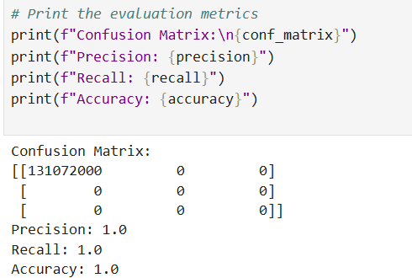
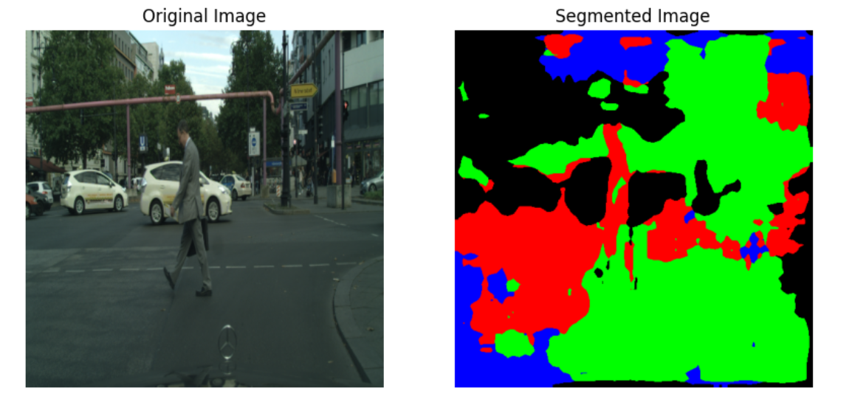
7)Discrepancy Between Validation and Testing Results with DeepLabV3+ model
CHALLENEGE:
When we validated the trained deeplabV3+ model (Resnet) we got perfect accuracy, precision. But during testing we got poor segmentation results.
Strategies to overcome this challenge:
Regularization Techniques: Apply techniques like dropout or L2 regularization to prevent overfitting during training.
Hyperparameter Tuning: Experiment with different hyperparameters to optimize the model's performance on unseen data.
14

Slide 16
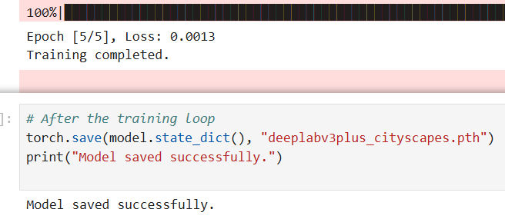
RESULTS:
U-Net Model: Succesfully Trained,Validated,Tested for semantic segmentation, achieving 80% accuracy.
DeepLabV3+ Model : Successfully trained on whole dataset and trying to rectify overfitting.
15

Slide 17
Acknowledgements
Mentorship and Guidance
I would like to extend my heartfelt thanks to Mr. Nitig Singh for his invaluable mentorship and support in guiding me through the project. His insights and expertise have been instrumental in deepening my understanding of semantic segmentation using the Cityscapes dataset.
Project Collaboration
Special thanks to the project team members Yaswa Anirwin, Deekshitha, Raju Kumar for their collaboration and shared dedication, which has made this experience enriching and motivating.
Internship Program Support
I am grateful to the entire internship program team for providing this opportunity and fostering a learning environment conducive to growth and innovation.
16

Slide 18

Thank you! Open for Q&A

