Slide 1

4. Programming in C

Slide 2



4.1 Review of C programming concept
Variables: A variable is a named memory location that stores a value. In C, variables must be declared before they are used, and they must be of a specific data type (e.g. int, char, float, etc.).
Data types: C provides a range of data types for representing different types of values, such as integers, characters, and floating-point numbers.
Input and Output: C provides functions for reading and writing data
Operators: C provides a range of operators that can be used to perform operations on values, such as arithmetic, logical, and comparison operations.
Control structures: C provides a range of control structures that can be used to control the flow of a program, such as if-else statements, for loops, and while loops.

Slide 3
Introduction of C
C is a structured programming language. It is considered a high-level language because it allows the programmer to concentrate on the problem at hand and not worry about the machine that the program will be using. That is another reason why it is used by software developers whose applications have to run on many different hardware platforms.

Slide 4

Features of C
Simple and Efficient
Fast
Portability
Extensibility
Function-Rich Libraries
Dynamic Memory Management
Modularity With Structured Language
Mid-Level Programming Language
Pointers
Recursion

Slide 5
FIGURE Structure of a C Program

Slide 6
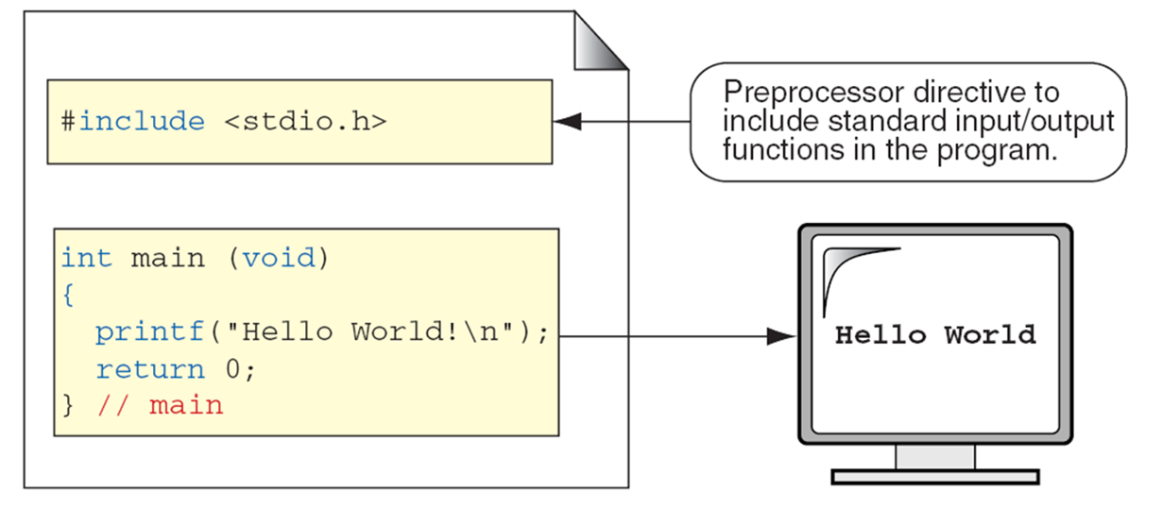
C Preprocessor and Header Files
A header file is a file containing C declarations and macro definitions to be shared between several source files. You request the use of a header file in your program by including it, with the C preprocessing directive ‘#include’.

Slide 7
First C Program
It's time to write your first C program.

Slide 8

FIGURE The Greeting Program

Slide 9
PROGRAM
The Greeting Program

Slide 10
FIGURE Examples of Block Comments

Slide 11
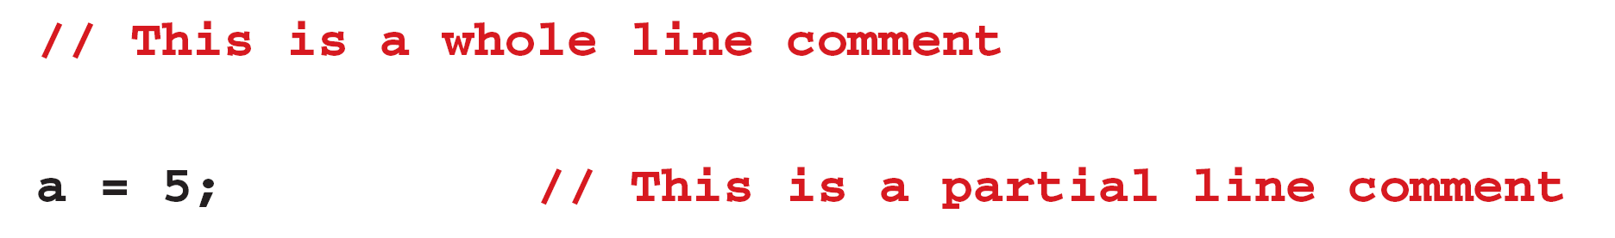
FIGURE Examples of Line Comments

Slide 12
Character set
Type of Character | Description | Characters
Lowercase Alphabets | a to z | a, b, c, d, e, f, g, h, i, j, k, l, m, n, o, p, q, r, s, t, u, v, w, x, y, z
Uppercase Alphabets | A to Z | A, B, C, D, E, F, G, H, I, J, K, L, M, N, O, P, Q, R, S, T, U, V, W, X, Y, Z
Digits | 0 to 9 | 0, 1, 2, 3, 4, 5, 6, 7, 8, 9
Special Characters | – | ` ~ @ ! $ # ^ * % & ( ) [ ] { } < > + = _ – | / \ ; : ‘ “ , . ?
White Spaces | – | Blank Spaces, Carriage Return, Tab, New Line
Notes:
Simple and Efficient
The basic syntax style of implementing C language is very simple and easy to learn. This makes the language easily comprehensible and enables a programmer to redesign or create a new application. C is usually used as an introductory language to introduce programming to school students because of this feature.
Fast
It is a well-known fact that statically typed programming languages are faster than dynamic ones. C is a statically typed programming language, which gives it an edge over other dynamic languages. Also, unlike Java and Python, which are interpreter-based, C is a compiler-based program. This makes the compilation and execution of codes faster.
Another factor that makes C fast is the availability of only the essential and required features. Newer programming languages come with numerous features, which increase functionality but reduce efficiency and speed. Since C offers limited but essential features, the headache of processing these features reduces, resulting in increased speed.
Portability
Another feature of the C language is portability. To put it simply, C programs are machine-independent which means that you can run the fraction of a code created in C on various machines with none or some machine-specific changes. Hence, it provides the functionality of using a single code on multiple systems depending on the requirement.
Extensibility
You can easily (and quickly) extend a C program. This means that if a code is already written, you can add new features to it with a few alterations. Basically, it allows adding new features, functionalities, and operations to an existing C program.
Function-Rich Libraries
C comes with an extensive set of libraries with several built-in functions that make the life of a programmer easy. Even a beginner can easily code using these built-in functions. You can also create your user-defined functions and add them to C libraries. The availability of such a vast scope of functions and operations allows a programmer to build a vast array of programs and applications.
Dynamic Memory Management
One of the most significant features of C language is its support for dynamic memory management (DMA). It means that you can utilize and manage the size of the data structure in C during runtime. C also provides several predefined functions to work with memory allocation. For instance, you can use the free() function to free up the allocated memory at any time. Similarly, there are other functions such as malloc(), calloc(), and realloc() to perform operations on data structure and memory allocations.
Modularity With Structured Language
C is a general-purpose structured language. This feature of C language allows you to break a code into different parts using functions which can be stored in the form of libraries for future use and reusability.. Structuring the code using functions increases the visual appeal and makes the program more organized and less prone to errors.
Mid-Level Programming Language
Although C was initially developed to do only low-level programming, it now also supports the features and functionalities of high-level programming, making it a mid-level language. And as a mid-level programming language, it provides the best of both worlds. For instance, C allows direct manipulation of hardware, which high-level programming languages do not offer.
Pointers
With the use of pointers in C, you can directly interact with memory. As the name suggests, pointers point to a specific location in the memory and interact directly with it. Using the C pointers, you can operate with memory, arrays, functions, and structures.
Recursion
C language provides the feature of recursion. Recursion means that you can create a function that can call itself multiple times until a given condition is true, just like the loops. Recursion in C programming provides the functionality of code reusability and backtracking.

Slide 13
Identifiers
One feature present in all computer languages is the identifier. Identifiers allow us to name data and other objects in the program. Each identified object in the computer is stored at a unique address.

Slide 14
Table
Rules for Identifiers

Slide 15
Note
An identifier must start with a letter or underscore: it may not have a space or a hyphen.

Slide 16
Note
C is a case-sensitive language.

Slide 17
Table
Examples of Valid and Invalid Names

Slide 18
Data Types
A type defines a set of values and a set of operations that can be applied on those values.
Topics discussed in this section:
Void Type
Integral Type
Floating-Point Types

Slide 19
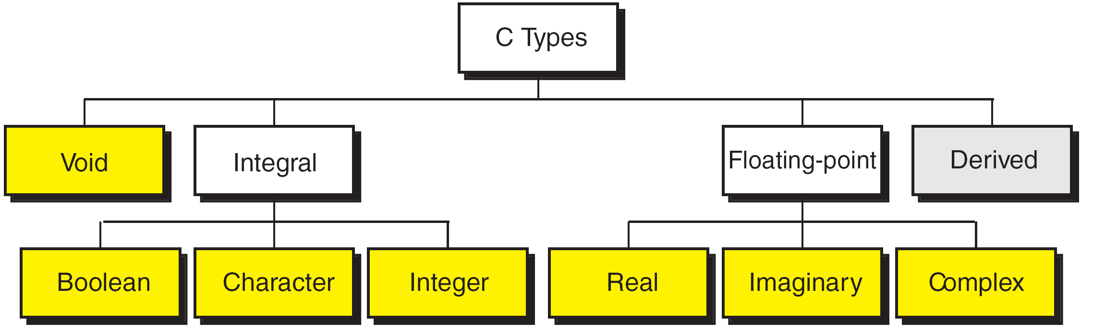
FIGURE Data Types

Slide 20
FIGURE Character Types
Notes:
wchar_t is a wide character: The increased datatype size allows for the use of larger coded character sets. Width is compiler specific (not portable).

Slide 21
FIGURE Integer Types

Slide 22
Note
sizeof (short) ≤ sizeof (int) ≤ sizeof (long) ≤ sizeof (long long)

Slide 23
Table
Typical Integer Sizes and Values for Signed Integers

Slide 24
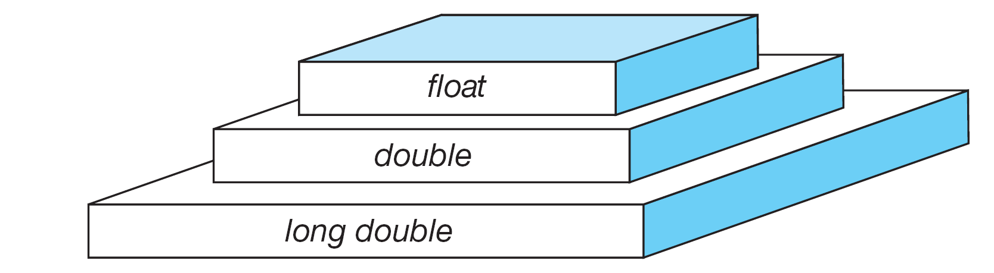
FIGURE Floating-point Types

Slide 25
Note
sizeof (float) ≤ sizeof (double) ≤ sizeof (long double)

Slide 26
Table
Type Summary

Slide 27
Variables
Variables are named memory locations that have a type, such as integer or character, which is inherited from their type. The type determines the values that a variable may contain and the operations that may be used with its values.
Topics discussed in this section:
Variable Declaration
Variable Initialization

Slide 28
FIGURE Variables

Slide 29
Table
Examples of Variable Declarations and Definitions

Slide 30
‘B’
FIGURE Variable Initialization

Slide 31
Note
When a variable is defined, it is not initialized. We must initialize any variable requiring prescribed data when the function starts.

Slide 32
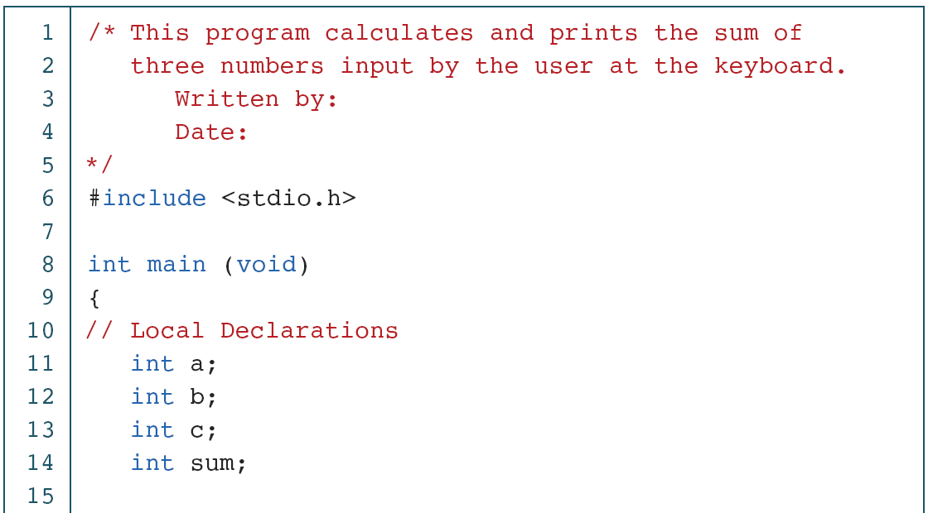
PROGRAM
Print Sum of Three Numbers

Slide 33
PROGRAM
Print Sum of Three Numbers (continued)

Slide 34
PROGRAM
Print Sum of Three Numbers (continued)

Slide 35
Constants
Constants are data values that cannot be changed during the execution of a program. Like variables, constants have a type. In this section, we discuss Boolean, character, integer, real, complex, and string constants.
Topics discussed in this section:
Constant Representation
Coding Constants

Slide 36
Note
A character constant is enclosed in single quotes.

Slide 37
Table
Symbolic Names for Control Characters

Slide 38
Table
Examples of Integer Constants

Slide 39
Table
Examples of Real Constants

Slide 40
FIGURE Some Strings

Slide 41
FIGURE Null Characters and Null Strings

Slide 42
Note
Use single quotes for character constants. Use double quotes for string constants.

Slide 43
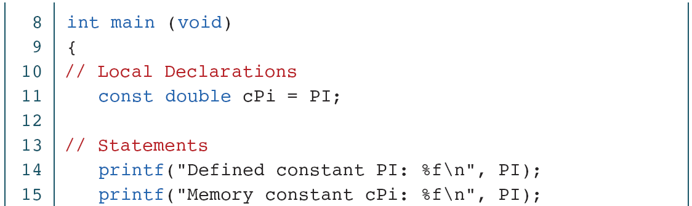
PROGRAM
Memory Constants

Slide 44
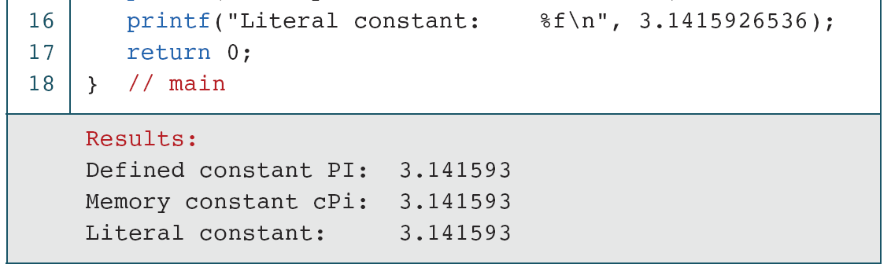
PROGRAM
Memory Constants (continued)

Slide 45
Operators in C

Slide 46
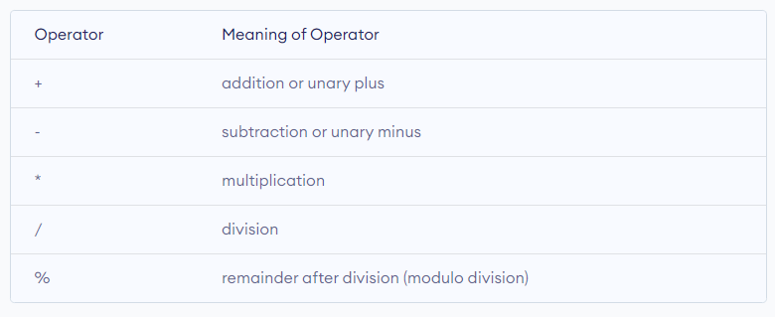
An operator is a symbol that operates on a value or a variable. For example: + is an operator to perform addition.
Table
C Arithmetic Operators

Slide 47
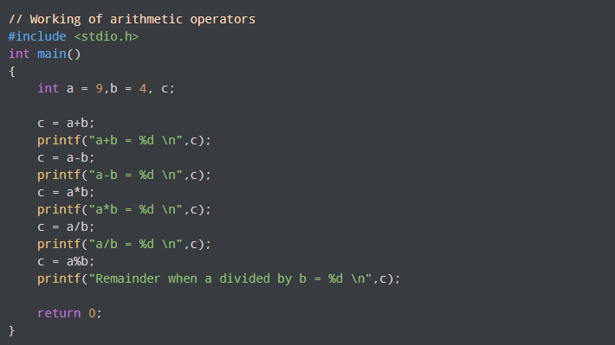
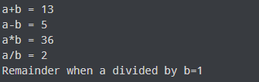
PROGRAM 2-3
Operators in C

Slide 48
Increment and Decrement Operators
C programming has two operators increment ++ and decrement -- to change the value of an operand (constant or variable) by 1.
Increment ++ increases the value by 1 whereas decrement -- decreases the value by 1. These two operators are unary operators, meaning they only operate on a single operand.

Slide 49
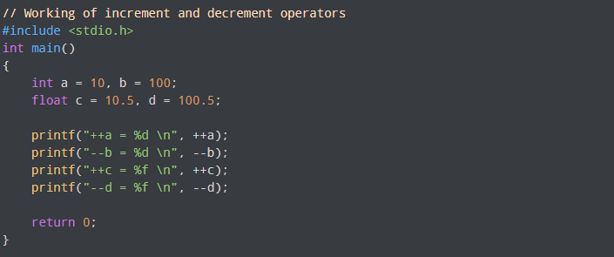
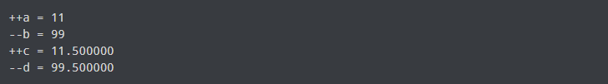
PROGRAM 2-3
Operators in C
Output

Slide 50
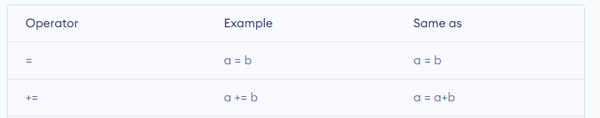
C Assignment Operators
An assignment operator is used for assigning a value to a variable. The most common assignment operator is =

Slide 51
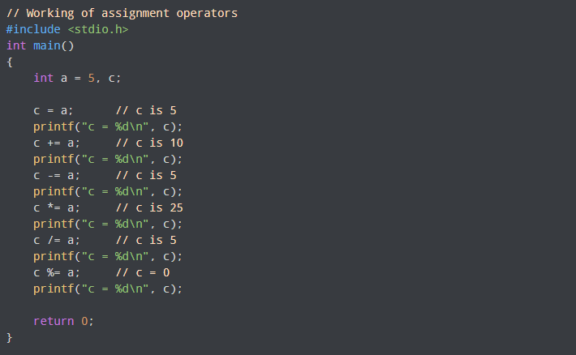
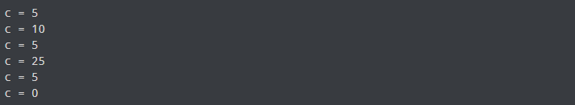
PROGRAM
Operators in C
Output

Slide 52
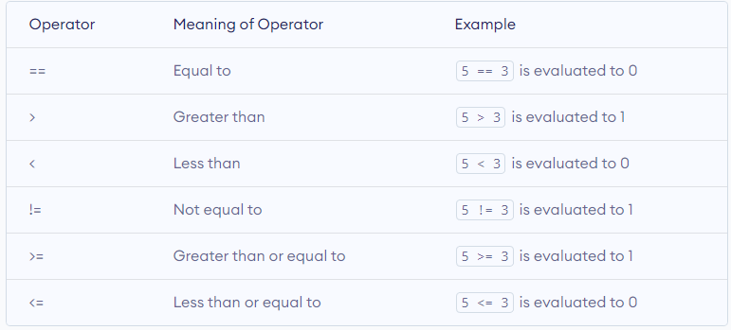
C Relational Operators
A relational operator checks the relationship between two operands. If the relation is true, it returns 1; if the relation is false, it returns value 0.
Relational operators are used in decision making and loops.

Slide 53
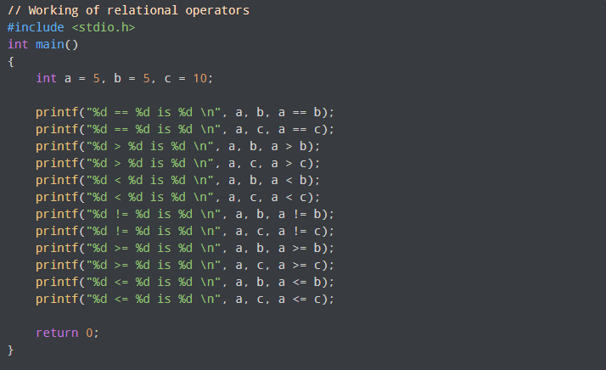
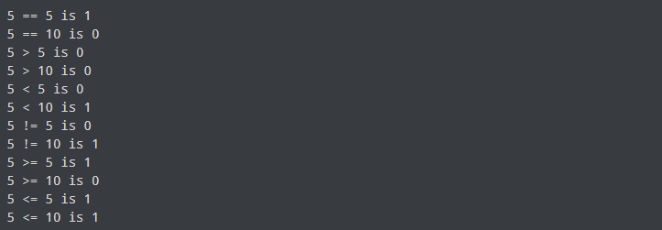
PROGRAM
Operators in C
Output

Slide 54
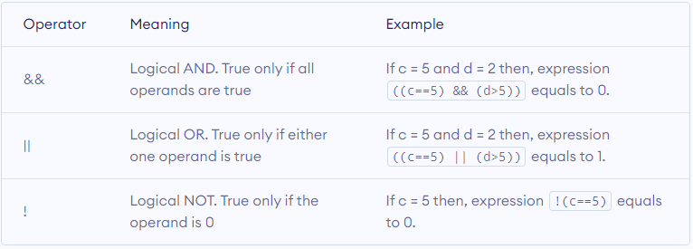
C Logical Operators
An expression containing logical operator returns either 0 or 1 depending upon whether expression results true or false. Logical operators are commonly used in decision making in C programming.

Slide 55
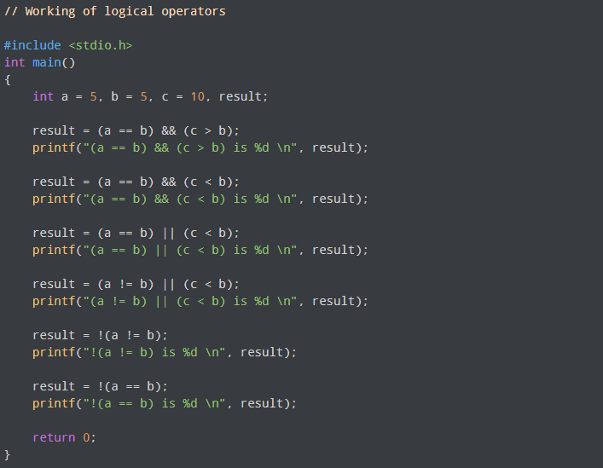
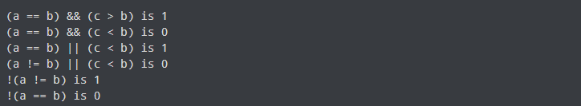
PROGRAM
Operators in C
Output

Slide 56
Selection and Control Statement in C
Selection and control statements are a fundamental part of any programming language and are used to control the flow of execution in a program. These statements allow you to specify conditions under which a certain piece of code should be executed and provide a way to choose between different courses of action based on those conditions.
The most common selection control statements in C are the if statement and the switch statement.

Slide 57
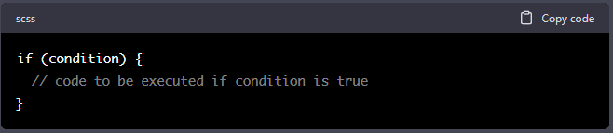
If in C
The if statement evaluates the condition in parentheses. If the condition is true, the code inside the curly braces {} is executed. If the condition is false, the code inside the curly braces is skipped and the program continues with the next statement after the if statement.

Slide 58
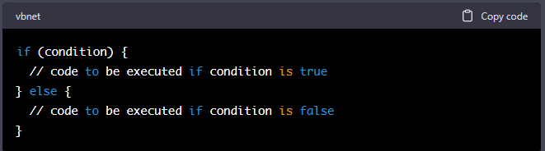
The else clause can be added to an if statement to specify an alternative block of code to be executed if the condition is false.
If-else in C
The else clause can be added to an if statement to specify an alternative block of code to be executed if the condition is false.

Slide 59
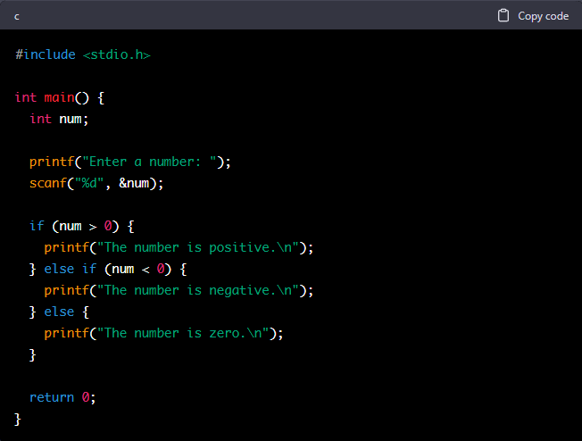
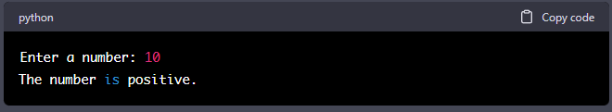
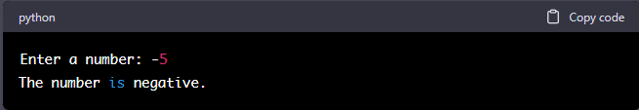
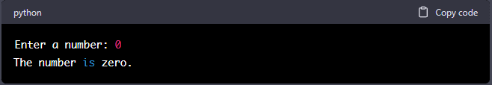
PROGRAM
If-else in C
This program prompts the user to enter a number, reads the number into the variable num, and then uses an if-else statement to determine if the number is positive, negative, or zero. If the number is positive, the message "The number is positive." is printed. If the number is negative, the message "The number is negative." is printed. If the number is zero, the message "The number is zero." is printed.

Slide 60
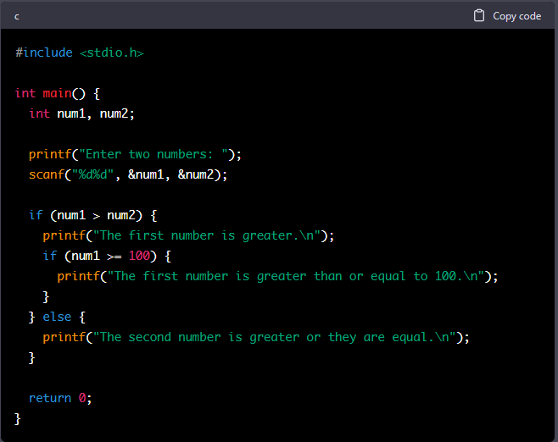
A nested if statement in programming is an if statement that is inside another if statement. The inner if statement is executed only if the conditions of the outer if statement are met.
Here's an example of a nested if statement in C:
Nested If

Slide 61
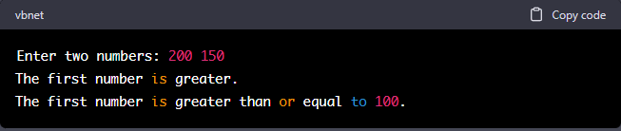
In this example, the first if statement checks if num1 is greater than num2. If the condition is true, the program prints "The first number is greater." and then checks if num1 is greater than or equal to 100. If that condition is true, the program prints "The first number is greater than or equal to 100.". If the condition of the first if statement is false, the program prints "The second number is greater or they are equal.".
Nested If
Example Output
In this example, the user entered 200 and 150 as the two numbers. Since 200 is greater than 150, the first if statement's condition is true and the program prints "The first number is greater.". Then, since 200 is also greater than or equal to 100, the second if statement's condition is also true and the program prints "The first number is greater than or equal to 100.".

Slide 62
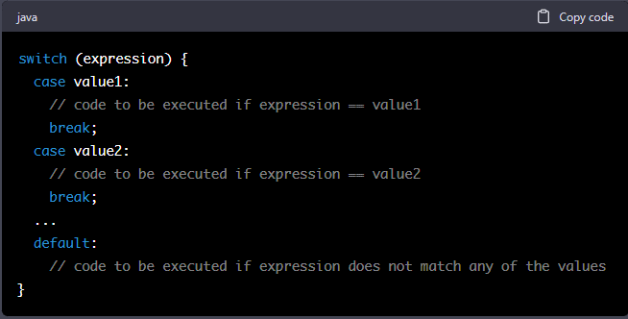
Switch - Case
The switch statement evaluates the expression in parentheses and compares it to the values in the case labels. If a match is found, the code associated with that case is executed. The break statement is used to exit the switch statement and move on to the next statement after the switch statement. If no match is found, the code associated with the default label is executed, if present. If there is no default label, the switch statement simply ends without executing any code.

Slide 63
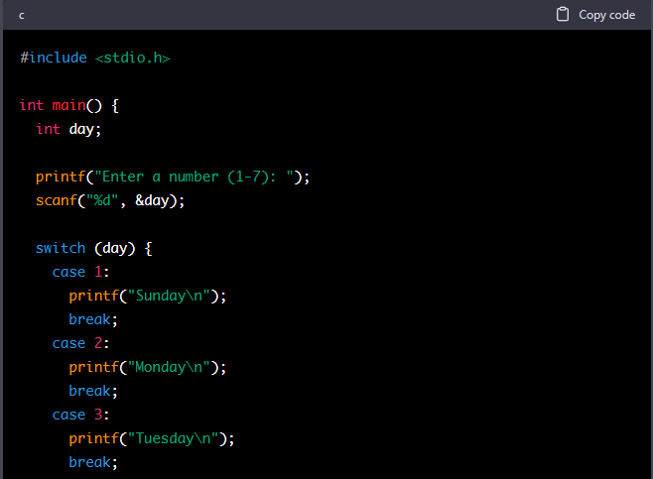
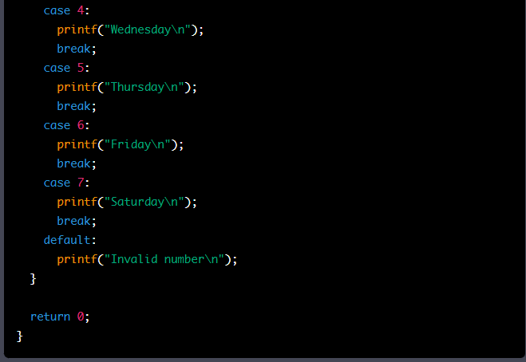
PROGRAM
Switch and case in C
This program prompts the user to enter a number (1-7), reads the number into the variable day, and then uses a switch statement to print the name of the corresponding day of the week. If the user enters a number that is not between 1 and 7, the message "Invalid number" is printed.

Slide 64
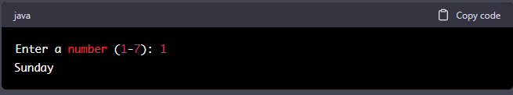
And finally, here's an example of what the output might look like if the user enters the number 10:
PROGRAM
Switch and case in C
The output of the above program would depend on the input provided by the user. Here's an example of what the output might look like if the user enters the number 1:
And here's an example of what the output might look like if the user enters the number 4:
And finally, here's an example of what the output might look like if the user enters the number 10:

Slide 65
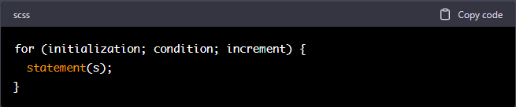
Loops in C allow you to repeat a section of code multiple times. There are two types of loops in C: for loops and while loops.
for Loops: A for loop is used when you know beforehand how many times you want to repeat a section of code. It has the following syntax:
For Loop
* initialization: Initializes the loop counter.
* condition: Specifies the condition for executing the loop body.
* increment: Increases the loop counter after each iteration.
* statement(s): The statements that are executed in each iteration of the loop.

Slide 66
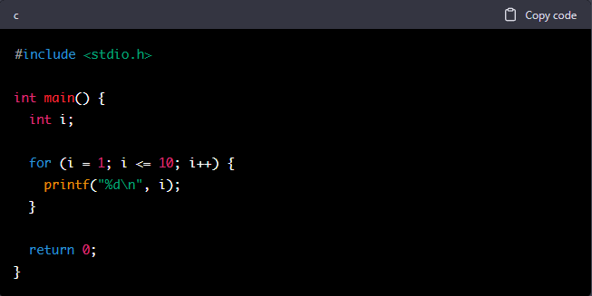
Here's an example of a for loop in C that prints the numbers from 1 to 10:
For Loop Example

Slide 67
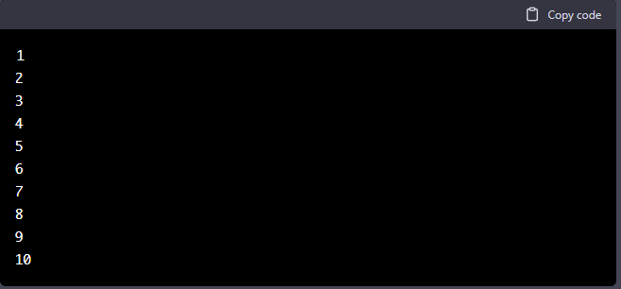
Explanation: The program uses a for loop to print the numbers from 1 to 10. The for loop starts with i = 1, continues as long as i <= 10, and increments i by 1 in each iteration. The printf function is used to print the value of i on a new line in each iteration.
For Loop Example Output

Slide 68
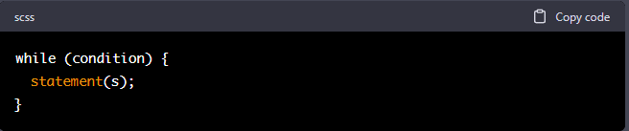
while Loops: A while loop is used when you don't know beforehand how many times you want to repeat a section of code. It has the following syntax:
While Loop
* condition: Specifies the condition for executing the loop body.
* statement(s): The statements that are executed in each iteration of the loop.

Slide 69
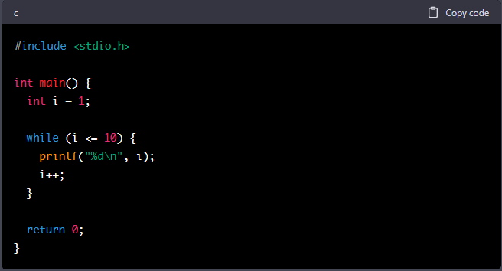
While Loop example
Here's an example of a while loop in C that prints the numbers from 1 to 10:

Slide 70
Explanation: The program uses a while loop to print the numbers from 1 to 10. The while loop continues as long as i <= 10 and increments i by 1 in each iteration. The printf function is used to print the value of i on a new line in each iteration. The loop continues until i becomes greater than 10, at which point the loop terminates and the program ends.
While Loop example output

Slide 71
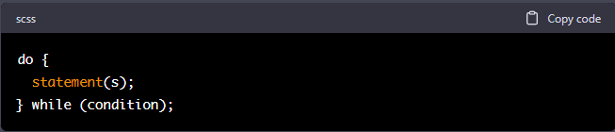
The do...while loop in C is similar to a while loop, but with one important difference: the loop body is guaranteed to execute at least once, even if the condition is not satisfied. The syntax for a do...while loop is as follows:
Do-while
* condition: Specifies the condition for executing the loop body.
* statement(s): The statements that are executed in each iteration of the loop.

Slide 72
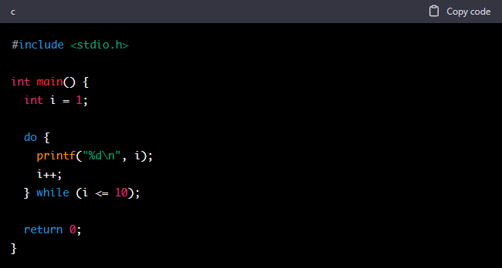
Do-while example
Here's an example of a do...while loop in C that prints the numbers from 1 to 10:

Slide 73
Explanation: The program uses a do...while loop to print the numbers from 1 to 10. The loop body is executed first, and then the condition i <= 10 is checked. If the condition is satisfied, the loop body is executed again. This process continues until i becomes greater than 10, at which point the loop terminates and the program ends.
Do-while example output

Slide 74
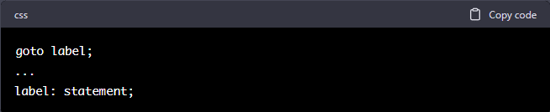
The goto statement in C is a transfer of control statement that allows jumping from one part of a program to another. The syntax for a goto statement is as follows:
Goto Statement
* label: A unique identifier followed by a colon. It specifies the target location where the control will be transferred.
* statement: The statement that is executed after the control is transferred to the target location.

Slide 75
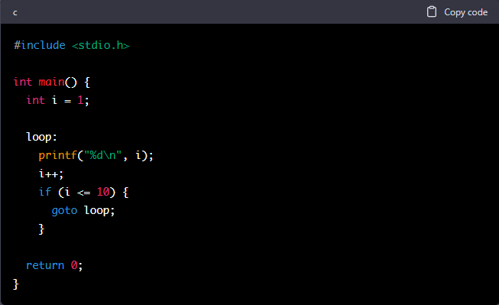
Goto Statement Example
Here's an example of a goto statement in C that prints the numbers from 1 to 10:
Explanation: The program uses a goto statement to print the numbers from 1 to 10. The goto statement transfers the control from the end of the loop body back to the beginning of the loop, where the printf function is called and i is incremented. This process continues until i becomes greater than 10, at which point the goto statement is not executed and the program ends.

Slide 76
Note: The goto statement is considered a controversial feature of the C language and should generally be avoided. It can make the code harder to read and understand, and can lead to difficult-to-debug problems. Alternative control structures, such as for loops, while loops, and do...while loops, are usually a better choice.
Goto Statement Example Output

Slide 77
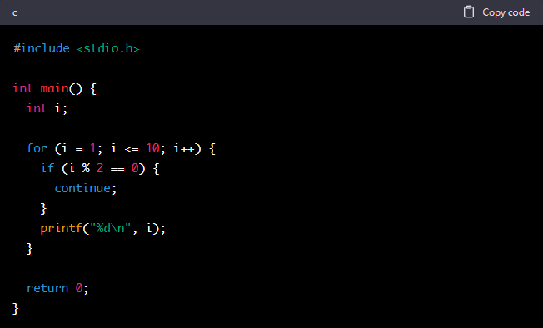
The continue statement in C is a control statement that skips the current iteration of a loop and goes on to the next iteration. The continue statement is typically used within a loop to skip certain iterations based on some condition.
Here's an example of using the continue statement in a for loop to print only the odd numbers from 1 to 10:
Continue Statement

Slide 78
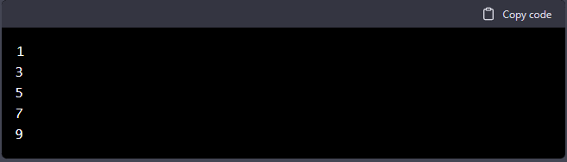
Continue Statement
The output of this program will be:

Slide 79
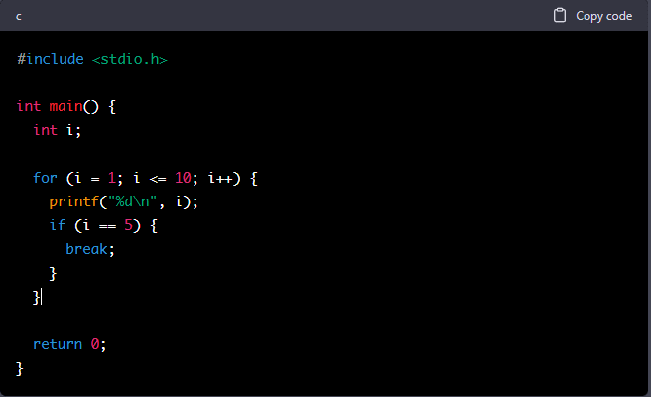
Break statement
The break statement in C is a control statement that terminates the execution of a loop or switch statement and transfers control to the statement immediately following the loop or switch. The break statement is typically used within a loop to exit the loop prematurely based on some condition.
Here's an example of using the break statement in a for loop to print the first 5 numbers from 1 to 10:

Slide 80
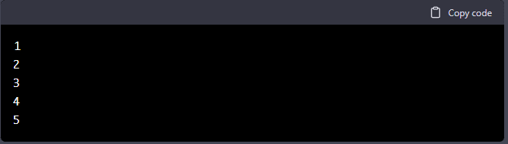
Break Statement
The output of this program will be:
Explanation: The for loop starts at i = 1 and goes up to i = 10. For each iteration of the loop, the printf function is called to print i. The condition i == 5 is checked after each iteration. If it's true, meaning i is equal to 5, the break statement is executed and the loop is terminated. If it's false, the loop continues to the next iteration. This process continues until either the break statement is executed or all iterations of the loop are completed.

Slide 81
Array in C
An array in C is a collection of elements of the same data type, stored in contiguous memory locations, and accessible by a common name. The elements of an array can be accessed by their index, which is an integer value that represents their position in the array.
Here's an example of declaring and initializing an array of integers in C:

Slide 82
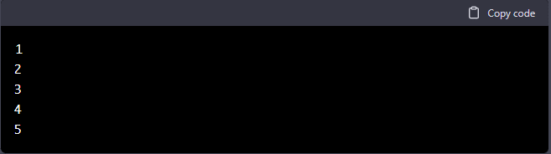
Array in C
The output of this program will be:
Explanation: The numbers array is declared as an array of 5 integers and initialized with the values 1, 2, 3, 4, and 5. The for loop starts at i = 0 and goes up to i = 4. For each iteration of the loop, the value of numbers[i] is printed using the printf function. This process continues until all iterations of the loop are completed.

Slide 83
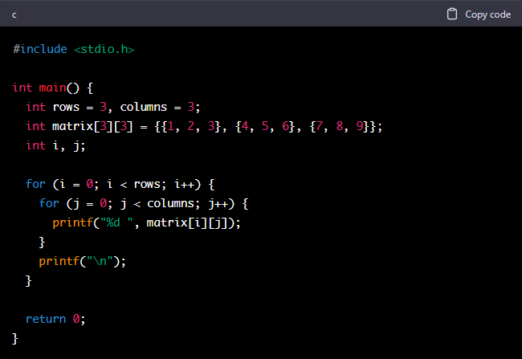
2D Array in C
A 2D array in C is an array of arrays, where each sub-array represents a row of the 2D array. It is useful for representing and manipulating tabular data, such as matrices or grids.
Here's an example of declaring and initializing a 2D array of integers in C:

Slide 84
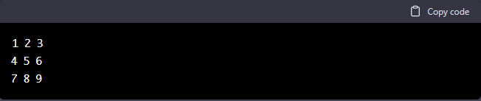
2D Array in C
The output of this program will be:
Explanation: The matrix array is declared as a 2D array with 3 rows and 3 columns and initialized with the values 1, 2, 3, 4, 5, 6, 7, 8, and 9. The outer for loop starts at i = 0 and goes up to i = 2. The inner for loop starts at j = 0 and goes up to j = 2. For each iteration of the inner loop, the value of matrix[i][j] is printed using the printf function, followed by a space. After each row, a newline character is printed to move to the next line. This process continues until all iterations of the loops are completed.

Slide 85
4.1 Concept of library and user defined
functions and advantages
A library in computer programming refers to a collection of pre-written code that can be used to perform common tasks. Libraries are often packaged as a set of functions, classes, or objects that can be used in a variety of programs.
The main advantage of using libraries is that they allow programmers to reuse existing code, saving time and effort. They also provide a standard set of functions and features, making it easier for different programs to work together.
For example, the C Standard Library is a collection of functions and macros that are part of the C programming language. It provides a range of functions for performing common tasks, such as input/output, memory allocation, string handling, and more.
When writing a program, you can include the libraries you need using preprocessor directives, such as #include in C. You can then call the functions in the library, just like you would any other function in your code.
Libraries can also be created by third-party developers and shared with the public, making it easier for programmers to find and use code that has already been tested and debugged. This helps to promote code reuse and improve the quality of software development.

Slide 86
4.2 Functions in C
User-defined functions are functions that are created and defined by the programmer. In other words, they are functions that you write yourself, as opposed to functions that are part of a pre-existing library.
User-defined functions provide a way to encapsulate and reuse code, making it easier to write, read, and maintain. They can also help to simplify complex programs by breaking them down into smaller, more manageable pieces.

Slide 87
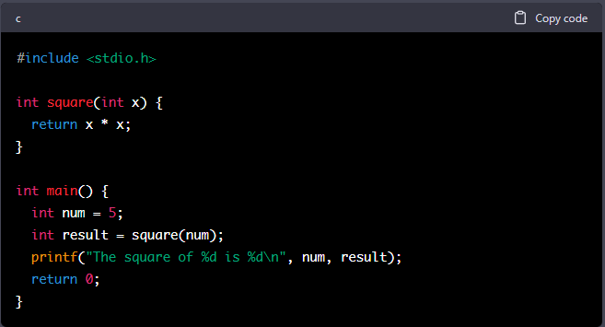
4.2 Functions in C
A function in C is a self-contained block of code that performs a specific task. Functions help to organize and reuse code, making it easier to read and maintain.
Here's an example of a simple function in C that calculates the square of a number:

Slide 88

4.2 Functions in C
The output of this program will be:
Explanation: The function square takes an integer argument x and returns its square, which is calculated by x * x. In the main function, an integer variable num is declared and assigned the value 5. The square function is then called with num as an argument, and the result is stored in the variable result. Finally, the value of result is printed using the printf function.
Functions can also accept multiple arguments, return multiple values, and have local variables, making them a powerful tool for code organization and reuse.

Slide 89

4.3 Function definition
A function definition in C is a blueprint for a subprogram that can be called from other parts of a program. It consists of the function signature, which specifies the name of the function, the types of its parameters, and its return type, and the function body, which contains the statements that are executed when the function is called.
Here's an example of a function definition in C:

Slide 90

4.3 Function prototype
A function prototype in C is a declaration of a function that specifies its name, parameters, and return type, but does not provide its implementation. Function prototypes are used to inform the compiler about the functions that will be used in the program so that it can validate the function calls and ensure that the parameters passed to the functions match the expected types.
Here's an example of a function prototype in C:

Slide 91

4.3 Function call and return statement
A function call in C is an expression that invokes a function and executes its statements. A function call consists of the function name followed by a list of arguments in parentheses. When a function is called, the arguments are passed to the function, the function's statements are executed, and the function returns a value to the caller.
Here's an example of a function call in C:

Slide 92
Functions in C can be accessed by passing values to them as arguments. Arguments are values that are passed to a function when it is called. The function can then use the values of the arguments to perform its operations.
To pass values to a function, the function call must include the arguments in the correct order and with the correct data types. The arguments must match the parameters declared in the function prototype or definition.
Here's an example of a function that accepts two integer arguments and returns their sum:
4.2.3 Accessing a Function by passing values
Explanation: The function add takes two integer arguments a and b. When the function is called in the main function with the arguments 3 and 5, the values of a and b inside the function are 3 and 5, respectively. The function adds the two values and returns the sum 8, which is then assigned to the variable result. The value of result is then printed to the console.

Slide 93

In C programming, there are two types of storage classes: automatic and external.
Automatic storage class: Variables declared within a function with the auto keyword or without any keyword are considered to have automatic storage class. These variables are created and destroyed automatically every time the function is called. The values of these variables are lost when the function returns.
Example:
4.2.4 Concept of storage: automatic and external

Slide 94

External storage class: Variables declared outside of any function with the extern keyword are considered to have external storage class. These variables are created once and persist for the duration of the program. The values of these variables can be accessed by any function in the program.
Example:
4.2.4 Concept of storage: automatic and external
In this example, the variable a is declared with the extern keyword outside of any function. It is then defined outside of the main function. The extern keyword tells the compiler that a is declared elsewhere and should be linked to its definition.
Notes:
In this example, the variable a is declared with the extern keyword outside of any function. It is accessible from both the func and main functions. The value of a is set inside the func function and can be accessed in the main function.

Slide 95

4.2.4 Concept of storage: automatic and external
The output of this program will be:
The value of a is first printed in the main function before func is called, then it is updated inside the func function, and finally the value of a is printed again in the main function after func is called. The output of the program will be:

Slide 96

4.2.5 Concept of Recursion: factorial and
Fibonacci problems
Recursion is a technique in computer programming where a function calls itself as a subroutine. It is a powerful tool for solving complex problems, but it must be used carefully as infinite recursion can cause a program to crash.
In a recursive function, the function calls itself until a defined stopping condition is met. This stopping condition is called the base case, and it is the only case in which the function does not call itself.
Here's an example of a recursive function in C that calculates the factorial of a given number:

Slide 97

4.2.5 Concept of Recursion: factorial and
Fibonacci problems
The Fibonacci sequence is a series of numbers in which each number is the sum of the two preceding numbers. It starts with 0, 1, and each subsequent number is the sum of the two previous numbers. Here's the first few numbers in the Fibonacci sequence:
0, 1, 1, 2, 3, 5, 8, 13, 21, 34, ...
The Fibonacci sequence can be calculated using a recursive function in C:

Slide 98

4.2.5 Concept of Recursion: factorial and
Fibonacci problems
The output of this program will be:
In this example, the fibonacci function calculates the nth number in the Fibonacci sequence. The base cases are when n is equal to 0 or 1, and the function returns 0 or 1 respectively. In the recursive case, the function returns the sum of the fibonacci of n - 1 and n - 2. The fibonacci function calls itself repeatedly until the base cases are reached, and the result is returned up the chain of calls. The output of the program will be:

Slide 99
4.3 Structures and Unions

Slide 100


In C, a structure is a collection of variables of different data types, grouped together under a single name, to form a composite data type. It allows you to store multiple values of different data types under a single variable name, making it easier to manage and organize data in a program. The syntax for defining a structure is as follows:
4.3.1 Structure: Definition, Declaration, Initialization and Size of Structure.
After defining the structure, you can declare variables of that structure type and access its members using the dot operator (.). For example:

Slide 101

4.3.1 Structure: Definition, Declaration, Initialization and Size of Structure.
The size of a structure in C depends on the data types of its members and the number of members it has. The total size of the structure is the sum of the sizes of its members. For example, if a structure has two int members and one float member, its size would be 2 * sizeof(int) + sizeof(float).
In C, the sizeof operator can be used to find the size of any data type, including structures. For example:
This will print the size of the student structure in bytes. The size may vary depending on the system you are using.

Slide 102

4.3.2 Accessing member of structure
The members of a structure can be accessed in multiple ways:
Using dot operator (.):

Slide 103

4.3.2 Accessing member of structure
Using arrow operator (->):
Both methods can be used interchangeably depending on the situation. The dot operator is used when you have the structure variable, while the arrow operator is used when you have a pointer to the structure.

Slide 104

4.3.3 Array of structure
An array of structure is an array of variables of the same structure type. The structure type consists of one or more members, each of which can be a different data type. The structure type defines the blueprint for each element of the array, and each element has its own individual set of values for the members. An example of an array of structure in C is shown:
In this example, s is an array of 3 elements of the student structure type. Each element of s has its own set of values for the members roll_no, name, and marks. The user is asked to input the values for each student, and then the details of all students are displayed on the screen.

Slide 105

4.3.4 Union: Definition, Declaration
A union is a user-defined data type in C programming which allows you to store different data types in the same memory location. Unlike a structure, where each member has its own memory location, a union uses a single memory location to store all its members.
The declaration of a union is similar to that of a structure, with the keyword "union" replacing the keyword "struct". Here's an example:

Slide 106
4.3.5 Difference between union and structure.
The main differences between union and structure in C programming are:
Memory Allocation: In a structure, each member has its own memory location, whereas in a union all members share the same memory location.
Size: The size of a structure is the sum of sizes of all its members, whereas the size of a union is the size of its largest member.
Accessing Members: In a structure, all members can be accessed individually, whereas in a union only one member can be accessed at a time.
Use Case: Structures are useful for organizing data that has different properties, whereas unions are useful for saving memory by allowing multiple members to share the same memory location.
Initialization: Structures can be initialized when they are declared or when they are created dynamically, whereas unions can only be initialized when they are declared.

