Slide 1

3.12 Server-Side Scripting using PHP

Slide 2
3.13 Introduction to PHP
PHP stands for Hypertext Preprocessor
It is a server-side scripting language used to create dynamic web pages
PHP is widely used in web development and can be integrated with HTML, CSS, and JavaScript
PHP code is executed on the server and the output is sent to the client's web browser

Slide 3
3.13 Hardware and Software Requirements
PHP can run on various operating systems, including Windows, Mac, and Linux
A web server is required to run PHP, such as Apache or Nginx
PHP also requires a database system, such as MySQL or PostgreSQL
A code editor, such as Sublime Text, Visual Studio Code, or PHPStorm, can be used to write and edit PHP code
A web browser is used to access the code via a URL

Slide 4

3.14 Object Oriented Programming in PHP
PHP supports object-oriented programming (OOP)
OOP allows you to model real-world objects in your code
The main concepts in OOP are classes, objects, properties, and methods
Classes define the blueprint for an object, and an object is an instance of a class
Properties are the variables that store the state of an object, and methods are the functions that define the behavior of an object
OOP allows for code reusability, encapsulation, and inheritance
PHP provides built-in support for OOP, including the ability to define classes, create objects, and inherit properties and methods from parent classes.
When using OOP in PHP, you will use keywords like class, extends, implements, public, protected, private.
It's important to understand the basics of OOP and how to use classes, objects, properties, and methods in order to write modular, maintainable, and efficient code.

Slide 5
Setting up a PHP Development Environment
PHP can be installed on a local machine or on a web server
A local development environment can be set up using a web server software such as XAMPP or WAMP
A code editor such as Sublime Text, Visual Studio Code, or PHPStorm can be used to write and edit PHP code
To run PHP code, a web browser is used to access the code via a URL

Slide 6



3.15 Basic PHP Syntax
PHP code is enclosed within PHP tags <?php ?>
Variables start with a dollar sign ($), and are case-sensitive
Comments can be added in PHP using // or /* */
PHP supports a variety of control structures, including if/else, switch, and loops
PHP also supports arrays and functions

Slide 7

3.16 PHP Data Types
PHP supports a variety of data types, including:
String: a sequence of characters, enclosed in single or double quotes
Integer: a whole number, without a decimal point
Float: a number with a decimal point
Boolean: a true or false value
Array: a collection of values, stored in a single variable
Object: an instance of a class, which can have properties and methods
PHP automatically determines the data type of a variable based on its value
The data type can be explicitly set by using type casting
PHP also supports NULL which means the variable has no value assigned

Slide 8

3.16 More specific PHP Data Types
PHP also has additional data types that are used less frequently such as :
Resource: a special variable that holds a reference to an external resource
Callback: a variable that holds a reference to a function
Mixed: a variable that can contain any type of data
Number: a variable that can be either an integer or a float
Array or ArrayObject: an advanced data structure that can store multiple values in a single variable
these data types are used less frequently but can be very powerful when used correctly

Slide 9

3.17 Basic Programming in PHP
Basic programming in PHP includes a variety of control structures, functions and arrays that allow you to organize and manipulate your code.
Control Structures:
Conditional statements: if, else, elseif
Loops: for, while, do-while
Functions:
User defined functions
Built-in functions
Arrays:
Indexed arrays
Associative arrays
Multidimensional arrays

Slide 10
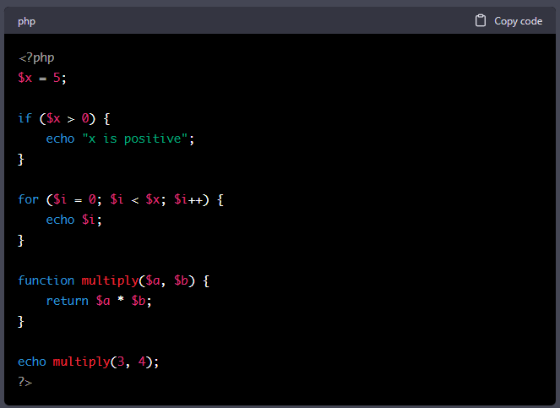
3.17 Basic Programming in PHP
Here is an example of a basic program that uses a conditional statement, a loop and a function in PHP:
This slide provides a glimpse of basic programming in PHP, and it's not limited to this, you can use many more advanced features and functions of PHP to make your program sophisticated.

Slide 11

3.18 Operators in PHP
Operators are used to perform operations on variables and values
PHP supports various types of operators, including:
Arithmetic operators (e.g. +, -, *, /)
Comparison operators (e.g. ==, !=, >, <)
Logical operators (e.g. &&, ||, !)
Assignment operators (e.g. =, +=, -=)
Operators can be used in expressions and conditions to control the flow of the program
Order of precedence can be controlled with parenthesis
It's also possible to chain the assignment operators for example $a = $b = $c = 0;

Slide 12
3.18 Operator Precedence in PHP
Operator precedence determines the order in which operations are performed in an expression.
In general, operators with higher precedence are executed before operators with lower precedence
For example, multiplication and division have higher precedence than addition and subtraction
Parentheses can be used to change the order of precedence and explicitly specify the order in which operations should be performed
If there are multiple operators with the same precedence, they are evaluated left-to-right.

Slide 13
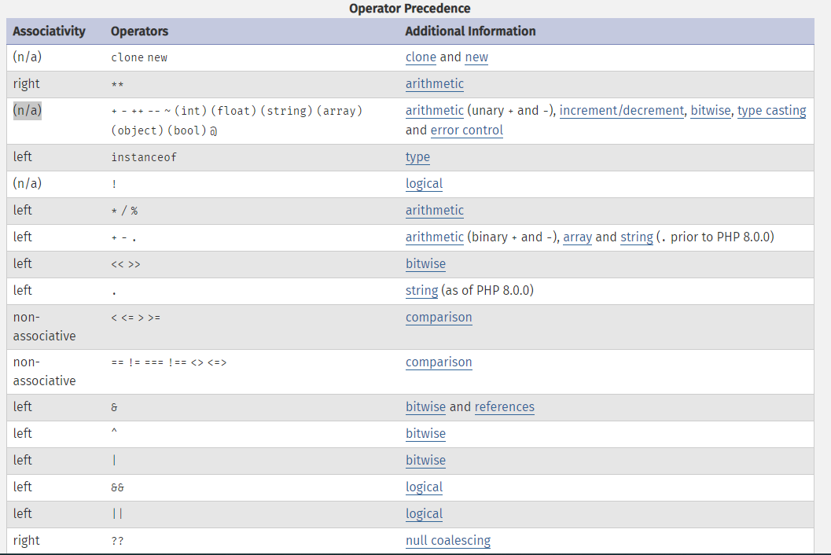
3.18 Operator Precedence in PHP

Slide 14
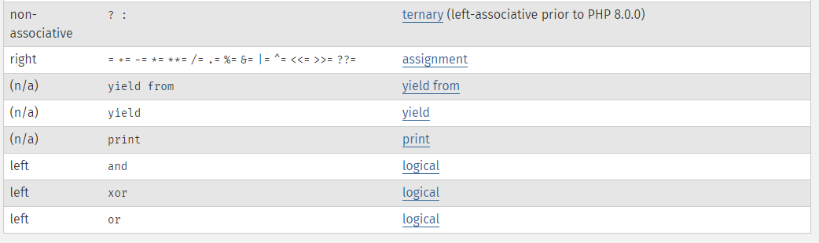
3.18 Operator Precedence in PHP

Slide 15
3.18 Operator Precedence Examples:
In the expression 4 + 5 * 2, the multiplication (*) has a higher precedence than the addition (+), so the multiplication is done first.
In the expression (4 + 5) * 2, the parentheses change the order of operations, so the addition is done first.
It's important to keep the operator precedence in mind when writing complex expressions, to ensure that the operations are performed in the order you expect.

Slide 16
3.19 Variables Manipulation
PHP allows you to manipulate variables in a variety of ways, including:
Assign values to variables using the assignment operator (=)
Concatenate strings using the concatenation operator (.)
Manipulate arrays using array functions such as sort(), count(), and implode()
Use type casting to explicitly change the data type of a variable
Use the global keyword to access global variables within a function
Use the reference operator (&) to pass variables by reference
It's important to understand how to manipulate variables in order to effectively use them in your code.

Slide 17
3.20 Database connectivity
PHP can be used to connect to a wide variety of databases, including MySQL, MariaDB, PostgreSQL, SQLite, and Oracle
PHP provides built-in support for connecting to databases through the use of extensions such as PDO (PHP Data Objects) and MySQLi
PDO is a database-agnostic extension that allows you to connect to multiple types of databases using a single API
MySQLi is a specific extension for working with MySQL databases
Both PDO and MySQLi provide methods for executing SQL statements, binding parameters, and fetching results
It's important to use prepared statements and parameter binding to protect against SQL injection attacks
Additionally, it's good practice to use an ORM (Object-Relational Mapping) library to abstract the database operations and make the code more readable and maintainable

Slide 18
3.20 Database connectivity
Examples of ORM library in PHP: Doctrine, Eloquent, and RedBeanPHP
These libraries provide a simple, object-oriented API for working with databases, making it easy to perform common tasks such as inserting, updating, and deleting records, as well as querying and retrieving data
ORM libraries also help to minimize the amount of SQL code you have to write, and they can handle tasks such as connecting to the database, creating tables, and defining relationships between tables
ORM libraries are widely used in PHP web development to make the interaction with databases simple and secure
They can also help to improve the performance of your application by caching frequently used data and reducing the number of database queries needed.

Slide 19
3.21 Connecting server-side script to database
To connect to a database from PHP, you will need to use the appropriate database extension (e.g. PDO or MySQLi) and provide the necessary connection details such as the hostname, username, password, and database name
Once connected, you can use the extension's methods to execute SQL statements, bind parameters, and fetch results
It's important to use prepared statements and parameter binding to protect against SQL injection attacks
It's also a good practice to use an ORM library to abstract the database operations and make the code more readable and maintainable
An example of connecting to a MySQL database using PDO:

Slide 20
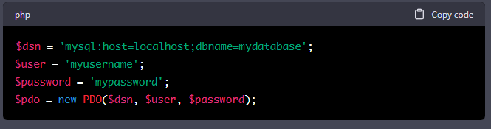
3.21 Connecting server-side script to database

Slide 21

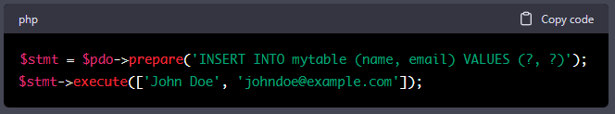
3.22 Making SQL queries in PHP
Once connected to the database, you can execute SQL statements using the appropriate methods of the database extension (e.g. PDO or MySQLi)
For example, to execute a SELECT statement using PDO, you can use the query() method:
To execute an INSERT statement using PDO, you can use the prepare() and execute() methods:

Slide 22
3.22 Making SQL queries in PHP
It's important to use prepared statements and parameter binding to protect against SQL injection attacks
ORM libraries provide an even more simple and secure way to interact with databases.

Slide 23
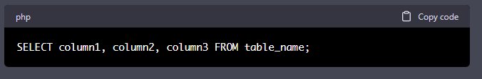
3.23 Fetching data sets
To retrieve data from a database, you can use the SELECT statement.
SELECT statement is used to select data from a database.
SELECT statement is used to select specific columns and rows from a table in a database
SELECT statement is the most common statement in SQL
Example of a SELECT statement:

Slide 24
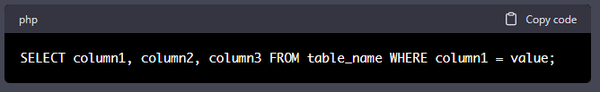
3.23 Fetching data sets
The WHERE clause is used to filter the results of a SELECT, UPDATE, or DELETE statement
The WHERE clause is used to extract only those records that fulfill a specified condition
It is used to filter the results of a SELECT, UPDATE, or DELETE statement
Example of using WHERE clause:

Slide 25
3.23 Fetching data sets
The WHERE clause is used to filter the results of a SELECT, UPDATE, or DELETE statement
The WHERE clause is used to extract only those records that fulfill a specified condition
It is used to filter the results of a SELECT, UPDATE, or DELETE statement
Example of using WHERE clause:

Slide 26
3.24 Creating SQL database with server-side scripting using PHP
Creating a SQL database with server-side scripting using PHP is a common task when building dynamic web applications. PHP provides several ways to interact with a SQL database, including the MySQLi and PDO extensions.
To create a SQL database using PHP, you need to:
Connect to a MySQL server using the MySQLi or PDO extension.
Send a SQL query to create the database.
Close the connection.

Slide 27
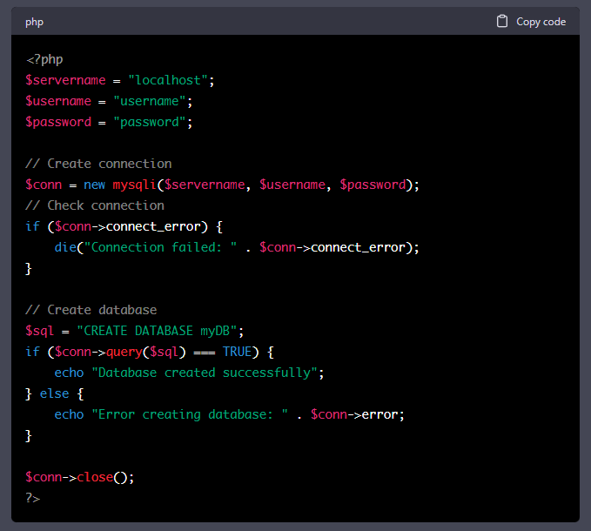
3.24 Creating SQL database with server-side scripting using PHP
Here is an example of creating a SQL database using the MySQLi extension:
It's important to note that creating a SQL database using PHP can be executed only by a user with sufficient privileges.

