Slide 1
Software Project Management

Slide 2
The System Development Life Cycle
What is an information system (IS)?
Hardware, software, data, people, and procedures that work together to produce quality information
System—Set of components that interact to achieve common goal
Businesses use many types of systems

Slide 3
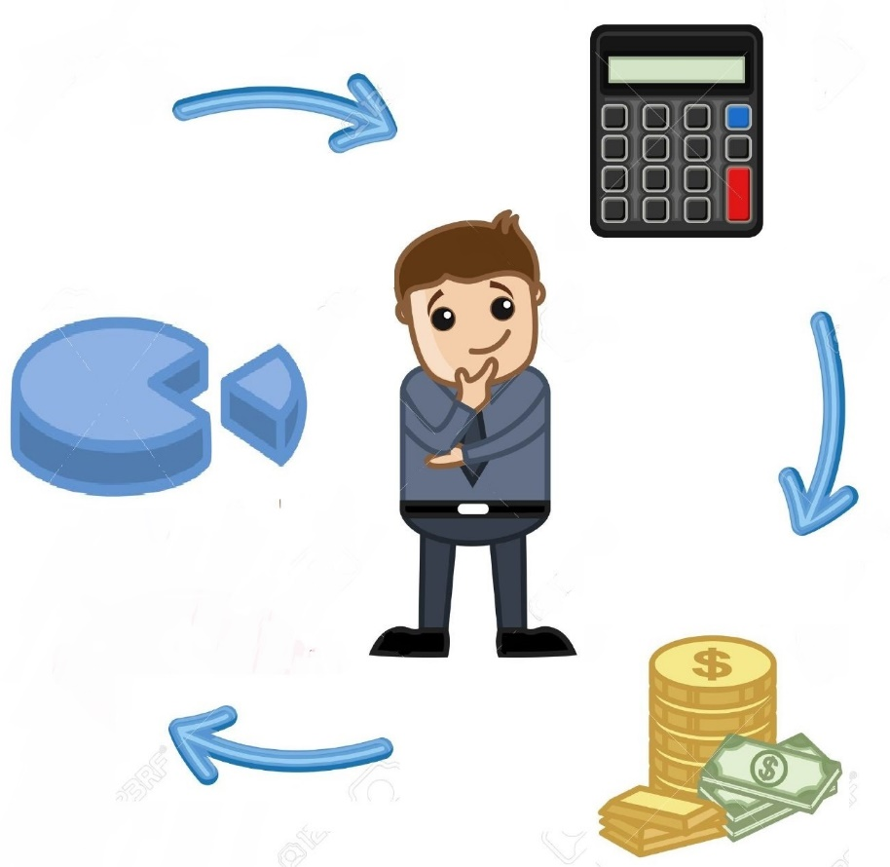
Project = Small business
Both project and small business:
Consume resources
Have stakeholders
Have critical success factors
Have financial targets

Slide 4
Software Project
A Software Project is the complete procedure of software development from requirement gathering to testing and maintenance, carried out according to the execution methodologies, in a specified period to achieve intended software product.
What is Project?
A Project is a sequence of unique, complex and connected activities having one goal or purpose and that must be completed by a specific time, within budget and according to the specification.

Slide 5
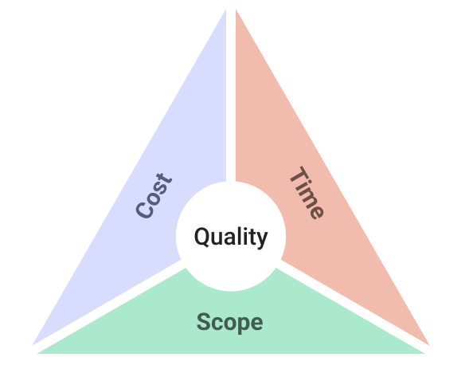
Need of Software Project Management
Software is said to be an intangible product. Software development is a kind of all new stream in world business and there's very little experience in building software products. Most software products are tailor made to fit client's requirements.
The most important is that the underlying technology changes and advances so frequently and rapidly that experience of one product may not be applied to the other one. All such business and environmental constraints bring risk in software development hence it is essential to manage software projects efficiently.

Slide 6
Software Project Manager
A software project manager is a person who undertakes the responsibility of executing the software project. Software project manager is thoroughly aware of all the phases of SDLC that the software would go through. Project manager may never directly involve in producing the end-product, but he controls and manages the activities involved in production.
A project manager closely monitors the development process, prepares and executes various plans, arranges necessary and adequate resources, maintains communication among all team members in order to address issues of cost, budget, resources, time, quality and customer satisfaction.

Slide 7
Responsibilities that are on Project Manager shoulders
Managing People
Act as project leader
Liaison with stakeholders
Managing human resources
Setting up reporting hierarchy etc.
Managing Project
Defining and setting up project scope
Managing project management activities
Monitoring progress and performance
Risk analysis at every phase
Take necessary step to avoid or come out of problems
Act as project spokesperson

Slide 8
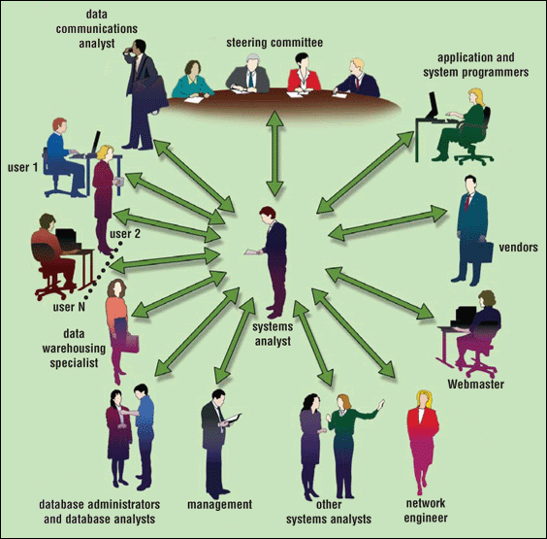
System Analyst Vs Software Engineer
Who participates in the system development life cycle?

Slide 9
System Analyst
What is a systems analyst?
Responsible for designing and developing information system
Liaison between users and IT professionals

Slide 10
Project Team
What is the project team?
Formed to work on project from beginning to end
Consists of users, systems analyst, and other IT professionals
Project leader—one member of the team who manages and controls project budget and schedule

Slide 11
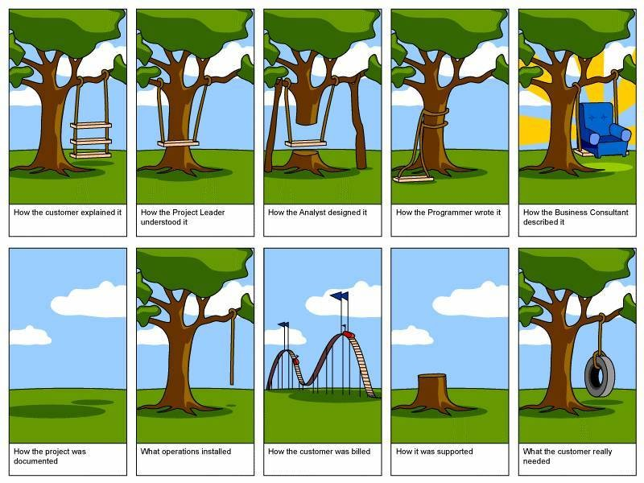
Explain this scenario

Slide 12
The System Development Life Cycle
What are the phases of the system development cycle?
Phase 2. Analysis
Phase 1. Planning
Conduct preliminary investigation
Perform detailed analysis activities:
Study current system
Determine user requirements
Recommend solution
Phase 3. Design
Review project requests
Prioritize project requests
Allocate resources
Identify project development team
Acquire hardware and software, if necessary
Develop details of system
Phase 5. Support
Phase 4. Implementation
Conduct post-implementation system review
Identify errors and enhancements
Monitor system performance
Develop programs, if necessary
Install and test new system
Train users
Convert to new system

Slide 13
The System Development Life Cycle
What are guidelines for system development?
Arrange tasks into phases (groups of activities)
Involve users (anyone for whom system is being built)
Develop clearly defined standards (procedures company expects employees to follow)

Slide 14
The System Development Life Cycle
What is feasibility?
Operational feasibility
Measure of how suitable system development will be to the company
Four feasibility tests:
Schedule feasibility
Economic feasibility (also called cost/benefit feasibility)
Technical feasibility

Slide 15
The System Development Life Cycle
What is documentation?
Collection and summarization of data and information
Includes reports, diagrams, programs, and other deliverables

Slide 16

The System Development Life Cycle
What are six data and information gathering techniques?
Review documentation
Observe
Questionnaire
Interview
Joint-application design (JAD) session
Research

Slide 17
The System Development Life Cycle
What are some reasons to create or modify an information system?
To correct problem in existing system
To improve existing system
Outside group may mandate change
Competition can lead to change

Slide 18
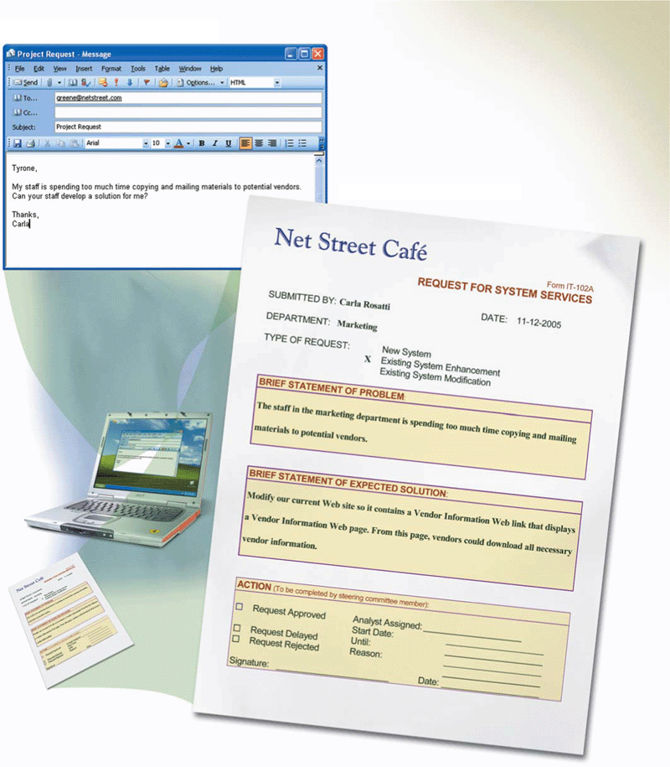
The System Development Life Cycle
What is a request for system services?
Formal request for new or modified information system
Also called project request

Slide 19
The System Development Life Cycle
What is the planning phase?
Begins when steering committee receives project request
Steering committee—decision-making body for the company
Function of committee:
Review and approve project requests
Prioritize project requests
Allocate resources
Form project development team for each approved project

Slide 20
The System Development Life Cycle
What is the analysis phase?
Conduct preliminary investigation, also called feasibility study
Perform detailed analysis

Slide 21
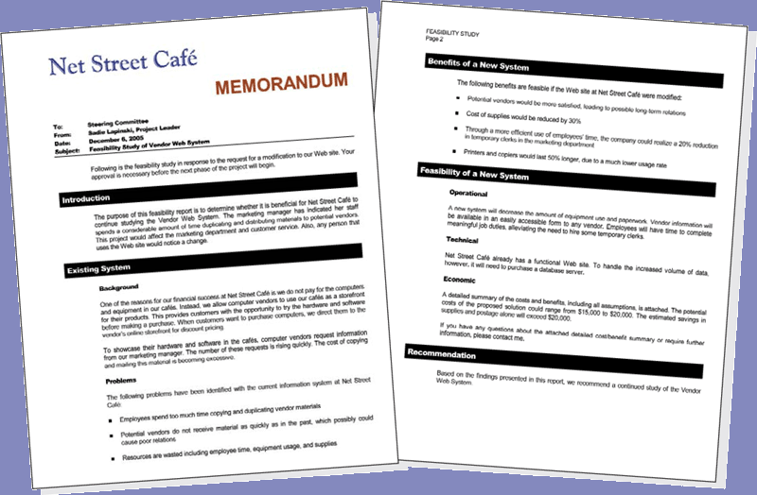
The System Development Life Cycle
What is the preliminary investigation?
Determine exact nature of problem or improvement and whether it is worth pursuing
Findings are presented in feasibility report, also known as a feasibility study

Slide 22
The System Development Life Cycle
What is detailed analysis?
1. Study how current system works
2. Determine user’s wants, needs, and requirements
3. Recommend solution
Sometimes called logical design

Slide 23
The System Development Life Cycle
What is the system proposal?
Assesses feasibility of each alternative solution
Presented to steering committee, which decides how system will be developed
Recommends the most feasible solution for the project

Slide 24
The System Development Life Cycle
What are possible solutions?
Horizontal market software—meets needs of many companies
Buy packaged software—prewritten software available for purchase
Vertical market software—designed for particular industry
Write own custom software—software developed at user’s request
Outsource—have outside source develop software

Slide 25
The System Development Life Cycle
What is the design phase?
Acquire hardware and software
Develop all details of new or modified information system

Slide 26
The System Development Life Cycle
What is needed to acquire new hardware and software?
Identify all hardware and software requirements of new or modified system
Talk with other systems analysts
Surf Web
Visit vendors’ stores
Read print and online trade journals, newspapers, and magazines

Slide 27
The System Development Life Cycle
What are three basic documents used to summarize technical specifications?
Identifies product(s) you want
Vendor quotes price(s) for listed product(s)
Request for quotation (RFQ)
Request for proposal (RFP)
Vendor selects product(s) that meet(s) your requirements and then quotes price(s)
Less formal method that uses standard form to request information about product or service
Request for information (RFI)

Slide 28
The System Development Life Cycle
How do systems analysts test software products?
References from vendor
Talk to current users of product
Product demonstrations
Trial version of software
Benchmark test measures performance

Slide 29
The System Development Life Cycle
What is a detailed design?
Detailed design specifications for components in proposed solution
Includes several activities
Database design
Input and output design
Program design

Slide 30
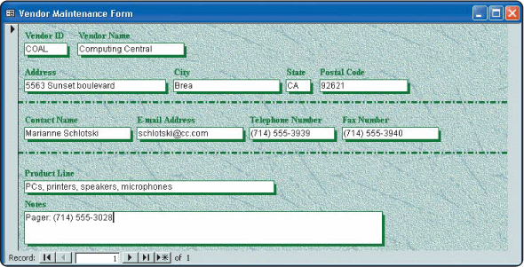
The System Development Life Cycle
What is a mockup?
Sample of input or output that contains actual data

Slide 31
The System Development Life Cycle
What is a prototype?
Working model of proposed system
Beginning a prototype too early may lead to problems

Slide 32
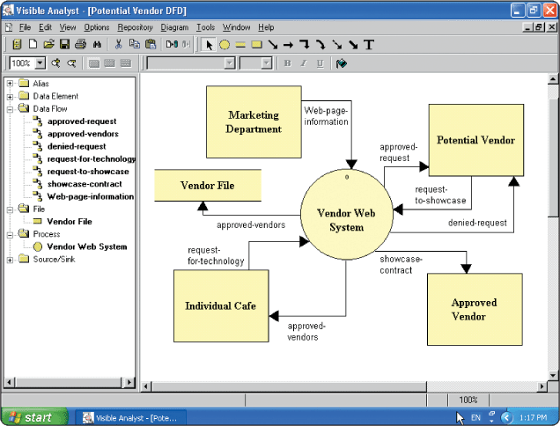
The System Development Life Cycle
What is computer-aided software engineering (CASE)?
Software tools designed to support activities of system development cycle

Slide 33
The System Development Life Cycle
What is the implementation phase?
Purpose is to construct, or build, new or modified system and then deliver it to users
Convert to new system
Train users
Install and test new system
Develop programs

Slide 34
The System Development Life Cycle
What are the three types of tests performed by system developers?
Unit Test
Systems test
Verifies each individual program works by itself
Verifies all programs in application work together
Integration Test
Verifies application works with other applications

Slide 35

The System Development Life Cycle
What is training?
Showing users exactly how they will use new hardware and software in system

Slide 36
The System Development Life Cycle
Conduct post-implementation system review—meeting to find out if information system is performing according to expectations
Identify errors
What is the support phase?
Provides ongoing assistance after system is implemented
Identify enhancements
Monitor system performance

Slide 37
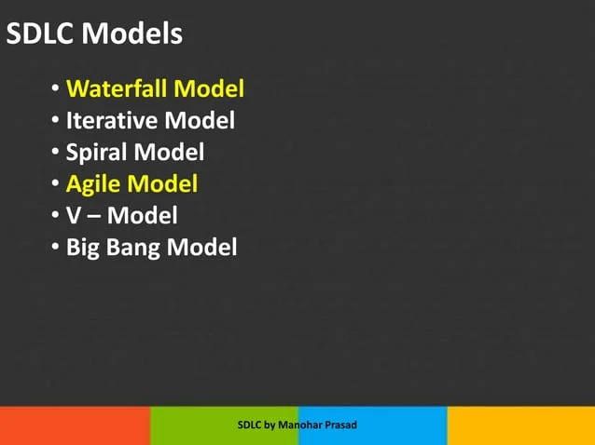
SDLC Models

Slide 38
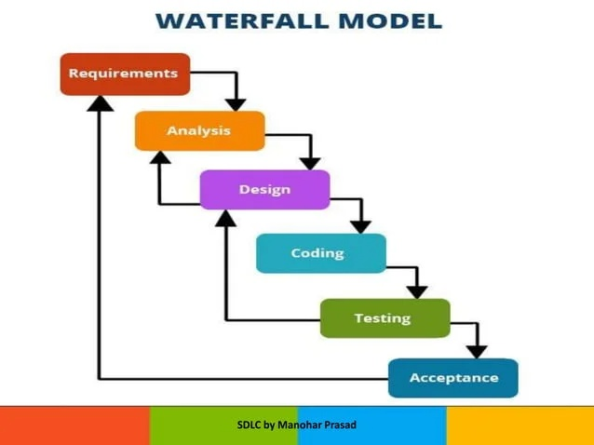
Waterfall Models

Slide 39
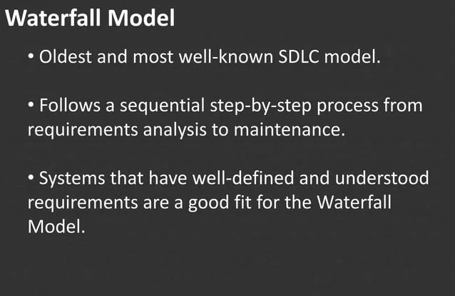
Waterfall Models

Slide 40
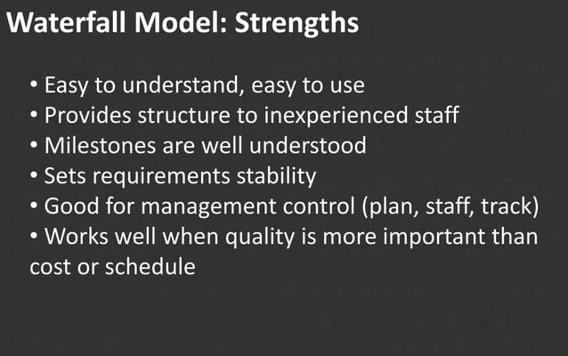
Waterfall Models : Pros

Slide 41
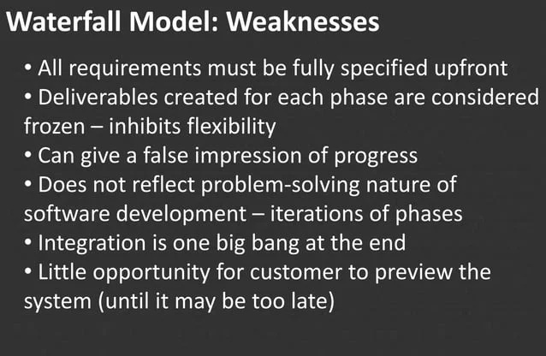
Waterfall Models : Cons

Slide 42
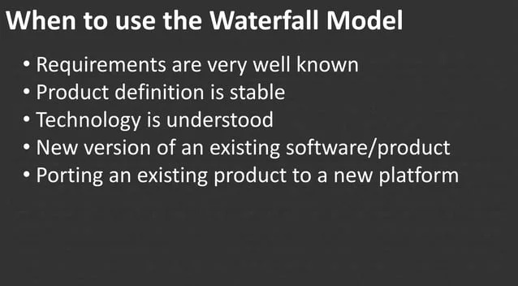
Waterfall Models : when to use?

Slide 43
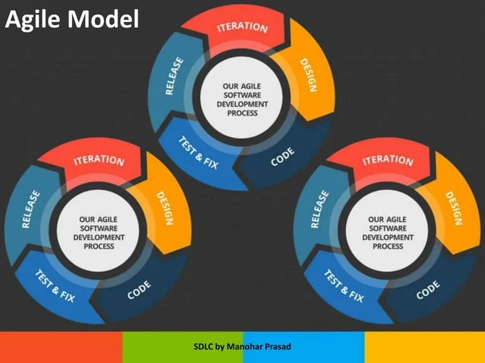
Agile Model

Slide 44
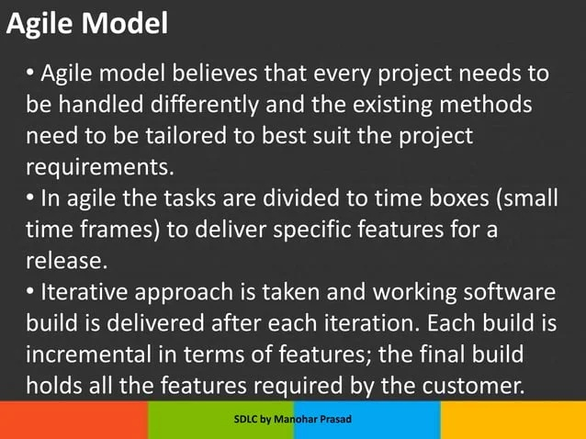
Agile Models

Slide 45
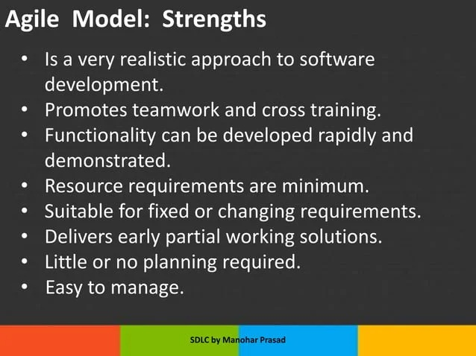
Agile Models : Pros

Slide 46
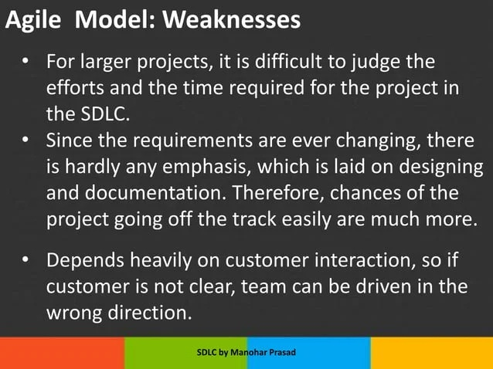
Agile Models : Cons

Slide 47
Thank You!

