Slide 1

4. Programming in C

Slide 2



4.1 Review of C programming concept
Variables: A variable is a named memory location that stores a value. In C, variables must be declared before they are used, and they must be of a specific data type (e.g. int, char, float, etc.).
Data types: C provides a range of data types for representing different types of values, such as integers, characters, and floating-point numbers.
Input and Output: C provides functions for reading and writing data
Operators: C provides a range of operators that can be used to perform operations on values, such as arithmetic, logical, and comparison operations.
Control structures: C provides a range of control structures that can be used to control the flow of a program, such as if-else statements, for loops, and while loops.

Slide 3
Introduction of C
C is a structured programming language. It is considered a high-level language because it allows the programmer to concentrate on the problem at hand and not worry about the machine that the program will be using. That is another reason why it is used by software developers whose applications have to run on many different hardware platforms.

Slide 4

Features of C
Simple and Efficient
Fast
Portability
Extensibility
Function-Rich Libraries
Dynamic Memory Management
Modularity With Structured Language
Mid-Level Programming Language
Pointers
Recursion

Slide 5
FIGURE Structure of a C Program

Slide 6
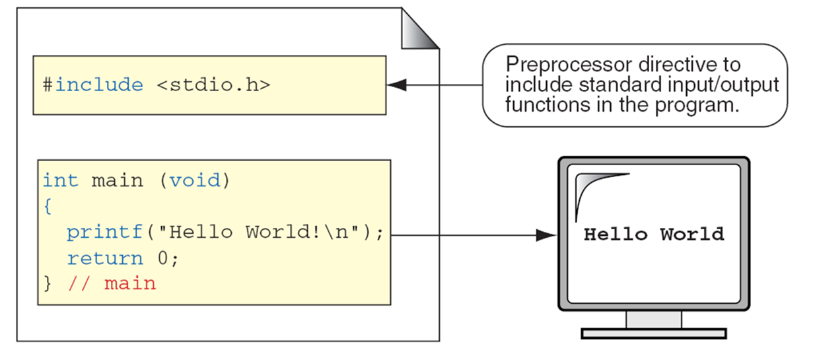
C Preprocessor and Header Files
A header file is a file containing C declarations and macro definitions to be shared between several source files. You request the use of a header file in your program by including it, with the C preprocessing directive ‘#include’.

Slide 7
First C Program
It's time to write your first C program.

Slide 8

FIGURE The Greeting Program

Slide 9
PROGRAM
The Greeting Program

Slide 10
FIGURE Examples of Block Comments

Slide 11
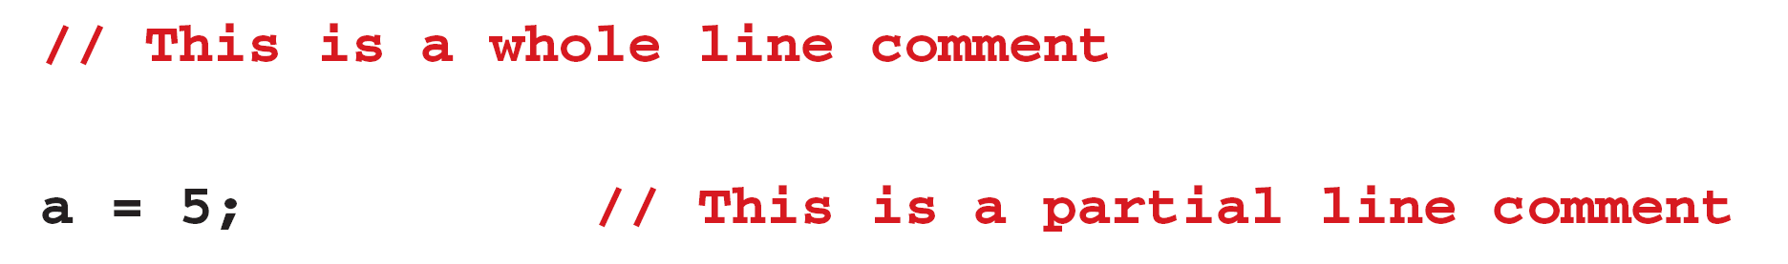
FIGURE Examples of Line Comments

Slide 12
Character set
Type of Character | Description | Characters
Lowercase Alphabets | a to z | a, b, c, d, e, f, g, h, i, j, k, l, m, n, o, p, q, r, s, t, u, v, w, x, y, z
Uppercase Alphabets | A to Z | A, B, C, D, E, F, G, H, I, J, K, L, M, N, O, P, Q, R, S, T, U, V, W, X, Y, Z
Digits | 0 to 9 | 0, 1, 2, 3, 4, 5, 6, 7, 8, 9
Special Characters | – | ` ~ @ ! $ # ^ * % & ( ) [ ] { } < > + = _ – | / \ ; : ‘ “ , . ?
White Spaces | – | Blank Spaces, Carriage Return, Tab, New Line
Notes:
Simple and Efficient
The basic syntax style of implementing C language is very simple and easy to learn. This makes the language easily comprehensible and enables a programmer to redesign or create a new application. C is usually used as an introductory language to introduce programming to school students because of this feature.
Fast
It is a well-known fact that statically typed programming languages are faster than dynamic ones. C is a statically typed programming language, which gives it an edge over other dynamic languages. Also, unlike Java and Python, which are interpreter-based, C is a compiler-based program. This makes the compilation and execution of codes faster.
Another factor that makes C fast is the availability of only the essential and required features. Newer programming languages come with numerous features, which increase functionality but reduce efficiency and speed. Since C offers limited but essential features, the headache of processing these features reduces, resulting in increased speed.
Portability
Another feature of the C language is portability. To put it simply, C programs are machine-independent which means that you can run the fraction of a code created in C on various machines with none or some machine-specific changes. Hence, it provides the functionality of using a single code on multiple systems depending on the requirement.
Extensibility
You can easily (and quickly) extend a C program. This means that if a code is already written, you can add new features to it with a few alterations. Basically, it allows adding new features, functionalities, and operations to an existing C program.
Function-Rich Libraries
C comes with an extensive set of libraries with several built-in functions that make the life of a programmer easy. Even a beginner can easily code using these built-in functions. You can also create your user-defined functions and add them to C libraries. The availability of such a vast scope of functions and operations allows a programmer to build a vast array of programs and applications.
Dynamic Memory Management
One of the most significant features of C language is its support for dynamic memory management (DMA). It means that you can utilize and manage the size of the data structure in C during runtime. C also provides several predefined functions to work with memory allocation. For instance, you can use the free() function to free up the allocated memory at any time. Similarly, there are other functions such as malloc(), calloc(), and realloc() to perform operations on data structure and memory allocations.
Modularity With Structured Language
C is a general-purpose structured language. This feature of C language allows you to break a code into different parts using functions which can be stored in the form of libraries for future use and reusability.. Structuring the code using functions increases the visual appeal and makes the program more organized and less prone to errors.
Mid-Level Programming Language
Although C was initially developed to do only low-level programming, it now also supports the features and functionalities of high-level programming, making it a mid-level language. And as a mid-level programming language, it provides the best of both worlds. For instance, C allows direct manipulation of hardware, which high-level programming languages do not offer.
Pointers
With the use of pointers in C, you can directly interact with memory. As the name suggests, pointers point to a specific location in the memory and interact directly with it. Using the C pointers, you can operate with memory, arrays, functions, and structures.
Recursion
C language provides the feature of recursion. Recursion means that you can create a function that can call itself multiple times until a given condition is true, just like the loops. Recursion in C programming provides the functionality of code reusability and backtracking.

Slide 13
Identifiers
One feature present in all computer languages is the identifier. Identifiers allow us to name data and other objects in the program. Each identified object in the computer is stored at a unique address.

Slide 14
Table
Rules for Identifiers

Slide 15
Note
An identifier must start with a letter or underscore: it may not have a space or a hyphen.

Slide 16
Note
C is a case-sensitive language.

Slide 17
Table
Examples of Valid and Invalid Names

Slide 18
Data Types
A type defines a set of values and a set of operations that can be applied on those values.
Topics discussed in this section:
Void Type
Integral Type
Floating-Point Types

Slide 19
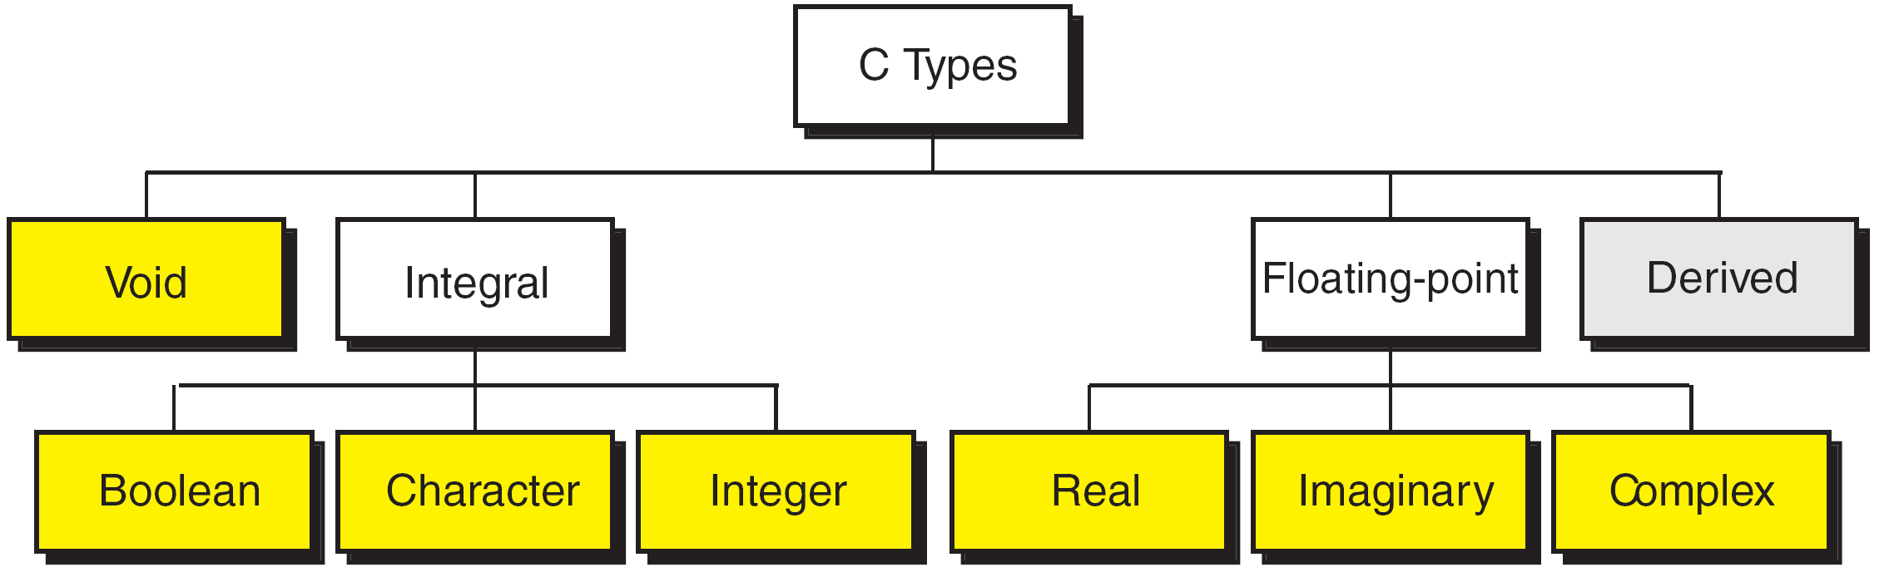
FIGURE Data Types

Slide 20
FIGURE Character Types
Notes:
wchar_t is a wide character: The increased datatype size allows for the use of larger coded character sets. Width is compiler specific (not portable).

Slide 21
FIGURE Integer Types

Slide 22
Note
sizeof (short) ≤ sizeof (int) ≤ sizeof (long) ≤ sizeof (long long)

Slide 23
Table
Typical Integer Sizes and Values for Signed Integers

Slide 24
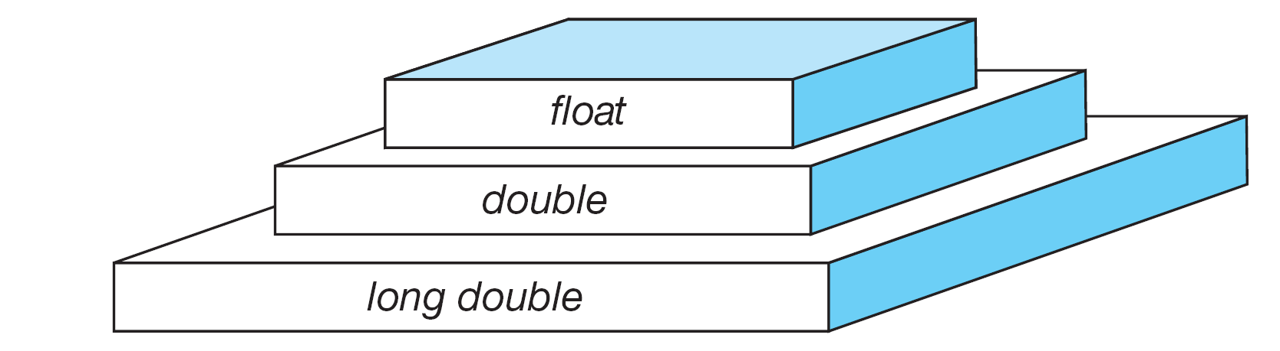
FIGURE Floating-point Types

Slide 25
Note
sizeof (float) ≤ sizeof (double) ≤ sizeof (long double)

Slide 26
Table
Type Summary

Slide 27
Variables
Variables are named memory locations that have a type, such as integer or character, which is inherited from their type. The type determines the values that a variable may contain and the operations that may be used with its values.
Topics discussed in this section:
Variable Declaration
Variable Initialization

Slide 28
FIGURE Variables

Slide 29
Table
Examples of Variable Declarations and Definitions

Slide 30
‘B’
FIGURE Variable Initialization

Slide 31
Note
When a variable is defined, it is not initialized. We must initialize any variable requiring prescribed data when the function starts.

Slide 32
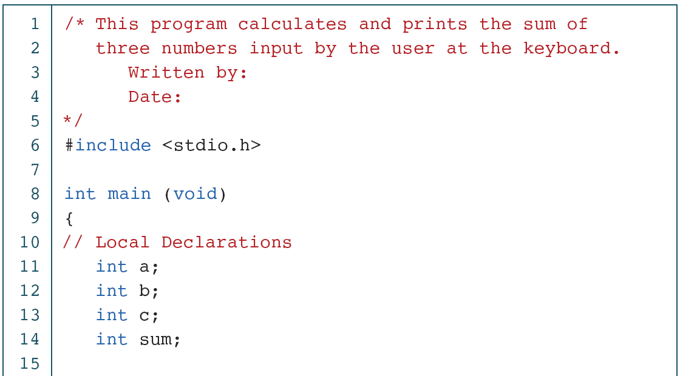
PROGRAM
Print Sum of Three Numbers

Slide 33
PROGRAM
Print Sum of Three Numbers (continued)

Slide 34
PROGRAM
Print Sum of Three Numbers (continued)

Slide 35
Constants
Constants are data values that cannot be changed during the execution of a program. Like variables, constants have a type. In this section, we discuss Boolean, character, integer, real, complex, and string constants.
Topics discussed in this section:
Constant Representation
Coding Constants

Slide 36
Note
A character constant is enclosed in single quotes.

Slide 37
Table
Symbolic Names for Control Characters

Slide 38
Table
Examples of Integer Constants

Slide 39
Table
Examples of Real Constants

Slide 40
FIGURE Some Strings

Slide 41
FIGURE Null Characters and Null Strings

Slide 42
Note
Use single quotes for character constants. Use double quotes for string constants.

Slide 43
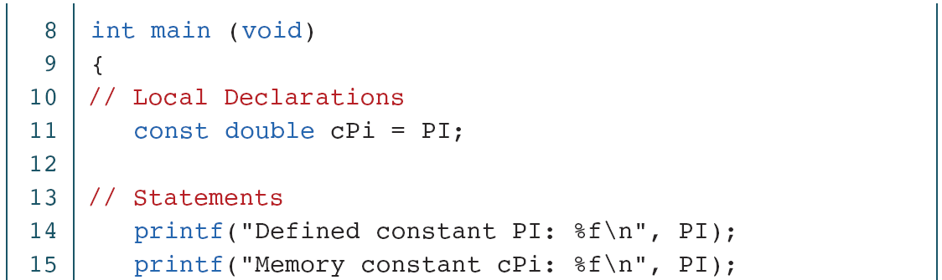
PROGRAM
Memory Constants

Slide 44
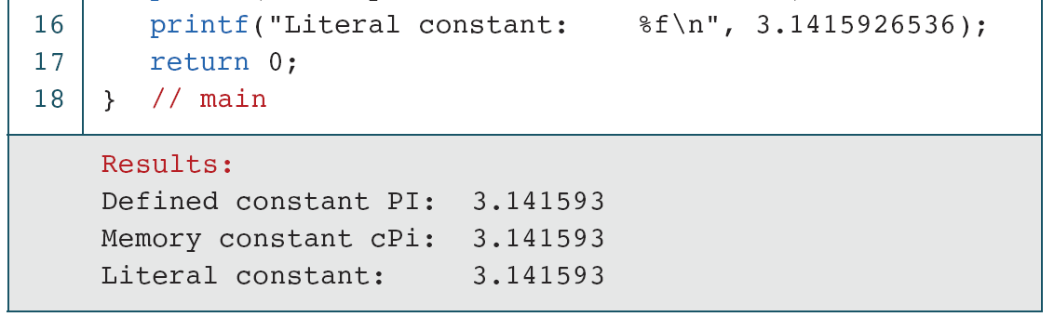
PROGRAM
Memory Constants (continued)

Slide 45
Operators in C

Slide 46
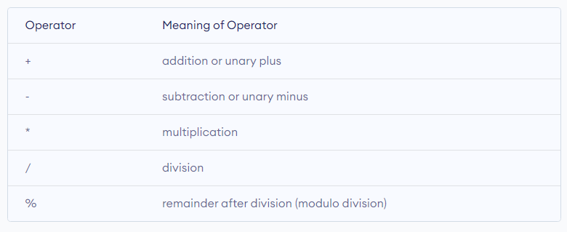
An operator is a symbol that operates on a value or a variable. For example: + is an operator to perform addition.
Table
C Arithmetic Operators

Slide 47
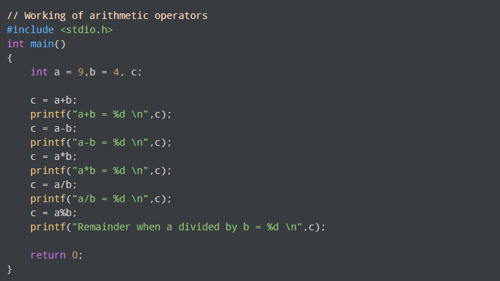
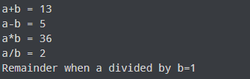
PROGRAM 2-3
Operators in C

Slide 48
Increment and Decrement Operators
C programming has two operators increment ++ and decrement -- to change the value of an operand (constant or variable) by 1.
Increment ++ increases the value by 1 whereas decrement -- decreases the value by 1. These two operators are unary operators, meaning they only operate on a single operand.

Slide 49
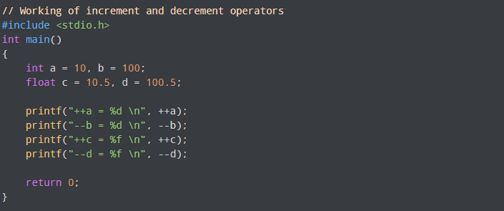
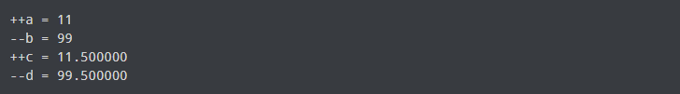
PROGRAM 2-3
Operators in C
Output

Slide 50
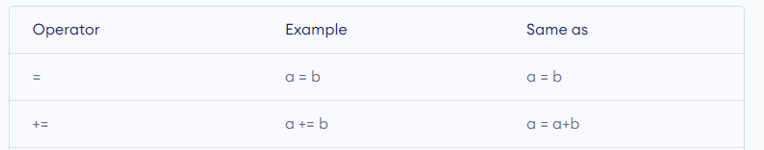
C Assignment Operators
An assignment operator is used for assigning a value to a variable. The most common assignment operator is =

Slide 51
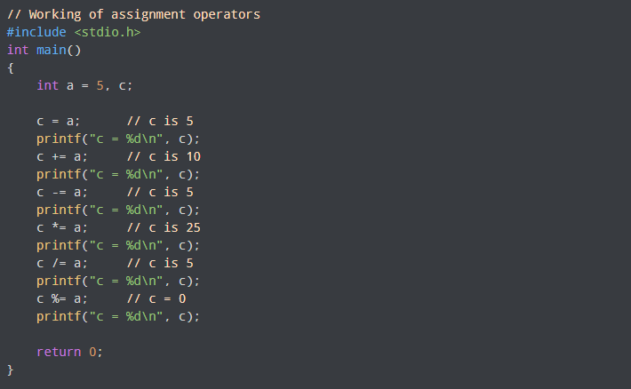
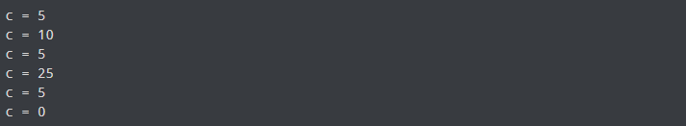
PROGRAM
Operators in C
Output

Slide 52
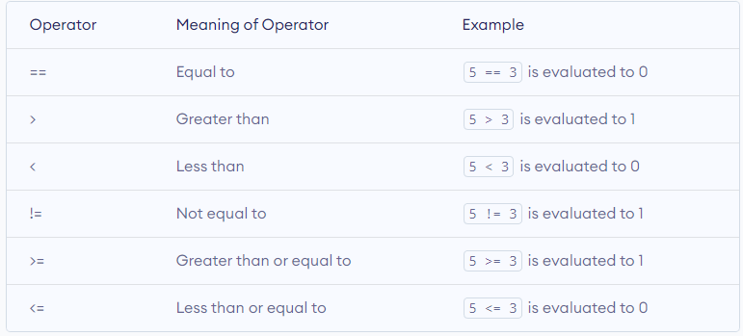
C Relational Operators
A relational operator checks the relationship between two operands. If the relation is true, it returns 1; if the relation is false, it returns value 0.
Relational operators are used in decision making and loops.

Slide 53
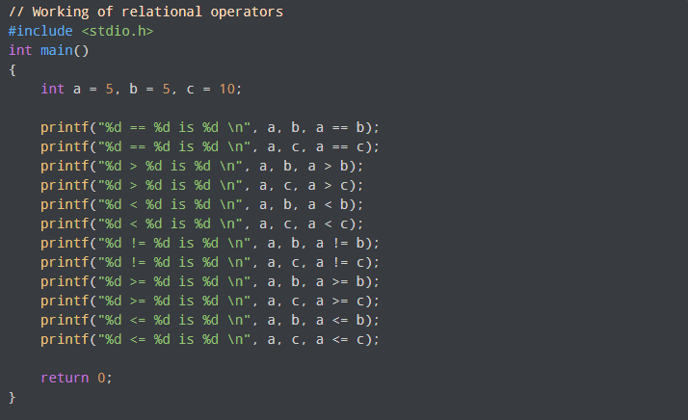
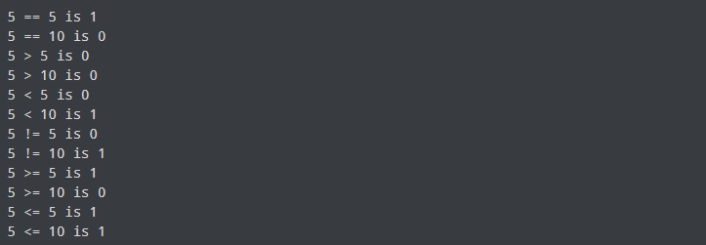
PROGRAM
Operators in C
Output

Slide 54
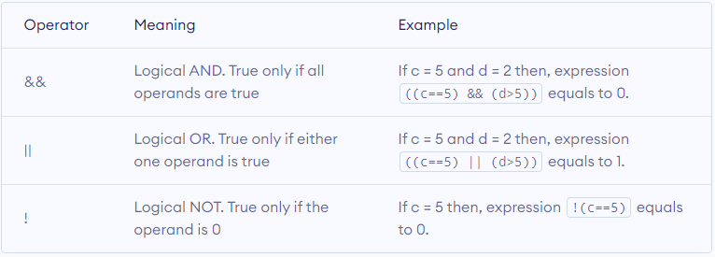
C Logical Operators
An expression containing logical operator returns either 0 or 1 depending upon whether expression results true or false. Logical operators are commonly used in decision making in C programming.

Slide 55
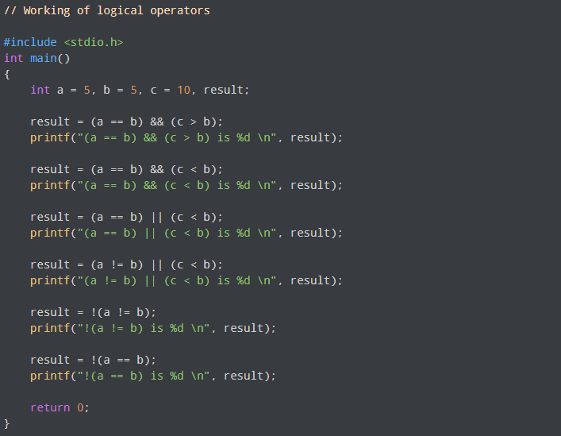
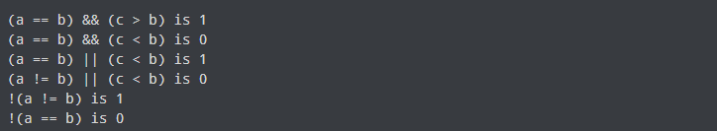
PROGRAM
Operators in C
Output

