Slide 1
7. Recent Trends
In Technology

Slide 2
What will we learn?
7.1 Concept of Artificial Intelligence (AI) and Robotics
7.2 Concept of Cloud Computing
7.3 Concept of Big Data
7.4 Concept of Virtual Reality
7.5 Concept of e-com, e-medicine, e-gov.
7.6 Concept of Mobile Computing
7.7 Concept of Internet of things (IoT)

Slide 3
7.1 Concept of Artificial Intelligence (AI) and Robotics

Slide 4
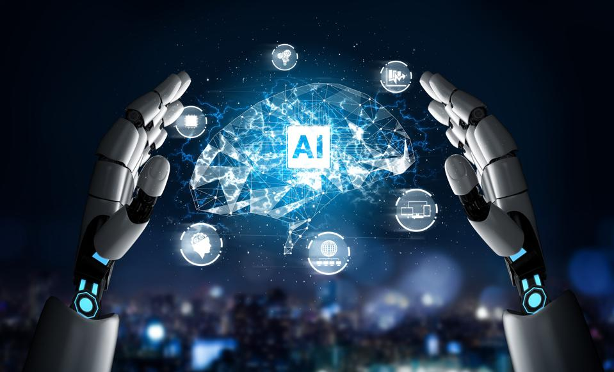
Artificial Intelligence
Artificial intelligence (AI) refers to the simulation of human intelligence in machines that are programmed to perform tasks that normally require human cognition, such as visual perception, speech recognition, decision-making, and language translation. AI systems can be designed to learn from data and improve their performance over time, making them increasingly sophisticated and capable of tackling complex problems.

Slide 5
There are several different types of AI, including:
This is a field of AI that focuses on the development of intelligent machines that can perceive and interact with their environment.
Rule-based AI
This type of AI is based on a set of predetermined rules that the machine follows to make decisions or take actions.
Machine learning
This is a type of AI that uses algorithms to analyze and learn from data, without being explicitly programmed.
Deep learning
This is a type of machine learning that uses artificial neural networks, modeled on the structure and function of the human brain, to analyze and learn from large amounts of data.
This is a type of AI that enables machines to understand, interpret, and generate human language.
Robotics
Natural language processing (NLP)
1
2
3
4
5

Slide 6
Summary
AI has the potential to revolutionize many aspects of our lives, from healthcare and transportation to finance and education. However, there are also concerns about the ethical and social implications of AI, such as the potential for bias and discrimination, privacy violations, and job displacement.

Slide 7
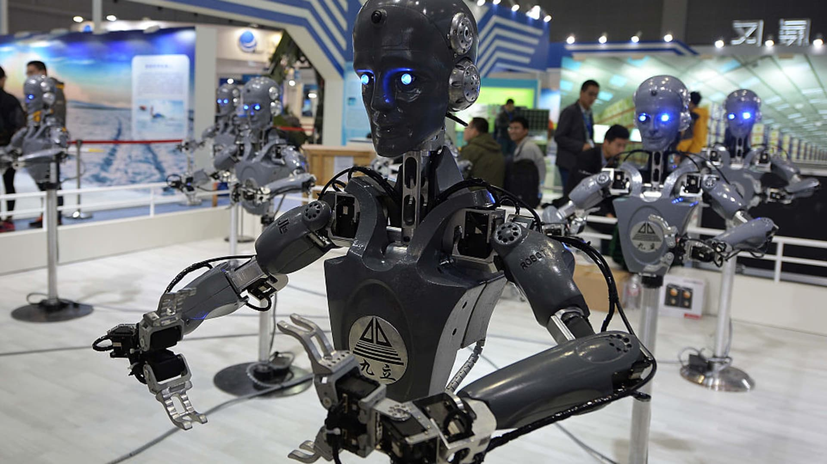
Robotics
Robotics is the interdisciplinary field of study that involves the design, construction, operation, and use of robots. It combines elements of computer science, electrical engineering, mechanical engineering, and other related fields to develop machines that can perform tasks that would normally require human intervention. Robots are typically designed to sense, move, and manipulate their surroundings, often with the goal of completing a specific task or set of tasks. Robotics has a wide range of applications, from manufacturing and healthcare to agriculture and space exploration.

Slide 8
Types of Robots
Industrial Robots: These robots are used in manufacturing plants to automate tasks such as welding, painting, and assembly.
Medical Robots: Medical robots are used in healthcare facilities to assist in surgeries, rehabilitation, and diagnosis. Examples include surgical robots, prosthetics, and exoskeletons.
Service Robots: Service robots are used in various industries, including hospitality, retail, and transportation. Examples include cleaning robots, delivery robots, and autonomous vehicles.
Military Robots: These robots are designed to perform tasks that are too dangerous or difficult for humans to perform, such as reconnaissance and bomb disposal.
Entertainment Robots: These robots are designed for recreational purposes, such as toys, companion robots, and robots used in theme parks.
Agricultural Robots: Agricultural robots are used in farming to assist with tasks such as planting, harvesting, and spraying pesticides.
Educational Robots: Educational robots are used in schools and universities to teach students about robotics and programming.

Slide 9
Importance of Robotics in modern times
Increased Efficiency: Robots can perform repetitive tasks more quickly and accurately than humans, which leads to increased productivity and efficiency.
Improved Quality: Robots can perform tasks with a high degree of precision and consistency, which helps to improve the quality of products and services.
Reduced Labor Costs: By automating tasks that would normally require human labor, companies can reduce labor costs and increase profitability.
Increased Safety: Robots can perform tasks in dangerous environments or situations that are unsafe for humans, which helps to reduce the risk of injury or death.
Ability to Work in Harsh Environments: Robots can work in environments that are too hot, cold, or toxic for humans, such as outer space, deep sea exploration, and hazardous waste cleanup.
Healthcare Advancements: Medical robots are used in various healthcare applications such as surgeries, prosthetics, and exoskeletons which help to improve patient outcomes and recovery.
Exploration of Space: Robots play an important role in space exploration, performing tasks such as gathering data, repairing equipment, and building structures.

Slide 10
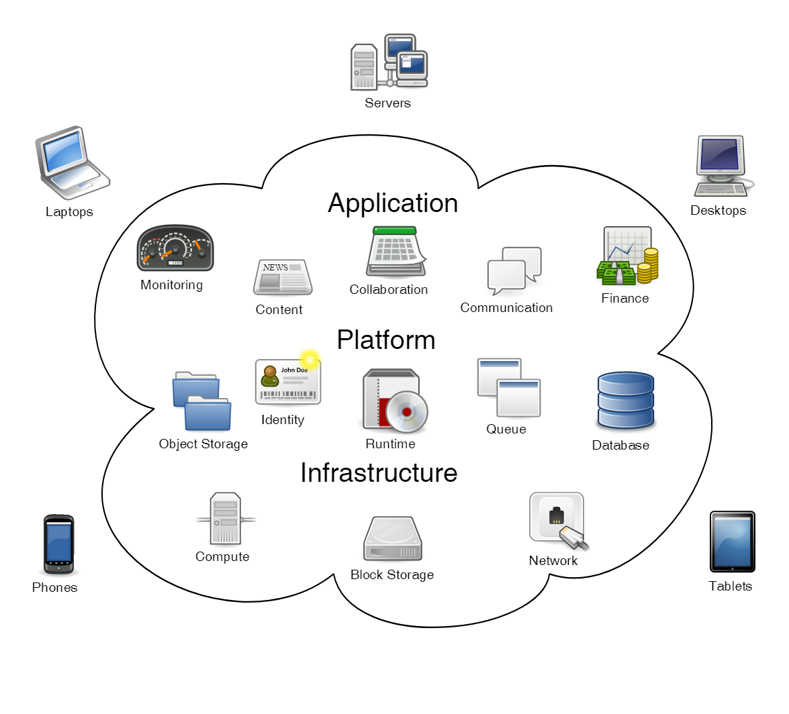
7.2 Concept of Cloud Computing
Cloud computing refers to the delivery of computing services such as servers, storage, databases, networking, software, and analytics over the internet. In other words, it is a model of on-demand access to a shared pool of configurable computing resources that can be rapidly provisioned and released with minimal management effort.
The concept of cloud computing allows users to access computing services without the need for extensive infrastructure investment or IT expertise. Cloud providers typically operate large data centers that house the necessary hardware, software, and network infrastructure to deliver these services.

Slide 11
Cloud computing can be classified into three main service models:
Infrastructure as a Service (IaaS): This model provides users with access to virtualized computing resources such as servers, storage, and networking infrastructure.
Platform as a Service (PaaS): This model provides users with access to a computing platform such as an operating system, programming language, or database environment.
Software as a Service (SaaS): This model provides users with access to a complete software application that is hosted and managed by a third-party provider.

Slide 12
Benefits of Cloud Computing
Scalability: Users can easily scale up or down their computing resources based on their needs without the need for significant upfront investments.
Cost savings: Cloud computing can help to reduce the costs associated with hardware, software, and maintenance.
Accessibility: Users can access their applications and data from anywhere with an internet connection.
Reliability: Cloud providers typically offer high levels of uptime and availability.
Security: Cloud providers offer advanced security features to protect user data and applications.

Slide 13
7.3 Concept of Big Data
Big Data refers to extremely large and complex sets of data that traditional data processing applications are unable to handle. These data sets can come from a variety of sources such as social media platforms, internet searches, sensors, and other devices.

Slide 14
Big Data is characterized by three main characteristics, also known as the three V's:
Volume: Big Data involves large amounts of data that can range from terabytes to petabytes and beyond.
Velocity: Big Data is generated at a high speed and requires real-time processing and analysis to extract meaningful insights.
Variety: Big Data comes in various forms, such as structured, unstructured, and semi-structured data.

Slide 15
7.4 Concept of Virtual Reality
Virtual Reality (VR) refers to a computer-generated simulation or environment that allows users to interact with a 3D world using special electronic equipment, such as a VR headset or gloves with sensors. VR technology creates an immersive experience that mimics real-world situations and allows users to interact with a virtual environment as if they were actually there.

Slide 16
7.4 Concept of Virtual Reality
The concept of VR has been around for decades, but recent advancements in technology have made it more accessible and affordable to consumers. VR technology works by using computer algorithms and sensors to track the user's movements and adjust the display accordingly. This creates a sense of presence, where the user feels like they are actually in the virtual environment.

Slide 17
7.4 Concept of Virtual Reality
VR technology has many practical applications, such as in gaming, entertainment, education, and training. In gaming, VR technology allows players to immerse themselves in the game environment and interact with it in a more realistic and engaging way. In entertainment, VR technology can be used to create interactive movies, concerts, and theme park experiences.

Slide 18
7.4 Concept of Virtual Reality
VR technology has many practical applications, such as in gaming, entertainment, education, and training. In gaming, VR technology allows players to immerse themselves in the game environment and interact with it in a more realistic and engaging way. In entertainment, VR technology can be used to create interactive movies, concerts, and theme park experiences.

Slide 19
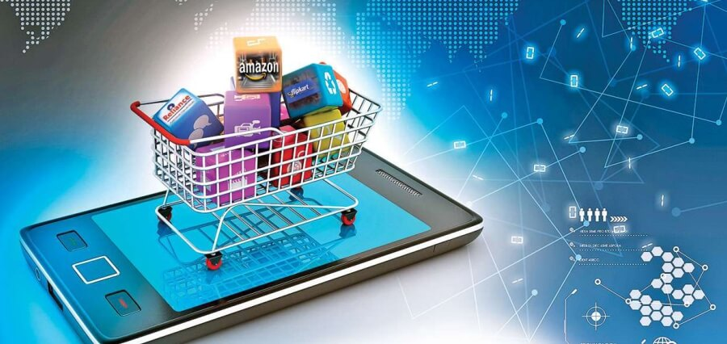
7.5 Concept of E-Commerce:
E-commerce, short for electronic commerce, refers to the buying and selling of goods and services over the internet. This concept has revolutionized the way businesses operate and interact with customers. With the growth of the internet and online platforms, e-commerce has become increasingly popular and has opened up new markets and opportunities for businesses of all sizes. E-commerce can be conducted through various channels such as online marketplaces, social media, and company websites.

Slide 20
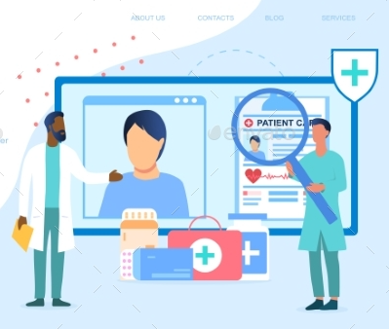
7.5 Concept of E-Medicine:
E-medicine refers to the use of technology and electronic communication tools to provide medical care and services remotely. This concept has become increasingly popular due to the growth of telemedicine and the need for remote healthcare services. With e-medicine, patients can access medical care and consultations from the comfort of their own homes, without the need to visit a healthcare facility. E-medicine also includes the use of electronic medical records, online appointment scheduling, and remote monitoring tools.

Slide 21
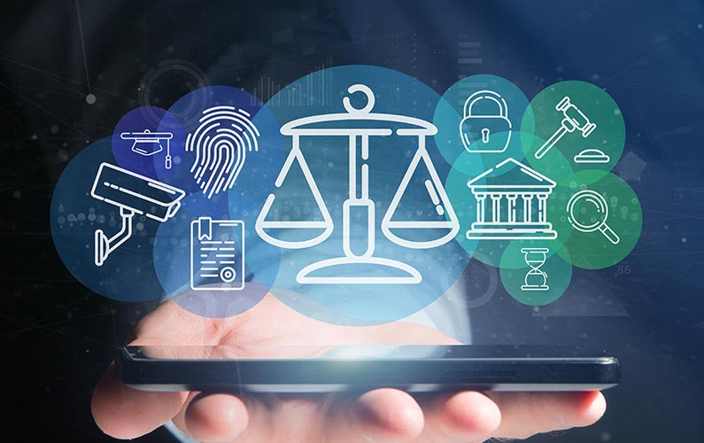
7.5 Concept of E-Government:
E-government refers to the use of technology to improve government services and interactions with citizens. This concept aims to make government services more accessible, efficient, and transparent through the use of digital platforms and tools. E-government includes various initiatives such as online portals for government services, digital identity systems, and electronic voting systems. The goal of e-government is to improve citizen engagement and participation in government, reduce administrative costs, and improve overall government efficiency.

Slide 22
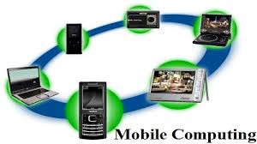
7.6 Concept of Mobile Computing:
Mobile computing refers to the use of portable electronic devices such as smartphones, tablets, laptops, and wearables to access and use computing resources and applications on the go. Mobile computing has become an integral part of modern life, allowing people to stay connected and productive no matter where they are.

Slide 23
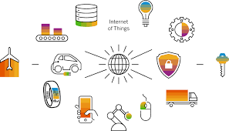
7.7 Concept of Internet of things (IoT):
The Internet of Things (IoT) is a concept that refers to the network of physical objects, devices, and sensors that are connected to the internet, allowing them to collect and exchange data. These objects can be anything from smartphones, wearables, and home appliances to industrial machines, vehicles, and infrastructure.
IoT devices are equipped with sensors and software that allow them to collect data and communicate with other devices and systems. This data can be analyzed and used to inform decision-making and optimize various processes.

Slide 24
Thank you
Ajay Singh
ajay@nrb.org.np
www.ajaysingh.com.np

