Slide 1

Web Technology II
Javascript

Slide 2

Image, event and form objects

Slide 3

What Is An Event?
An instance that happens by interaction of user (or operating system or application program) and computer can detect it and give a response to it is called event. For example, when user click on any icon or, program gives the response by executing the command. The clicking of the mouse is an even.

Slide 4
Event Handling and Event handler:
The browser waits for events to occur. When an event occurs, the browser performs a processing, which is related to that event. The processing that is performed in response to the occurrence of an event is known as even handling. The code that performs this processing called an event handler. I can be said that an even handler is a piece of code that is executed when an event occurs. Event handler are associated with different events.
For example, an event handler is associated with the click event of the button. When the button is clicked, this event handler is executed.

Slide 5
Example event handling
<form> <input type="button" value="First button" onClick='alert("First button is clicked");'> <input type="button" value="Second button" onClick="sum(25,33);"> </form>
<form> <input type="button" value="First button" onClick='alert("First button is clicked");'> <input type="button" value="Second button" onClick="sum(25,33);"> </form>
<form> <input type="button" value="First button" onClick='alert("First button is clicked");'> <input type="button" value="Second button" onClick="sum(25,33);"> </form>
<form> <input type="button" value="First button" onClick='alert("First button is clicked");'> <input type="button" value="Second button" onClick="sum(25,33);"> </form>
<form> <input type="button" value="First button" onClick='alert("First button is clicked");'> <input type="button" value="Second button" onClick="sum(25,33);"> </form>
<html>
<head> </head>
<body>
<h1> Testing Image Event Handling </h1>
<form>
<input type="button" value="First button" onClick='alert("First button is clicked");'>
<input type="button" value="Second button" onClick="sum(25,33);"> </form>
</body>
</html>

Slide 6

Image Event Handling:
Various events are also associated with image element of html. usually, image events handling are used to monitor the progress of image loading. The images take more time to load than normal text. In many web application, it is important to know whether a specific image has been loaded, or in the process of loading or loading process is interrupted. The image event handling provide this capability.
The most important image event are described as follows: Load, Error, Abort, KeyDown etc.

Slide 7
Example image event
<html>
<head> </head>
<body>
<h1> Testing Image Event Handling </h1>
<img src="test.jpg" alt="test" onLoad='alert("image is successfully loaded");'onError='alert("Error in loading image");'></img>
</body>
</html>

Slide 8
Form validation
Form validation is a process of confirming the relevant information entered by the user in the input field. Here we will be validating a simple form that consists of a username, password and a confirmed password using jQuery.

Slide 9
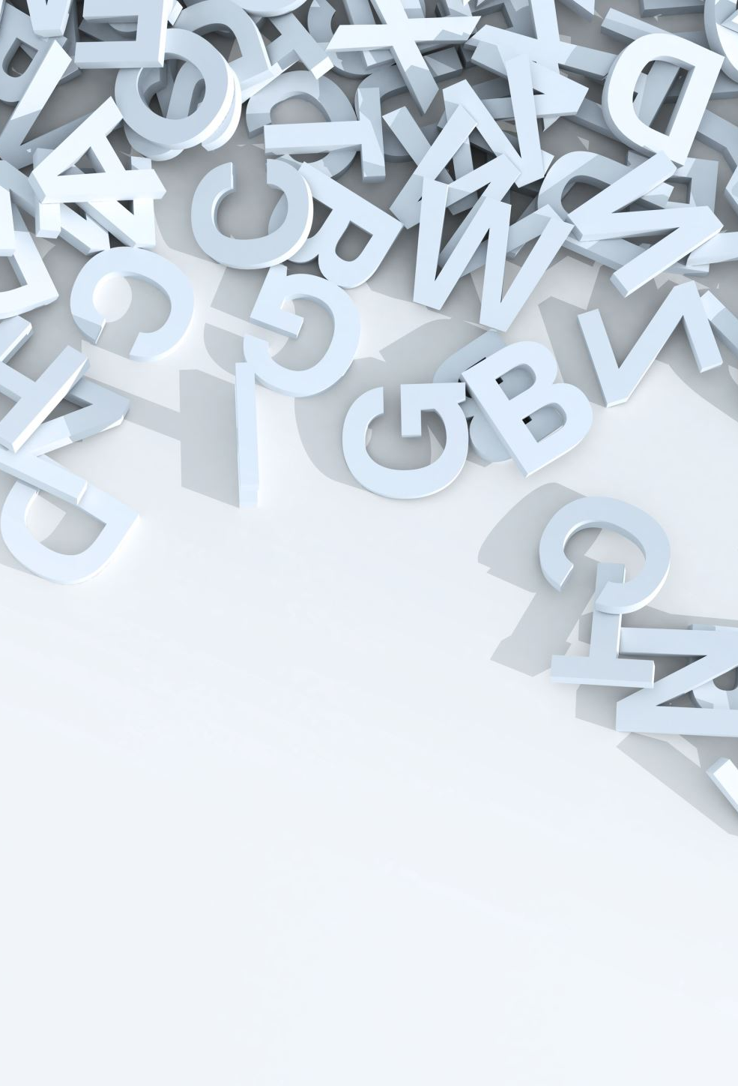
What is jQuery?
jQuery is a fast, small, and feature-rich JavaScript library. It makes things like HTML document traversal and manipulation, event handling, animation, and Ajax much simpler with an easy-to-use API that works across a multitude of browsers. With a combination of versatility and extensibility, jQuery has changed the way that millions of people write JavaScript.

Slide 10
Example form validation
// Document is ready
$(document).ready(function () {
// Validate Username
$("#usercheck").hide();
let usernameError = true;
$("#usernames").keyup(function () {
validateUsername();
});
function validateUsername() {
let usernameValue = $("#usernames").val();
if (usernameValue.length == "") {
$("#usercheck").show();
usernameError = false;
return false;
} else if (usernameValue.length < 3 || usernameValue.length > 10) {
$("#usercheck").show();
$("#usercheck").html("**length of username must be between 3 and 10");
usernameError = false;
return false;
} else {
$("#usercheck").hide();
}
}

