Slide 1

Mentorskool
Flipped Learning Sessions

Slide 2

Mentorskool
By | Ravi Kiran Reddy G

Slide 3
Agenda:
What is API
Importance of API in Data Science
Open API
Paid API

Slide 4
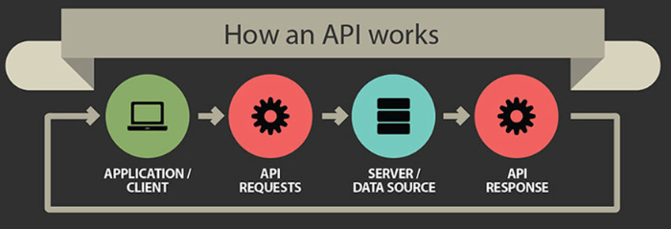
What is an API
An API is the messenger that delivers your request to the provider that you're requesting it from and then delivers the response back to you.
Examples of API:
Weather API
Movies API

Slide 5
Importance of API in Data Science
API plays a major role in analytics because, the first task in analytics is to identify the problem statement.
The second thing is to identify the data set with good quality, API makes this one simpler
Examples:
Twitter api:
We can access tweets made by any user, tweets containing a particular term or even a combination of tweets done in a particular date range
Google api:
We can retrieve the information like coordinates,distance between locations, routes.

Slide 6
Participant’s View

