Slide 1
Menu 429 Iteration 1
Danny Tran
Ryan Sheng
Katie Pham
Phu Nguyen

Slide 2
Iteration 1 Plan
Register GitHub accounts
Install xampp
Design UI
Create MySQL database with appropriate fields
Become acquainted with PHP
Become acquainted with SimpleTest

Slide 3
GitHub
Repository
Command-line based

Slide 4
xampp
Bundle of Apache, MySQL, PHP, PHPMyAdmin
Necessary for web development
localhost

Slide 5
UI Design

Slide 6
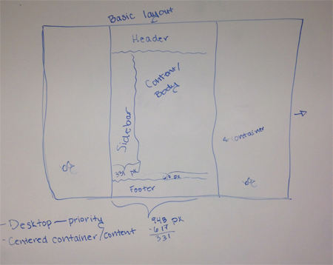
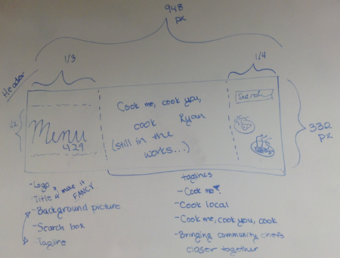
<- The overall layout for all
pages
The header for all pages ->

Slide 7
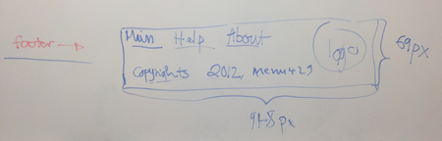
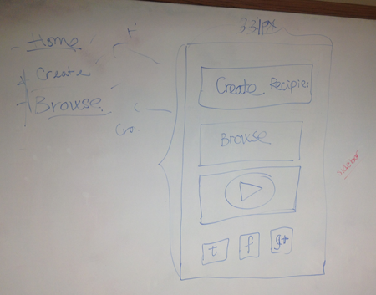
<- Footer for all
pages
Sidebar/navigation for
all pages ->

Slide 8
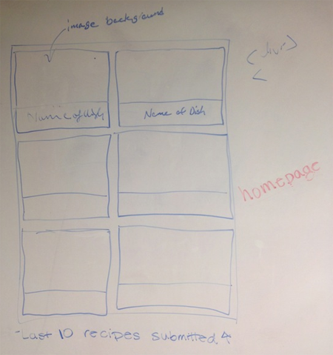
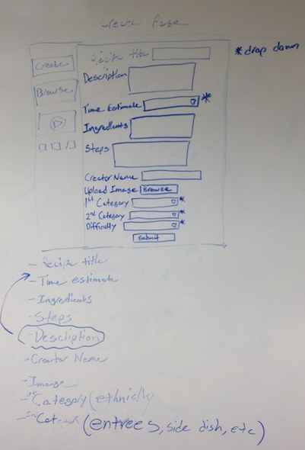
<- List of recipes on the homepage
The page to create recipes ->

Slide 9
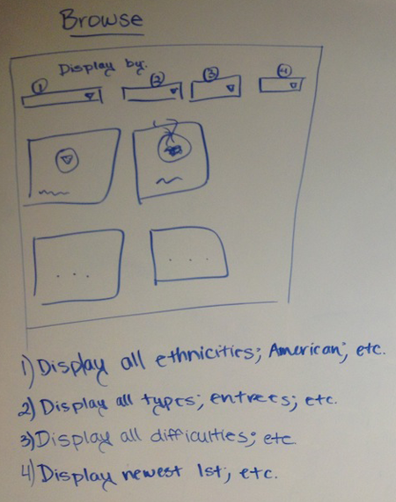
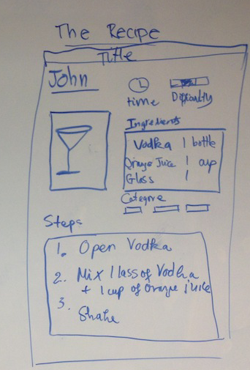
<- The browse recipes page
How each recipe page will look ->

Slide 10
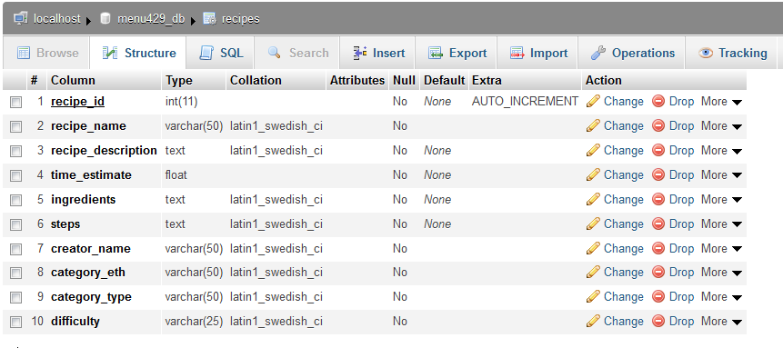
MySQL/databases
Uses PHPMyAdmin
11 columns/entries (Image column to be added later)

Slide 11
SimpleTest
Attempted to get familiar with it
Looking for a PHP framework
Set up SimpleTest on all machines

Slide 12
Questions?

