Slide 1

STUDY OF SHOPHOMORE STUDENT RETENTION RATE OF A MIDWEST COLLEGE
RISHI RAJ POUDYAL|A20032927
Oklahoma State University , Stillwater.

Slide 2
overview
Getting oriented
The Midwest college would like to examine retention rate to see if there is program that could be implemented to support students and help them continue their education
Data provided to analysis contains following variables
GPA (student with a low freshman GPA
College ( the specific college in which the students enroll might affect the decision to return)
Accommodations ( whether students live in dorm or on-campus)
Part-Time Works Hours (Number of hours worked per week)
Attends Office Hours (Describes how often students attend office hours)
High School GPA ( Highest GPA obtained in High School)
Miles from Home ( Measures how many miles a way the Home of students from college)
Return-target variable ( return or otherwise, 1= if student returns for sophomore year,0= otherwise)
Identifying problems
what is the pattern of the data set using Exploratory and Descriptive analysis
Which factors are important to predict the retention of students?
What are the decision rules?
Performing Analysis
Build it
Insights/Action planning
Goal : To see if there is a program/s that could be implemented to support students and help them continue their education.

Slide 3
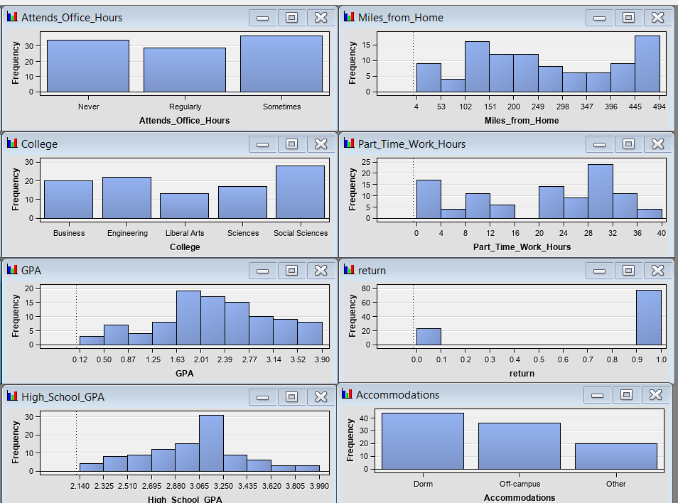
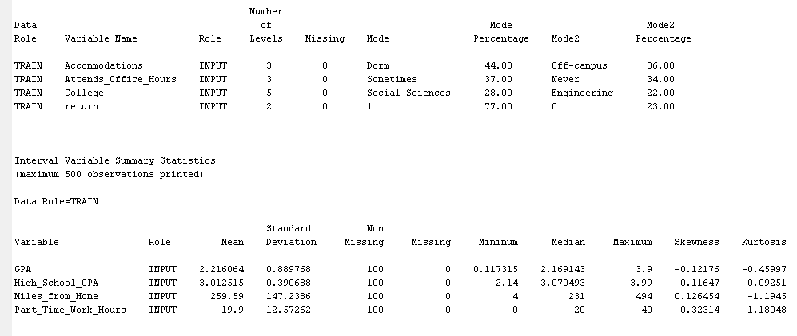
Study of pattern of the data set:
The descriptive statistics of the numerical and categorical variables are shown in the along side figure.
As we see the distribution of interval variables, there is some skewness in the variables Miles_from_Home and Part_Time_Work_Hours, however, this is not so much. So, they need not have to be transformed.
There is no issue of high difference in different levels in a class variable, so there is no need of consolidation of levels
There is no missing values.
There is no issue of outliers

Slide 4
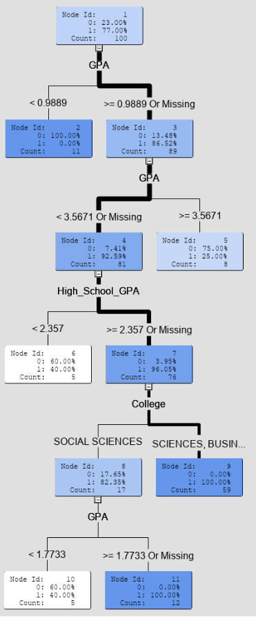
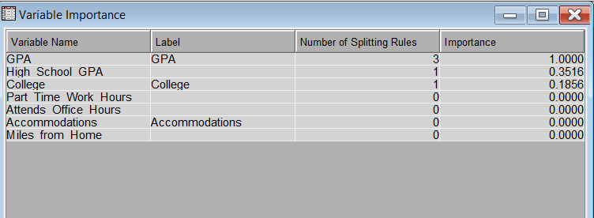
Decision tree and Important variables
The adjacent diagrams show decision tree and important variables.
From decision tree we can see, there are six leaf nodes.
From variable importance table, we can see only three variable are important for splitting the tree. These variables are GPA, High School GPA and College.
35% variability of the variability explained by GPA to retention rate is explained by High School GPA
18.5% variability of the variability explained by GPA to retention rate is explained by College

Slide 5
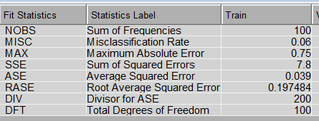
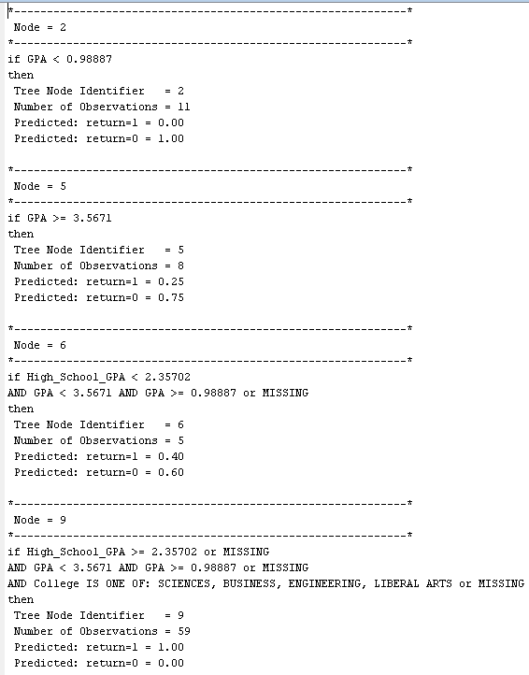
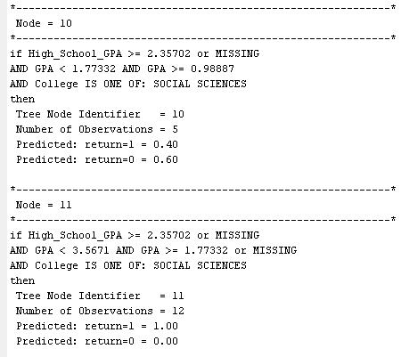
Model Assessment and Decision Rule
The table of Fit Statistics and decision rules are shown in the adjoining figure.
From Fit statistics, it is seen that Misclassification rate is 6% which is very low. Similarly, Average Square Error is about 4% which is also low indicating that the model is very good.
From decision rule, what we see in node 9 that if High_School_GPA is >= 2.35702 or missing and GPA is < 3.5671 and >= 0.98887 or missing and college is one of Sciences, Business, Engineering, Liberal arts or missing then 100% students return. In this group no. of obs is 59 out of 100 which is significantly large.

Slide 6
Conclusion and recommendation:
The model built in training data set is found to be good as the misclassification and average square error are very small.
Variables GPA that is GPA that a student obtained in his/her sophomore, High School GPA and college are important variables to determine whether a student will return or not after sophomore.
A Student having GPA less than 0.98887 in her/ his sophomore has 100% chance that he or she will not return
A student having GPA greater or equal to 3.5671 have only 25% chance that they will return which might not be a good criteria to decide if a student return after sophomore.
A student having high school GPA greater or equal to 2.35702 or missing and sophomore GPA greater or equal to 0.9887 and less than 3.5671 or missing, and studying in one of the colleges Science, Business, Engineering or Liberal Arts then there is 100% chance that he or she will return after the sophomore. These students cover about 59% of total students. Thus, I would like to recommend to keep focus on these student because these criteria might be useful in future to determine who are more likely to return after sophomore and what need to be done to minimize the retention rate of students.
A student who is studying social science having high school GPA greater or equal to 2.35702 or missing and sophomore GPA greater or equal to 1.77332 and less than 3.5671 or missing then there will be 100% chance that he or she will return after sophomore. However, these student cover only 12% of total observations. So, focusing on these criteria may not be useful.

