Slide 2

IN silico Design of Universal Vaccines for RNA viruses
Author: Menno Van Damme
Promotor: prof. dr. ir. Wim Van Criekinge Tutor: Christian Rausch

Slide 3

RNA Viruses
Notes:
As we’ve all learned the past 2 years, RNA viruses can have a big impact on our lives and health. This is why the search for good vaccines against them is so important.

Slide 4
RNA viruses
Influenza A & B, SARS-CoV-2, HIV
High mutation rates
Immune system evasion
RNA-dependant RNA polymerase
Universal vaccine
Resistance against all variants
Highly conserved
Notes:
In my thesis I will investigate 4 viruses: …, but for now I have only looked at the two Influenza viruses.
All of these viruses have very high mutation rates, which is why they’re so successful at evading our immune system and our vaccines. Their high mutation rates are mostly caused by the fact that they use an RNA-dependant RNA polymerase to replicate and this enzyme usually doesn’t have any proofreading activity so mutations can accumulate quickly. An exception to this are the Coronaviruses which do have a small proofreading capability.
Because of this high mutation rate researchers everywhere are looking for a universal vaccine that would achieve resistance against all variants of a virus, also against future ones. To do this we need to find a vaccine that targets a highly conserved part of the virus. This is what I’m trying to do in my thesis by looking at a large amount of genomes of these viruses.

Slide 5
Pipeline
Data Collection
& Filtering
Multiple Sequence
Alignment
Phylogenetic
Tree
Variability
Scoring
RNA Secondary
Structure Prediction
Structure - Variability
Correlation

Slide 6
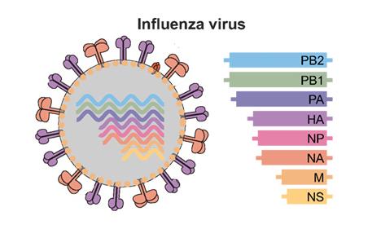
Pipeline
NCBI
No duplicates
No ambiguous characters
Minimum length (>95%)
Amount of sequences
Influenza A: 160 000
Influenza B: 40 000
MAFFT: large alignments
Removal of rare insertions (<10%)
Consensus sequence
Data Collection
& Filtering
Multiple Sequence
Alignment
Notes:
Amount of sequences: 160k for A, 40k for B, but Influenza has 8 separate genome segments and these numbers are divided over these 8

Slide 7
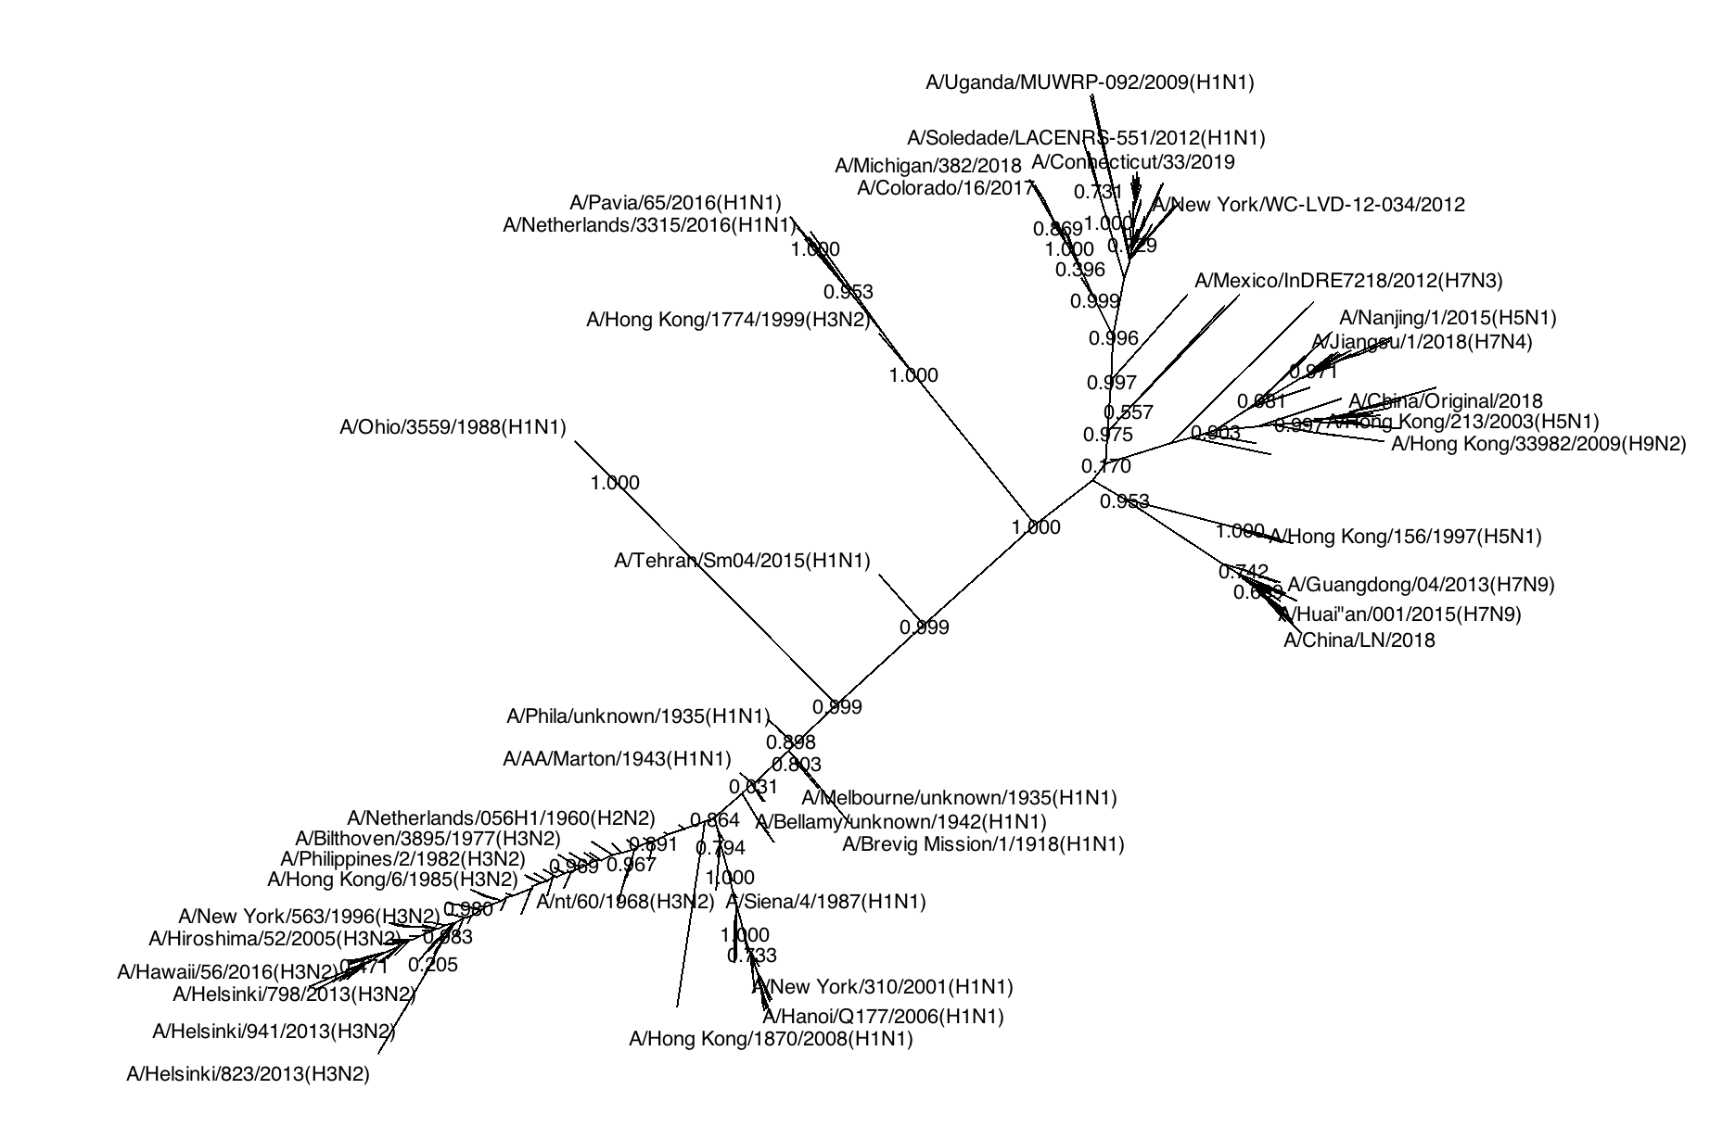
Phylogenetic tree
Clustering (300-750 sequences)
Fasttree: large trees
Phylogenetic tree of
Influenza A Segment 3,
visualized with Dendroscope
Notes:
I clustered the sequence according to their similarity and was left with between 300 and 750 sequences for each tree. Tree building was done using Fasttree which also is especially adapted to deal with large datasets.
In the trees you can clearly see that older sequences are at the centre and when you follow the branches the sequences become more recent.

Slide 8
Phylogenetic tree
Clustering (300-750 sequences)
Fasttree: large trees
Phylogenetic tree of
Influenza A Segment 3,
visualized with Dendroscope
Notes:
We can also see that the subtypes of the viruses tend to cluster together in groups.

Slide 9
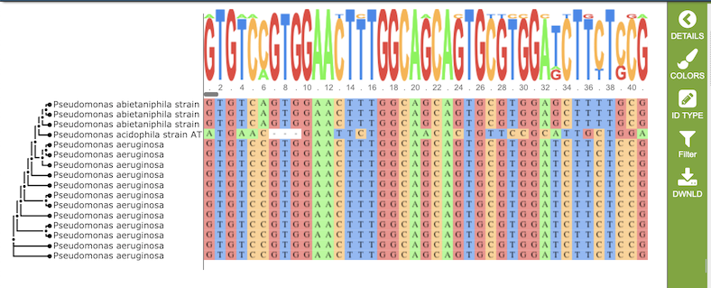
Variability scoring
Estimate how often each position mutates
3 measures
Shannon entropy
Nucleotide frequencies
Notes:
Shannon entropy:
Based on how often each nucleotide occurs at each position
If entropy is high, the variability is high at that position

Slide 10
Variability scoring
Mutation count
Amount of individual mutations
Time dependant
Variability
Corrected mutation count
Divided by #sequences per year
TATCGGCTATGCT
TATCGGATATGCT
TATAGGCTATGCT
TATAGGTTATGCT
TATCGGCTATGCT
time
2
4
TATCGGC TATCGGC
TATCGGT TATAGGC
TATCGGC TATCGGC
TATCGGC
TATCGGC
2000 2010
time
Notes:
2 other measures, both dependent on the time the sequence was collected
Mutation count: sequences ordered based on collection date, each sequence compared to the one that came before, differences counted per position
Variability: amount of sequencing has gone up a lot in recent years => easier to detect mutations => correct for this by dividing by amount of sequences/year

Slide 11
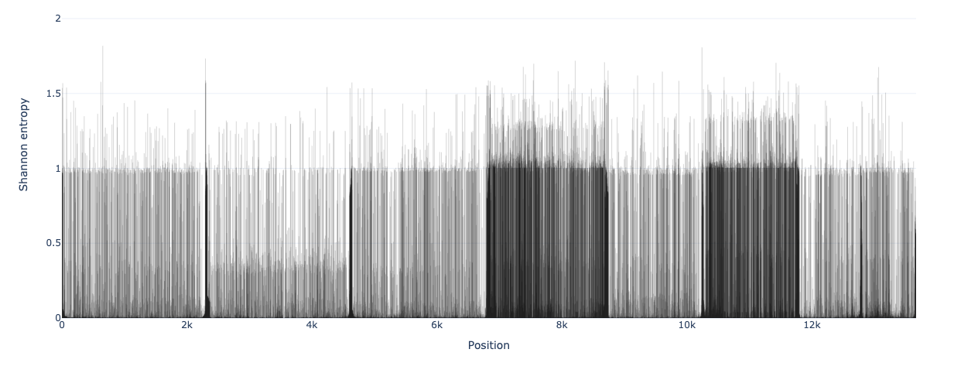
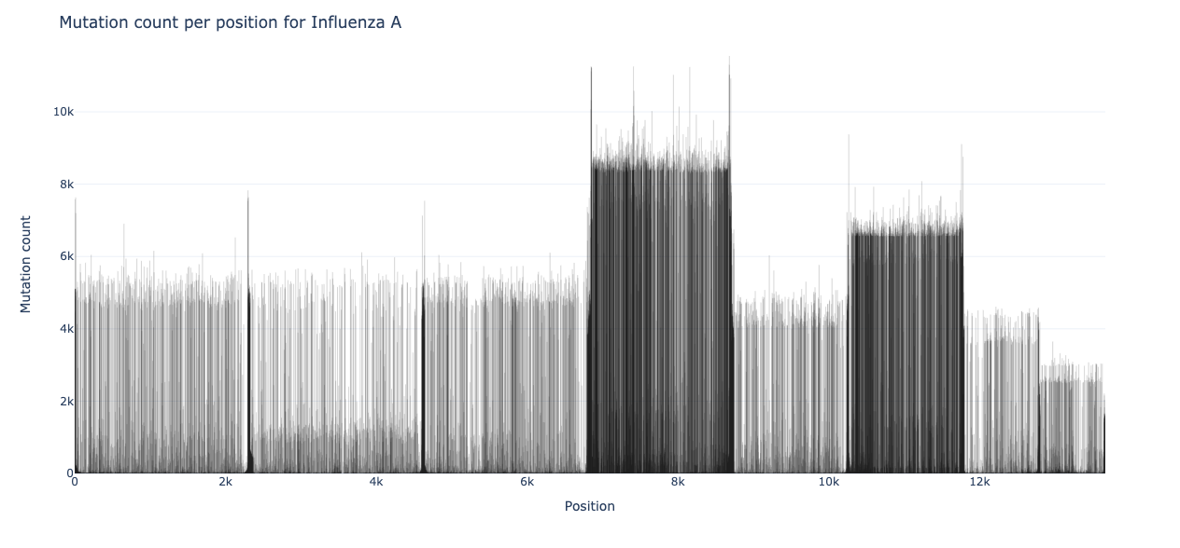
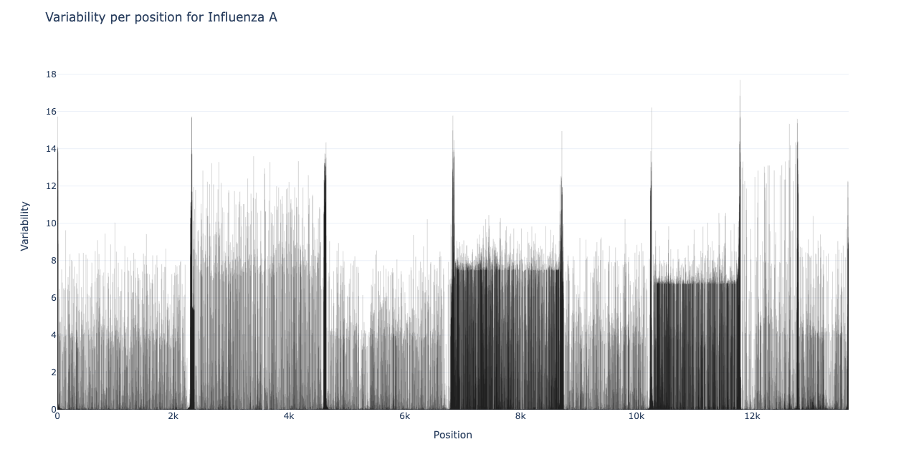
Variability scoring
Shannon entropy
Mutation count
Variability
Notes:
Here you can see graphs of the 3 variability measures plotted for each position in the Influenza A genome
As you can see they look relatively similar to each other
The 2 darker regions in each of the plots are the 4th and 6th segment of the genome which code for the H and N protein on the surface of the virion, these are very variable and determine the subtype of virus

Slide 12
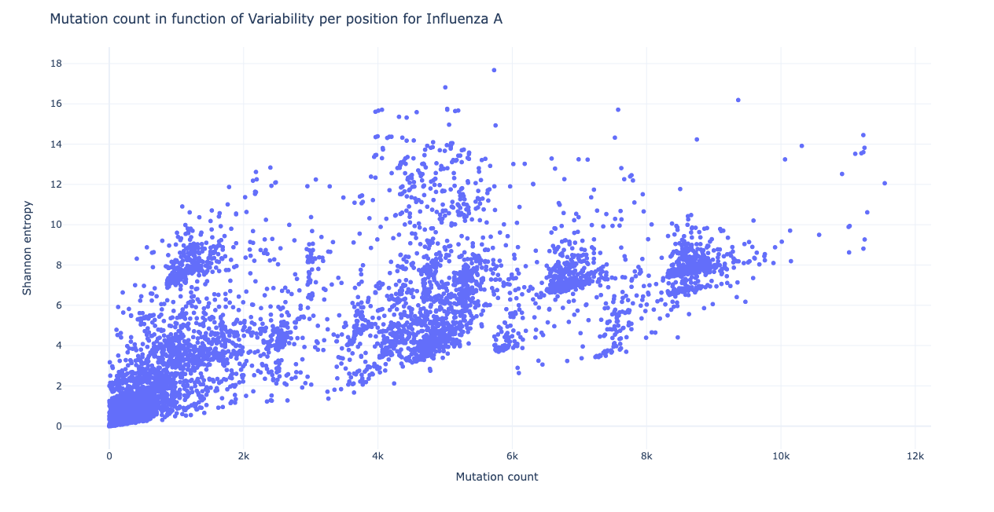
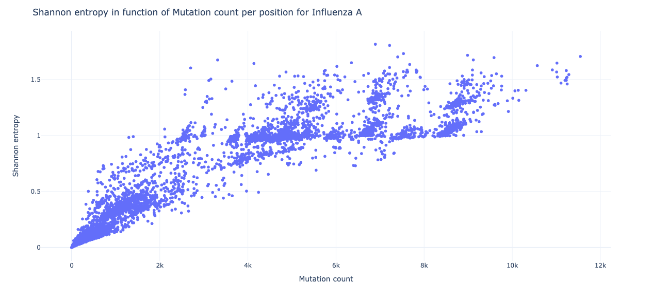
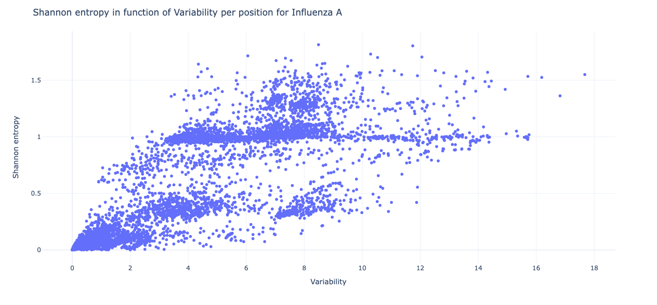
Variability scoring
Mutation count - Variability
Shannon entropy - Mutation count
Shannon entropy - Variability
Notes:
Correlation between the 3 measures
Quite well correlated

Slide 13
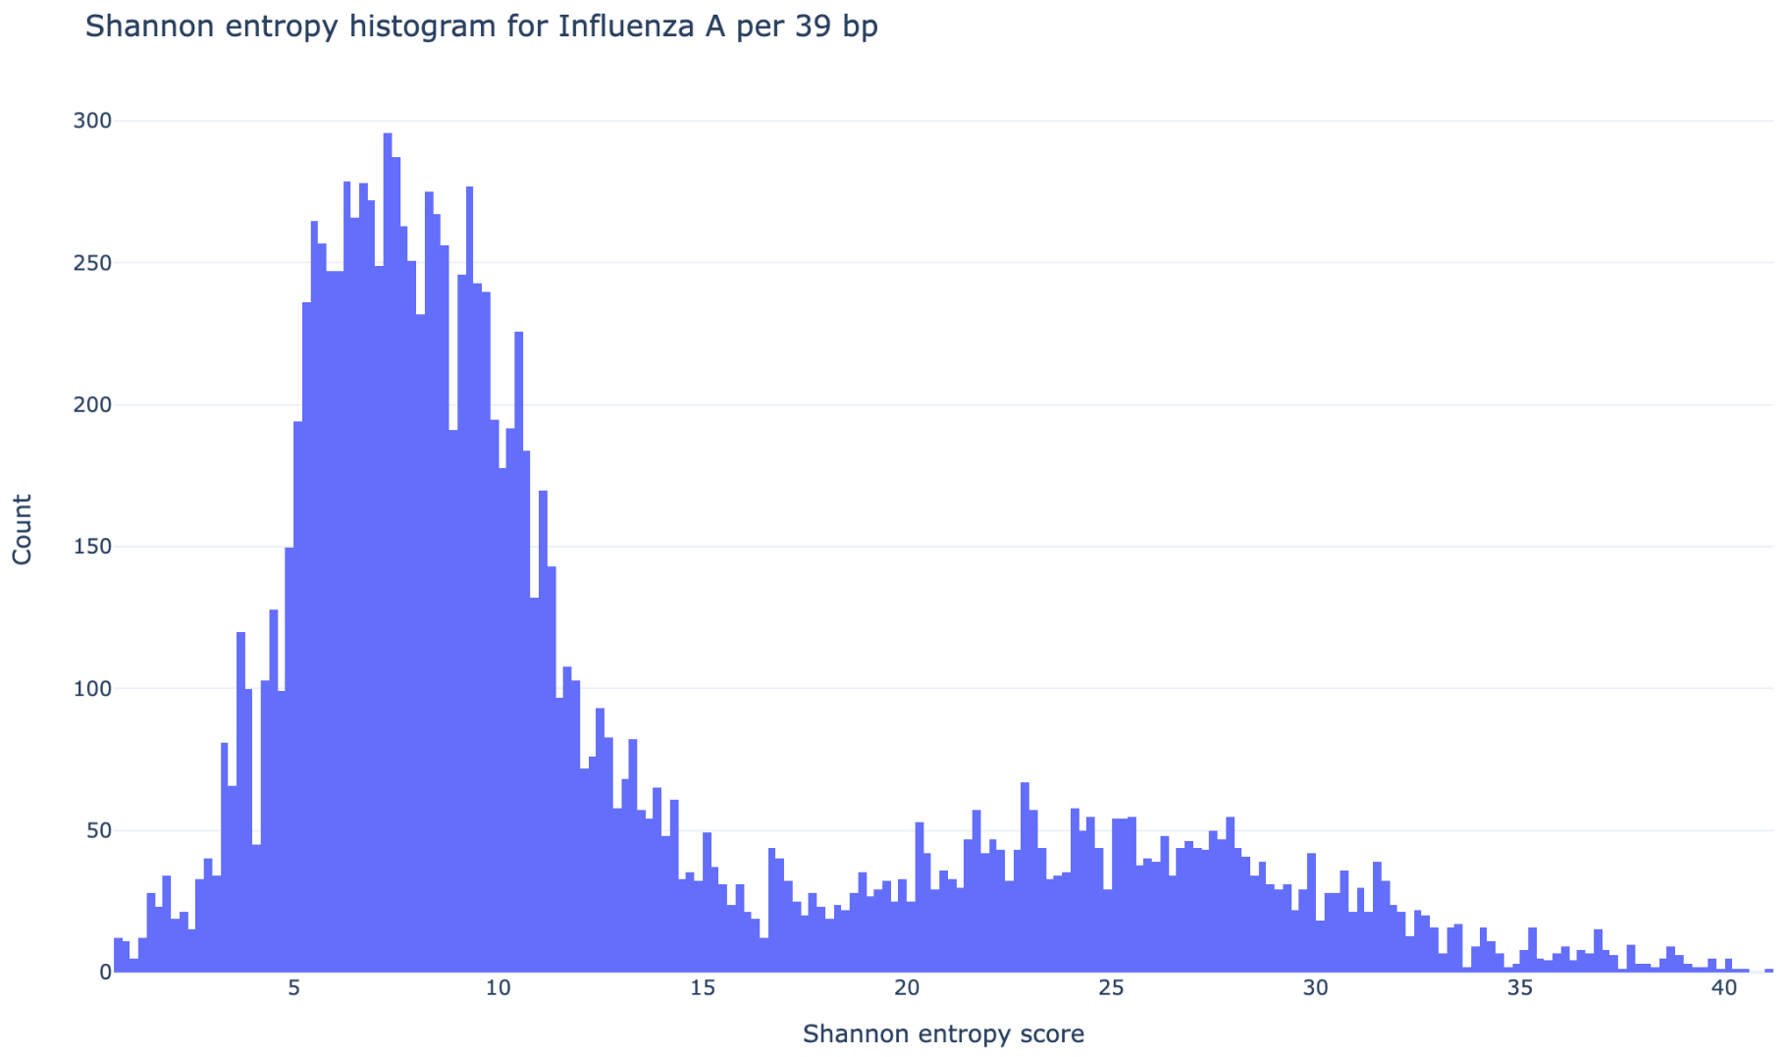
Variability scoring
Vaccine candidate regions
Coding & conserved
39 bp ~ 13 aa
Top 10 for each variability measure
Notes:
After scoring the variability for each position we can look for vaccine candidate regions
These need to be in protein coding regions and have to have low variability
I took a sequence length of 39 bp which is about 13 amino acids (depending on ORF)
For each of the 3 variability measures I took the 10 lowest scoring sequences of 39 bp

Slide 14
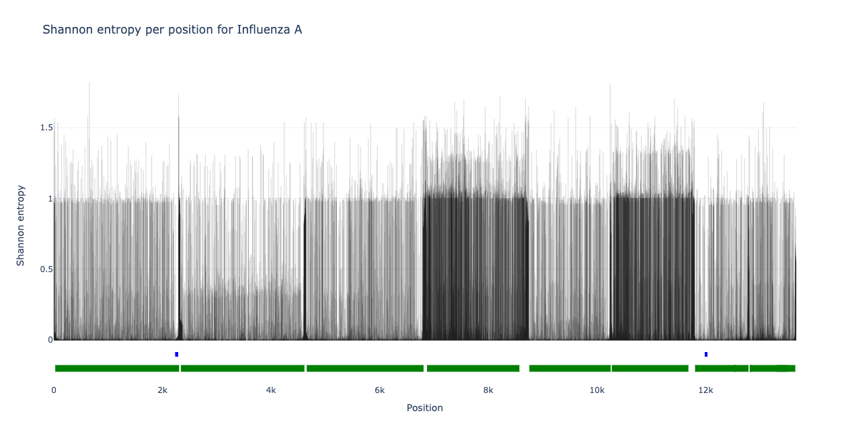
Variability scoring
Vaccine candidate regions
Notes:
Here you can see the Shannon entropy per position for Influenza A again
The protein coding regions are indicated by the green bars
And the 30 vaccine candidate regions are indicated by the blue bars in the red circles
You can clearly see that they cluster in 2 places which in on the 1st and 7th segment of the genome

Slide 15
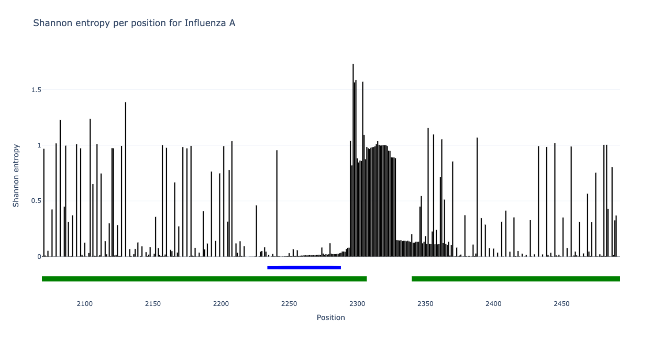
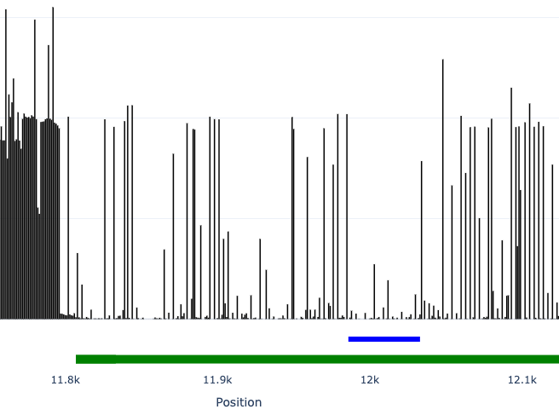
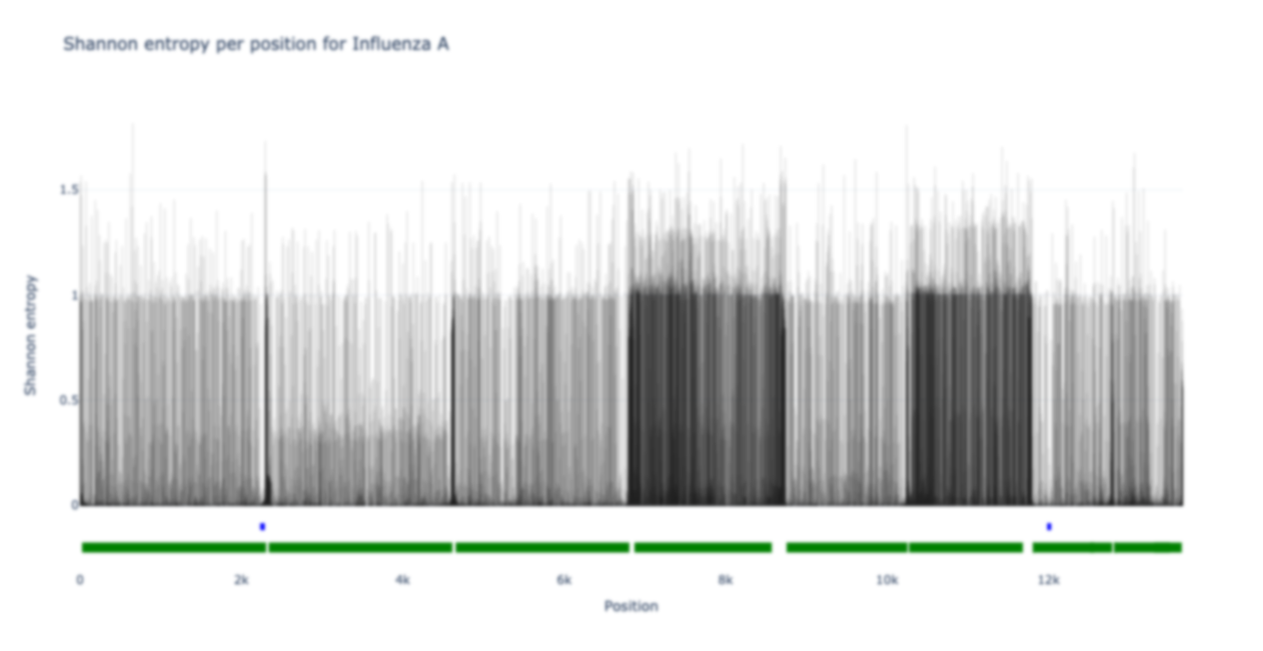
Variability scoring
Vaccine candidate regions
Notes:
If we zoom in it also becomes clear that the blue bars lie in regions that are stretches of low Shannon entropy, this also holds for the other 2 variability measures

Slide 16
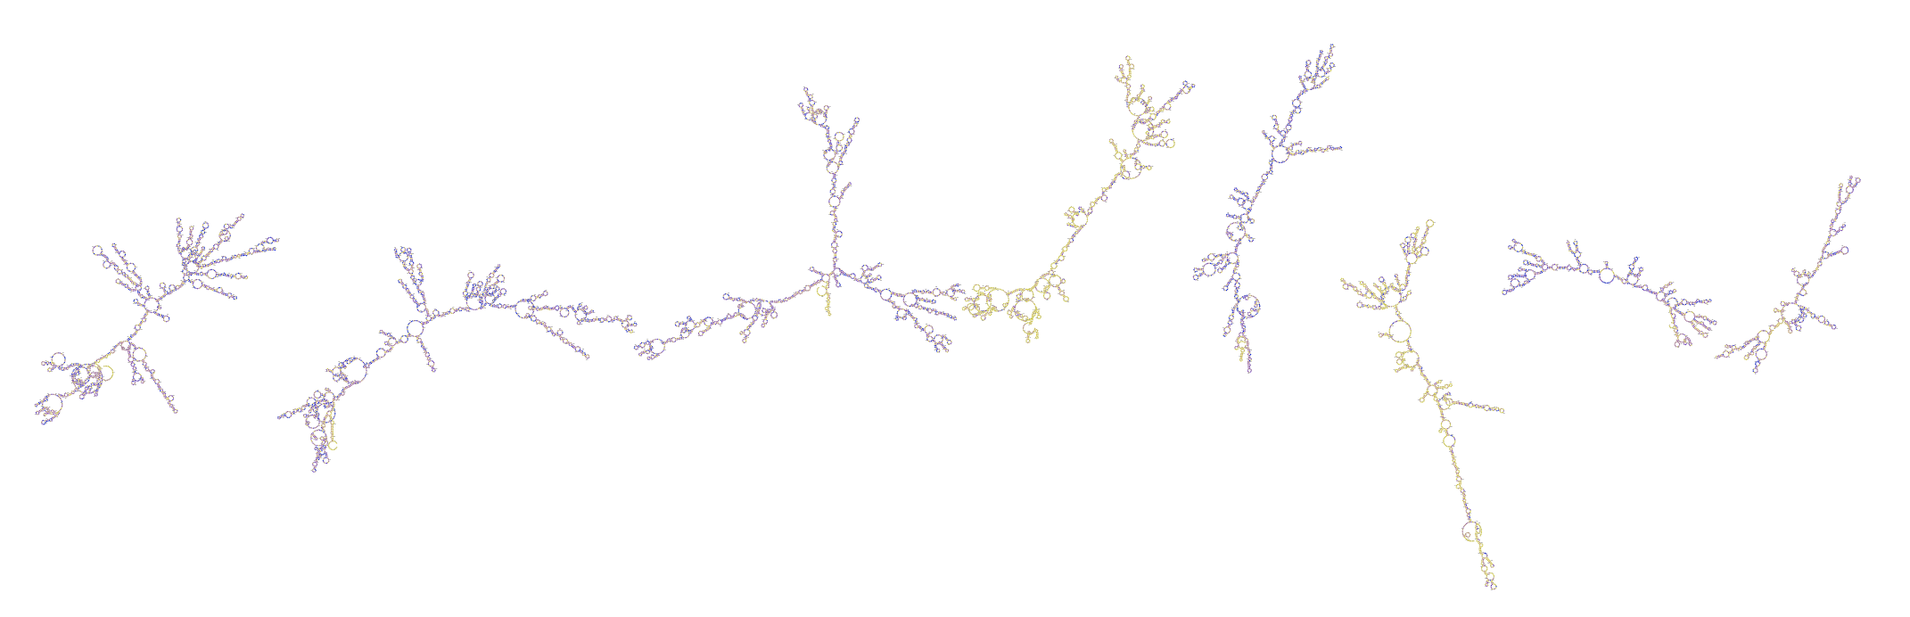
Secondary structure prediction
Important feature of ssRNA viruses
Stability
Very conserved
Notes:
I also did a secondary structure prediction of the consensus genome, here you can see the 8 separate segments of the Influenza A genome
The yellow parts are the ones with high variability while the blue ones have lower variability.
SS is a very important feature of ssRNA viruses because it determines the stability of the RNA and sometimes has other functions as well, that’s also why the secondary structure is often very conserved

Slide 17
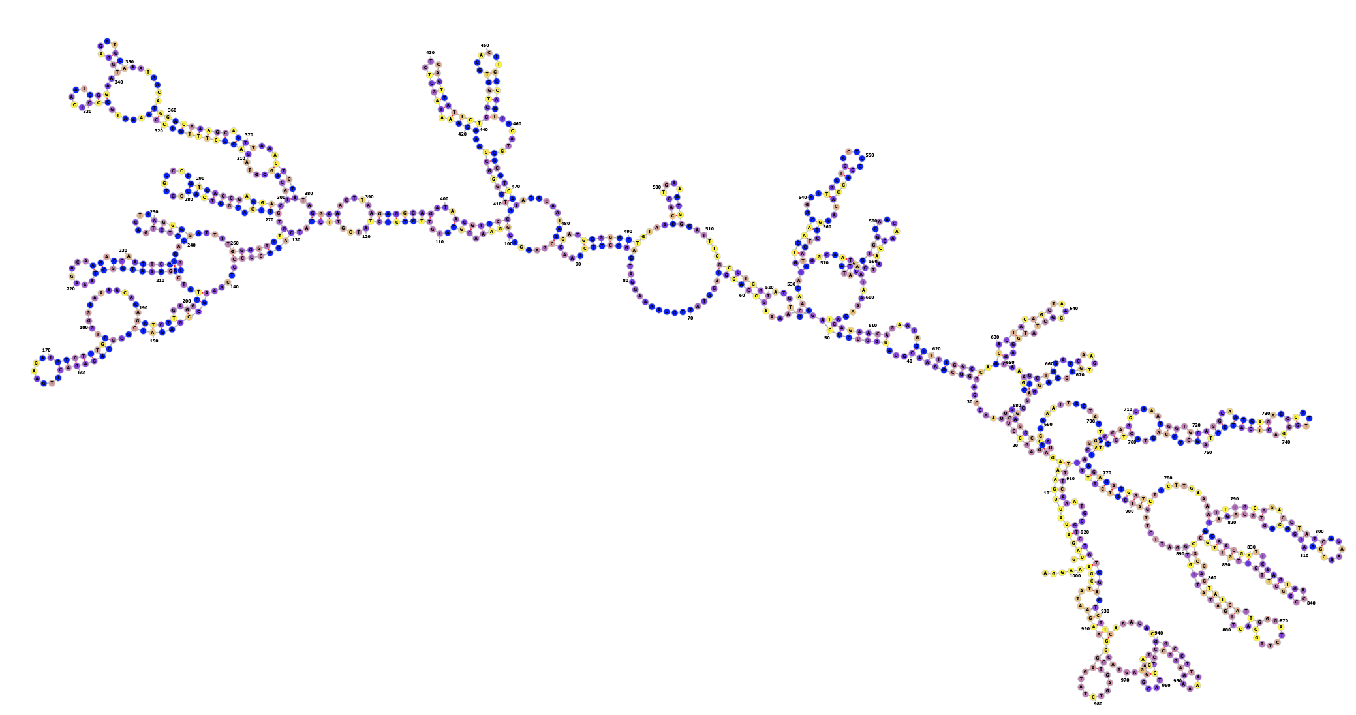
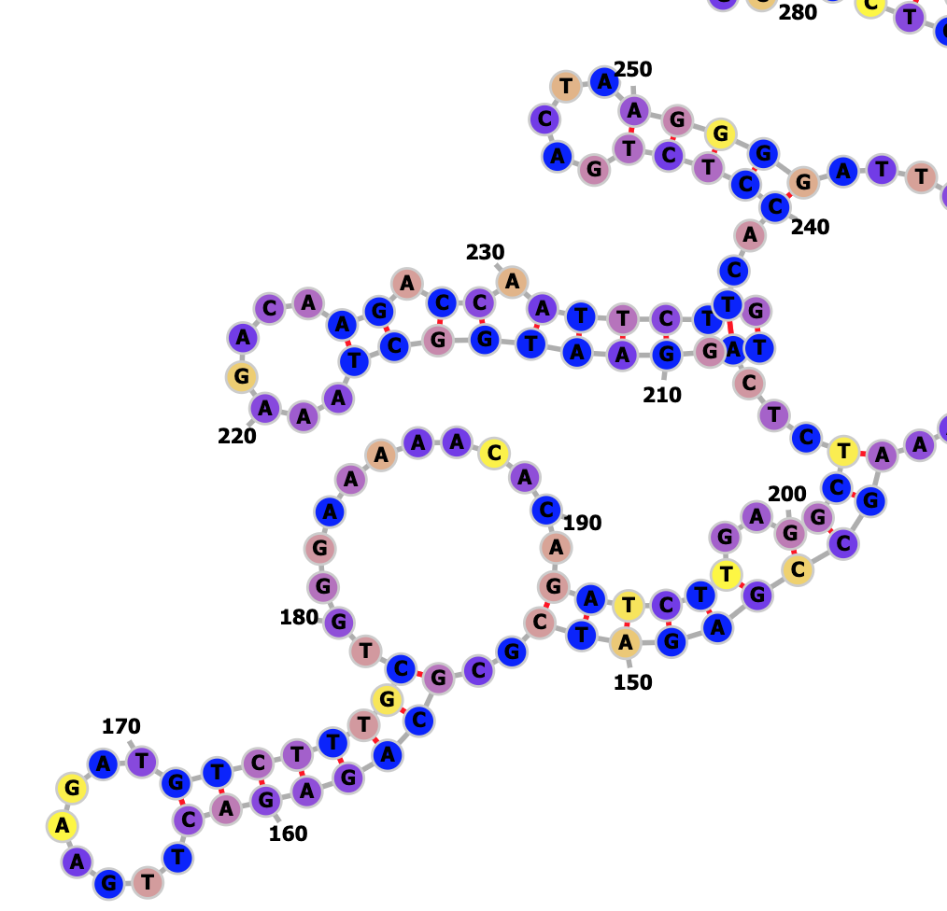
Secondary structure prediction
Notes:
Here you can see the structure of the 7th segment and a close-up of one of the vaccine candidate regions, as you can see it’s colored more blue and so more conserved than the rest of the sequence

Slide 18
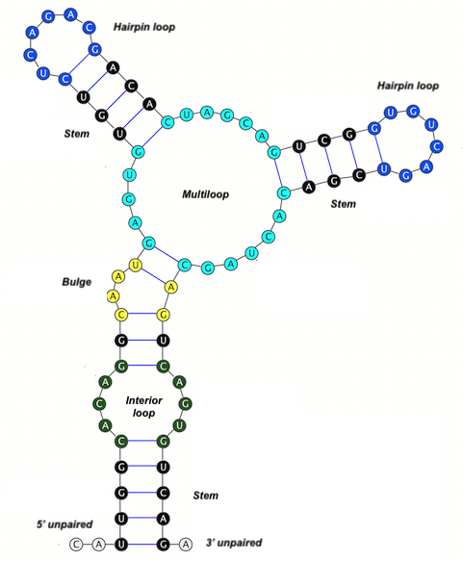
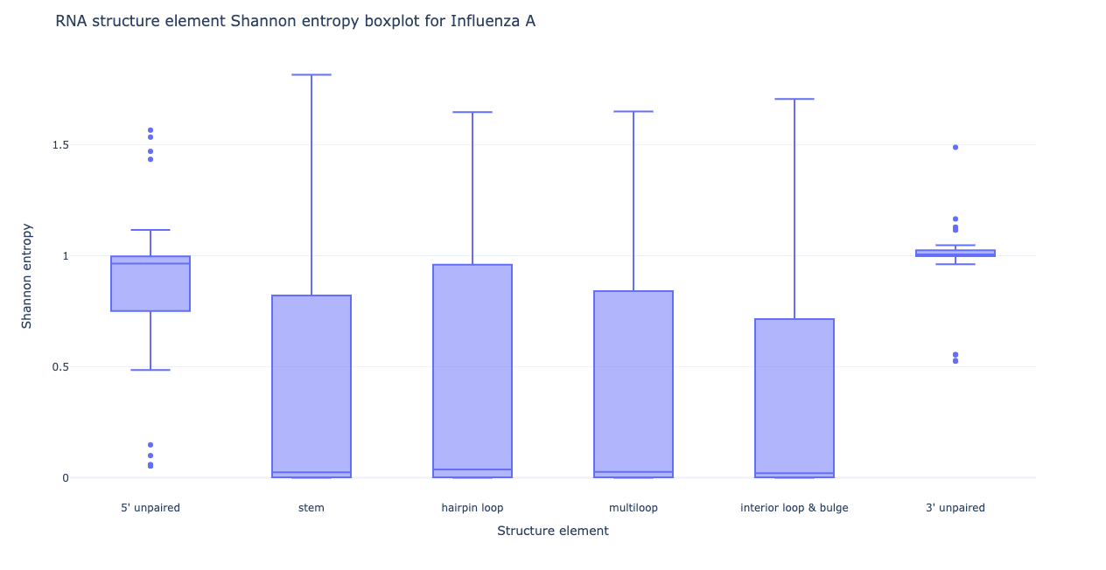
Structure ↔ Variability
Link between RNA structure & variability?
Notes:
Since the genome of RNA viruses is so highly structured I also wanted to see whether we can use the structure to predict the variability of that part of the genome. As you can see in the picture on the left RNA can form several types of substructures and on the right you can see how the Shannon entropy is distributed for the different substructures for Influenza A. You can clearly see that the 5’ and 3’ unpaired ends of the RNA tend to have a higher median Shannon entropy while the internal structures of the RNA are more conserved. The same is true for the for the mutation count and variability.

Slide 19
What’s next
Why conserved?
Other ways to predict variability?
Correlated mutations
SARS-CoV-2 & HIV
Notes:
In the upcoming months I’m also going to try and figure out why these specific regions are conserved, for example if they code for some specific function.
I’m also going to try and find other ways to predict the variability, for example by looking at correlated mutations.
And I’m also going to do the same type of analysis for the other viruses.

Slide 20



Menno Van Damme Master Bio-ingenieurswetenschappen Cell and Gene Biotechnology menno.vandamme@ugent.be www.ugent.be
Universiteit Gent @ugent
@ugent Ghent University

