Slide 1

COMPUTATIONAL EXPLORATION TOWARDS UNIVERSAL VACCINES FOR INFLUENZA AND CORONAVIRUSES
Author: Menno Van Damme
Promotor: prof. dr. ir. Wim Van Criekinge Tutor: dr. Christian Rausch

Slide 2
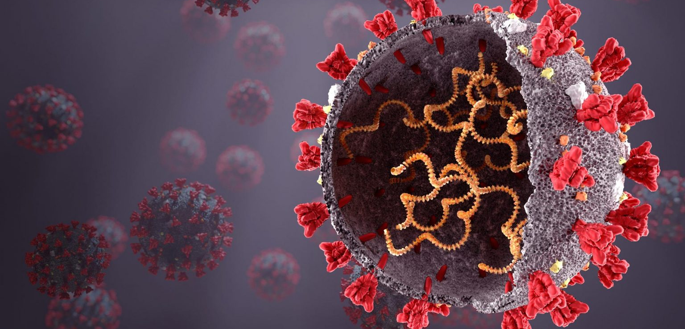
RNA Viruses
Notes:
As we’ve all learned these past few years, RNA viruses can have a big impact on our lives and health. This is why the search for effective vaccines against them is so important.

Slide 3
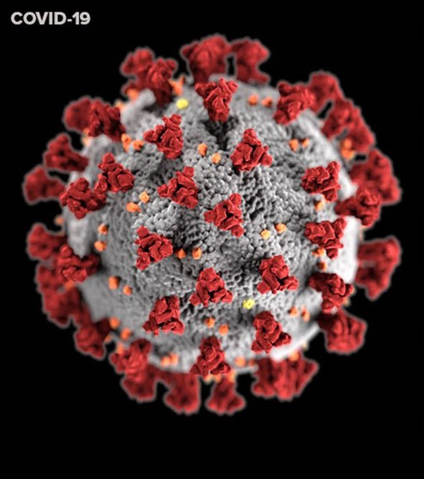
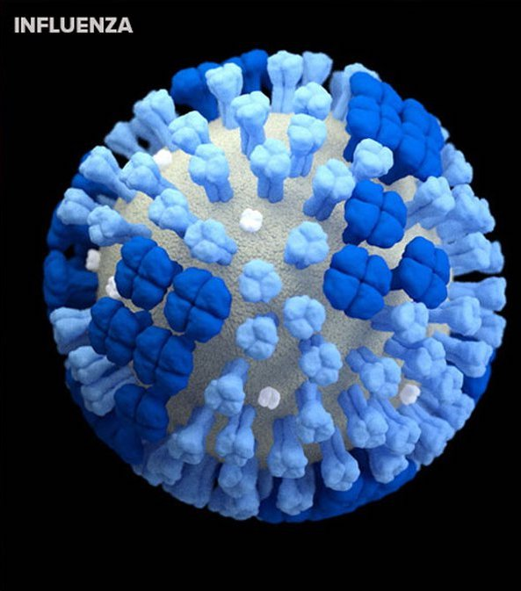
RNA viruses
Influenza A & SARS-CoV-2
High mutation rates
Immune system evasion
RNA-dependant RNA polymerase
Recombination
Universal vaccine
Resistance against all variants
Highly conserved
Notes:
In my thesis I investigated 2 RNA viruses: IAV and SARSCoV2
RNA viruses have very high mutation rates, which is why they’re so successful at evading our immune system and our vaccines. Their high mutation rates are mostly caused by the fact that they use an RNA-dependant RNA polymerase to replicate and this enzyme usually doesn’t have any proofreading activity so mutations can accumulate quickly. An exception to this are the Coronaviruses which do have a small proofreading capability. Most viruses are also capable of recombination which also increases genetic diversity.
Because of this high mutation rate researchers everywhere are looking for a universal vaccine that would achieve resistance against all variants of a virus, including future ones. To do this we need to find a vaccine that targets a highly conserved part of the virus. This is what I tried to look for during my thesis using large alignments of the virus’s genome sequences.

Slide 4
Pipeline
Sequence Retrieval
& Filtering
Multiple Sequence
Alignment
Phylogenetic
Analysis
Conservation
Analysis
RNA Secondary
Structure Analysis
Structure - Conservation
Relationship
Notes:
This is the pipeline I followed during the project. First I started with collecting and filtering of genome sequences of the viruses. These were then aligned. From the alignment a phylogenetic analysis, conservation analysis and RNA secondary structure analysis was performed. I also investigated the relationship between the RNA structure and its conservation.

Slide 5
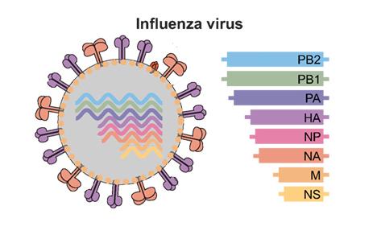
Sequences
Sequence Retrieval
& Filtering
NCBI genome sequences
✓ Human host ✓ Full-length
✗ Ambiguous ✗ Duplicates
Influenza A: 13 000 - 30 000
SARS-CoV-2: 350 000
MAFFT
SARS-CoV-2: HPC
Alignment trimming
Consensus sequence
Multiple Sequence
Alignment
Notes:
The RNA genome sequences were retrieved from NCBI. Only full length sequences from human hosts were used. Sequences containing ambiguous characters and duplicate sequences were removed.
This resulted in around 13k to 30k sequences for influenza A and 350k for SARSCoV2. The number of sequences for Influenza A varies because its genome is segmented into 8 segments, each segment has its own number of available sequences. The sequences were then aligned using MAFFT which is especially adapted for making large alignments. The alignment was then trimmed and a consensus sequence was constructed.

Slide 6
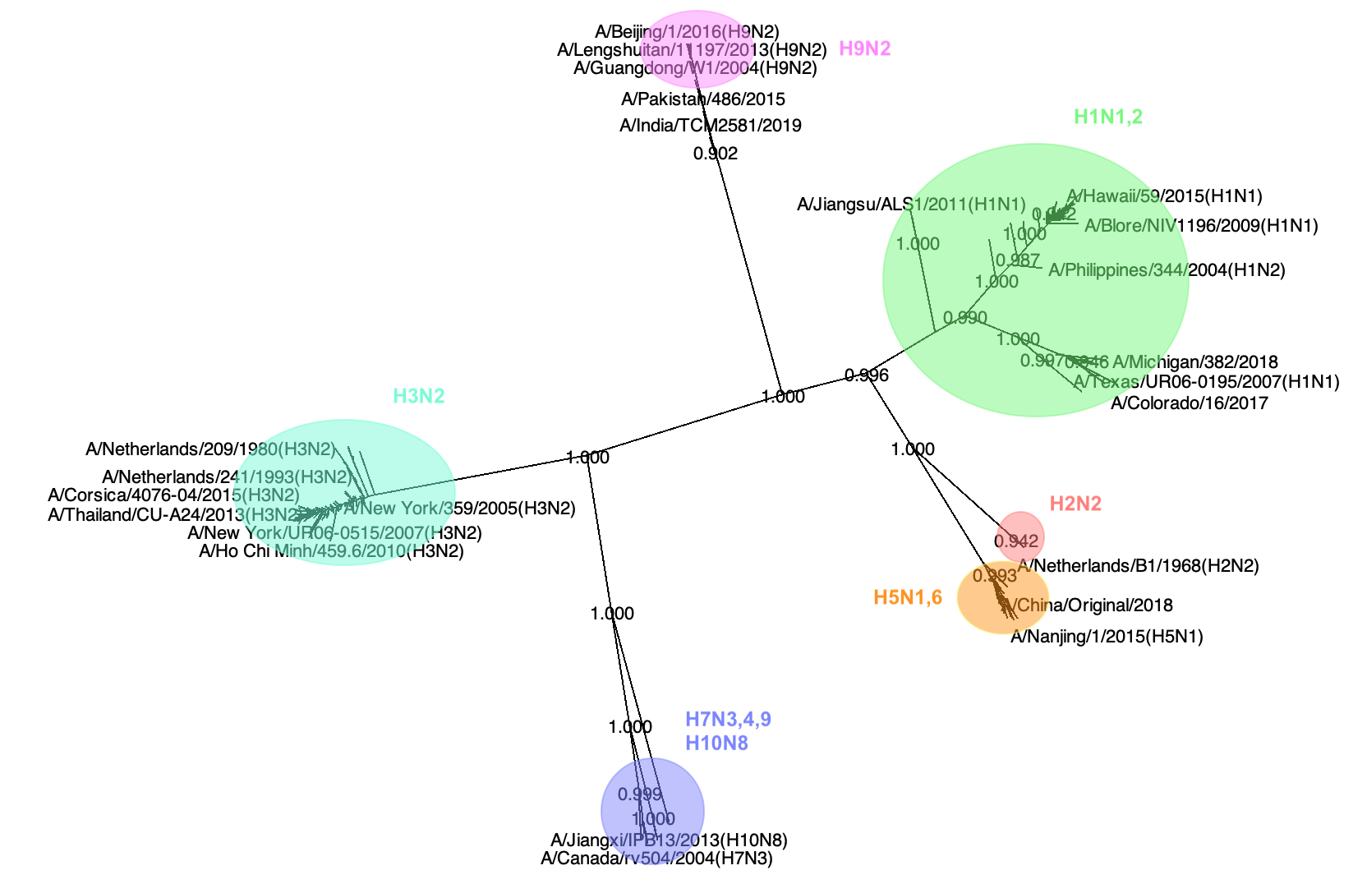
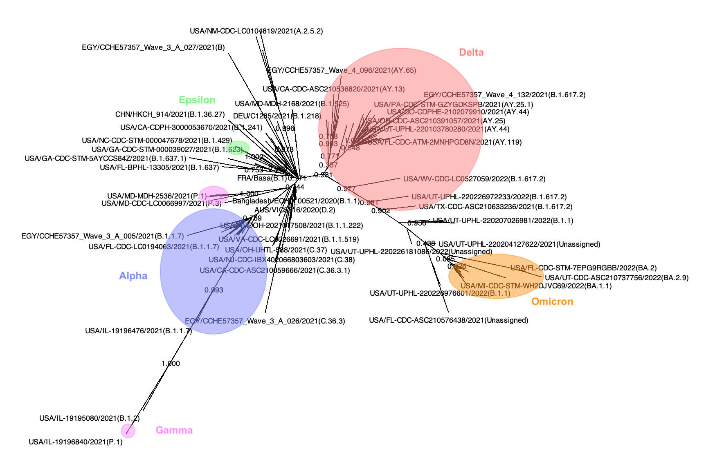
Phylogeny
CD-HIT: Clustering
FastTree
Influenza A Segment 4
SARS-CoV-2
Notes:
In order to investigate the phylogenetic relationships in the dataset, I constructed phylogenetic trees. The sequences were first clustered according to their similarity and then trees were made using FastTree which is adapted to deal with large datasets.
From the trees of both viruses it was clear that sequences clustered together according to their strain and their collection date.

Slide 7
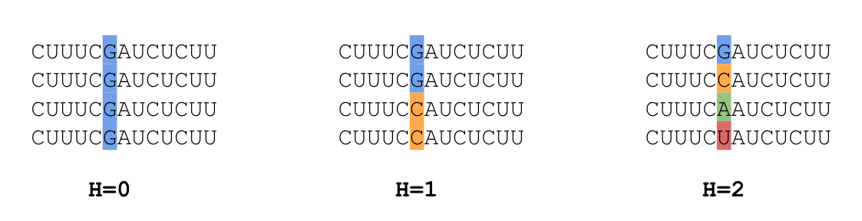
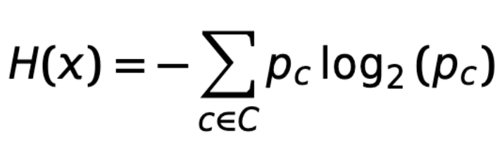
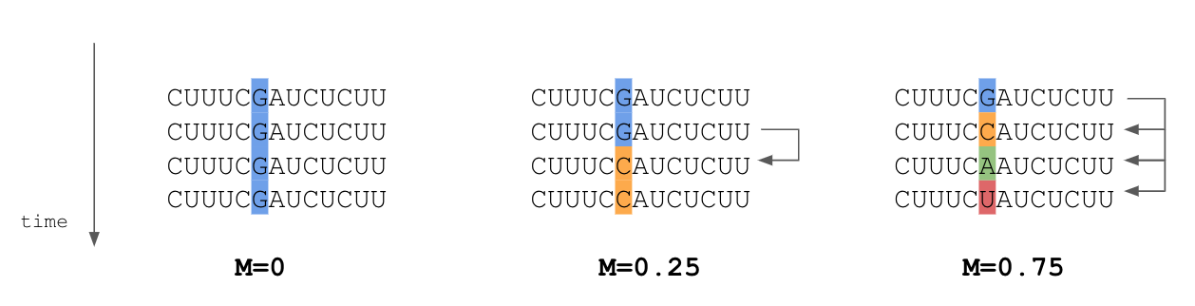
Conservation
Shannon entropy (H)
Nucleotide frequencies
Mutability (M)
Time dependant
Substitutions / Sequences
Notes:
The goal of the conservation analysis was to find conserved regions in the viruses’ genomes. In order to do this the conservation of each position in the alignment had to be scored. This was done using 2 metrics: the Shannon entropy and the Mutability.
The Shannon entropy describes the uncertainty of observing a specific nucleotide at a position in the genome. Its calculation is based on the nucleotide frequencies.
To calculate the Mutability the sequences were first ordered according to their collection date and then the amount of nucleotide substitutions were summed and divided by the amount of sequences. This resembles a type of observed mutation rate.
For both metrics a low value means that the position is more conserved.

Slide 8
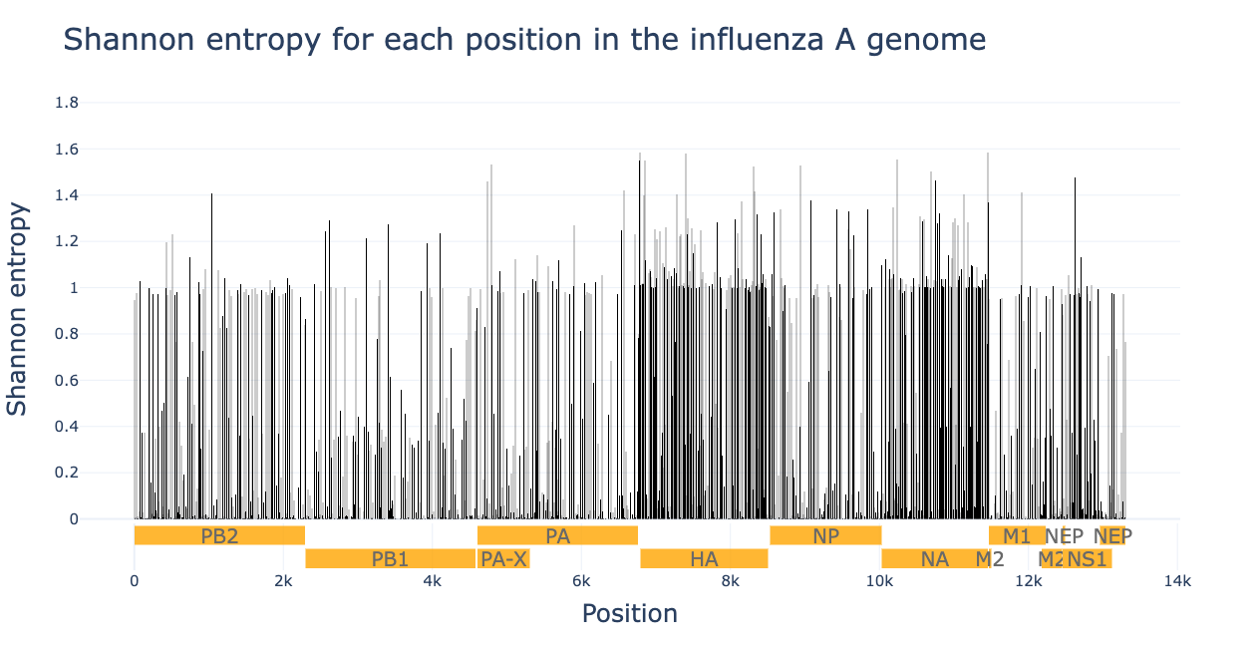
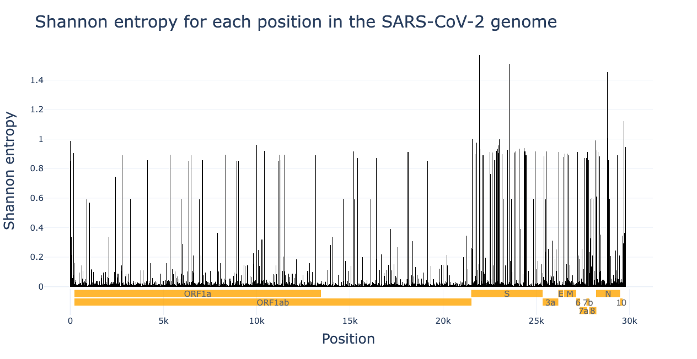
Conservation
Notes:
These figures show the Shannon entropy for each position in the genome. The entropy is displayed on the y-axis using the black vertical bars and x-axis is the genome position. The horizontal yellow bars indicate the viral protein coding regions. It is clear that in both viruses there are regions of high and low conservation.

Slide 9
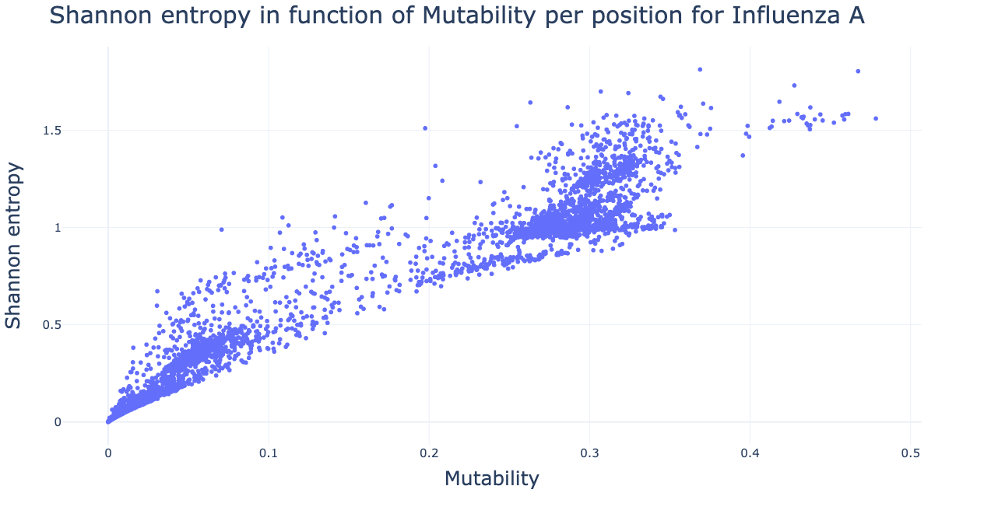
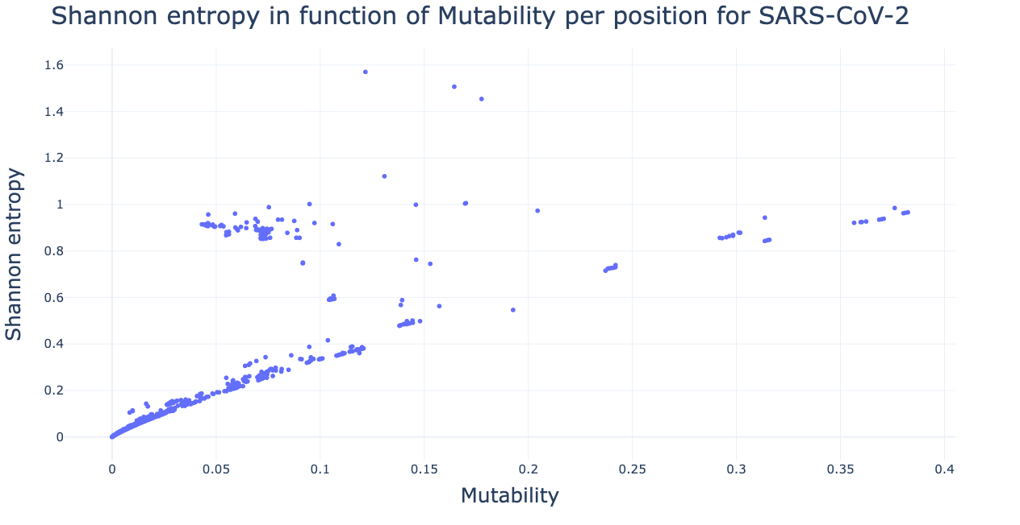
Conservation
Notes:
I also looked into the correlation of the metrics. These figures display the Shannon entropy on the y-axis and the mutability on the x-axis per position. It is clear that these are quite well correlated and this was also confirmed statistically.

Slide 10
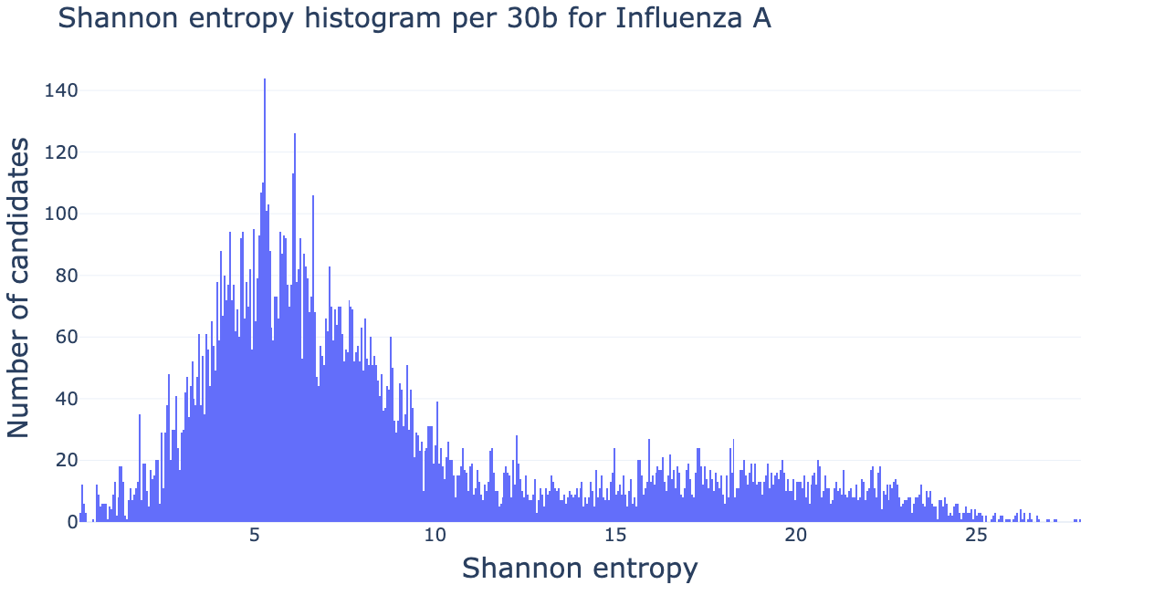
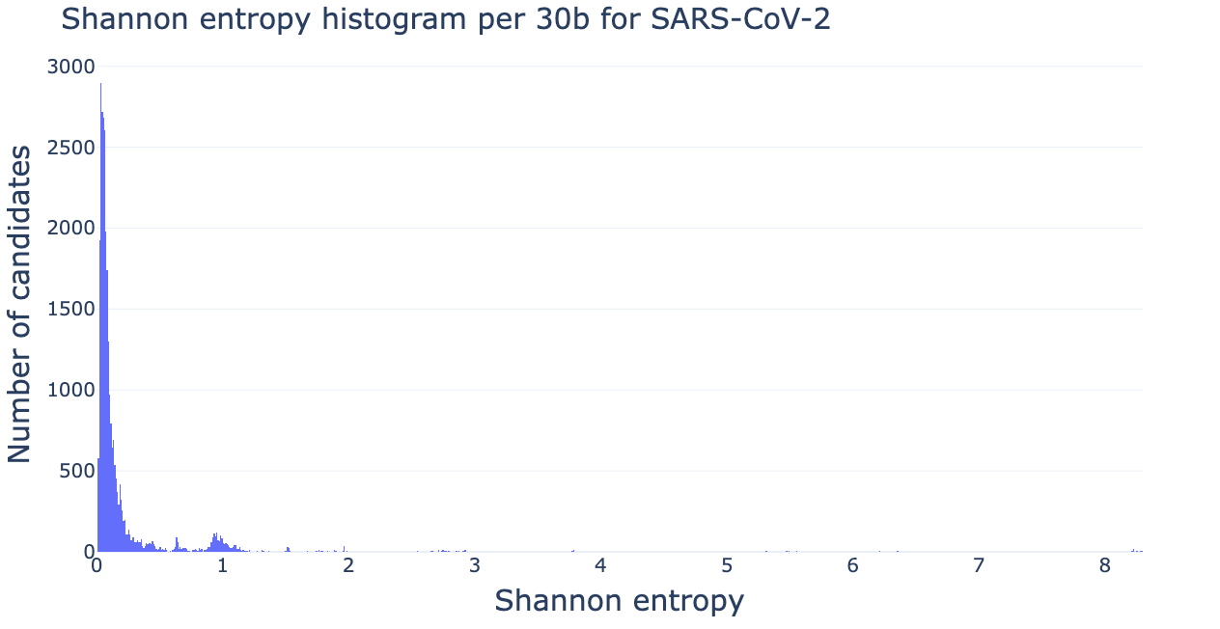
Conservation
Vaccine candidate regions
Coding & Conserved
30 b ~ 10 aa
Top 10
Notes:
After scoring the conservation for each position I looked for vaccine candidate regions.
These need to be in protein coding regions and have to have a high conservation, which means a low score on the metrics.
I took a sequence length of 30 bases which is about 10 amino acids (depending on ORF), this is the optimal size for antigen presentation and then I summed the conservation metrics over this window
For both of the conservation measures I reported the 10 lowest scoring regions.
On the bottom you can see the histograms of the entropy per 30 bases. It’s clear the IAV has higher scores then the SARSCoV2 but this is most likely because SARCoV2 has had a lot less time to evolve

Slide 11

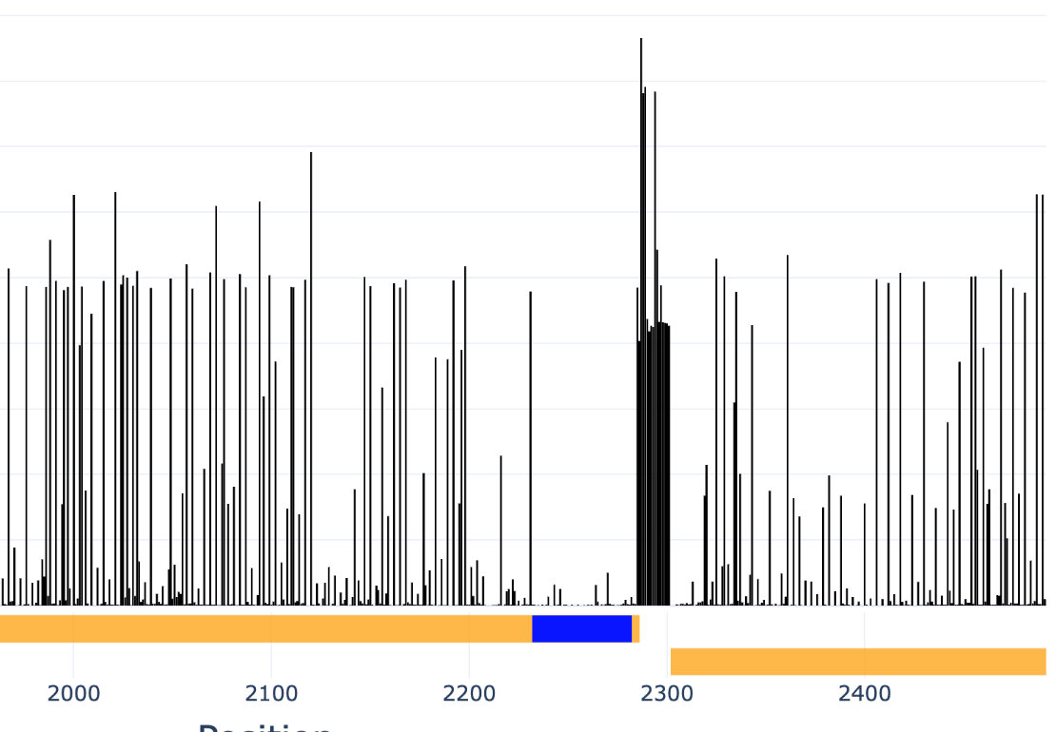
Conservation
Vaccine candidate regions: Influenza A
BP2
Notes:
For influenza A the top 10 were the same for both conservation metrics. They all clustered in the same region at the 3’ end of the first segment, which is indicated by the blue bar. This segment codes for the BP2 protein which is an essential protein during transcription. This region also contains important packaging signals.

Slide 12

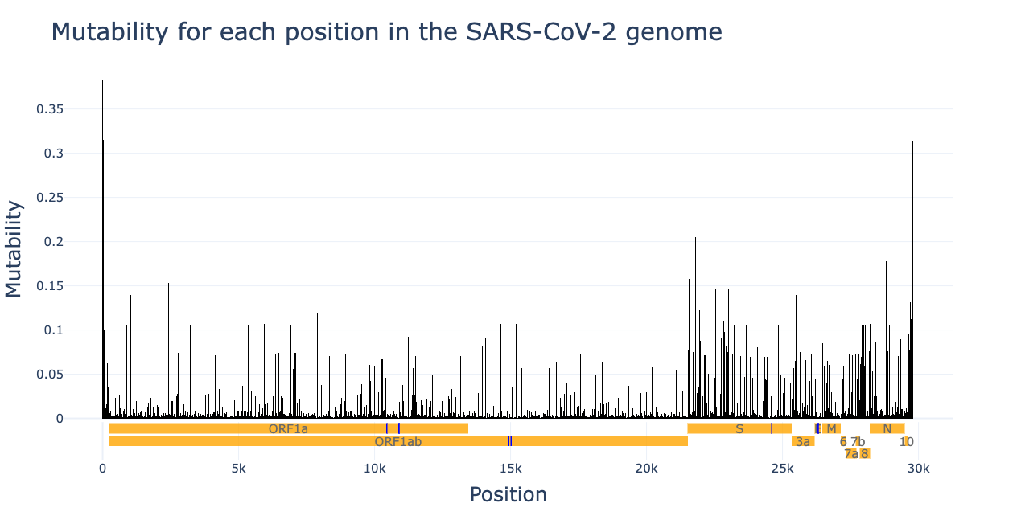
Conservation
Vaccine candidate regions: SARS-CoV-2
S, NSP12, E, NSP5
Notes:
For the SARSCoV2 the most conserved regions were more spread out and there were some differences between the entropy results and the mutability results. However, they both indicated the same 4 proteins. Namely S, NSP12, E and NSP5. Some of these regions could also be identified as essential sites in these proteins.

Slide 13
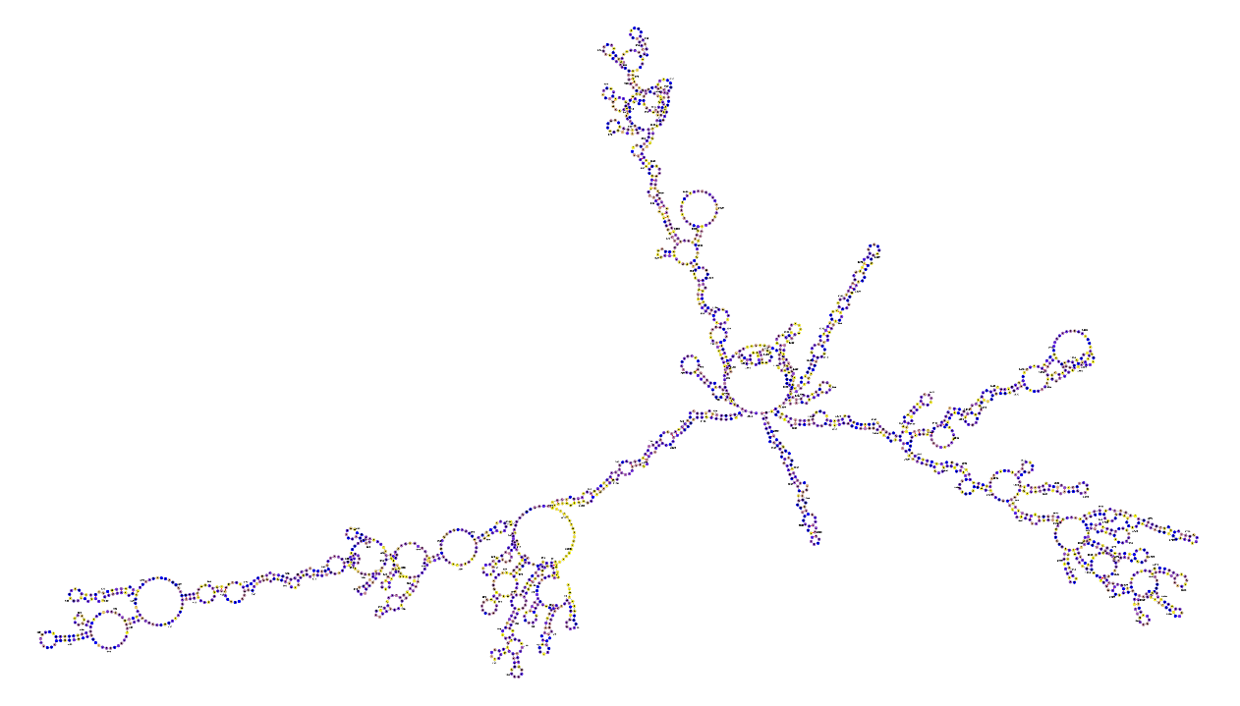
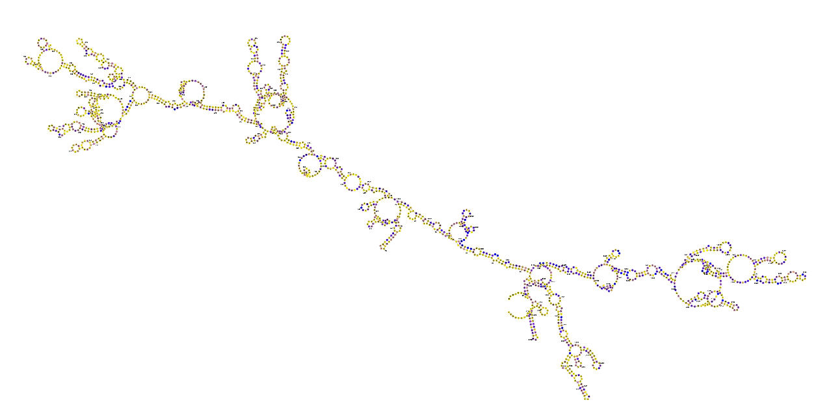
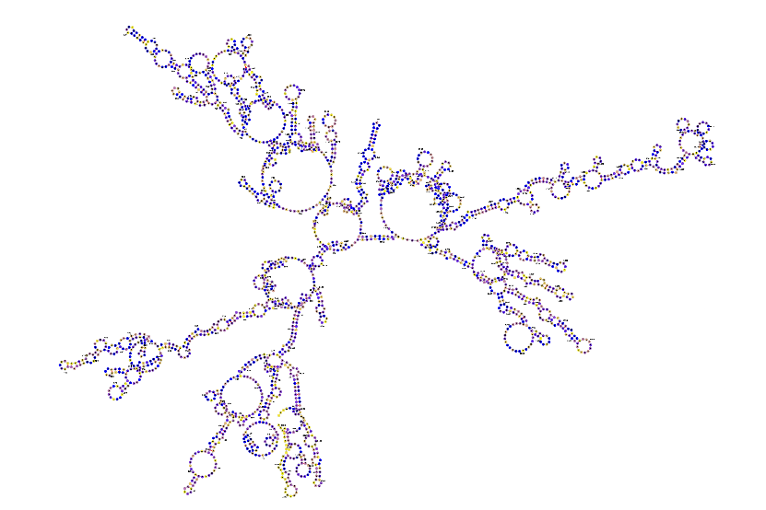
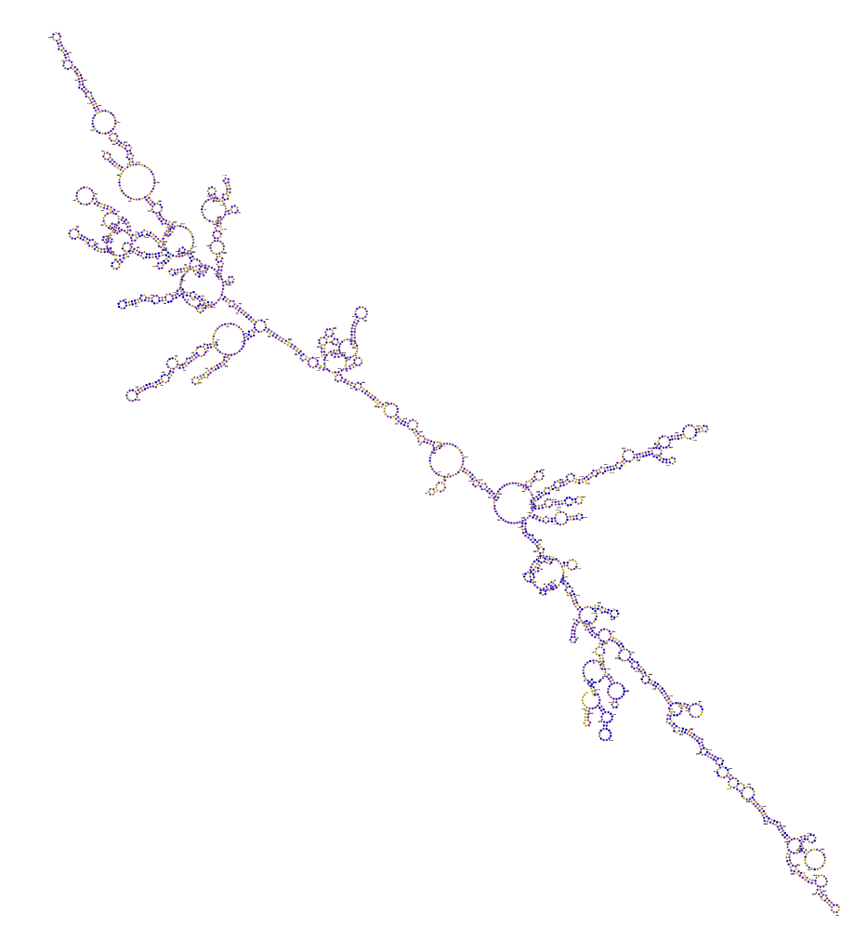
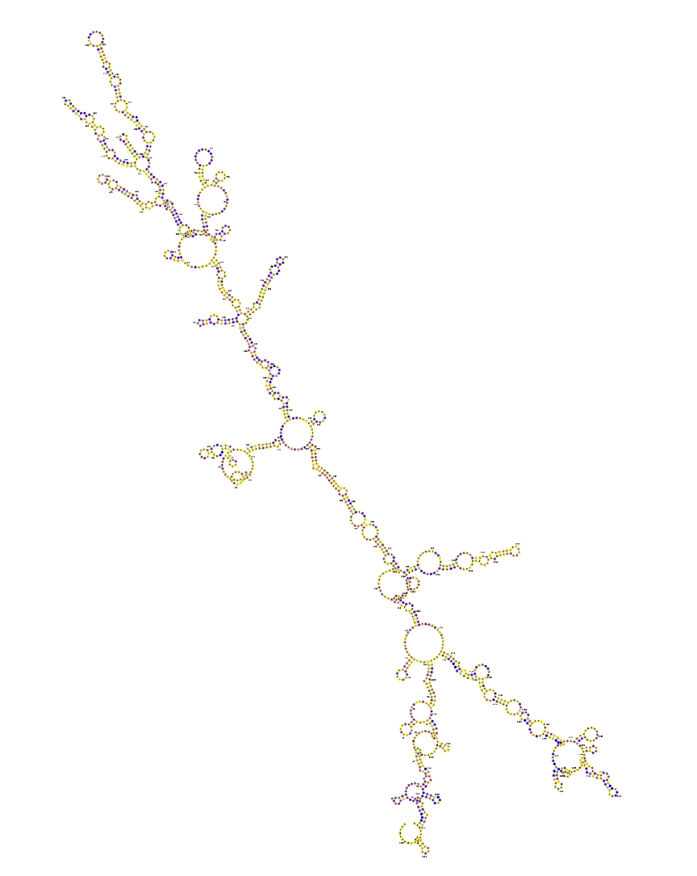
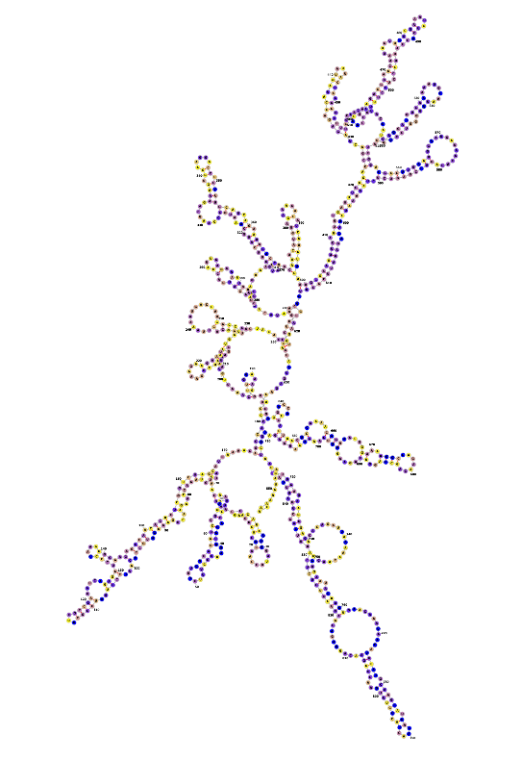
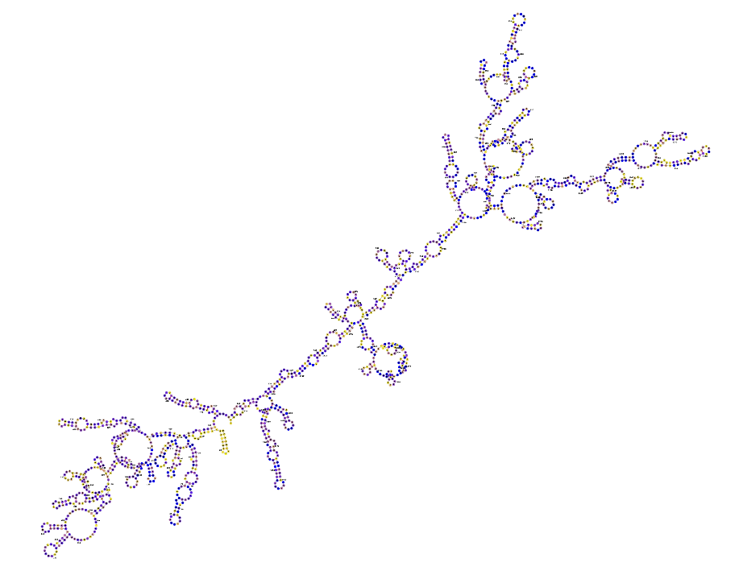
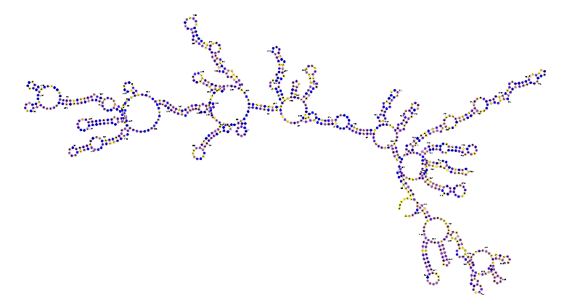
RNA Secondary structure
ssRNA
ViennaRNA
Notes:
Lastly I performed a secondary structure prediction of the consensus genomes using the ViennaRNA software. Secondary structure is a very important feature of ssRNA viruses because it is involved in many processes such as transcription and translation. That’s also why the secondary structure is often very conserved. Here you can see the 8 segments of the Influenza A genome. The bases are colored according to their conservation, blue means high conservation and yellow means low conservation.

Slide 14
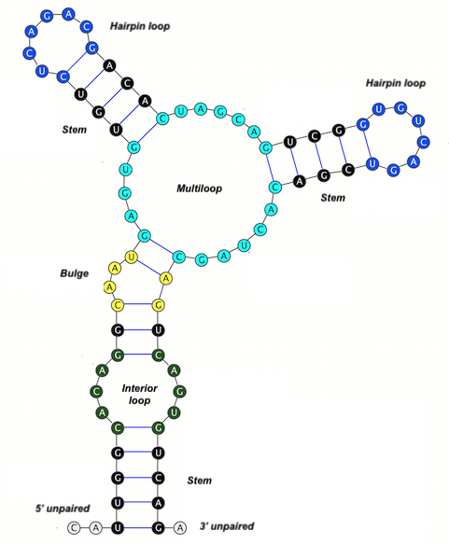
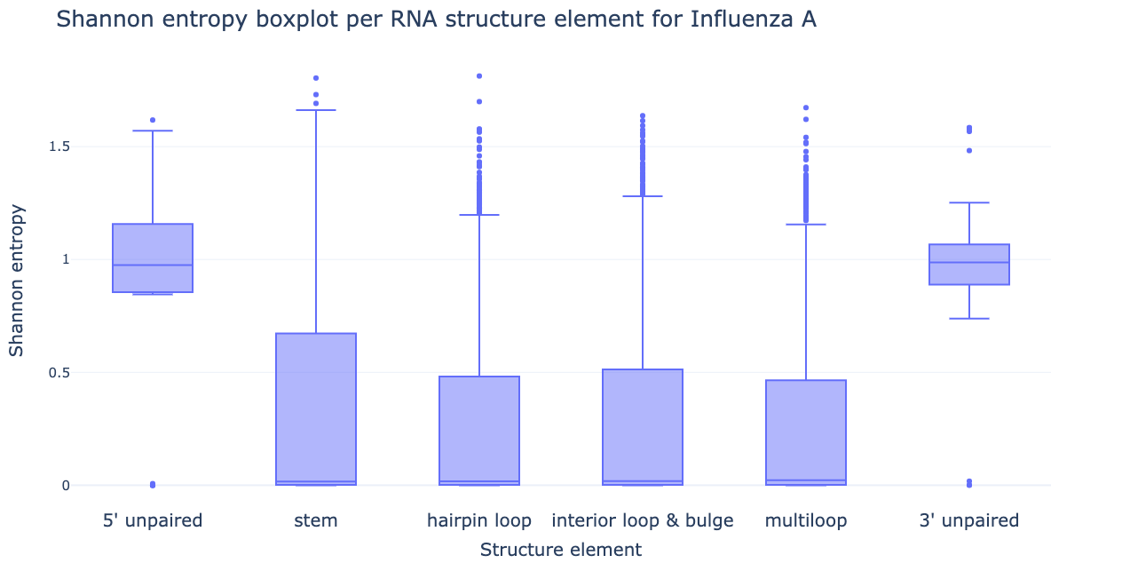
Structure ↔ conservation
Notes:
Since the genome of RNA viruses is so highly structured I also wanted to see whether we can use the structure to predict the conservation. As you can see in the picture on the left RNA can form several types of structure elements and on the right you can see how the Shannon entropy is distributed for the different elements for Influenza A. You can clearly see that the 5’ and 3’ unpaired ends of the RNA are less conserved then the internal structures. This was also confirmed statistically.

Slide 15
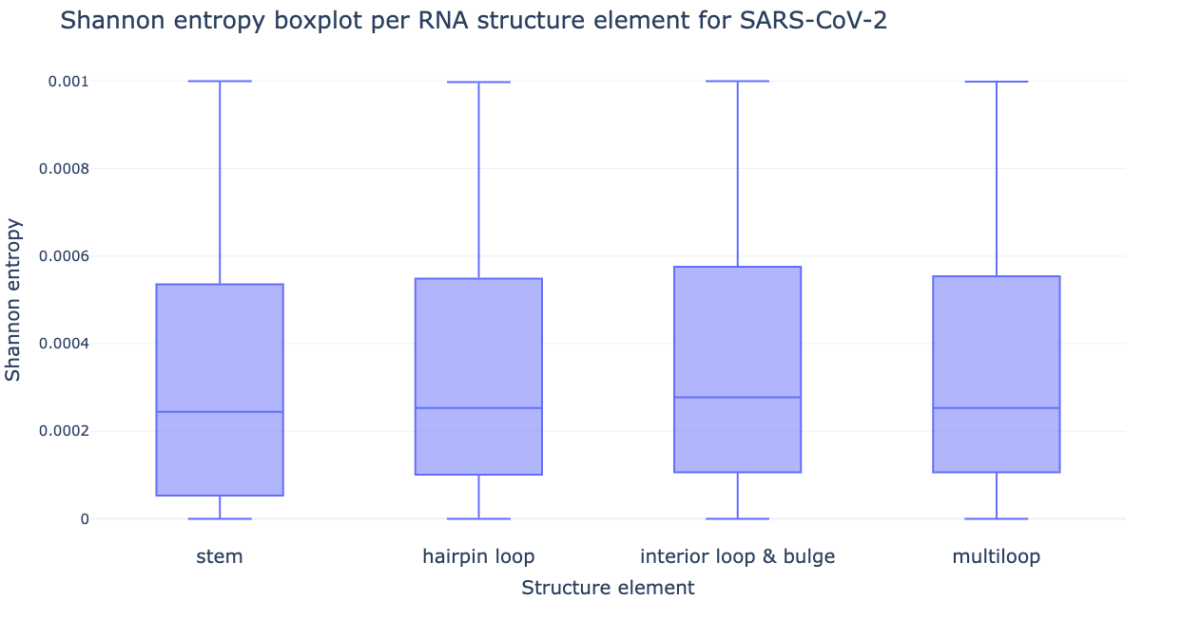
Structure ↔ conservation
Notes:
For SARSCoV2 I came to the conclusion that stems were slightly more conserved then hairpin loops. However, the statistical significance was a lot lower then for the IAV.

Slide 16
Conclusion
Phylogenetic
Analysis
Conservation
Analysis
RNA Secondary
Structure Analysis
Evolutionary insight
Vaccine candidates
Further analysis
Further screening
Notes:
To conclude,
I constructed phylogenetic trees in order to gain insight into the evolutionary relationships in the sequence datasets.
I was able to identify highly conserved regions in their genomes which have potential to be used as universal vaccine. The conserved regions I identified need to go through further screening such as immunogenicity prediction and population coverage analysis before they could be considered as actual vaccines.
And I investigated the relationship between the conservation of genome and its secondary structure.
However, this analysis was relatively limited and the results only of minor interest. So more in-depth analysis could be useful.

Slide 17



Menno Van Damme Master Bio-ingenieurswetenschappen Cell and Gene Biotechnology menno.vandamme@ugent.be www.ugent.be
Universiteit Gent @ugent
@ugent Ghent University

