Slide 1
Database Project
An easy way to book a hotel room

Slide 2
Motivation
Have you ever struggled in finding a hotel for your vacation when there are so many hotels nowadays that you can’t know which one suits you best
The idea of making my trip becomes more comfortable starting from the very beginning – booking rooms, has encouraged us to make a website which rallies all information of hotels in one place

Slide 3
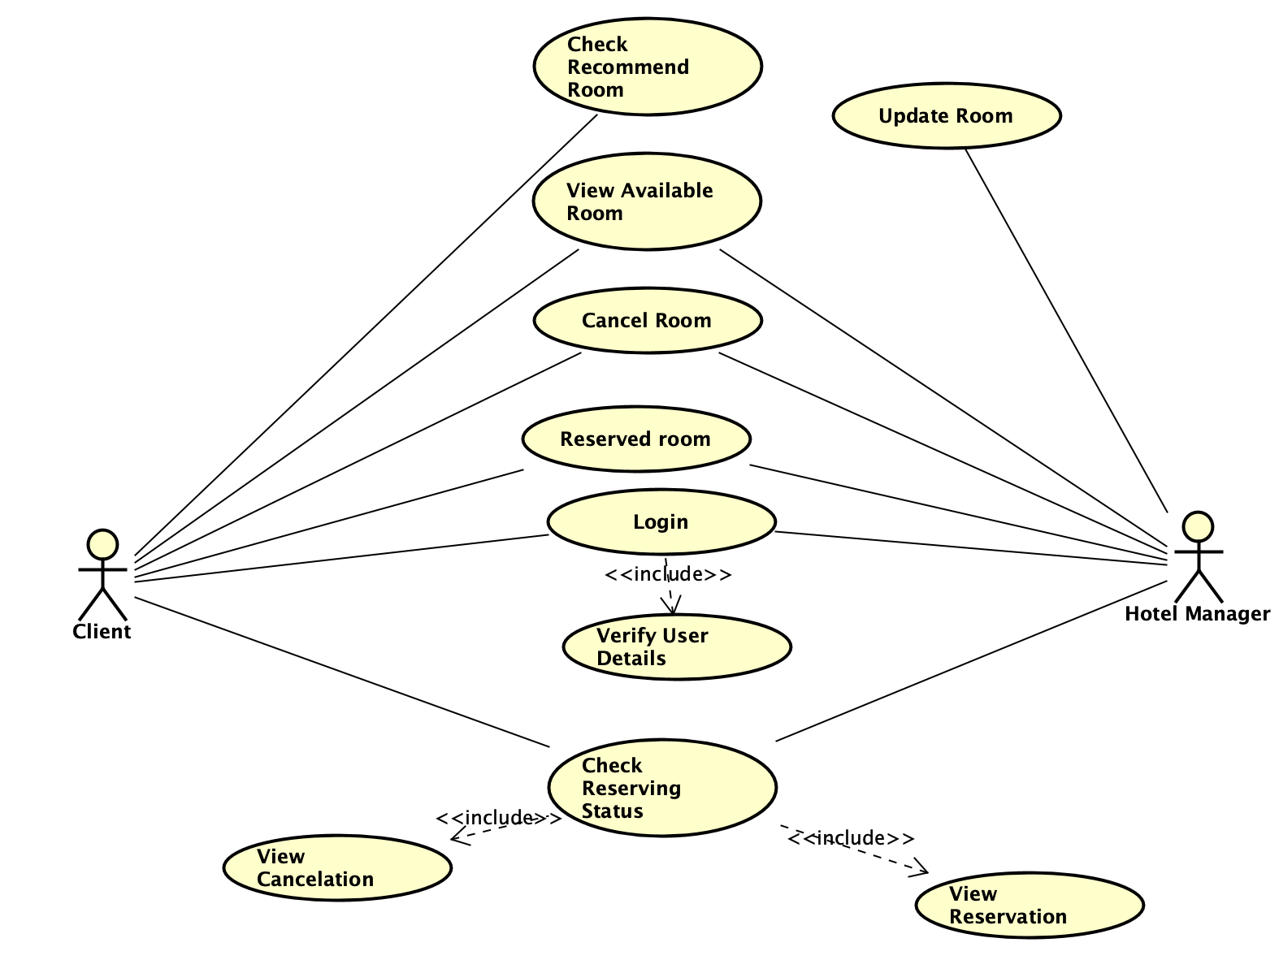
UseCase Diagram

Slide 4
Clients
Search by name
Show recommend hotel
Client can have information of a hotel by search its name
The client can fill in a set of fillters (destination province, type of room, required extension,..) to get a list of suggested hotels
See information
Book a room
Cancel a booking
Book a room by fill in contact information, day of check in and out
See detail information of a hotel which contains: address, extension, rating, …
Cancel a booking by booing id

Slide 5
Hotel Managers
See booking details
Login
See booking information (checkin time, check outtime,number of rooms)
Each hotel managers has their own account which manages their rooms information
Update room status
Confirm bookings
Update the status of a room: available or not
Verify whether a booking is succesful or not

Slide 6

Thank you for your attention !
The End

