Slide 1
Embedded Systems in Silicon
TD5102
Other Architectures
Henk Corporaal
http://www.ics.ele.tue.nl/~heco/courses/EmbSystems
Technical University Eindhoven
DTI / NUS Singapore
2005/2006

Slide 2
Introduction
Design alternatives:
  provide more powerful operations
    goal is to reduce number of instructions executed
    danger is a slower cycle time and/or a higher CPI
  provide even simpler operations
    to reduce code size / complexity interpreter
Sometimes referred to as “RISC vs. CISC”
  virtually all new instruction sets since 1982 have been RISC
  VAX: minimize code size, make assembly language easy
  instructions from 1 to 54 bytes long!
We’ll look at IA-32 and Java Virtual Machine

Slide 3
Topics
Recap of MIPS architecture
  Why RISC?
Other architecture styles
  Accumulator architecture
  Stack architecture
  Memory-Memory architecture
  Register architectures
Examples
  80x86
  Pentium Pro, II, III, 4
  JVM

Slide 4
Recap of MIPS
RISC architecture
Register space
Addressing
Instruction format
Pipelining

Slide 5
Why RISC? Keep it simple
RISC characteristics:
Reduced number of instructions
Limited addressing modes
  load-store architecture
  enables pipelining
Large register set
  uniform (no distinction between e.g. address and data registers)
Limited number of instruction sizes (preferably one)
  know directly where the following instruction starts
Limited number of instruction formats
Memory alignment restrictions
......
Based on quantitative analysis
  " the famous MIPS one percent rule": don't even think about it when its not used more than one percent

Slide 6
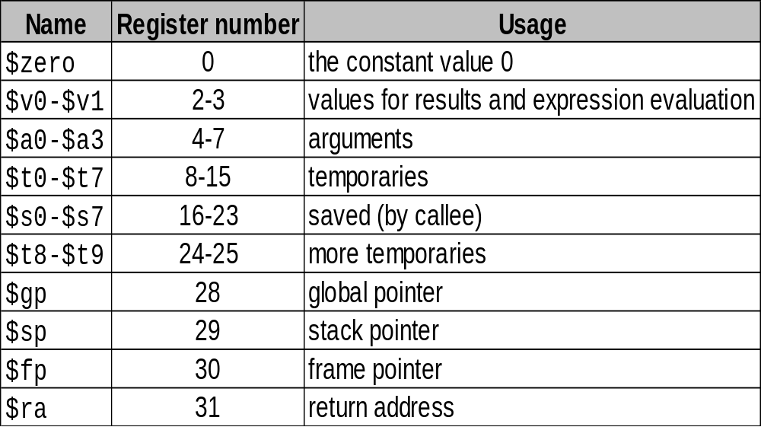
Register space
32 integer (and 32 floating point) registers of 32-bit

Slide 7
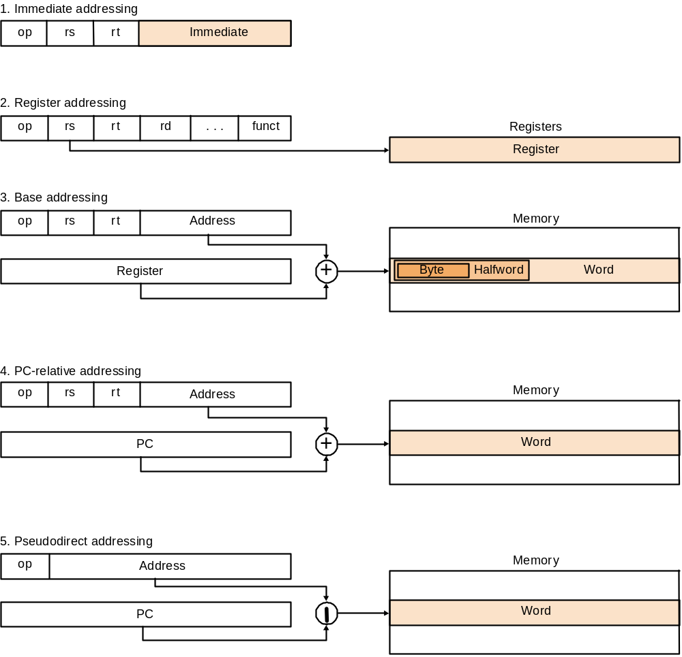
Addressing

Slide 8
Instruction format
op rs rt rd shamt funct
R
I
J
op rs rt 16 bit address
op 26 bit address
Example instructions
Instruction Meaning
add $s1,$s2,$s3 $s1 = $s2 + $s3
addi $s2,$s3,4 $s2 = $s3 + 4
lw $s1,100($s2) $s1 = Memory[$s2+100]
bne $s4,$s5,L if $s4<>$s5 goto L
j Label goto Label

Slide 9
Pipelining
All integer instructions fit into the following pipeline
time
IF
ID
EX
MEM
WB
IF
ID
EX
MEM
WB
Instruction stream
IF
ID
EX
MEM
WB
IF
ID
EX
MEM
WB
IF
ID
EX
MEM
WB

Slide 10
Other architecture styles
Accumulator architecture
Stack
Register (load store)
Register-Memory
Memory-Memory

Slide 11
Accumulator architecture
latch
Accumulator
ALU
Memory
address
registers
latch
Example code: a = b+c;
load b; // accumulator is implicit operand
add c;
store a;

Slide 12
Stack architecture
latch
latch
stack
ALU
Memory
latch
stack pt
Example code: a = b+c;
push b;
push c;
add;
pop a;
push b
push c
add
pop a
stack:
b
c
b+c
b

Slide 13
Other architecture styles
Let's look at the code for C = A + B
Stack Architecture | Accumulator Architecture | Register-Memory | Memory-Memory | Register (load-store)
Push A | Load A | Load r1,A | Add C,B,A | Load r1,A
Push B | Add B | Add r1,B |  | Load r2,B
Add | Store C | Store C,r1 |  | Add r3,r1,r2
Pop C |  |  |  | Store C,r3
Q: What are the advantages / disadvantages of load-store (RISC) architecture?

Slide 14
Other architecture styles
Accumulator architecture
  one operand (in register or memory), accumulator almost always implicitly used
Stack
  zero operand: all operands implicit (on TOS)
Register (load store)
  three operands, all in registers
  loads and stores are the only instructions accessing memory (i.e. with a memory (indirect) addressing mode
Register-Memory
  two operands, one in memory
Memory-Memory
  three operands, may be all in memory
(there are more varieties / combinations)

Slide 15
Examples
80x86
  extended accumulator
Pentium x
  extended accumulator
JVM
  stack
IA-32

Slide 16
A dominant architecture: x86/IA-32
A bit of history:
  1978: The Intel 8086 is announced (16 bit architecture)
  1980: The 8087 floating point coprocessor is added
  1981: IBM PC was launched, equipped with the Intel 8088
  1982: The 80286 increases address space to 24 bits + new instructions
  1985: The 80386 extends to 32 bits, new addressing modes
  1989-1995: The 80486, Pentium, Pentium Pro add a few instructions (mostly designed for higher performance)
  1997: MMX is added
  2000: Pentium 4; very deep pipelined; extends SIMD instructions
  2002: Hypertreading
  “This history illustrates the impact of the “golden handcuffs” of compatibility
  “adding new features as someone might add clothing to a packed bag”
  “an architecture that is difficult to explain and impossible to love”

Slide 17
IA-32 Overview
Complexity:
  Instructions from 1 to 17 bytes long
  two-address instructions: one operand must act as both a source and destination
    ADD EAX,EBX ; EAX = EAX+EBX
  one operand can come from memory
  complex addressing modes
  e.g., “base or scaled index with 8 or 32 bit displacement”
Saving grace:
  the most frequently used instructions are not too difficult to build
  compilers avoid the portions of the architecture that are slow
“what the 80x86 lacks in style is made up in quantity,
making it beautiful from the right perspective”

Slide 18
80x86 (IA-32) registers
16
8
8
general
purpose
registers
AH
AX
AL
EAX
BH
BX
BL
EBX
CH
CX
CL
ECX
DH
DX
DL
EDX
index
registers
ESI
EDI
pointer
registers
EBP
ESP
CS
SS
segment
registers
DS
ES
FS
GS
PC
EIP
condition codes (a.o.)

Slide 19
IA-32 Addressing Modes
Addressing modes: where are the operands?
  Immediate
    MOV EAX,10 ; EAX = 10
  Direct
    MOV EAX,I ; EAX = Mem[&i]
    I DW 3
  Register
    MOV EAX,EBX ; EAX = EBX
  Register indirect
    MOV EAX,[EBX] ; EAX = Memory[EBX]
  Based with 8- or 32-bit displacement
    MOV EAX,[EBX+8] ; EAX = Mem[EBX+8]
  Based with scaled index (scale = 0 .. 3)
    MOV EAX,ECX[EBX] ; EAX = Mem[EBX + 2^{scale} * ECX]
  Based plus scaled index with 8- or 32-bit displacement
    MOV EAX,ECX[EBX+8]

Slide 20
IA-32 Addressing Modes
Not all modes apply to all instructions
  one of the operands must be a register
Not all registers can be used in all modes
Why? Simply not enough bits in the instruction

Slide 21
Control: condition codes
Many instructions set condition codes in EFLAGS register
Some condition codes:
  sign: set if the result of an operation was negative
  zero: set if the result was zero
  carry: set if the operation had a carry out
  overflow: set if the operation caused an overflow
  parity: set when result had even parity
Subsequent conditional branch instructions test condition codes to determine if they should jump or not

Slide 22
Control
Special instruction: compare
    CMP SRC1,SRC2 ; set cc’s based on SRC1-SRC2
Example
    for (i=0; i<10; i++)
    a[i]++;
  MOV EAX,0 ; EAX = i = 0
  _L: CMP EAX,10 ; if (i<10)
  JNL _EXIT ; jump to _EXIT if i>=10
  INC [EBX] ; Mem[EBX](=a[i])++
  ADD EBX,4 ; EBX = &a[i+1]
  INC EAX ; EAX++
  JMP _L ; goto _L
  _EXIT: ...

Slide 23
Control
Peculiar control instruction
  LOOP _LABEL ; decrease ECX, if (ECX!=0) goto _LABEL
Previous example rewritten:
  MOV ECX,10
  _L: INC [EBX]
  ADD EBX,4
  LOOP _L
Fewer instructions, but LOOP is slow

Slide 24
Procedures/functions
Instructions
  CALL AProcedure ; push return address on stack
  ; and goto AProcedure
  RET ; pop return address from stack
  ; and jump to it
EBP is used as a frame pointer which points to a fixed location within stack frame (to access locals)
ESP is used as stack pointer
Special instructions:
  PUSH EAX ; ESP -= 4, Mem[ESP] = EAX
  POP EAX ; EAX = Mem[ESP], ESP += 4

Slide 25
IA-32 Machine Language
IA-32 instruction formats:
Bytes
0-5
1-2
0-1
0-1
0-4
0-4
prefix
opcode
mode
sib
displ
imm
Bits
6
1
1
Bits
2
3
3
Source operand
Bits
2
3
3
scale
index
base
Byte/word
mod
reg
r/m
00 memory
01 memory+d8
10 memory+d16/d32
11 register

Slide 26
Pentium, Pentium Pro, II, III, 4
Issue rate:
  Pentium : 2 way issue, in-order
  Pentium Pro .. 4 : 3 way issue, out-of-order
    IA-32 operations are translated into μops (by hardware)
Pipeline
  Pentium: 5 stage pipeline
  Pentium Pro, II, III: 10 stage pipeline
  Pentium 4: 20 stage pipeline
Extra SIMD instructions
  MMX (multi-media extensions), SSE/SSE-2 (streaming simd extensions)
+

Slide 27
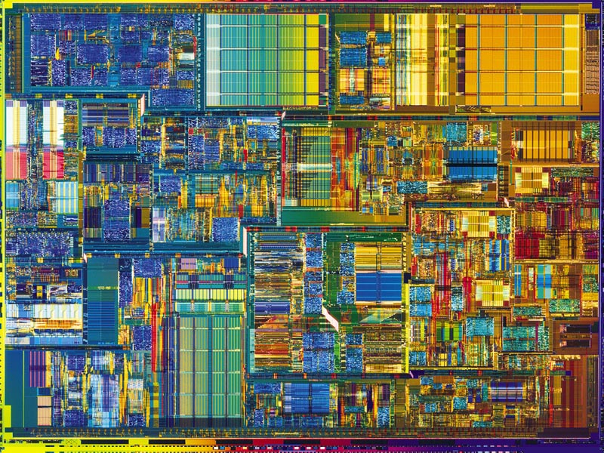
Die example: Pentium 4

Slide 28
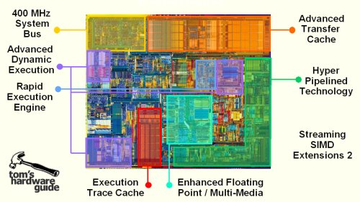
Pentium 4 chip area breakdown

Slide 29
Pentium 4
Trace cache
Hyper threading
Add with ½ cycle throughput (1 ½ cycle latency)
add least signif. 16 bits
add most signif. 16 bits
calculate flags
forwarding carry
cycle
cycle
cycle

Slide 30
Pentium® 4 Processor
Block Diagram
P4 slides from
Doug Carmean, Intel
L2 Cache and Control
L2 Cache and Control
BTB
Store
AGU
3.2 GB/s System Interface
Load
AGU
ALU
Integer RF
ALU
ALU
Trace Cache
Decoder
3
3
ALU
BTB & I-TLB
Rename/Alloc
uop Queues
L1 D-Cache and D-TLB
Schedulers
FP move
FP store
FP RF
FMul
FAdd
MMX
SSE
uCode
ROM
Notes:
Lets look at Wmt’s basic block diagram.
Here is a collection of boxes -- some may be familiar and some new.

Slide 31
P4 vs P II, PIII
Intro at
733MHz
.18µ
Basic P6 Pipeline
1
2
3
4
5
6
7
8
9
10
Fetch
Fetch
Decode
Decode
Decode
Rename
ROB Rd
Rdy/Sch
Dispatch
Exec
Intro at
≥ 1.4GHz
.18µ
Basic Pentium® 4 Processor Pipeline
1
2
3
4
5
6
7
8
9
10
11
12
13
14
15
16
17
18
19
20
TC Nxt IP
TC Fetch
Drive
Alloc
Rename
Que
Sch
Sch
Sch
Disp
Disp
RF
RF
Ex
Flgs
Br Ck
Drive
Notes:
Make it clear that this is the branch mispredict pipeline. This is just
One of the key pipelines in the machine. One of the more interesting
And important pipelines.
Even higher frequencies on 0.18u. Rest of the presentation refers to 1.4GHz. Expect to see this even faster as the design matures on this process.
Point out that decode is missing in the P6 pipeline

Slide 32
Example with Higher IPC and Faster Clock!
Pentium® 4
Processor
@1.4GHz
Code
Sequence
  Ld
  Add
  Add
  Ld
  Add
  Add
P6
@1GHz
10 clocks
10ns
IPC = 0.6
6 clocks
4.3ns
IPC = 1.0
Notes:
Loads, adds common sequences in most applications. Highly
Optimized performance for these critical sections.

Slide 33
The Execution Trace Cache
L2 Cache and Control
BTB
Store
AGU
BTB
3.2 GB/s System Interface
Load
AGU
ALU
Integer RF
ALU
ALU
Trace Cache
Trace Cache
Decoder
3
3
ALU
BTB & I-TLB
Rename/Alloc
uop Queues
L1 D-Cache and D-TLB
Schedulers
FP move
FP store
FP RF
FMul
FAdd
MMX
SSE
uCode
ROM

Slide 34
Execution Trace Cache
Advanced L1 instruction cache
  Caches “decoded” IA-32 instructions (uops)
Removes decoder pipeline latency
Capacity is ~12K uOps
Integrates branches into single line
  Follows predicted path of program execution
Execution Trace Cache feeds fast engine
Notes:
Cafeteria example: A trace cache is like a pre-made sandwich.
Allows more flexible issue rules.
IA-32 instructions are quite difficult to decode. This is especially true when trying decode several instructions each clock cycle and when trying to run this decoder at the clock rate of Wmt. By caching or remembering the previously decoded instructions, or “uops”, Wmt bypasses the instruction decoder most of the time. This allows Wmt to have a less expensive decoder since it is not used as often.
Also, a high bandwidth IA-32 decoder takes several pipeline stages to do its work. When a branch is mispredicted the recovery time is shorter if the machine does not need to re-decode the instructions it needs to fetch.
The trace cache not only caches previously decoded instructions but it also does something unique with branch instructions. It remembers where the branch previously went and it stores the target of a taken branch in the same line as the branch instruction, even if the target is 1000’s of bytes away in the program. This removes the bubbles that are seen with conventional instruction caches when taken branches are encountered.
So what the execution trace cache does is provide a very high bandwidth instruction fetch engine to feed Wmt’s very fast execution units farther down its pipeline.

Slide 35
Execution Trace Cache
1 cmp
2 br -> T1
..
... (unused code)
T1: 3 sub
4 br -> T2
..
... (unused code)
T2: 5 mov
6 sub
7 br -> T3
..
... (unused code)
T3: 8 add
9 sub
10 mul
11 cmp
12 br -> T4
Trace Cache Delivery
1 cmp 2 br T1 3 T1: sub
4 br T2 5 mov 6 sub
7 br T3 8 T3:add 9 sub
10 mul 11 cmp 12 br T4
Notes:
We do this in 4 clocks vs 8 clocks on P6
Lets go over an example of how this Trace Cache works.
This example has 4 different basic blocks or groups of instructions each shown in different colors. The instructions are labeled 1-12 for reference.
The first block of code does a compare and then does a branch to target #1. This branch instruction causes the machine to branch around or skip many instructions, possibly thousands, in the program binary, that are not used right now.
The second block of code shown here does a similar thing, and so on.
#1 Lets see how Wmt’s Execution Trace Cache supplies these instructions.
The first clock it supplies instructions #1 thru #3 -- It supplies not only the compare and the branch instructions like a traditional Instruction Cache would but also the instruction at the target of the branch, labeled here instr. #3. Traditional machines would have a clock bubble to get to the target of the branch.
#2 The second clock the Trace Cache supplies instruction #4 which is also a taken branch instruction and the next two instructions, instr #5 and #6 which also could have been thousands of bytes away in the program executable.
#3 The third clock it does a similar thing
#4 The 4th clock it supplies 3 instructions per clock just like a normal I-cache would have done.
This example takes Wmt 4 clocks to fetch all these instructions. It would have taken a P6 8 clocks to do this same sequence. Since Wmt’s clock rate is much higher than a P6 it would be more than 2 times faster doing this sequence.

Slide 36
Multi/Hyper-threading in Uniprocessor Architectures
Concurrent
Multithreading
Simultaneous
Multithreading
(Hyperthreading)
Superscalar
Empty Slot
Thread 1
Clock cycles
Thread 2
Thread 3
Thread 4
Issue slots

Slide 37
JVM: Java Virtual Machine
Make JAVA code run everywhere
  Use virtual architecture
  Platform (processor) independent
Java
program
Java
compiler
Java
bytecode
JVM
(interpreter)
JVM = stack architecture

Slide 38
Stack Architecture
JVM follows stack model of execution
  operands are pushed onto stack from memory and popped off stack to memory
  operations take operands from stack and place result on stack
Example (not real Java bytecode):
a = b+c;
push b
push c
add
pop a
b
c
b+c
b

Slide 39
JVM Architecture
For each method invocation, the JVM creates a stack frame consisting of
  Local variable frame: parameters and local variables, numbered 0, 1, 2, …
  Operand stack: stack used for evaluating expressions
local
var 3
local
var 0
local
var 1
local
var 2
static void add3(int x, int y, int z){
int r = x+y+z;
System.out.println(r);
}

Slide 40
Some JVM instructions
iload_n: push local variable n onto the stack
iconst_n: push constant n onto the stack (n=-1,0,...,5)
bipush imm8: push byte onto stack
sipush imm16: push short onto stack
istore_n: pop word from stack into local variable n
iadd, isub, ineg, imul, idiv, irem: usual arithmetic operations
if_icmpXX offset16 (XX can be eq, ne, lt, gt, le, ge):
  pop TOS into a
  pop TOS stack into b
  if (b XX a) PC = PC + offset16
goto offset16 : PC = PC + offset16

Slide 41
Example 1
Translate following expression to Java bytecode:
  v = 3*(x/y - 2/(u+y))
  assume x is local var 0, y local var 1, u local var 3, v local var 4
  Stack
  iconst_3 ; 3
  iload_0 ; x | 3
  iload_1 ; y | x | 3
  idiv ; x/y | 3
  iconst_2 ; 2 | x/y | 3
  iload_3 ; u | 2 | x/y | 3
  iload_1 ; y | u | 2 | x/y | 3
  iadd ; u+y | 2 | x/y | 3
  idiv ; 2/(u+y) | x/y | 3
  isub ; x/y - 2/(u+y) | 3
  imul ; 3*(x/y - 2/(u+y))
  istore_4 ; v = 3*(x/y - 2/(u+y))

Slide 42
Example 2
Translate following Java code to Java bytecode:
  if (x < 2) x = 0;
  assume x is local var 0
  Stack
  iload_0 ; x
  iconst_2 ; 2 | x
  if_icmpge endif ; if (x>=2) goto endif
  iconst_0 ; 0
  istore_0 ;
  endif:
  ...

