Slide 1
INSuRE Project: “Analyzing VoIP at UC Davis”
Date: 06/01/2018
Ibrahim Ahmed, Ayush Jain, Abdulhai Naqvi, Dixit Paudel, and Mark Redican at UC Davis
Overview of project
Operational capability and status
Explore security flaws with the UC Davis Voice-over-IP (VoIP) implementation.
Focus on Privacy and Integrity issues
Completed: Proposal, Literature Review, Test-environment in the security lab, Built communication profiles, Working with open-source soft-phone (SIP) agent, Writing final report
Yet to be completed: Final Report, Presentation, Poster
Technical approach
Schedule
Call using the phones in the test-environment
Connect switch to the computer
Use Wireshark for packet sniffing
Call phones using soft-phone client
Send test data with soft-phone client
Modified bareSIP to send test data
Finish final assignments
Notes:
We can make the squares bigger. If there is a little icon system we want to adopt that can go in the upper right hand corner of a square, that is fine. Perhaps this can signify %done, %effort, alert to a problem, indicate a critical path, or otherwise bring attention. Teams should be able to put graphics in the boxes as well.

Slide 2



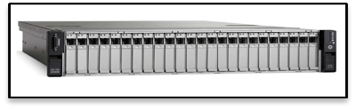
System Setup
VLAN ID : 0
UC Davis Internet WAN
Cisco Phone
Computer
Wireshark
BareSIP
Netgear Switch
Cisco NAM
Cisco Phone
UC Davis VoIP WAN
Cisco Phone
VLAN ID : 200

Slide 3
Sending test data with bareSIP
SIP module
SIP module
Audio Stream Module
Mock Audio Stream Module
Generic Stream Module
Generic Stream Module
Jitter Buffer
Jitter Buffer
RTP
RTP

Slide 4
INSuRE Project Progress
Project: Analyzing VoIP at UC Davis Date: 06/01/2018
✓
Next Week’s Work
This Week’s Progress
Report sections: Background: VoIP, S(RTP) SIP(S); Test Environment: Switch Setup, Phone Setup, Desktop Setup; Findings: Comm Profiles, Network loopback, Junk Streams
Extended bareSIP with mock audio source module
Finish report, poster, presentation
X
Impediments/Problems/Issues
Other Questions
Tracing through audio source module
Easiest and safest way to modify bareSIP to send test data?

Slide 5
Audio Stream Module: Advanced Linux Sound Architecture (ALSA)
ALSA_PLAY
MOCK_PLAY
ALSA_SRC
MOCK_SRC

Slide 6
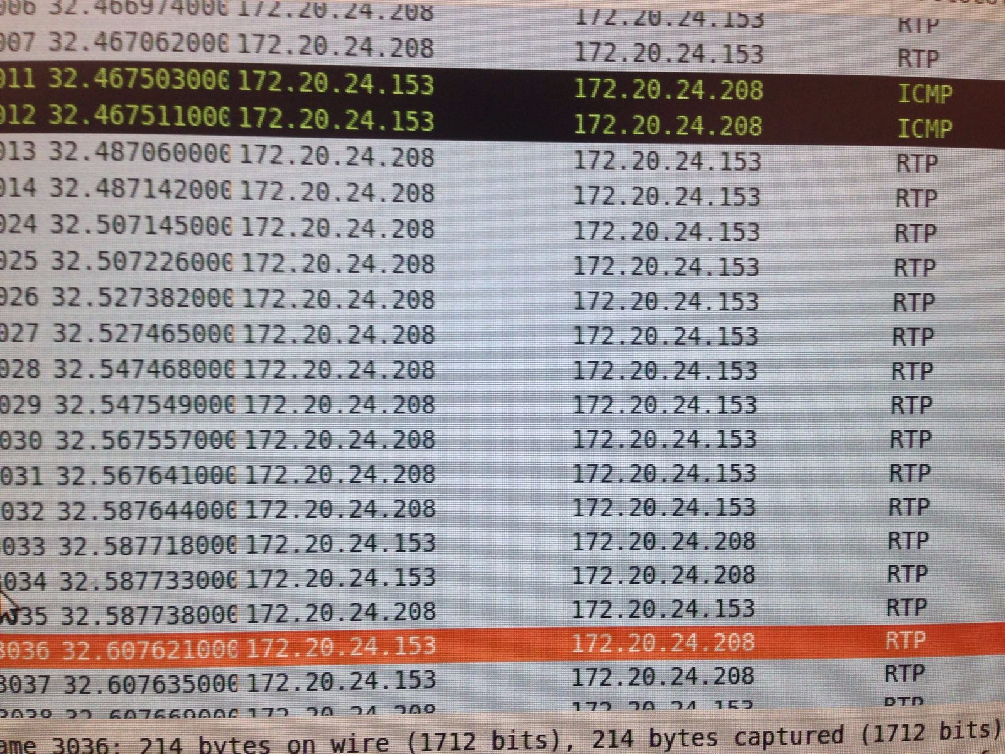

Slide 7
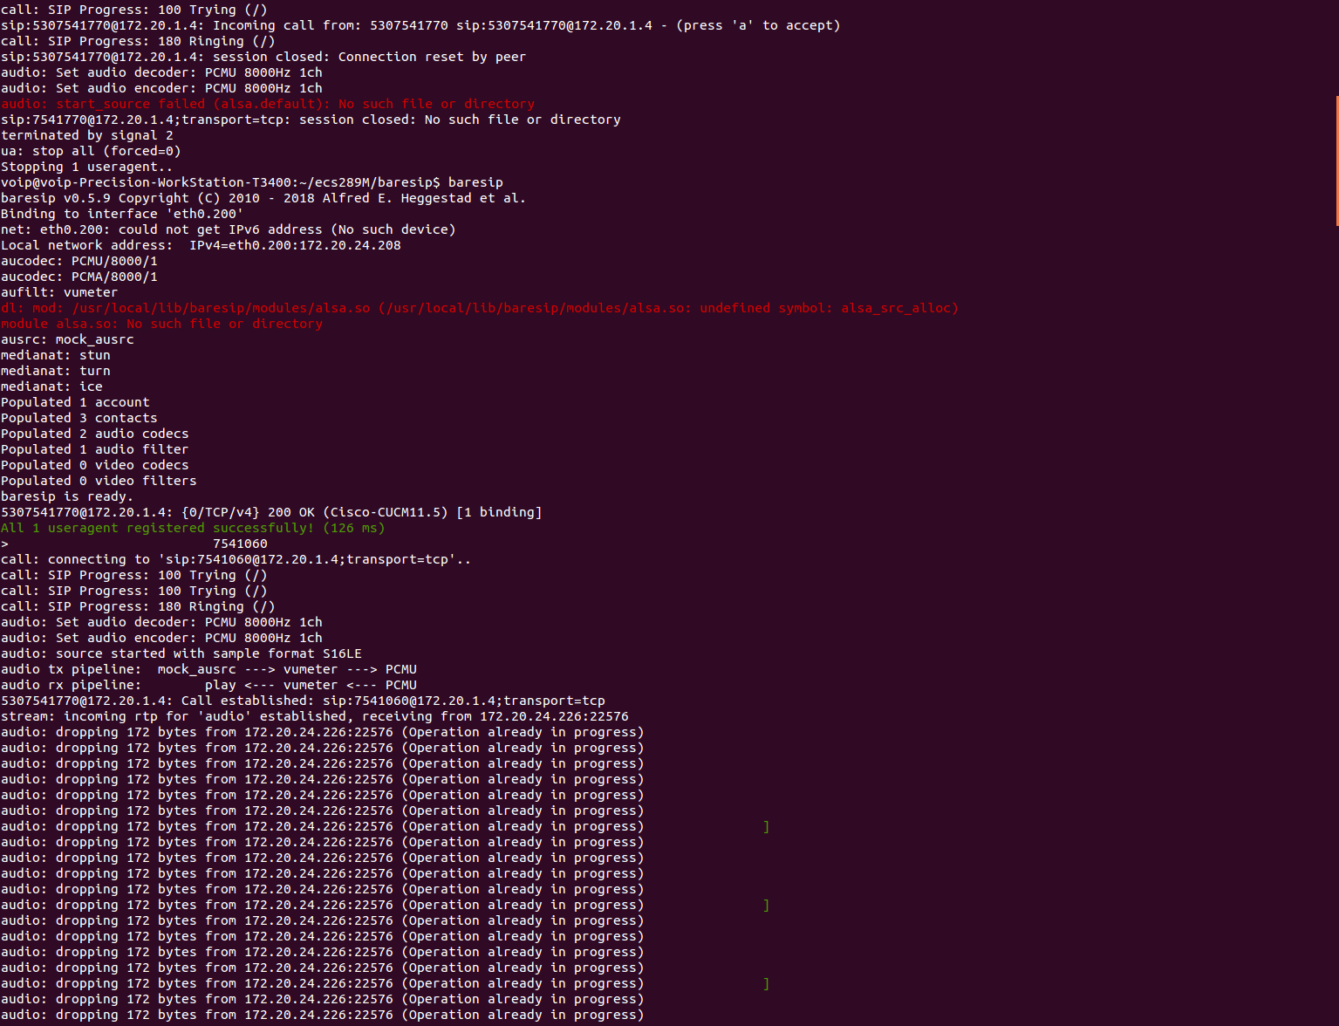

Slide 8
