Slide 1
INSuRE Project: “Analyzing VoIP at UC Davis”
Date: 05/04/2018
Ibrahim Ahmed, Ayush Jain, Abdulhai Naqvi, Dixit Paudel, and Mark Redican at UC Davis
Overview of project
Operational capability and status
Explore security flaws with the UC Davis Voice-over-IP (VoIP) implementation.
Focus on Privacy and Integrity issues
Completed: Proposal, Literature Review, Test-environment in the security lab, Building communication profiles, Identifying SIP agent
Yet to be completed: Reproduce Existing Cisco Phone Bugs & Discovering novel vulnerabilities
Technical approach
Schedule
Call using the phones in the test-environment
Connect switch to the computer
Use Wireshark for packet sniffing
Call phones using mock phone client
Building phone client using bareSIP
Reproduce/discover phone bugs
Notes:
We can make the squares bigger. If there is a little icon system we want to adopt that can go in the upper right hand corner of a square, that is fine. Perhaps this can signify %done, %effort, alert to a problem, indicate a critical path, or otherwise bring attention. Teams should be able to put graphics in the boxes as well.

Slide 2



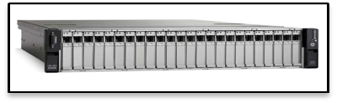
System Setup
VLAN ID : 0
UC Davis Internet WAN
Cisco Phone
Computer
Wireshark
BareSIP
Netgear Switch
Cisco NAM
Cisco Phone
UC Davis VoIP WAN
Cisco Phone
VLAN ID : 200

Slide 3
INSuRE Project Progress
Project: Analyzing VoIP at UC Davis Date: 05/04/2018
✓
Next Week’s Work
This Week’s Progress
Configured bareSIP with provided parameters
Sent REGISTER request with bareSIP
Debug transport issues with bareSIP
Discover/Engineer novel attacks to exploit bugs
X
Impediments/Problems/Issues
Other Questions
Configuring VLAN on computer
Identifying loopback in connection
TCP packets from bareSIP not noticeable
Locating bugs for current phone firmware 11.7.1
Can the ttl and ctl files on the phones be exploited in some manner?
Can vulnerabilities in TLS 1.2 be used in a “big” way?

Slide 4
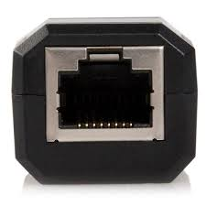
No route to host
Cisco Phone
Computer
Netgear Switch
NAM
Cisco Phone
NAM
Netgear POE Switch
Cisco Phone

Slide 5
Connection timed out
Cisco Phone
Computer
Netgear Switch
NAM
Cisco Phone
NAM
Netgear POE Switch
Cisco Phone

Slide 6
Better: Connection timed out
Cisco Phone
Computer
Cisco Phone
NAM
Netgear POE Switch
Cisco Phone

