Slide 1

Harmony-Hub : the cool experience for the cool you!!
Omyaasree Balaji
Email: osbalaji@dons.usfca.edu
Cs-110
3- Final project upload (December14)

Slide 2

A playlist creator welcome to Harmony-Hub This awesome web app throws the spotlight on you! Drop a keyword that vibes with your mood, and boom! It serves up a killer playlist with all the jams matching your keyword.
Specifics provided:
Name of the song
Name of the artist
Popularity or plays of each song
Lets you pick from every song displayed and create a cute or cool playlist of your liking.

Slide 3

Have we succeeded our motives and objectives?
Create a list of selected songs and display them in the next page by the user’s will.
Beautification of the webapp for a user friendly experience.
Creating a homepage and end page for the webapp

Slide 4
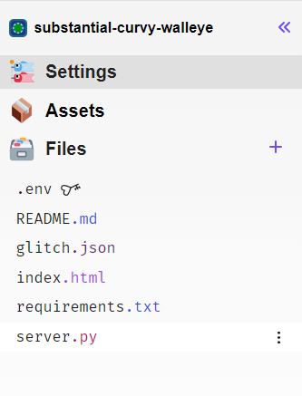
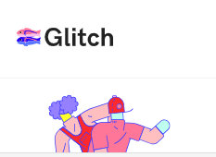
Has been hosted globally on glitch.com ^-^
https://exuberant-pointy-pastry.glitch.me
The URL is not substantial-curvy.glitch.me anymore *-*

Slide 5
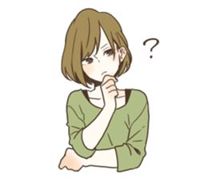
Number of files Submitted(5)
HarmonyHub-omyaasree.py
Templates -form_input.html
- welcome.html
-selected_songs.html
Slides (Powerpoint)
Report
Demo Video
Python packages used
Json
Requests
Request
Render template
Session
Flask

Slide 6
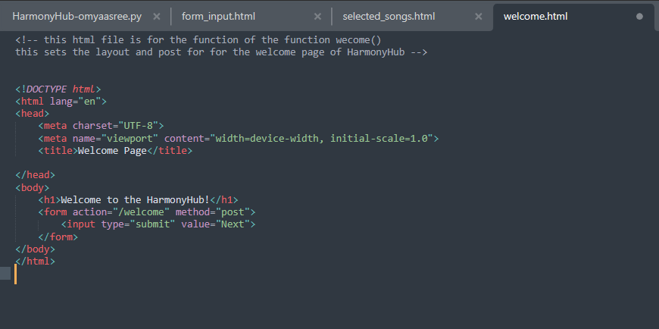
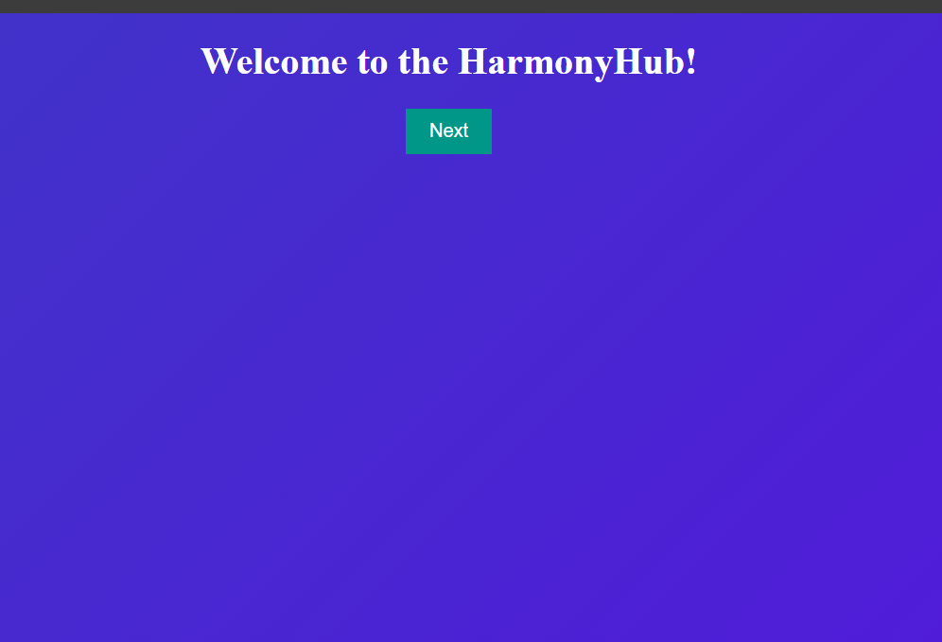
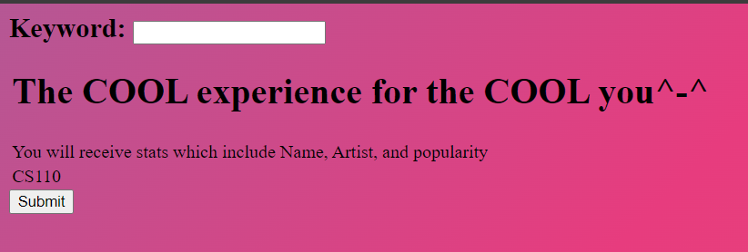
This was Milestone number 3 in the Beta update(December 5)
welcome.html: html file for the working and display of the Welcome page at the start of the WebPage >_<
FRONT END !!!

Slide 7
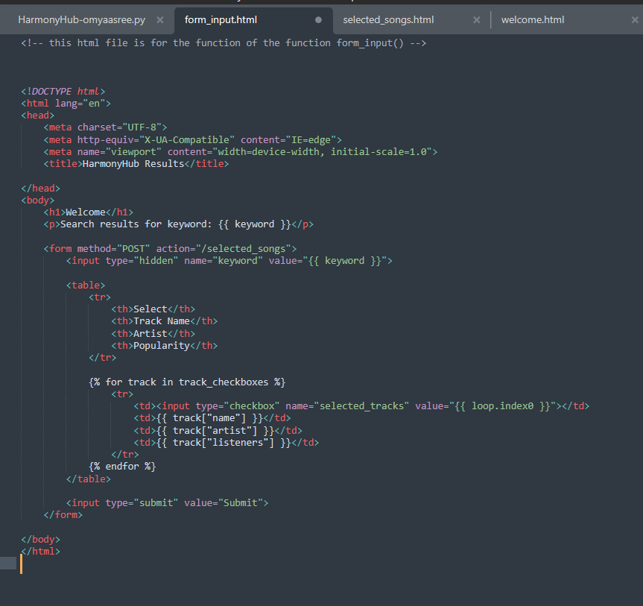
form_input.html : file for the running and output page for the form_input() function

Slide 8
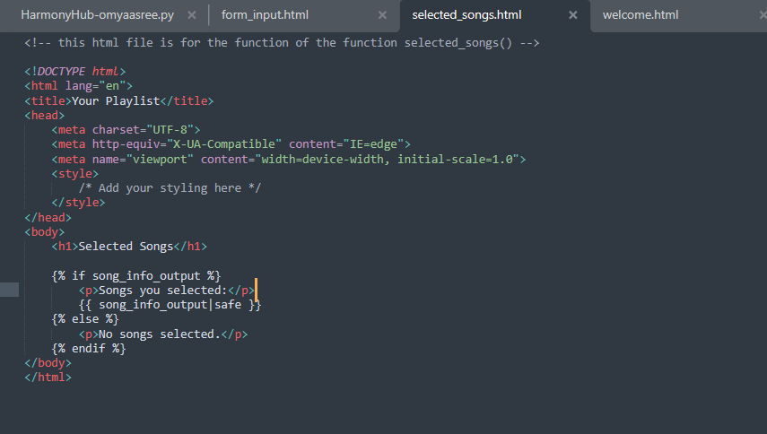

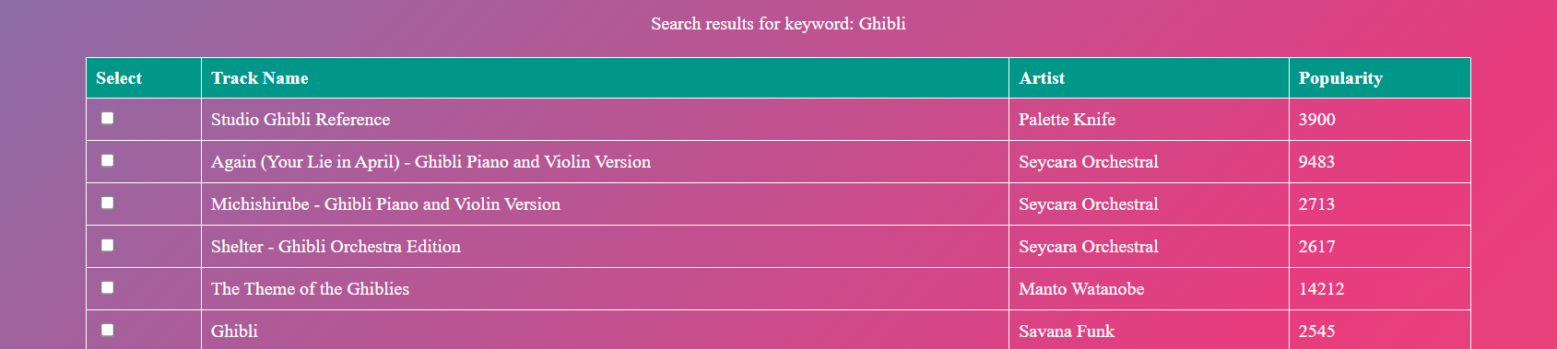
FRONT END!!!
Selected_song.html : file for the output page with checkboxes for display of all the songs.*-*

Slide 9
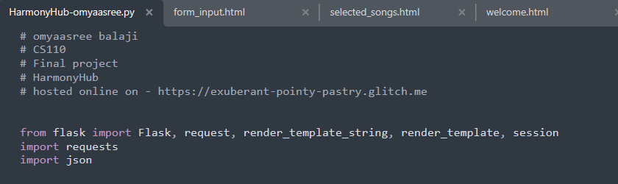



Source code and function definitions used throughout the program for the functioning of the WebPage ^-^
BACK END!!!

Slide 10

Tasks completed:
Application and implementation of API key.
Importing source code to a global webapp.
Receive right and verified output of songs, artists and popularity.
Applying a checkbox to all the songs in the output.
Upcoming Milestones (ACHIEVED) yay!!:
Create a list of selected songs and display them in the next page by the user’s will.
Beautification of the webapp for a user friendly experience.
Creating a homepage and end page for the webapp
Road Blocks (CLEARED):
Creating a list of the songs and display is in order with repeated feature to search song.

Slide 11
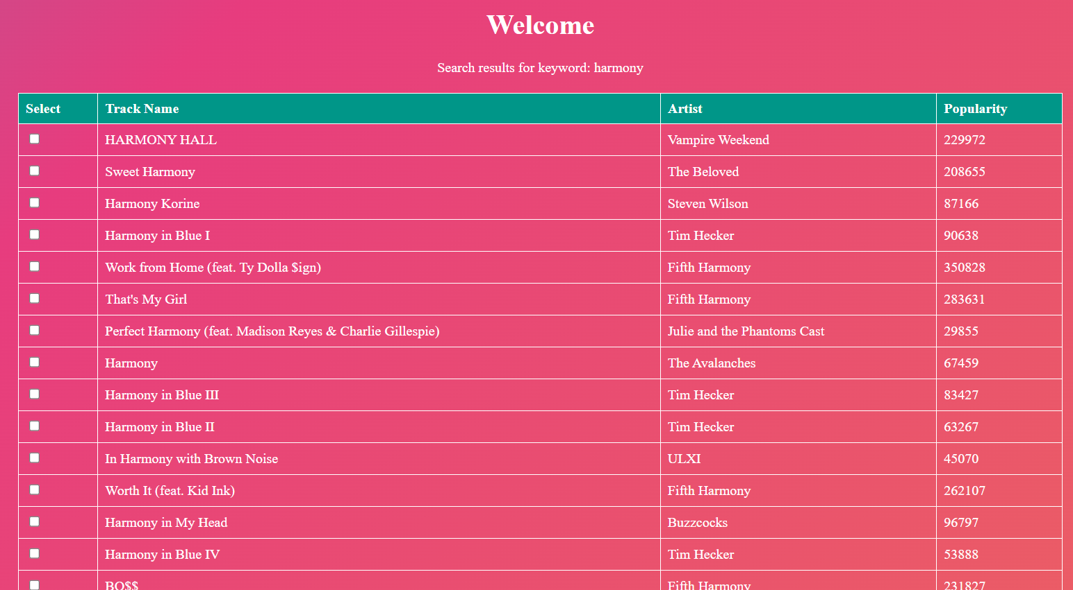



Milestones (ACHIEVED) yay!!:
Create a list of selected songs and display them in the next page by the user’s will.
Beautification of the webapp for a user friendly experience.
Creating a homepage and end page for the webapp

Slide 12
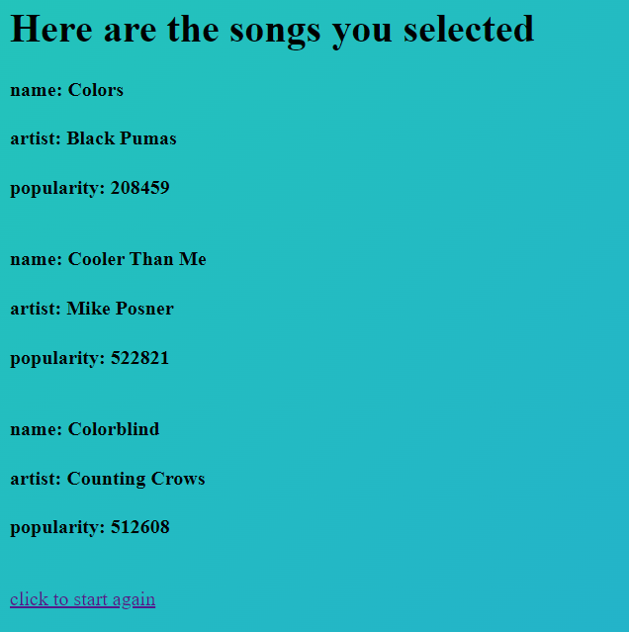
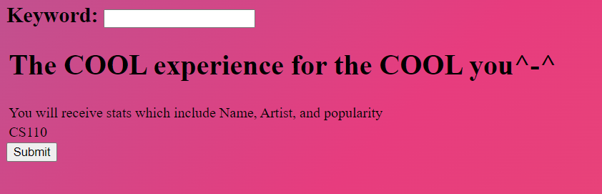
Road Blocks (CLEARED):
Creating a list of the songs and display is in order with repeated feature to search song.

Slide 13

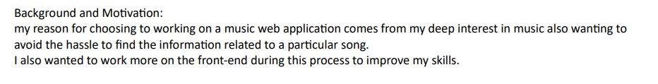
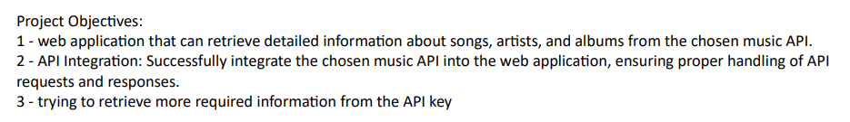
THINGS TO KEEP NOTE OF:
CURRENT API KEY:
'da859b9b879f78be4c8b25c81e3b3891’
LAST.FM
HarmonyHub!! customizes and provides the best 30 songs with your keyword

Slide 14

FUTURE: (if I had more experience and knowledge)
I would look more into different music APIs which would not only provide the features but the option to play the mp3 as well
Be able to develop more features which would help the user to create not 1 but multiple playlists. Which I really wished to do.
Provide the links of the songs you selected which you could use to enjoy your song right away.

Slide 15

Thank you !!

