Slide 1
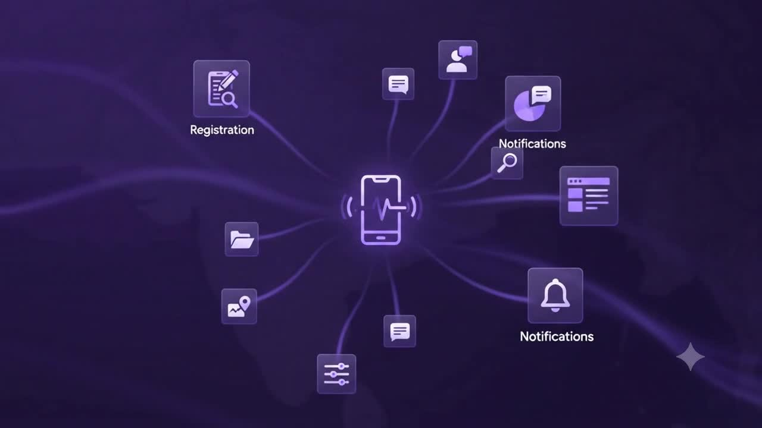

SHUBHAM - RUCHA
- AAYUSH - SHANTARAM

Slide 2

PROBLEM STATEMENT:
Organizers of diverse gatherings—from spiritual events and rallies to corporate summits—struggle with fragmented, single-purpose tools for crowd control, scheduling, and communication.
This lack of an all-in-one platform creates logistical chaos for hosts and a confusing, disconnected experience for attendees.

Slide 3
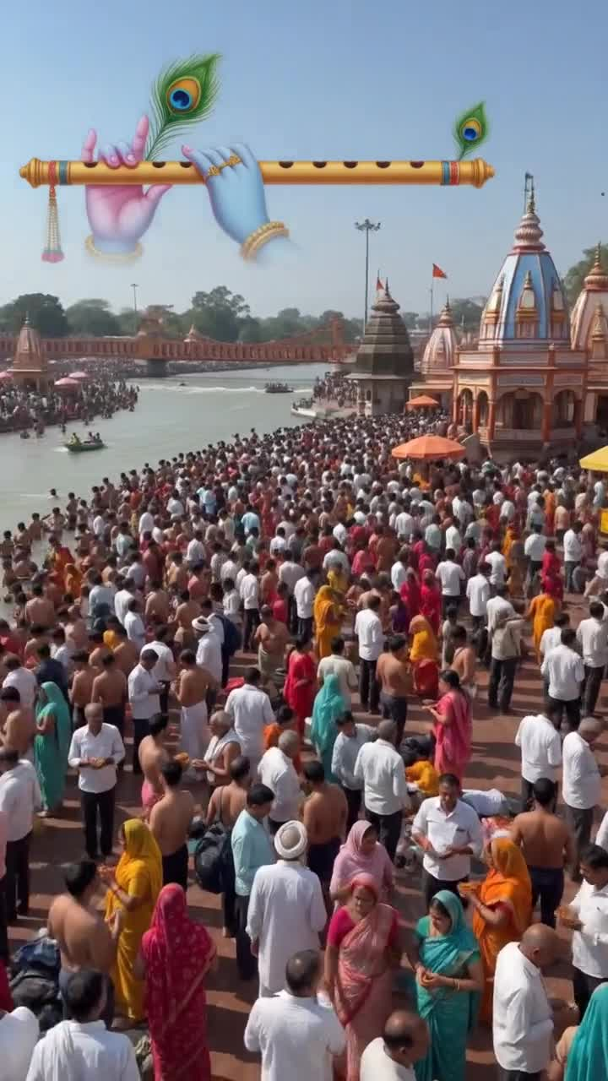

INTRODUCTION
Large-scale gatherings such as Simhastha Kumbh Mela, Pandharpur Wari, religious camps, corporate summits, and public concerts attract thousands or even lakhs of attendees.
Traditional Operational Bottlenecks:
Organizers rely heavily on phone calls, paper logs, spreadsheets, and messaging apps—leading to severe delays, coordination gaps, and resource mismanagement.
The Smart Solution:
A centralized mobile application uniting accommodation, food distribution, volunteer duty logs, emergency alerts, and organizer workflows under one roof.

Slide 4
PROBLEMS
Managing mega events without an integrated digital ecosystem causes widespread operational inefficiencies:
Manual Registrations
Inflexible Accommodation
Paper-based records create long queues and data errors for pilgrims and attendees.
Chaos and unfair distribution due to real-time room availability tracking absence.
Unmonitored Food Distribution
Poor Volunteer Coordination
Food wastage or shortages in Bhandaras without automated schedule broadcasts.
Lack of dynamic duty allocation causing overlaps and unmonitored zones.
Delayed Emergency Responses
Communication Breakdown
Critical medical response delays due to missing geo-tagged SOS alerts.
Inability to issue instant official warnings and crowd control advisories.

Slide 5


PROPOSED SOLUTION
A unified mobile & web platform designed to streamline mass-gathering logistics with end-to-end automation.
For Pilgrims & Attendees
Seamless online registration, slot-based stay booking (6h/12h), live Bhandara meal timings, volunteer sign-up, and instant panic SOS alerts.
For Event Organizers
Centralized administrative dashboard for live resource tracking, volunteer dispatch, push broadcast announcements, and emergency triage.

Slide 6
SYSTEM MODULES
MODULE 01
MODULE 02
MODULE 03
MODULE 04
User Registration
Accommodation
Food Management
Volunteer Desk
Secure onboarding with mobile OTP and email verification for pilgrims and visitors.
6-hour and 12-hour stay booking with live room allocation and capacity tracking.
Real-time Bhandara schedules, food tent locations, and meal distribution logs.
Volunteer registration, duty shift assignments, and location shift management.
MODULE 05
MODULE 06
MODULE 07 — CORE ENGINE
Medical & SOS
Push Alerts
Organizer Central Control Dashboard
One-tap panic alert dispatching real-time location to nearest medical teams.
Instant official broadcasts, crowd control alerts, and schedule changes.
Real-time telemetry and reporting on registrations, stay occupancy, food stocks, active emergency tickets, and volunteer density maps.

Slide 7






SCOPE
Religious Events
Corporate Events
Public Gatherings
Tailored for massive spiritual gatherings with high footfall:
Structured delegate and resource management:
High-capacity public crowd management:
•
Simhastha Kumbh Mela
•
National Conferences
•
Trade Exhibitions
•
Pandharpur Wari Palkhi
•
Seminars & Workshops
•
Sports Events & Arenas
•
Temple Festivals & Camps
•
Employee Expos & Meets
•
Music Concerts & Festivals

Slide 8
BENEFITS & OUTCOMES
Benefits for Participants
Easy online registration
Hassle-free accommodation booking
Quick access to food information
Volunteer participation through the application
Faster emergency assistance
Better communication with organizers
Benefits for Organizers
Centralized event management
Reduced paperwork
Better crowd management
Efficient volunteer coordination
Real-time monitoring of resources
Easy generation of reports and statistics

Slide 9
FUTURE SCOPE
AI Crowd Analytics
QR & RFID Entry
In-Venue GPS
Predictive crowd density models and automated resource allocation.
Automated gate verification and seamless participant tracking.
Live indoor navigation mapping camps, food tents, and medical hubs.
Digital Payment Gateway
Multi-Language & Offline
AI Chatbot Assistant
UPI & card integrations for
paid bookings and digital donations.
Regional language support and offline sync for low-network zones.
Automated 24/7 attendee support answering inquiries instantly.

Slide 10

THANKYOU!
Questions & Discussion

