Slide 1
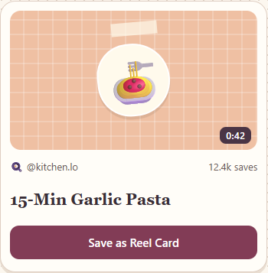
PRODVERSE / SOCIAL MEDIA
01
Reel Cards
A flashcard you can save while watching a reel.
Instagram feature proposal / ProdVerse Theme 02

Slide 2
PRODVERSE / SOCIAL MEDIA
02
Dinner, three days later
The oil is hot. You remember the garlic pasta reel. What did the cook keep before draining the pot?
Finding the video still leaves you looking for the right second.

Slide 3
PRODVERSE / SOCIAL MEDIA
03
Where RemNote fits
RemNote accepts a YouTube link, generates flashcards and schedules reviews.
Reel Cards proposes a different starting point. While watching a reel, tap Save as Reel Card to keep one editable question.
Notes:
RemNote product source: https://www.remnote.com/youtube_to_cards . The proposed Instagram placement is a product design, demonstrated in a standalone prototype.

Slide 4
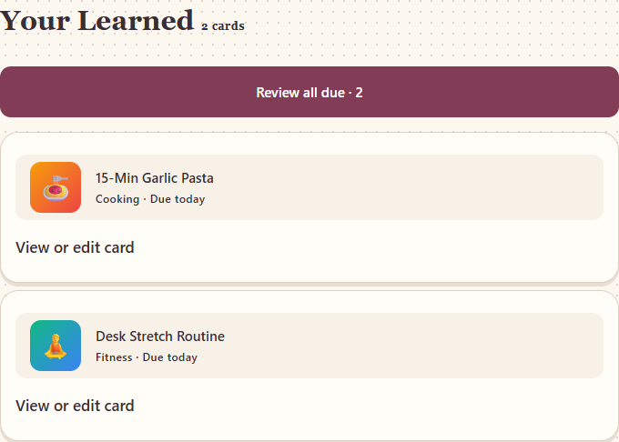
PRODVERSE / SOCIAL MEDIA
04
One tap while watching
Choose the lesson you want to practise. Your card keeps the creator and the steps together.
Only reels you explicitly save as cards enter Learned.

Slide 5
PRODVERSE / SOCIAL MEDIA
05
When the card returns
Try answering from memory. Flip to check. Rate how you did.
Successive correct reviews schedule the next check in 1, 3 and then 8 days. A forgotten card returns tomorrow.

Slide 6
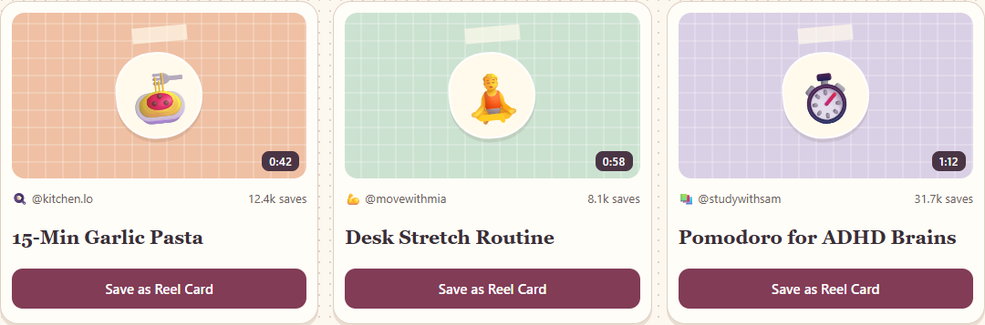
PRODVERSE / SOCIAL MEDIA
06
The prototype feed
Three prepared lessons let you try the whole experience.

Slide 7
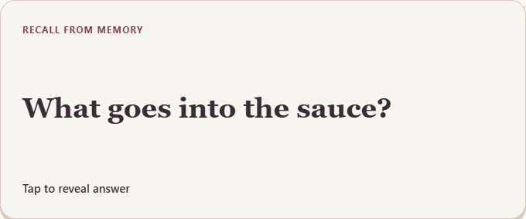
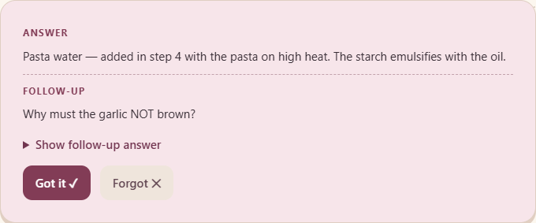
PRODVERSE / SOCIAL MEDIA
07
The flip moment
What goes into the sauce?
Give the audience a moment to guess before showing the answer.

Slide 8
PRODVERSE / SOCIAL MEDIA
08
Who would use it?
Start with home cooks who already screenshot instructions. Ask them to bring one recipe they tried last week.
Then test the same interaction with a desk routine or a study technique.

Slide 9
PRODVERSE / SOCIAL MEDIA
09
What would prove it works?
Seven days after the save, can the viewer recall the key step without replaying the reel?
Compare correct answers in the Reel Cards and ordinary Saved groups using the same question and scoring rule.

Slide 10
PRODVERSE / SOCIAL MEDIA
10
An eight-week pilot
Randomly offer the feature to half of a pilot sample of Instagram users aged 18–30 in India.
Proposed expansion threshold: a 10 percentage point lift in seven-day recall and at least half of started reviews completed.

