Slide 1
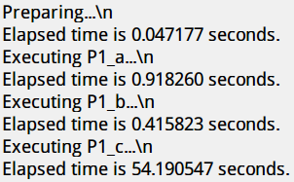
Homework1
To execute my programs
For problem 1 , please execute “P1.m” .
For problem 2 , please execute “P2.m” .
For problem 3 , please execute “P3.m” .
To evaluate the results
For problem 1 , please seek the results in directory “P1_results” .
For problem 2 , please seek the results in directory “P2_results_X” .
For problem 3 , please seek the results in directory “P3_results” .

