Slide 1
高斯在1829年就證明了Least Square效果優於其他Objective Function，在「Data不存在outlier」的情況，在預測i.i.d(相同趨勢的獨立)未知數據點時，有最小的誤差期望值。
在Regression中，(2)式懲罰在某個維度上產生過大的誤差，而(1)式只要能「在某個維度增加誤差e₁，而讓其他維度的誤差總和下降>e₁的量」，就會使整體誤差下降。
現在考慮如右圖的情況，在一個平面上分布許多點， 利用(1)式和(2)式分別擬合後得到兩條趨勢線，紅線為 (1)式的結果，綠線為(2)式的。
那麼你可以看見由紅線轉為綠線後，綠色點的 誤差減少了，而紅色點和黃色點誤差增加了。
已知黃色點是outlier，那麼(2)式可以降低outlier的影響 ，在已知outlier濃度的情況下，甚至有助於找出outlier。
因此，在理想的情況下， (1)式較好。反之若對資料有一定了解，例如存在少量outlier，或其他特殊應用(需要根據當時情況判斷)下，(2)式則可能有較好的表現。
(Empirical error)

Slide 2
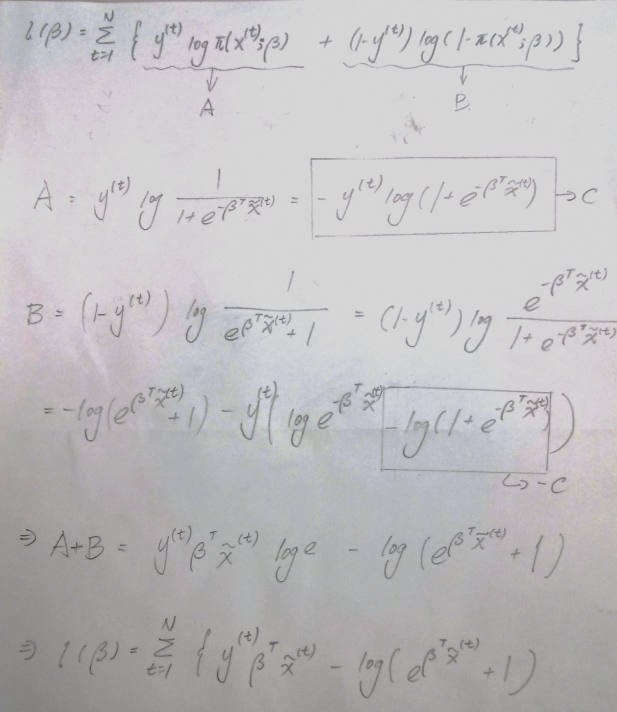

Slide 3
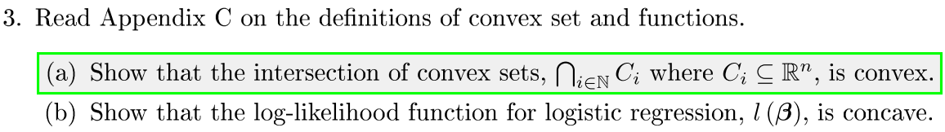
凸集合的充要條件是：一個集合，任兩個集合內的點連線上的所有點都在該集合內。
欲證明任意多個凸集合的交集是凸集合，只要證明兩個凸集合的交集是凸集合即可。
兩個凸集合的交集可能是空集合，而空集合是凸集合。
若兩個凸集合的交集不是空集合：
Given two points x₁,x₂，and two sets S₁,S₂
Given that x₁ ∈ S₁ , x₂ ∈ S₁ , x₁ ∈ S₂ , x₂ ∈ S₂ , x₃ = θx₁+(1-θ)x₂ ,where θ ∈ [0,1]
Then we have x₃ ∈ S₁ , x₃ ∈ S₂
That is, x₃ ∈ S₁∩S₂
Thus, the set S₁∩S₂ is concave, for x₃ is any linear interpolation of two points x₁ and x₂ in S₁∩S₂ , and x₃ ∈ S₁∩S₂

Slide 4
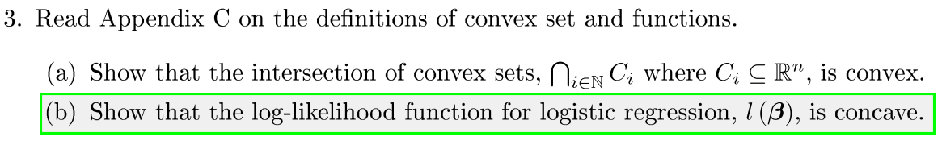

Result of adding 2 concave functions is a concave function.
A linear function is both a convex function and a convex function.
The goal is to proof that is concave.
Linear function is concave, by property A.
is convex, for its first derivative and second derivative are both greater than 0. Thus, is concave.
Hence, by property B, is concave.
As a consequence, is concave, by property B.

Slide 5
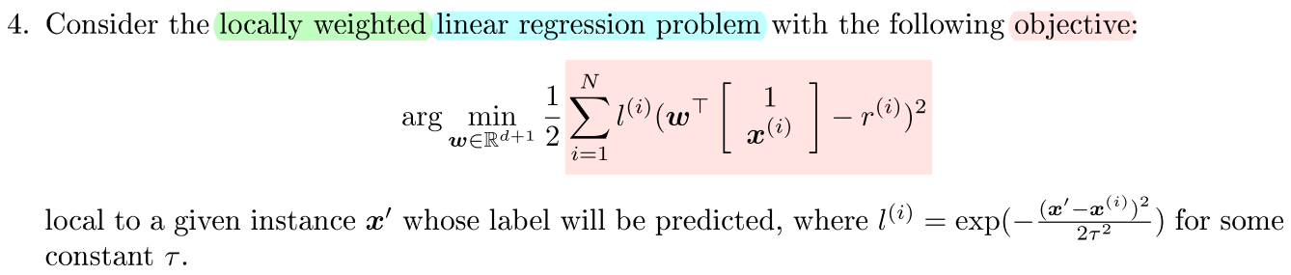
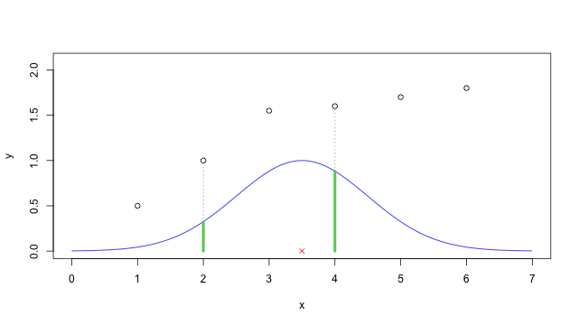
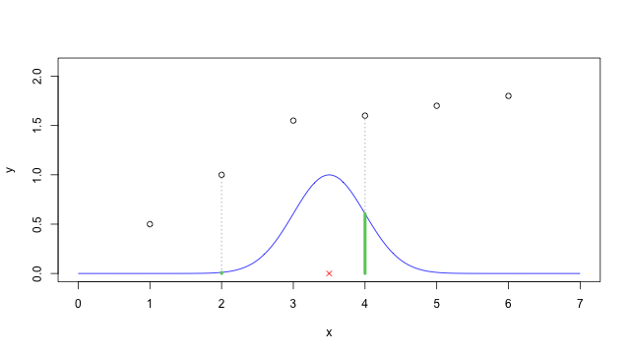
1-D example : x = 3.5 with τ = 1
1-D example : x = 3.5 with τ = 0.5
y = l^{(i)}
y = l^{(i)}
Images copied from: http://www.gtwang.org/2013/07/standford-machine-learning-3.html

Slide 6
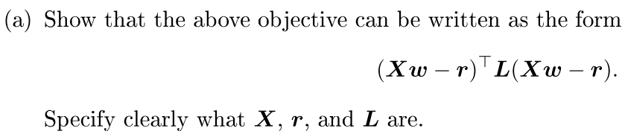
X is all the data, each row is a single data point, which contains 1 and x^{(i)}.
w is the coefficient array, in which row 1 is w₀, row 2 is w₁, and so on.
r is the label array, dimension of which agrees with Xw.
Xw – r is the error term, which means the error (distance) of Xw and r.
L is a N × N diagonal matrix, with elements from ½l ⁽¹⁾ to ½l ^{(n)} .
In fact, we can drop the ½.
Details as below. You can see that ( Xw – r )^{T} L ( Xw – r ) is the objective.
1 | x⁽¹⁾
x⁽²⁾
x⁽³⁾
…
x^{(n)}
x⁽¹⁾w
x⁽²⁾w
x⁽³⁾w
…
x^{(n)}w
r⁽¹⁾
r⁽²⁾
r⁽³⁾
…
r^{(n)}
x⁽¹⁾w - r₁
x⁽²⁾w – r₂
x⁽³⁾w – r₃
…
x^{(n)}w - r_{n}
l ⁽¹⁾
 | l ⁽²⁾
 |  | l ⁽³⁾
 |  |  | …
 |  |  |  | l ^{(n)}
½ l ⁽¹⁾ ( x⁽¹⁾w - r⁽¹⁾ )² +
½ l ⁽²⁾ ( x⁽²⁾w – r⁽²⁾ )² +
½ l ⁽³⁾ ( x⁽³⁾w – r⁽³⁾ )² +
… +
½ l ^{(n)} ( x^{(n)}w - r^{(n)} )²
w₀
w₁
…
X
w
Xw
r
Xw-r
2L
( Xw – r )^{T} L ( Xw – r )

Slide 7
Objective of linear regression is ( w₀ + w₁x^{(i)} +… -r^{(i)} )² , and its close form solution is w = (X^{T} X)⁻¹ X^{T} r .
Objective of linear regression is ½ l^{(i)} ( w₀ + w₁x^{(i)} +… -r^{(i)} )², which is equal to ½ ( w₀√l^{(i)} + w₁ √l^{(i)}x^{(i)} +… - √l^{(i)}r^{(i)} )² .
So we can turn X into X_{weighted} , just like the right table.
Thus, X_{weighted}^{T} X_{weighted} = X^{T}LX.
And turn r into r_{weighted} , just like the right table.
Thus, ( X^{T} L X )⁻¹ X_{weighted}^{T} r_{weighted} = X^{T}Lr.
As a conclusion, the closed form solution of w is ( X^{T} L X )⁻¹ X^{T} L r .
Σ | N
 | i=1
√(½l⁽¹⁾) | √(½l⁽¹⁾) x⁽¹⁾
√(½l⁽²⁾) x⁽²⁾
√(½l⁽³⁾) x⁽³⁾
…
√(½l^{(n)}) x^{(n)}
Σ | N
 | i=1
Σ | N
 | i=1
X_{weighted}
√(½l⁽¹⁾) r⁽¹⁾
√(½l⁽²⁾) r⁽²⁾
√(½l⁽³⁾) r⁽³⁾
…
√(½l^{(n)}) r^{(n)}
r_{weighted}

Slide 8
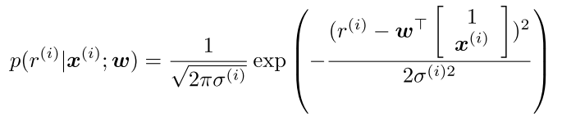
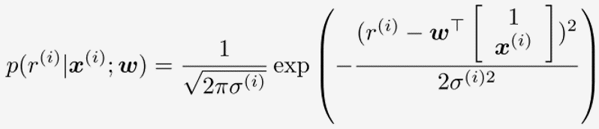
arg_{w} max
≡ arg_{w} min
≡ arg_{w} min …(1)
Π | N
 | i=1
Π | N
 | i=1
Π | N
 | i=1
Π | N
 | i=1

Slide 9
Since is a constant value for a certain sample set, (1) can be done by arg_{w} min
≡ arg_{w} min , which is a locally weighted regression problem, with l^{(i)} = 1 / (σ^{(i)})².
Π | N
 | i=1
Π | N
 | i=1
Σ | N
 | i=1

Slide 10
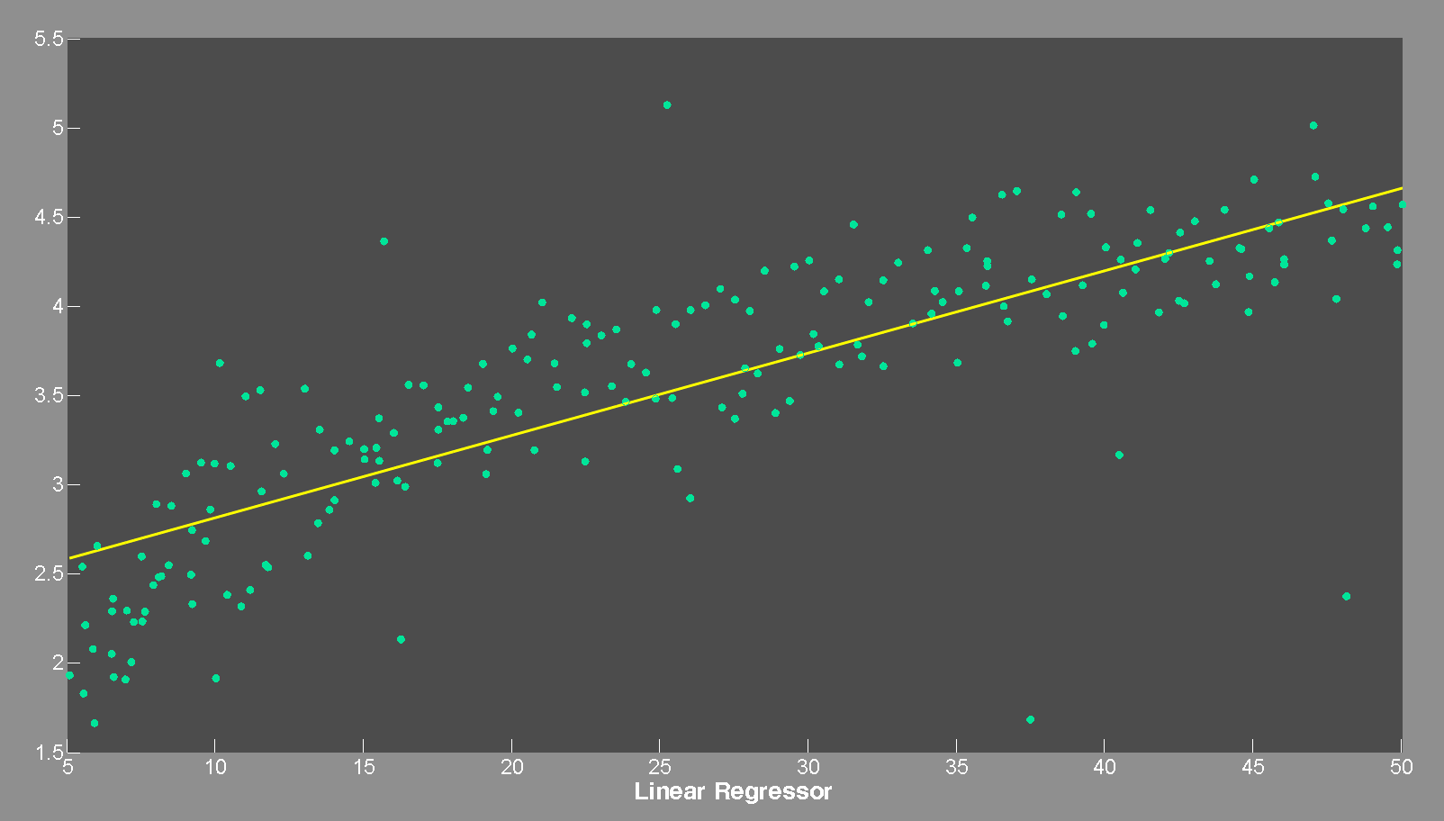

Slide 11
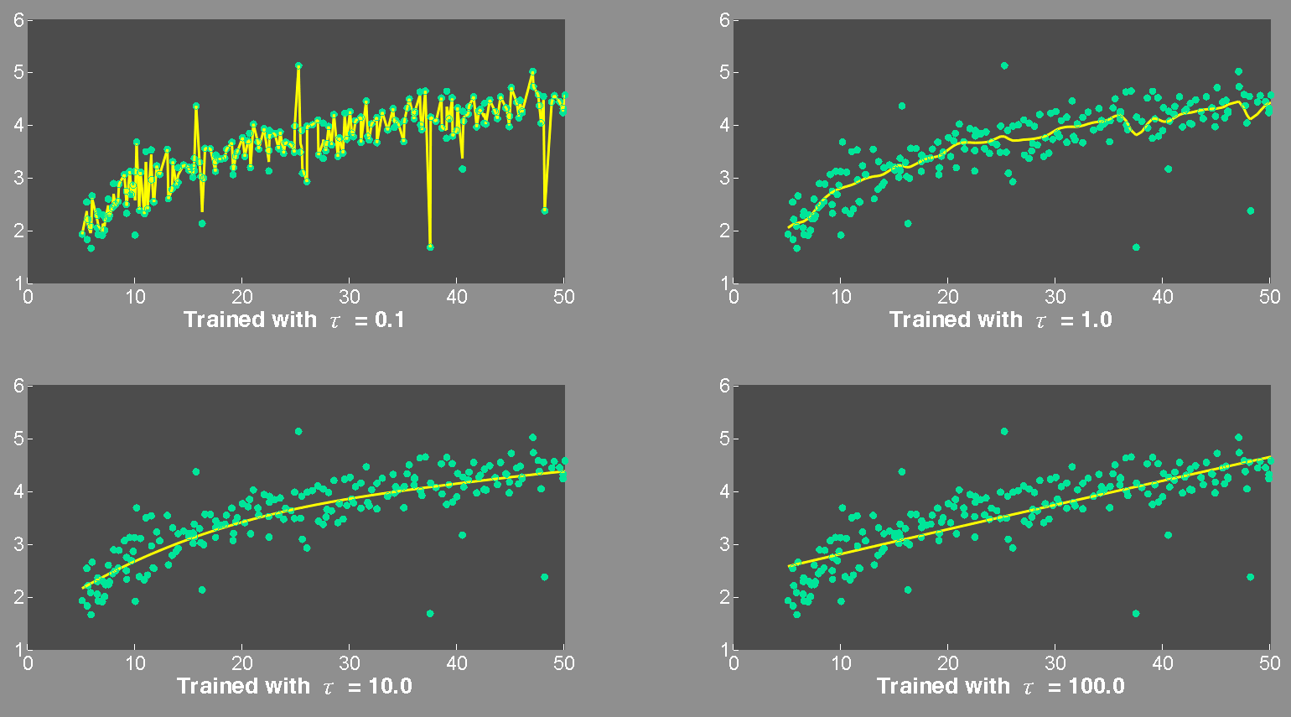

Slide 12
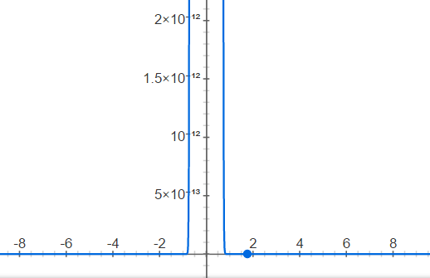
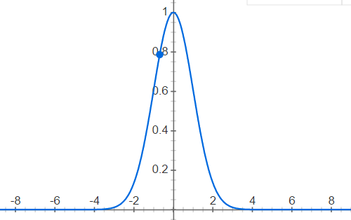
這裡的 τ (bandwidth) 與資料在X軸上分布的範圍有關，對於不同的dataset，需要不同的τ
l with τ = 0.1
τ = 0.1時，效果非常差，因為參與考慮的只有非常鄰近的資料，因此發生了過適(over-fitting)
l with τ = 1
τ = 1時，效果顯著改善，雖然可以明顯看出受到雜訊影響，不過整體迴歸合理性已經大幅上升

Slide 13
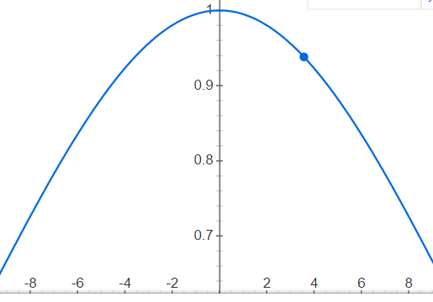
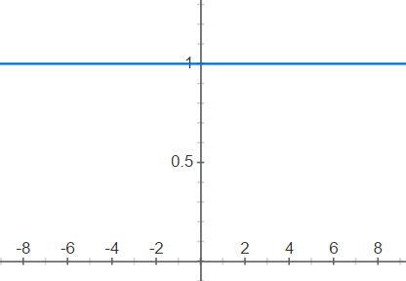
l with τ = 10
τ = 10時，曲線更加平滑
l with τ = ∞
τ = 100，或更大時， 即喪失local weight的效果， 退化為普通的線性回歸
對於這個dataset而言，0.1是一個過小的 τ ，而100則過大。

