Slide 1
Sentimental Style Transfer in Text
With
Multigenerative Variational Autoencoder
Presented by
Mehedi Hasan Palash
Reg. No: 2015331048
Partha Protim Das
Reg. No: 2015331011
Supervisor
Summit Haque
Lecturer
Department of Computer Science and Engineering
Shahjalal University of Science and Technology
Notes:
Good morning, I’m mehedi hasan palash.
Our thesis work is based on Transfer of styles in text.

Slide 2
What is style?
The “style curve” of a random human specimen
score
Political
stand
Humour
Empathy
Narcissism
Sentiment
. . .
attributes
Notes:
Every human stands in a specific range in the big space of different aspects of socio-personal life. For example, everybody has different views and opinions about politics. Everyone individually has a unique sentimental standpoint.
This hypothetical graph shows how much a random person can be sensitive to these aspects. The curve goes thru the averages of the ranges.
We choose to work on the human sentiment values.

Slide 3
Our goal
Changing sentiment of text (positive and negative) using multi-generative variational autoencoder
positive
negative
Notes:
The task of transferring style is huge and diverse.
We narrowed down our job to just change the sentiment of the given sentences, that is-to interchange between positive, and negative sentences
keeping the context similar.

Slide 4
Challenges in Language Style Transfer
Linguistic expressions work in subtle ways
Content must be preserved
Discreteness
Notes:
There are some challenges in language style transfer. The structure of language is very complex. It’s very hard to separate style from content. And other problem is discreteness. It makes meaning of language very ambiguous.

Slide 5
Datasets
Prothom Alo comments
From prothom-alo website
Multi Domain
13000 data
Cricket dataset
From github
Only about cricket
2700 comments
Restaurant dataset
From github
Only about restaurant
1600 comments
Facebook comments
Multi Domain
21000 comments
Notes:
We worked with two types of data: single domain and multi domain.
The prothom alo and facebook comments datasets are multi domain datasets. Comments about cricket and restaurant collected from github are single domain datasets.
In size the facebook comments dataset is the largest, but it was not clean, on the other hand the cricket dataset is the cleanest. It is also tagged well.

Slide 6
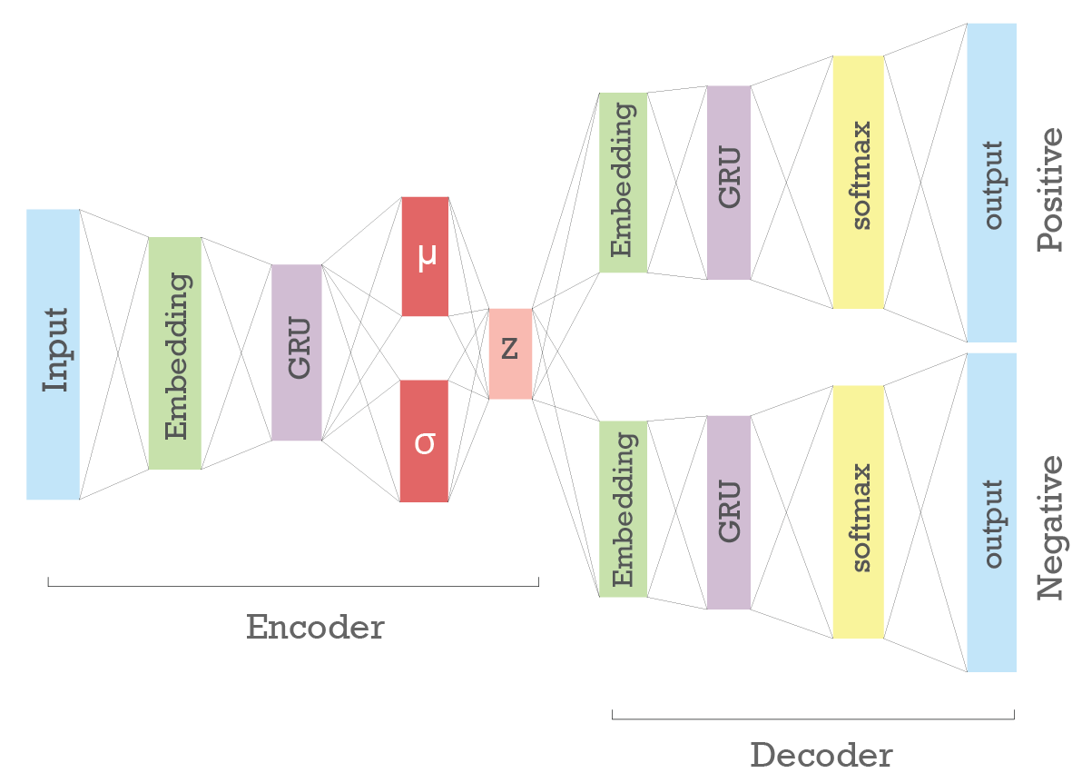
Architecture
Notes:
We choose to work with a variational autoencoder.
At the encoder part we fed the labeled sentences and at the generator we tried to reconstruct the sentences.
We used one generator for positive sentences and one for negative sentences.
In the mean time the internal structure of the language is learnt.
We added an embedding layer in the encoder and generator so that the words are better learnt. For the generation task, we used Gated Recurrent Unit.

Slide 7
Hyper-Parameters
HIDDEN SIZE | 300
LATENT SIZE | 10
LEARNING RATE | 0.001
BATCH SIZE | 32
STEPS | 300
Notes:
These are the hyper parameters of our model.
We trained our model for 300 epochs.

Slide 8
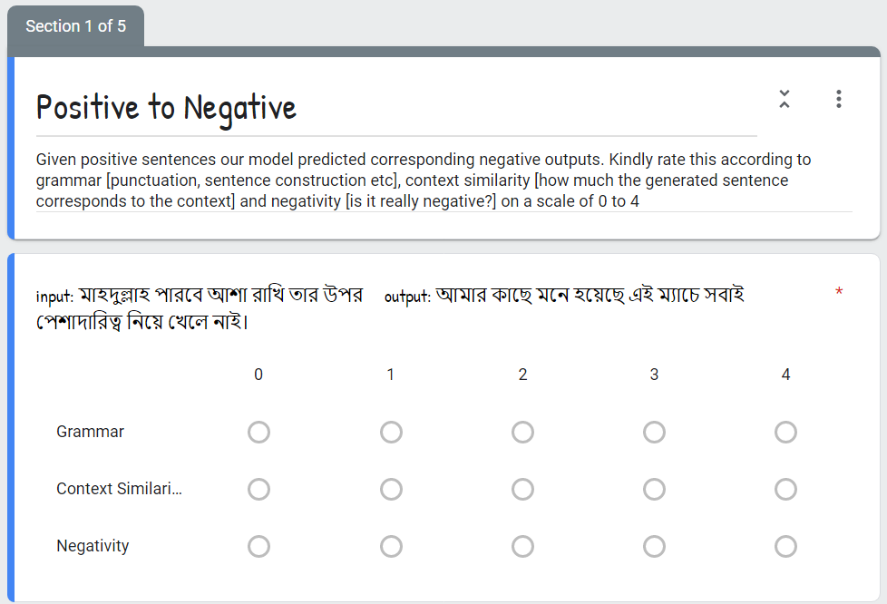
Evaluation Method
Notes:
We used three parameters in our evaluation method: the grammatical correctedness, the context similarity and the positivity and negativity of the generated texts.
We set up a google form and gathered some sentences along with the generated outputs. We collected 20 responses and used the mean of the points.

Slide 9
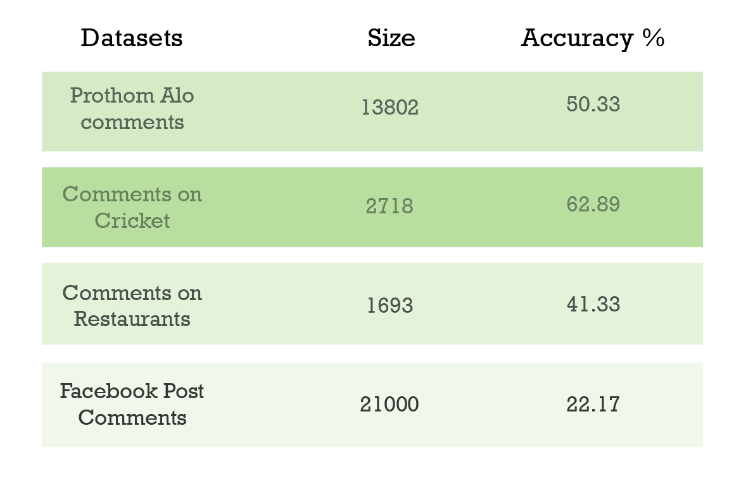
Experiments
Notes:
Of all the datasets we used, we found that the Cricket dataset gives the highest accuracy, 63%, because this is single domain, and also is tagged very well.
Though the facebook dataset is big in size, it doesn’t work well because it’s noisy and most of the comments are written in roman alphabet.

Slide 10
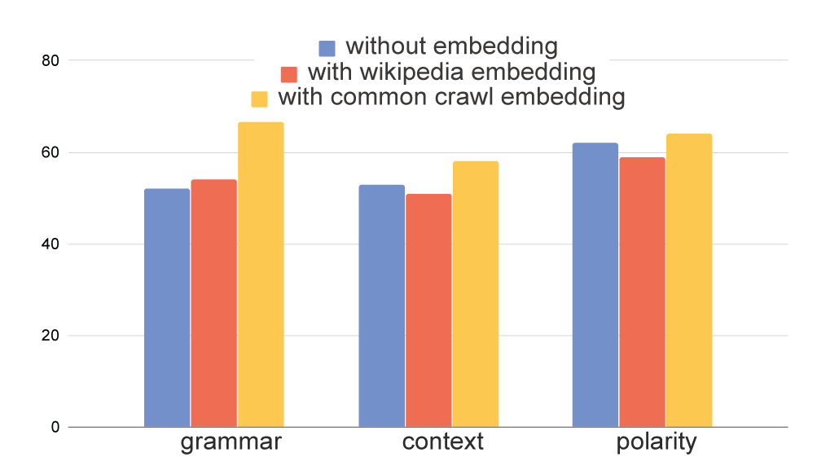
Result comparison (embeddings)
Notes:
We used three embeddings: untrained embedding, wikipedia embedding and common crawl embedding.
Here is a comparison between the used embedding in our model. As we can see that it works trememdously well especially in grammatical correctedness if embedding is used.
The common crawl embedding works better than the wikipedia one, because there are more words common between the cricket dataset and common crawl dataset, rather than the wikipedia embedding. Moreover, the common crawl embedding is pretty big than the other one, so it works well.

Slide 11
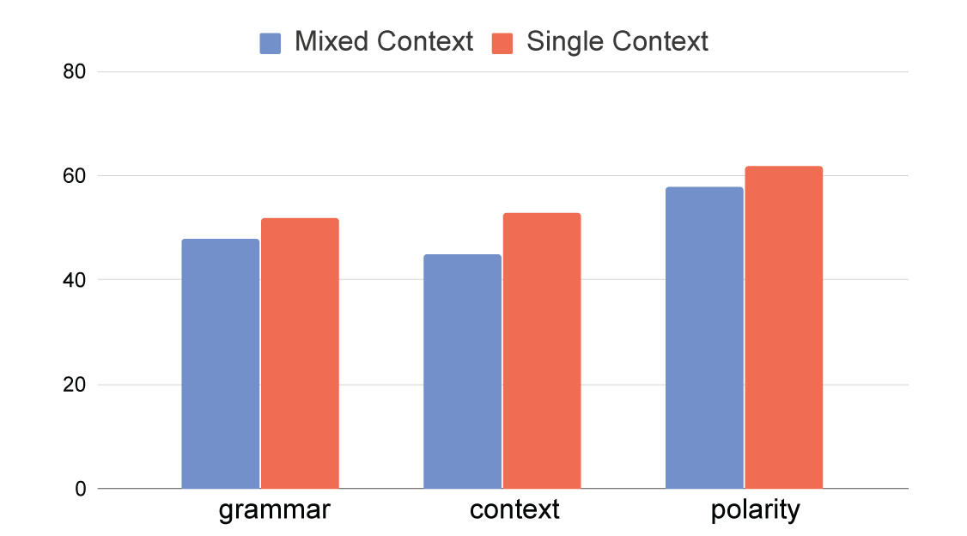
Result comparison (domains)
mixed domain single domain
Notes:
There is also some insightful finding we get while working with different domains. When we use a single domain, the model can generate sentences which are more accurate in context than if used a multi domain dataset.

Slide 12
Sample Output
Positive to Negative
রাজ্জাক নিজের জন্য নয়,
দেশের জন্য প্রাণ উজাড় করে খেলে
রাজ্জাক বুড়া হয়ে গেছে খেলা পারেনা
Notes:
Here is an example of our model’s sentence generation;
If we feed the positive sentence, we get a sentence which can be regarded as a negative sentence with a similar context.

Slide 13
Sample Output
Negative to Positive
একজন খেলোয়াড়ের ক্যরিয়ার কিভাবে ধ্বংস করতে হয় সেটা মমিনুলের উপর হাতুরুর যে ভয়াবহ আক্রোশ থেকেই প্রমাণিত হয়েছে
তাঁকে যদি জুনিয়রদের মতো সুযোগ দেওয়া হত সে বাংলাদেশ ক্রিকেটের অন্যতম তারকা হয়ে উঠত
Notes:
Likewise, for a negative sentence we can get a positive sentence.

Slide 14
Future Scopes
Exploring other sides of human sentiment
Inventing evaluation method in bangla
Notes:
In future, there are scopes to work with various sentiments of humane expressions, rather than just positivity and negativity.
Also, some standard evaluation method can also be formed like we have bleu for english.

Slide 15
Thank You!

