Slide 1


SMART INDIA HACKATHON 2026
System integration and interoperability among government digital platforms,resulting in fragmented service delivery
Problem Statement ID –SIH26129
Problem Statement Title- System integration and interoperability among government digital platforms,resulting in fragmented service delivery
Theme- Miscellaneous
PS Category- Software
Team ID-
Team Name (Registered on portal)

Slide 2
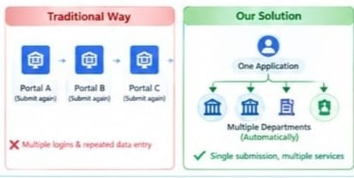
System integration and interoperability among government digital platforms,resulting in fragmented service delivery
VisionX
Proposed Solution & How the address the problem
→ Enter details only once.
→ One login for multiple government services.
→ Converts different department formats into one common format.
→ Connects REST, SOAP/XML & legacy systems through adapters.
→ Identifies existing citizen records and avoids duplication.
→ Data is shared only with authorized departments.
→ Application automatically moves between required departments.
→ Failed requests are queued and retried instead of making citizens reapply.
→ One Application ID shows the complete service journey.
→ Every important transaction is recorded and traceable.
→ Cryptographic ledger helps verify important records.
→ Departments can monitor applications, services and failures.
Innovative and Uniqueness
Apply Once → Protocol Translation → Consent →Failure Recovery → Unified Tracking

Slide 3
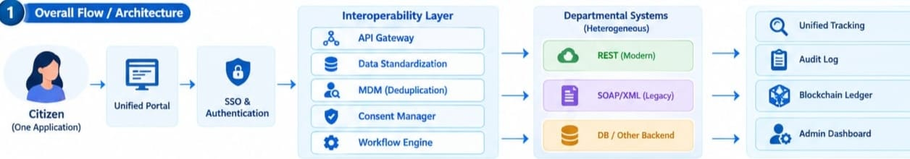
TECHNICAL APPROACH
VisionX
Technologies Used:
HTML, CSS, JavaScript
Python, Flask
SQLite
REST API, SOAP/XML
JWT, RBAC, SHA-256
Citizen → SSO Login → Unified Application → Data Standardization → API
Gateway → Workflow Engine → Government Departments → 360° Tracking
→ Service Delivery

Slide 4
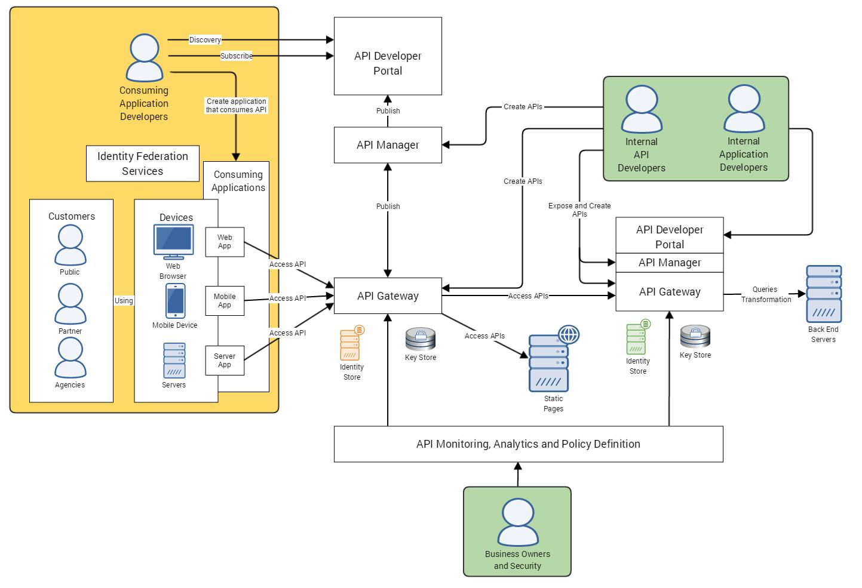
FEASIBILITY AND VIABILITY
VisionX
Citizens
Uses existing government platforms
Supports REST, SOAP/XML & legacy systems
Modular & scalable architecture
Uses open-source technologies
Strategies
Data standardization for different formats
API adapters for legacy systems
SSO + RBAC + Consent for security
MDM + validation for data quality
Challenges & Risks
Different data formats
Legacy system compatibility
Data privacy & security
Duplicate/inconsistent data

Slide 5

IMPACT AND BENEFITS
VisionX
👤 Citizens
One-stop access to government services
Less repeated form filling
Real-time application tracking
Faster & transparent services
🌍 Benefits
🏛 Government
Social: Transparent & accessible services
Economic: Reduced administrative cost
Environmental: Less paper & fewer physical visits
Seamless data sharing
Reduced duplicate records
Better inter-department coordination
Improved monitoring

Slide 6
RESEARCH AND REFERENCES
VisionX
RESEARCH & REFERENCES
Reference
Source / Link
Use in Solution
IndEA 2.0
India Enterprise Architecture Framework Guidelines (MeitY)
Interoperability, architecture & federated government services
DPDP Act 2023
Digital Personal Data Protection Act 2023
Consent, privacy, accountability & data handling controls
NeGD SSO
NeGD Single Sign-On / government SSO standards
Unified citizen authentication and federated access
Project Codebase
Live GitHub: github.com/mepellireeta-wq/interoperability-framework
Prototype implementation, connectors and integration workflow

