Slide 1
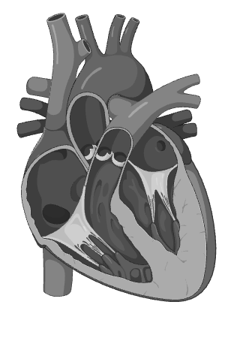
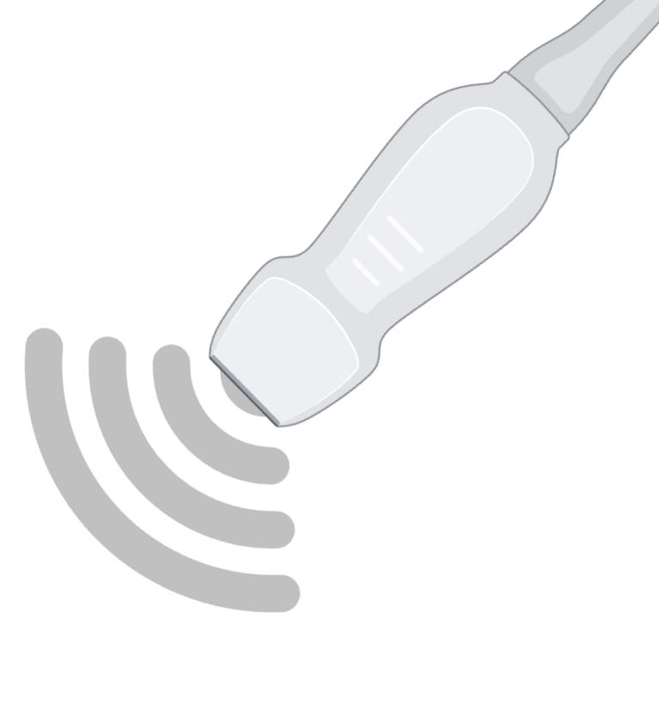


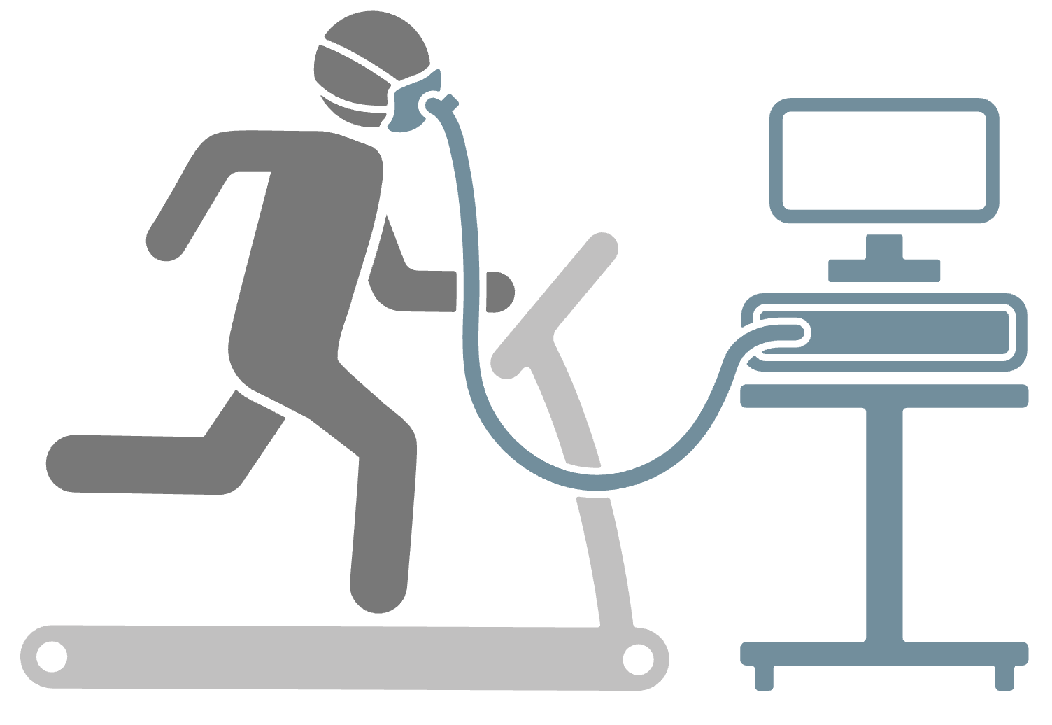

Graphical Abstract: Noninvasive diastolic dysfunction and clinical prognosis.
Study Design & Patient Selection
Functional Assessment & Data Collection
Analytic Approach & Outcomes
426 HCM Patients
(Phenotype +)
Echo: LVDD Assessment (ASE 2025)
1. Cross-sectional Association
LAVI
(>34 mL/m²)
Ar-A
(≥30 ms)
Piecewise nonlinear modeling (SEAMLSS)
INCLUSION
Peak VO₂
LVEF > 55%
Complete Diastolic Assessment
Serial CPET
Peak TR
(>2.8 m/s)
Avg E/e’
(> 14)
Individual LVDD Indices
Left Ventricular Diastolic Dysfunction
EXCLUSION
Cardiopulmonary Fitness (CPET)
2. Longitudinal Fitness Trajectory Prediction
Confounding Illness (Pulmonary, valvular, coronary)
Infiltrative cardiomyopathy
Inadequate CPET Effort
Generalized Additive Mixed Model (GAMM)
pVO₂
Lean B.M. adj.
Baseline
Δ Peak VO₂
Follow-up
HCM COHORT
(N = 398)
VE/VCO₂
Lean B.M. adj.
Individual LVDD Indices
Exercise Intolerance
Conclusion: A modest nonlinear relationship links E/e’ and pVO₂.

Slide 2
Table 1
Characteristic | N = 397¹
Age, years | 47.3 (16.1)
Sex
Male | 248 (62%)
Female | 149 (38%)
Body Mass Index, kg/m² | 27.2 (5.7)
Body Surface Area, m² | 1.9 (0.3)
Lean Body Mass Index, kg/m² | 23.4 (5.8)
HCM Phenotype
Apical | 49 (14%)
Asymmetric Septal | 253 (72%)
Burned-out | 3 (0.9%)
Symmetric | 45 (13%)
Peak RER | 1.1 (0.1)
Peak VO₂ (PP - FRIEND 2.0) | 75.5 (236.9)
VO₂ (PP – WASSERMAN) | 98.8 (83.2)
VE/VCO₂ Slope | 31.3 (5.8)
Heart Rate Recovery (1-min) | 27.5 (11.8)
¹Mean (SD); n (%)

Slide 3
Figure 1: Study cohort and baseline phenotypic distribution
F. Distribution of ASE 2025 diastolic grades
E/e’
LAVI
A-Ar Duration difference
TR velocity
EF
LVOT Gradient

Slide 4
Figure 2: Primary endpoint – cardiorespiratory fitness as a function of diastolic dysfunction.
A. Peak VO2 by ASE Diastolic Grade
B. VE/VCO2 slope by ASE Diastolic Grade
Box plots
Box plots
Peak VO2 (mL/min/kg L.B.M.)
VE/VCO2 Slope ([dimensionless]/kg L.B.M.)

Slide 5
Figure 3: Continuous nonlinear modeling via SEAMLSS between pVO₂ and diastolic indices.
A. pVO₂ by E/e’
B. pVO₂ by LAVI
Peak VO2 (mL/min/kg L.B.M.)
Peak VO2 (mL/min/kg L.B.M.)
VE/VCO2 Slope ([dimensionless]/kg L.B.M.)
VE/VCO2 Slope ([dimensionless]/kg L.B.M.)
E/e’
Left Atrial Volume Index (mL/m²)
C. pVO₂ by Ar-A Difference
D. pVO₂ by TR velocity
Peak VO2 (mL/min/kg L.B.M.)
Peak VO2 (mL/min/kg L.B.M.)
VE/VCO2 Slope ([dimensionless]/kg L.B.M.)
VE/VCO2 Slope ([dimensionless]/kg L.B.M.)
Ar-A Difference (ms)
Tricuspid Regurgitation velocity (m/s)

Slide 6
Figure 4: Predicting fitness trajectory using diastolic indices.
A. Serial pVO₂ by E/e’
B. Serial pVO₂ by LAVI
Peak VO2 (mL/min/kg L.B.M.)
VE/VCO2 Slope ([dimensionless]/kg L.B.M.)
VE/VCO2 Slope ([dimensionless]/kg L.B.M.)
VE/VCO2 Slope ([dimensionless]/kg L.B.M.)
Time (yrs)
Time (yrs)
C. Serial pVO₂ by Ar-A Difference
D. Serial pVO₂ by TR velocity
Peak VO2 (mL/min/kg L.B.M.)
VE/VCO2 Slope ([dimensionless]/kg L.B.M.)
VE/VCO2 Slope ([dimensionless]/kg L.B.M.)
VE/VCO2 Slope ([dimensionless]/kg L.B.M.)
Time (yrs)
Time (yrs)

