Slide 1
AUTOSAR RTE - Testing
R21-11

Slide 2
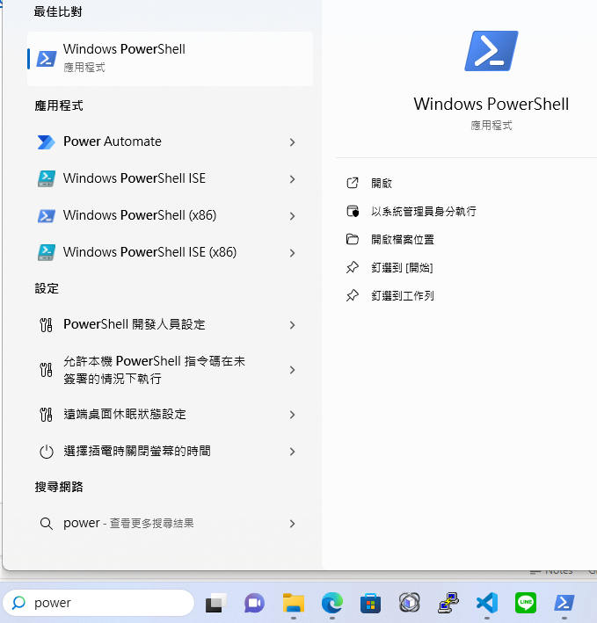
Install AUTOGEN

Slide 3
Install AUTOGEN
oslab-csie-ncku/af_rte_generator: This repo base on autosarfactory (github.com)

Slide 4
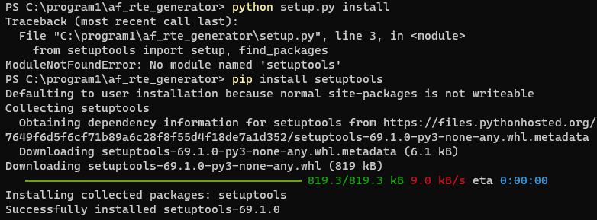
Install AUTOGEN

Slide 5
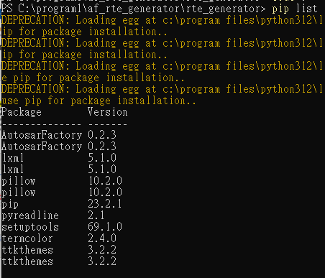
Install AUTOGEN

Slide 6
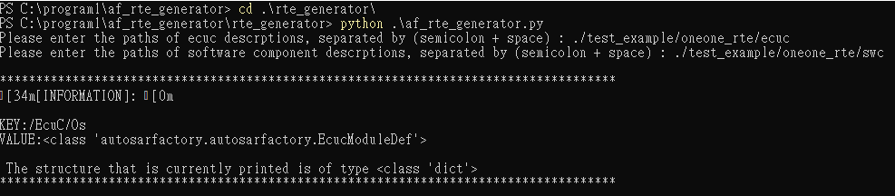
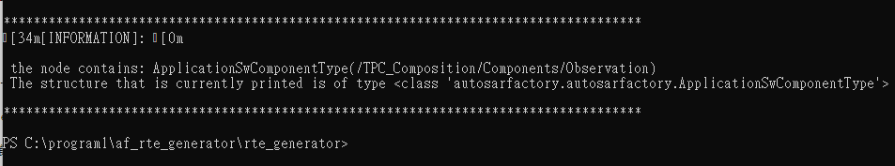
Using AUTOGEN to Generate RTE Code

Slide 7
Using AUTOGEN to Generate RTE Code
oneone_rte | ./test_example/oneone_rte/ecuc | ./test_example/oneone_rte/swc
oneone_ioc | ./test_example/oneone_ioc/ecuc | ./test_example/oneone_ioc/swc
oneone_com | ./test_example/oneone_com/ecuc | ./test_example/oneone_com/swc
one_many_rte | ./test_example/one_many_rte/ecuc | ./test_example/one_many_rte/swc
one_many_ioc | ./test_example/one_many_ioc/ecuc | ./test_example/one_many_ioc/swc
one_many_rte_ioc | ./test_example/one_many_rte_ioc/ecuc | ./test_example/one_many_rte_ioc/swc
many_one_rte | ./test_example/many_one_rte/ecuc | ./test_example/many_one_rte/swc
many_one_ioc | ./test_example/many_one_ioc/ecuc | ./test_example/many_one_ioc/swc
many_one_rte_ioc | ./test_example/many_one_rte_ioc/ecuc | ./test_example/many_one_rte_ioc/swc
af_rte_generator/rte_generator/test_example/tested_rte_functionality at main · oslab-csie-ncku/af_rte_generator (github.com)

Slide 8
Using AUTOGEN to Generate RTE Code
app1
T01
T02
Runnable TxTemp
Runnable TxAcc
Runnable RxAcc
Runnable RxTemp
Rte_Send_ PpIfTemperature_Temp(123)
Rte_Read _RpIfVehAcc_Acc()
Rte_Receive_ RpIfTemperature_Temp()
RTE
Rte_Write _PpIfVehAcc_Acc (254)
Rte Internal Data Instance
Rte_Update
Rte_Retch
254
Rte_Enqueue
Rte Internal buffer
Rte_Dequeue
123

Slide 9
Using AUTOGEN to Generate RTE Code
app1
app2
T01
T11
Runnable TxTemp
Runnable TxAcc
Runnable RxAcc
Runnable RxTemp
Rte_Send_ PpIfTemperature_Temp(123)
Rte_Read _RpIfVehAcc_Acc()
Rte_Receive_ RpIfTemperature_Temp()
RTE
Rte_Write _PpIfVehAcc_Acc (254)
Rte Internal Data Instance
Ioc_Write
Ioc_Read
254
Ioc_Send
Rte Internal buffer
Ioc_Receive
123

Slide 10
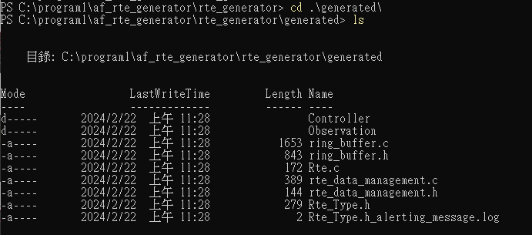
Using AUTOGEN to Generate RTE Code

Slide 11
Using AUTOGEN to Generate RTE Code
oneone_rte | ./test_example/oneone_rte/ecuc | ./test_example/oneone_rte/swc
oneone_ioc | ./test_example/oneone_ioc/ecuc | ./test_example/oneone_ioc/swc
oneone_com | ./test_example/oneone_com/ecuc | ./test_example/oneone_com/swc
one_many_rte | ./test_example/one_many_rte/ecuc | ./test_example/one_many_rte/swc
one_many_ioc | ./test_example/one_many_ioc/ecuc | ./test_example/one_many_ioc/swc
one_many_rte_ioc | ./test_example/one_many_rte_ioc/ecuc | ./test_example/one_many_rte_ioc/swc
many_one_rte | ./test_example/many_one_rte/ecuc | ./test_example/many_one_rte/swc
many_one_ioc | ./test_example/many_one_ioc/ecuc | ./test_example/many_one_ioc/swc
many_one_rte_ioc | ./test_example/many_one_rte_ioc/ecuc | ./test_example/many_one_rte_ioc/swc
af_rte_generator/rte_generator/test_example/tested_rte_functionality at main · oslab-csie-ncku/af_rte_generator (github.com)

Slide 12
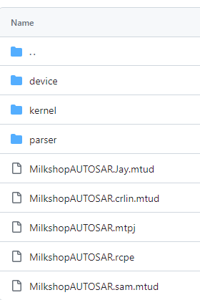
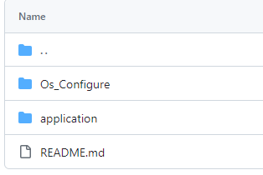
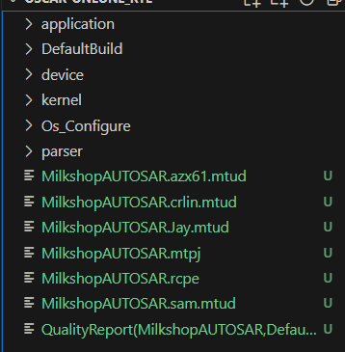
Testing Generated RTE Code – AUTOSAR Os Env
oslab-csie-ncku/AutosarOS (github.com)
AutosarOS/OSCAR at main · oslab-csie-ncku/AutosarOS (github.com)
AutosarOS/Testing/LATEST_MERGE at main · oslab-csie-ncku/AutosarOS (github.com)
1
2

Slide 13
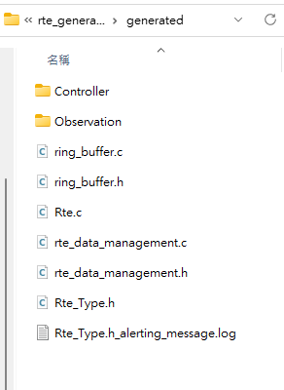
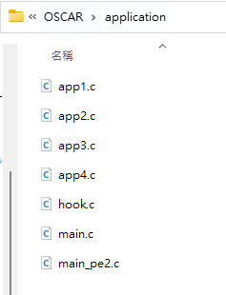
Testing Generated RTE Code
將 generated 的 RTE code 都移到 OSCAR/application 資料夾

Slide 14
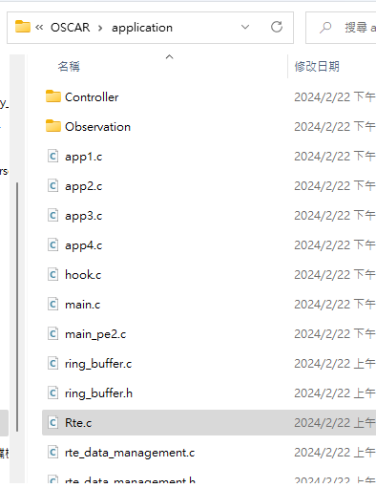
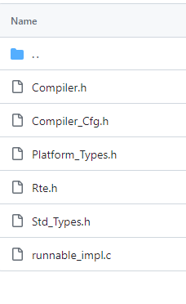
Testing Generated RTE Code
將 af_rte_generator/rte_generator/test_example/oneone_rte/template 檔案都移到 OSCAR/application 資料夾

Slide 15
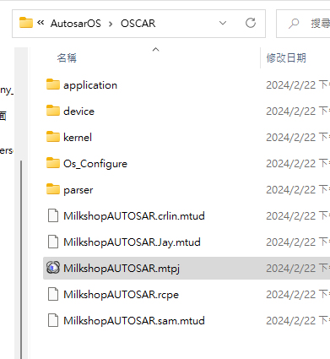
Testing Generated RTE Code
打開 OSCAR/MilkshopAUTOSAR.mtpj

Slide 16
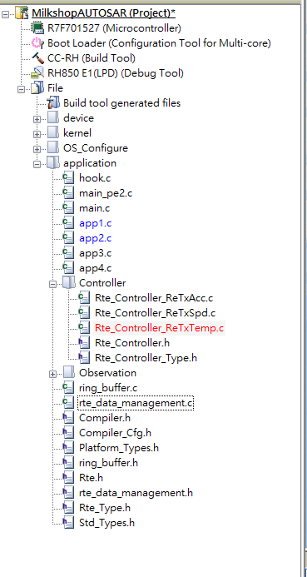
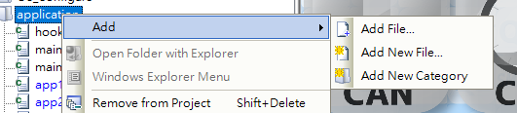
Testing Generated RTE Code
把剛才移到 OSCAR/application 的檔案 加入到
mtpj 左邊 application 的 file tree
runnable_impl.c 跟 Rte.c 不用

Slide 17
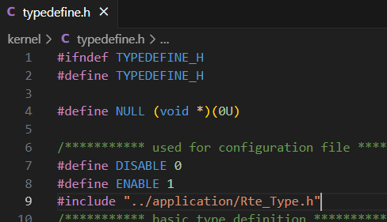

Testing Generated RTE Code
Inlcude Rte_type.h

Slide 18
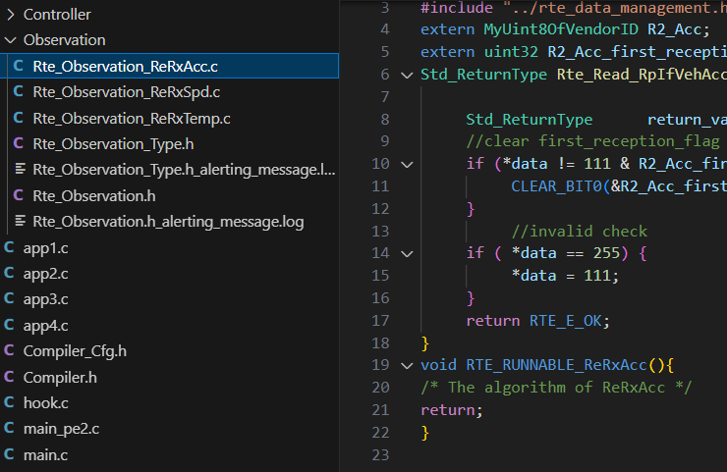
Testing Generated RTE Code
撰寫 Runnable Implementation

Slide 19
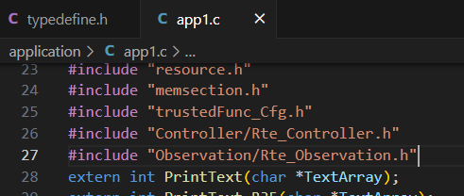
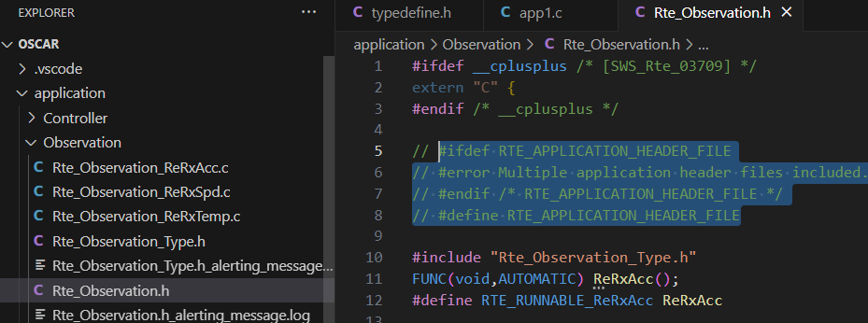
Testing Generated RTE Code
撰寫 app1.c

Slide 20
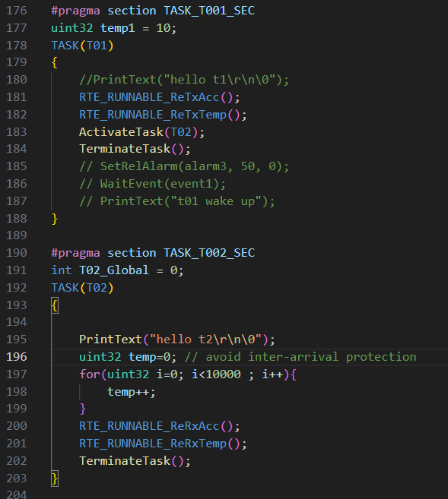
Testing Generated RTE Code
撰寫 app1.c

Slide 21
Lab
重現 oneone_rte & oneone_ioc case
af_rte_generator/rte_generator/test_example/tested_rte_functionality/OSCAR-oneone_rte
af_rte_generator/rte_generator/test_example/tested_rte_functionality/OSCAR-oneone_ioc
oneone_rte | ./test_example/oneone_rte/ecuc | ./test_example/oneone_rte/swc
oneone_ioc | ./test_example/oneone_ioc/ecuc | ./test_example/oneone_ioc/swc

Slide 22
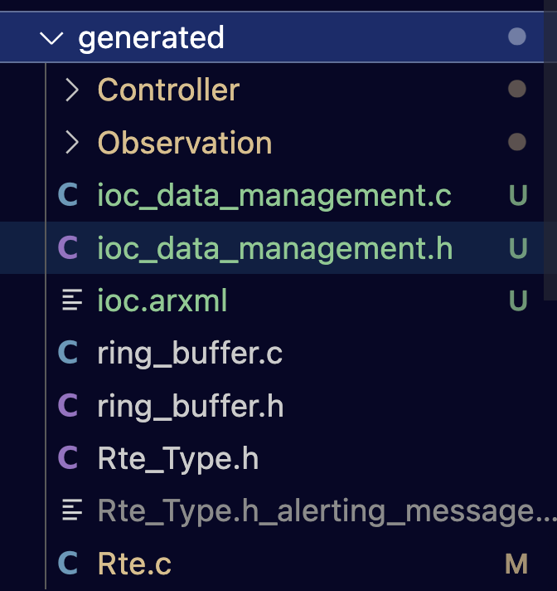
Using Ioc Service

Slide 23
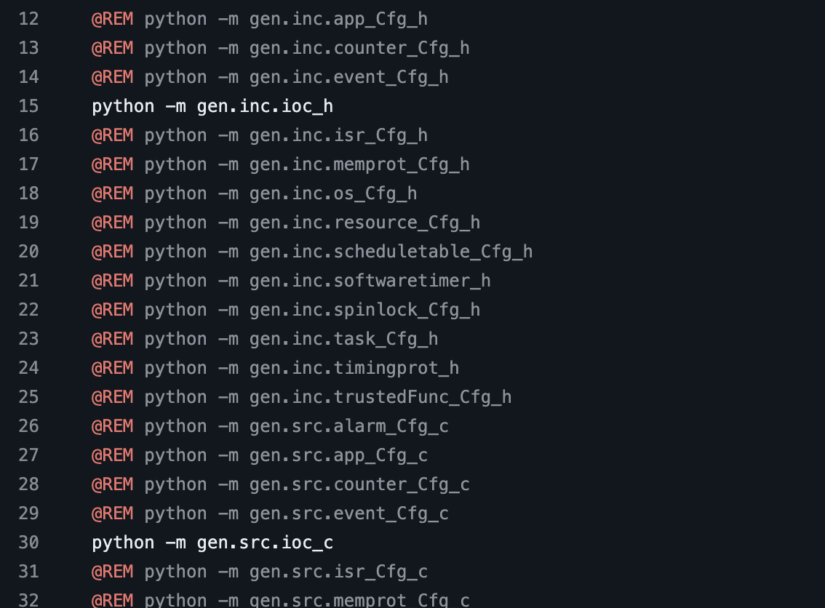
Using Ioc Service
參考 generated/ioc.arxml 來修改 OSCAR/parser/osek.oil
註解 run.bat

Slide 24
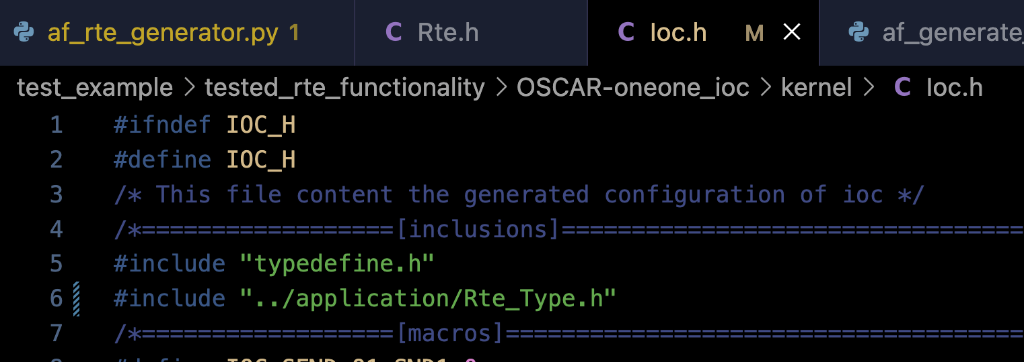
Using Ioc Service
執行 run.bat
這步會更新 OSCAR/kernel/ioc.h, OSCAR/kernel/ioc.c
這樣才會符合 ioc.arx
OSCAR/kernel/ioc.h 需要 include "../application/Rte_Type.h"

