Slide 1

HPC
<number> / 65

Slide 2
Основные характеристики вычислительного кластера
Пиковая (теоретическая) производительность (Tflops)
Linpack производительность (Tflops)
BogoMIPS производительность?
Пропускная способность Interconnect (Gbps)
Задержки Interconnect (ns)
<number> / 65

Slide 3
Основные характеристики вычислительного кластера
Пиковая (теоретическая) производительность (Tflops)
Linpack производительность (Tflops)
BogoMIPS производительность?
Пропускная способность Interconnect (Gbps)
Задержки Interconnect (ns)
<number> / 65

Slide 4
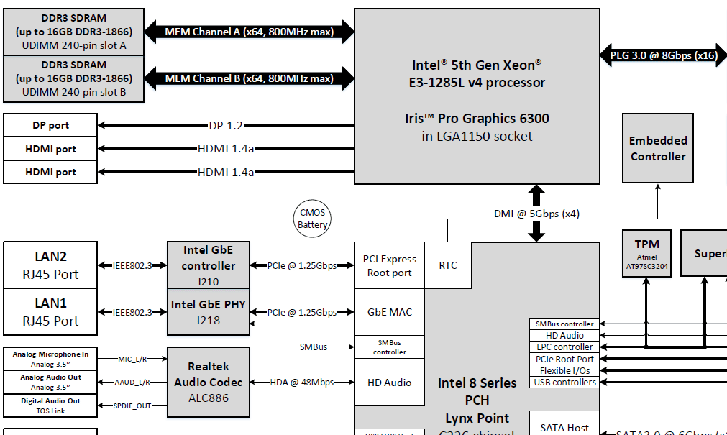
Remember?
<number> / 65

Slide 5
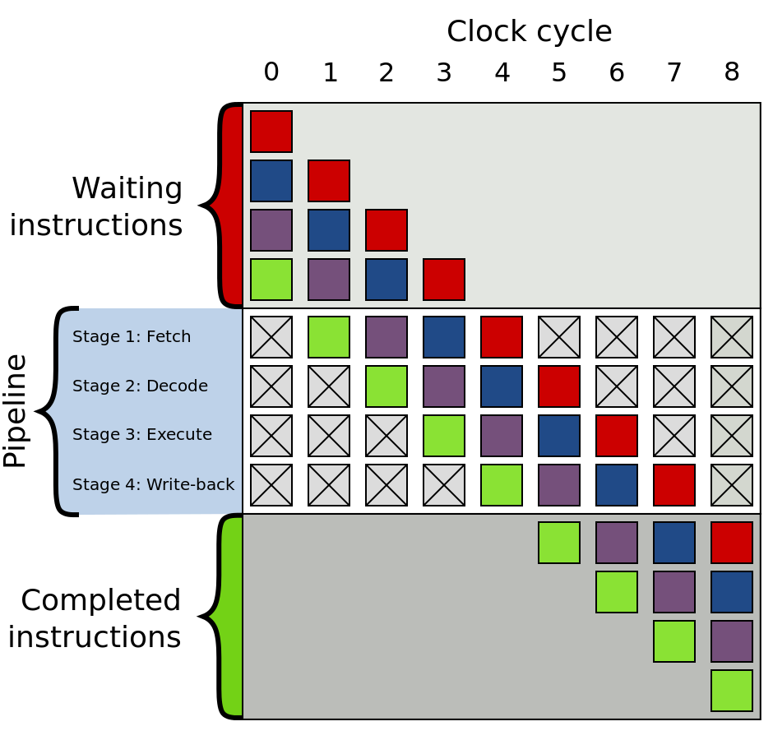
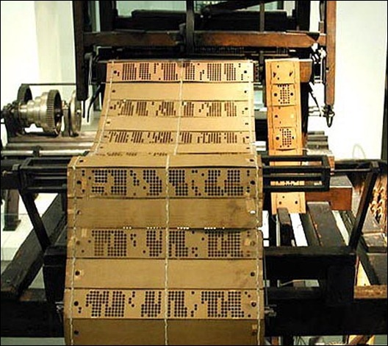
Waiting
instructions
<number> / 65

Slide 6
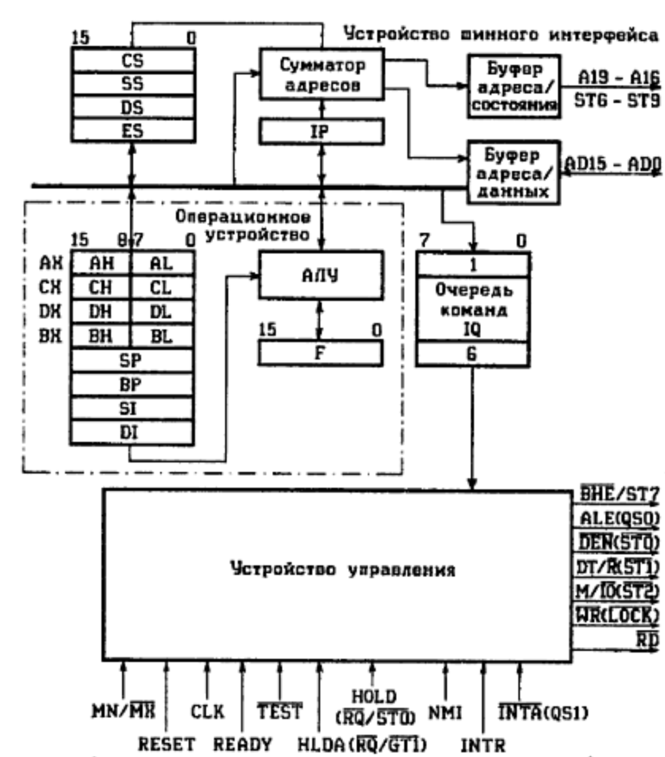
<number> / 65

Slide 7
We have a hardware, what is next?
<number> / 65

Slide 8
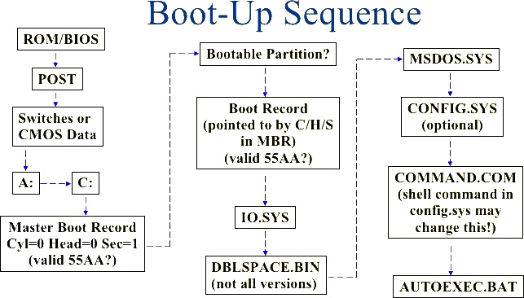
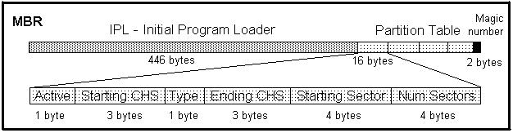
We have a hardware, what is next?
<number> / 65

Slide 9
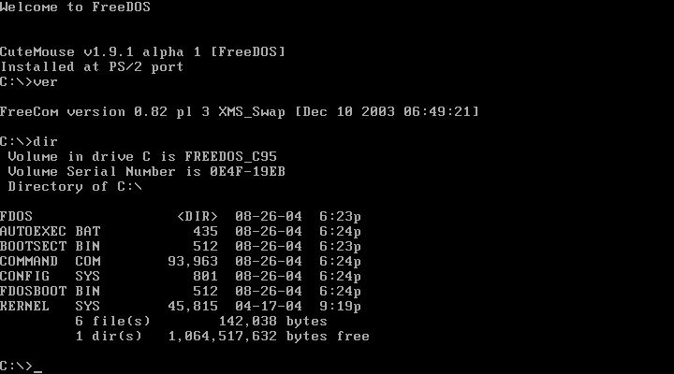
Disk Operating System
<number> / 65

Slide 10
Disk Operating System
MS DOS memory limit (640KB ought to be enough for anybody)
No memory protection, first-fit memory allocation scheme
Single task, but TSR (Terminate and Stay Resident)
Single user
<number> / 65

Slide 11
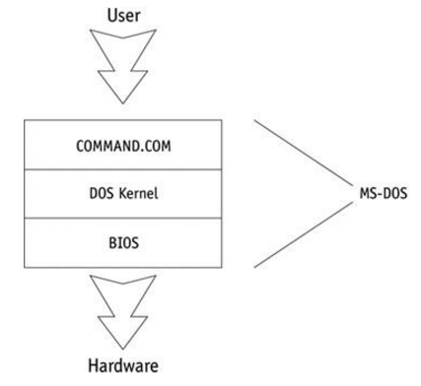
Disk Operating System
<number> / 65

Slide 12
BIOS
BIOS (Basic Input/Output System)
  Direct interface with I/O devices
  Contains device drivers
    Controls data flow to and from each device (except disk drives)
  Receives I/O operation status information
    Passes to processor
  Handles small differences among I/O units
    No need to write device driver for manufacturer printer
– Understanding Operating Systems, Fifth Edition
<number> / 65

Slide 13
DOS kernel
DOS kernel
  Contains routines to interface with disk drives
  Read into memory
    Initialization time from MSDOS.SYS file
    Resides in boot disk
  Microsoft proprietary program
  Accessed by application programs
  Provides hardware-independent services
    System functions
    Memory management, file and record management
  Provides transparency
    Compensates for manufacturer variations
  Manages file storage and retrieval
  Dynamically allocates and deallocates secondary storage as needed
– Understanding Operating Systems, Fifth Edition
<number> / 65

Slide 14
Command processor
Command processor (shell)
  Sends prompts to user
  Accepts typed commands
  Executes commands
    From system prompt
    Issues appropriate responses
  Resides in COMMAND.COM file
    Stored in two different main memory sections
  Appears on public directory
  Weakness: not interpretive
– Understanding Operating Systems, Fifth Edition
<number> / 65

Slide 15
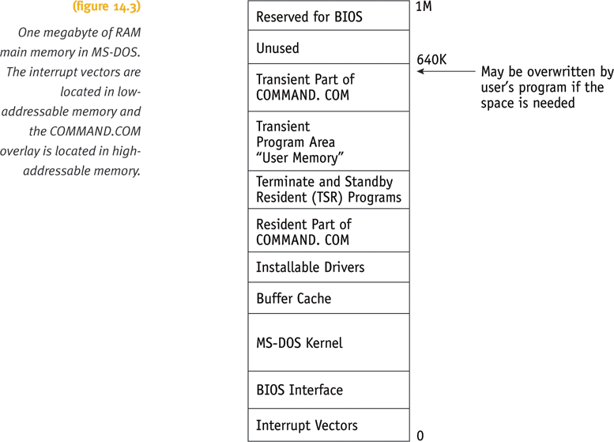

Main memory structure
  ROM
    Very small in size
    Contains program
    Contains section of BIOS with startup process (bootstrapping)
    Initializes computer
    Retrieves resident code and loads into RAM
  RAM
    Part of main memory
    Where programs are loaded and executed
– Understanding Operating Systems, Fifth Edition
<number> / 65

Slide 16
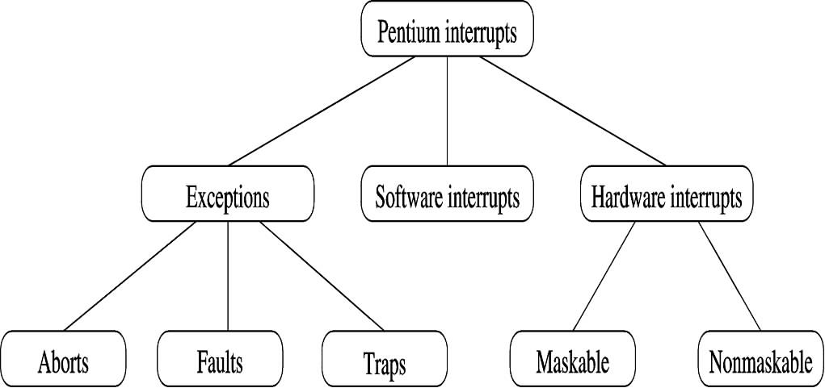
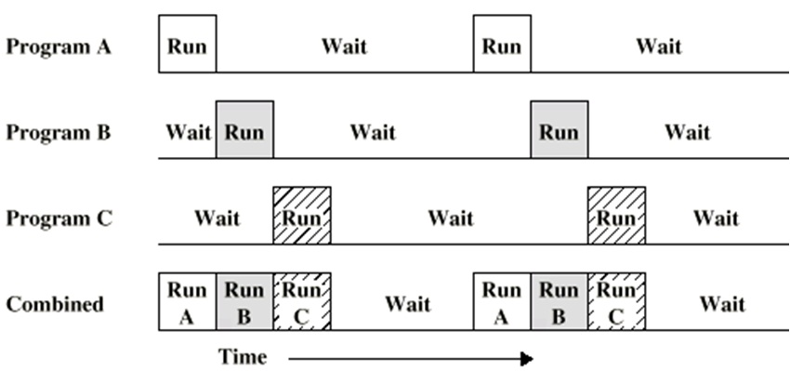
Single user, single task
Interrupts:
  Internal hardware interrupts
  External hardware interrupts
  Software interrupts
Multitasking:
<number> / 65

Slide 17
Single user, signle task
Unsafe, unsecure
A lot of code duplication
etc…
  Required to add hardware features!
<number> / 65

Slide 18
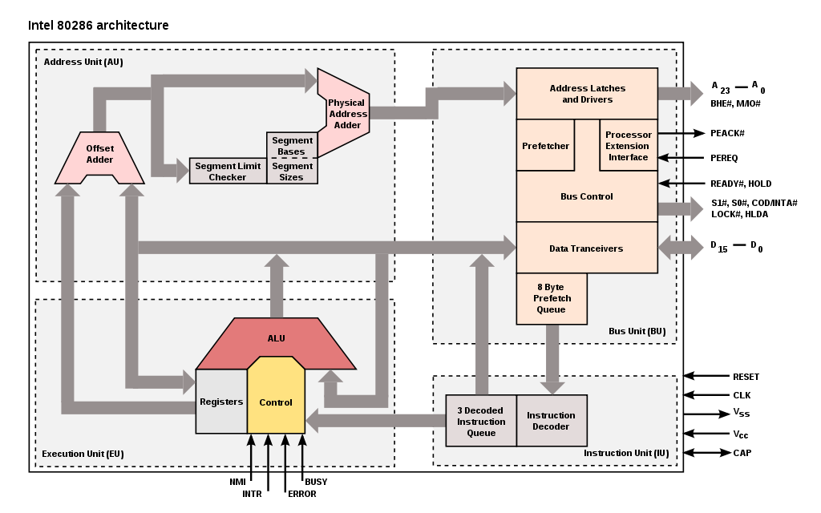
80286: protected mode, virtual memory, 20MHz
<number> / 65

Slide 19
protected mode, virtual memory
<number> / 65

Slide 20
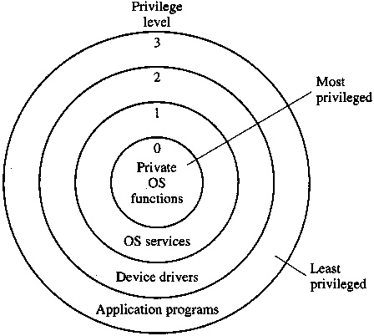
protected mode, virtual memory
Hardware
level:
<number> / 65

Slide 21
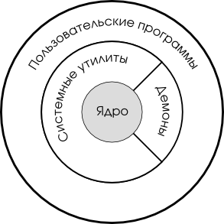
Software
level:
<number> / 65

Slide 22
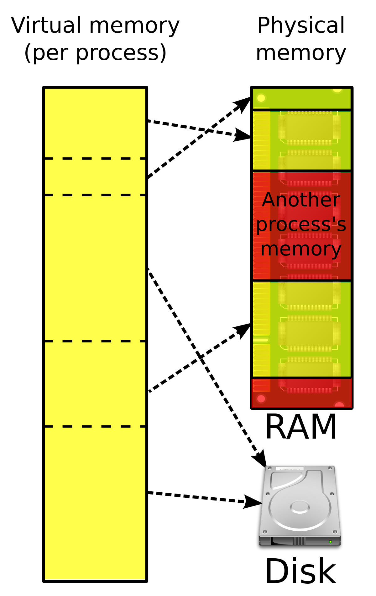
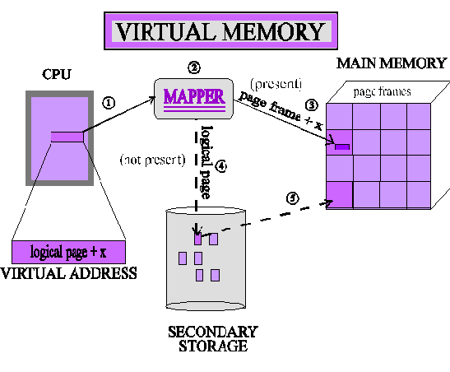
protected mode, virtual memory
<number> / 65

Slide 23
Again: we have a hardware, what is next?
<number> / 65

Slide 24

Monolithic vs Microkernel
<number> / 65

Slide 25
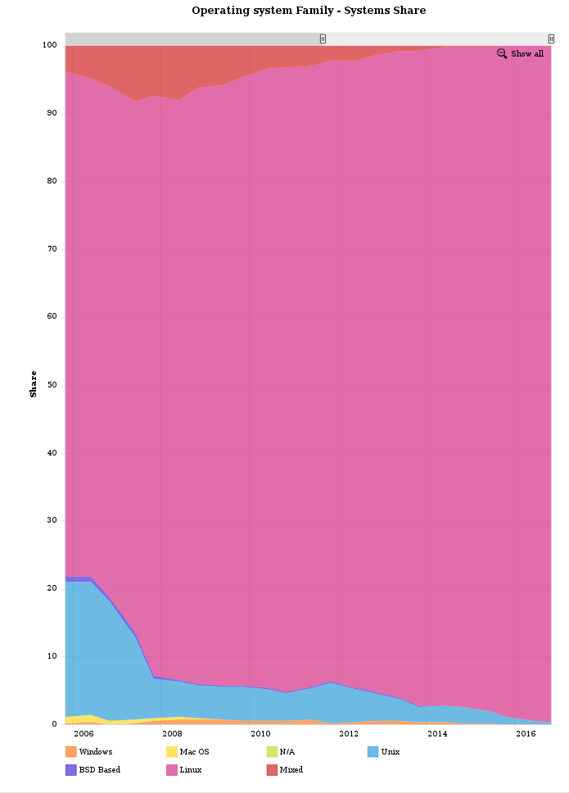
Tenenbaum-Torvalds debate
Linux (in HPC market share)
<number> / 65

Slide 26
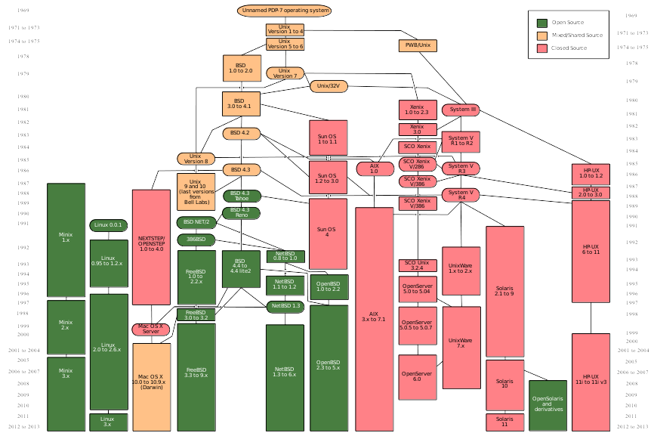
<number> / 65

Slide 27
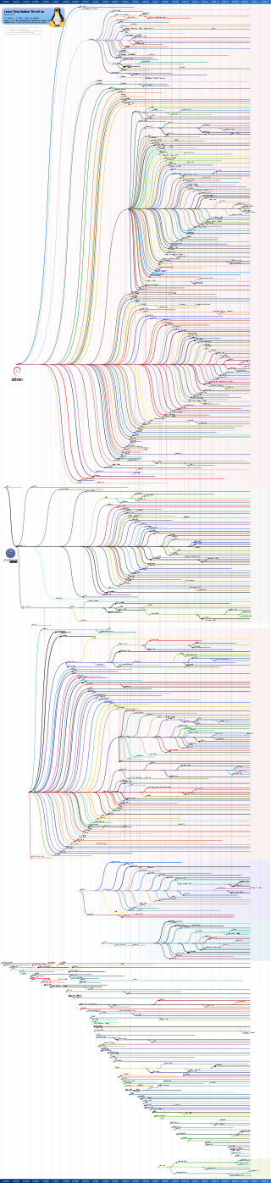
Linux distributions
<number> / 65

Slide 28
Must read
Tenenbaum-Torvalds debate
GNU C Library debates about Versioned Interfaces

Slide 29
Monolithic vs Microkernel
<number> / 65

Slide 30
<number> / 65

Slide 31
<number> / 65

Slide 32
<number> / 65

Slide 33
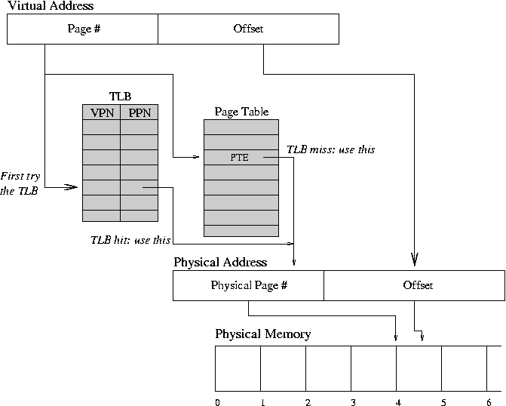
Virtual memory
<number> / 65

Slide 34
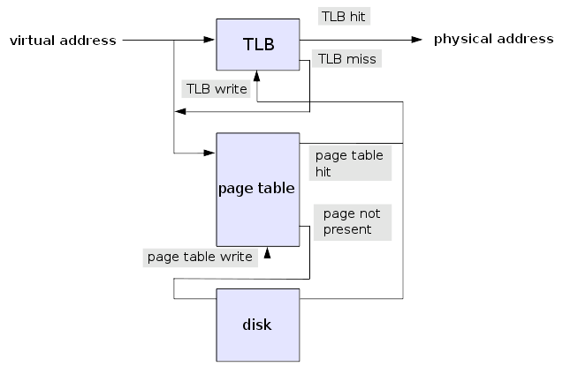
Virtual memory
<number> / 65

Slide 35
Virtual memory
Page fault exception
(handled by OS):
swap
zRAM
etc
<number> / 65

Slide 36
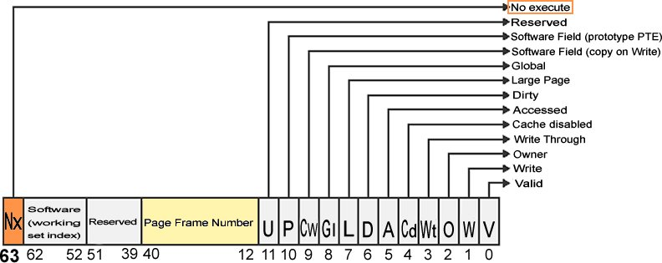
Virtual memory
<number> / 65

Slide 37
Application
<number> / 65

Slide 38
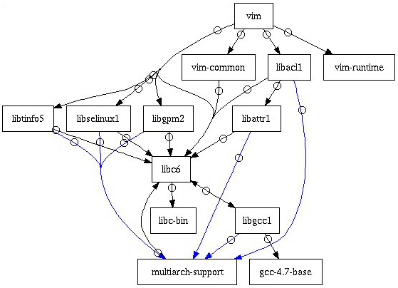
Application
<number> / 65

Slide 39
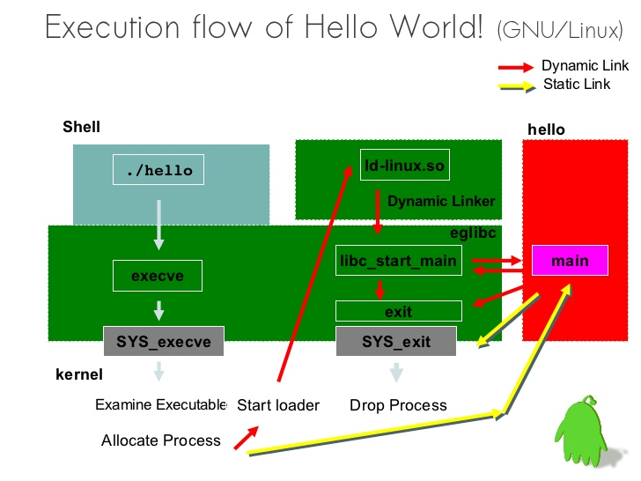
Application
<number> / 65

Slide 40

Application
<number> / 65

Slide 41
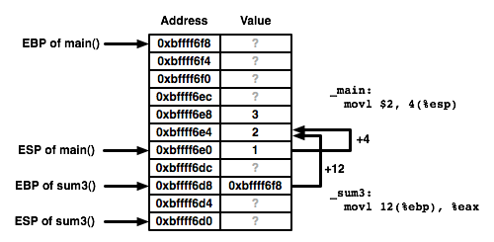
Application
<number> / 65

Slide 42
System Call
<number> / 65

Slide 43
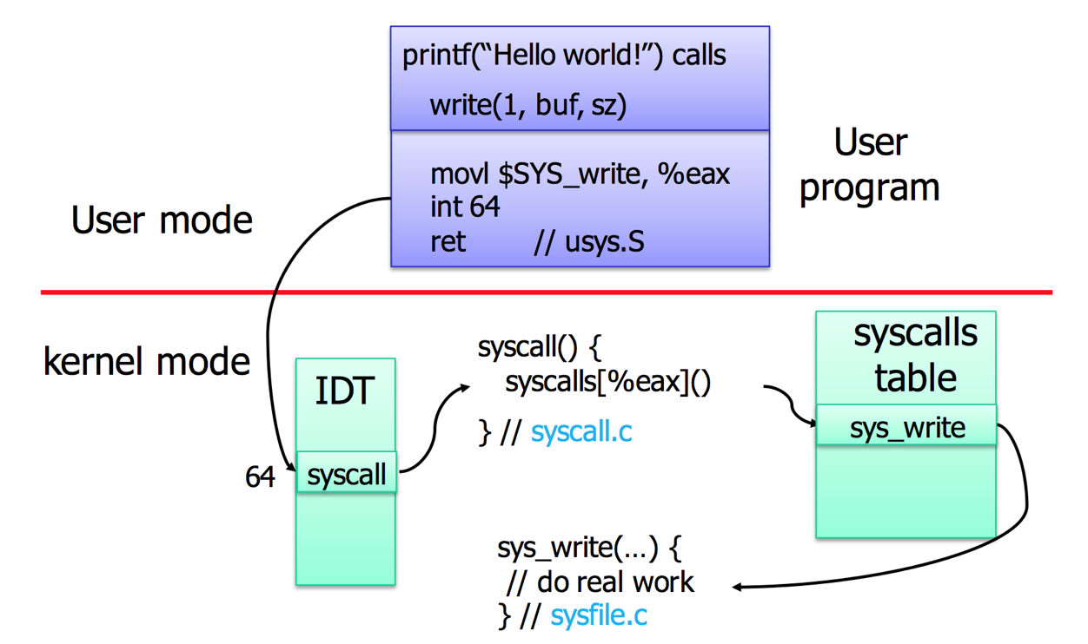
System call
<number> / 65

Slide 44
System call
context
switch!
<number> / 65

Slide 45
Filesystem, IPC
<number> / 65

Slide 46
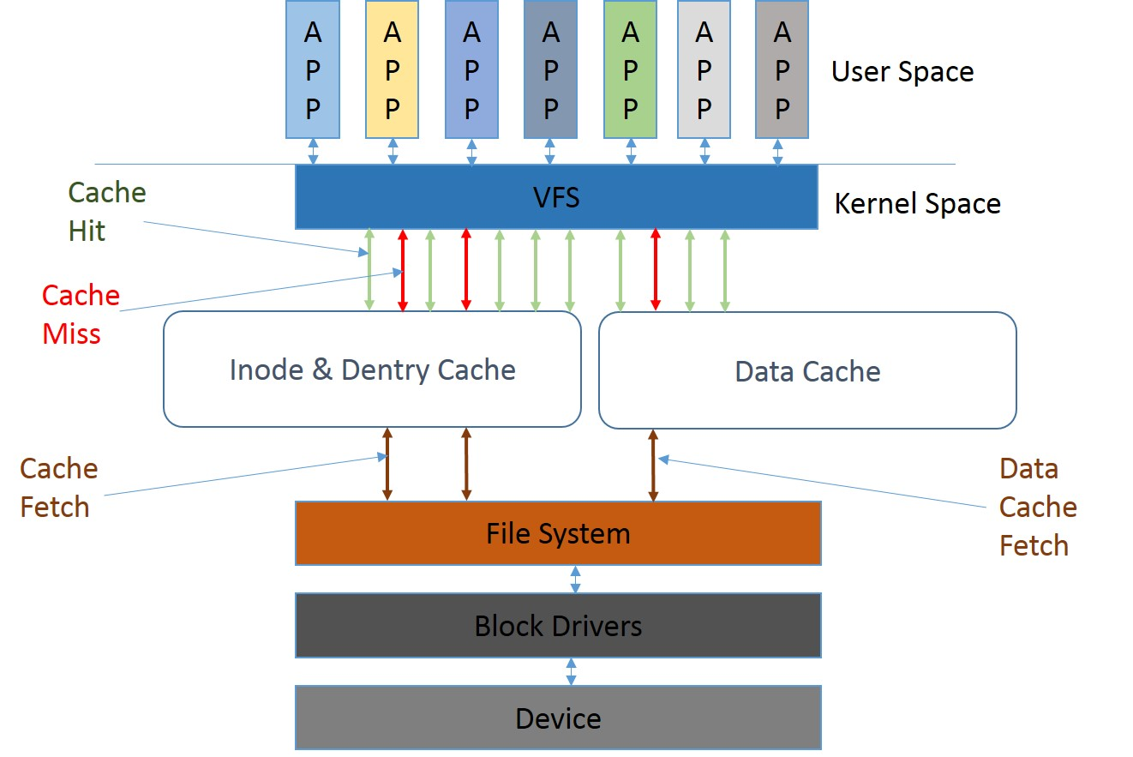
Filesystem: VFS
<number> / 65

Slide 47
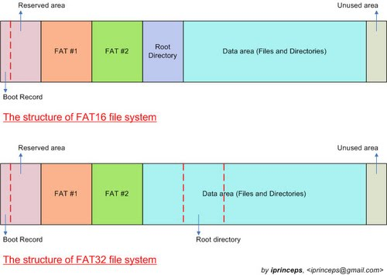
Filesystem (FAT32)
<number> / 65

Slide 48
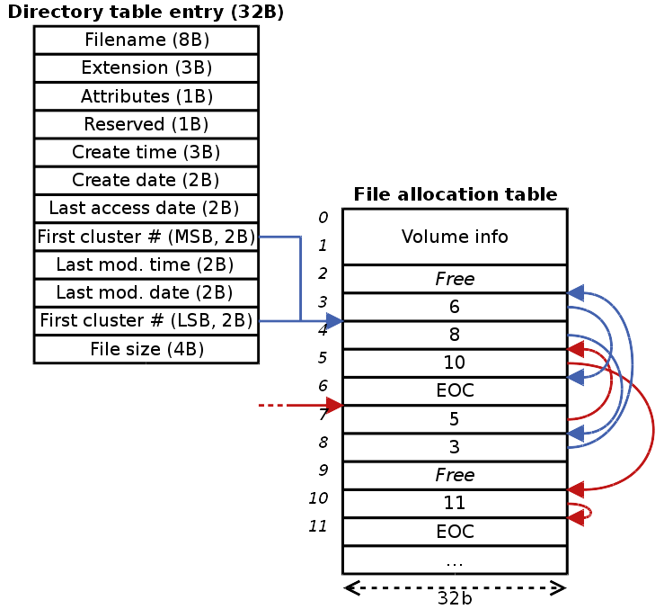
Filesystem (FAT32)
<number> / 65

Slide 49
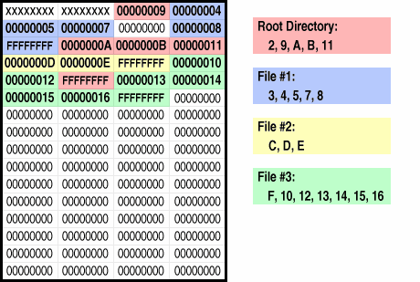
Filesystem (FAT32)
<number> / 65

Slide 50
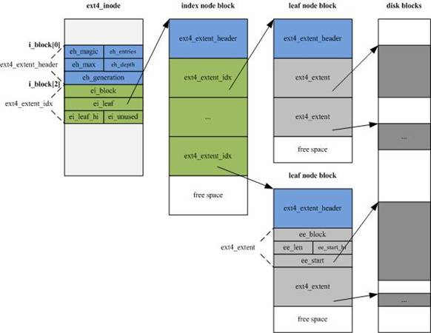
Filesystem (ext4)
<number> / 65

Slide 51
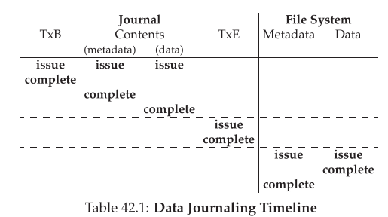
Filesystem (ext4)
<number> / 65

Slide 52
Filesystem
Copy on Write
Transparent compression
SSD-cache / TRIM
Network filesystems
Distributed filesystems
Pseudo file systems (wikipediaFS, PiFS, …)
…
<number> / 65

Slide 53
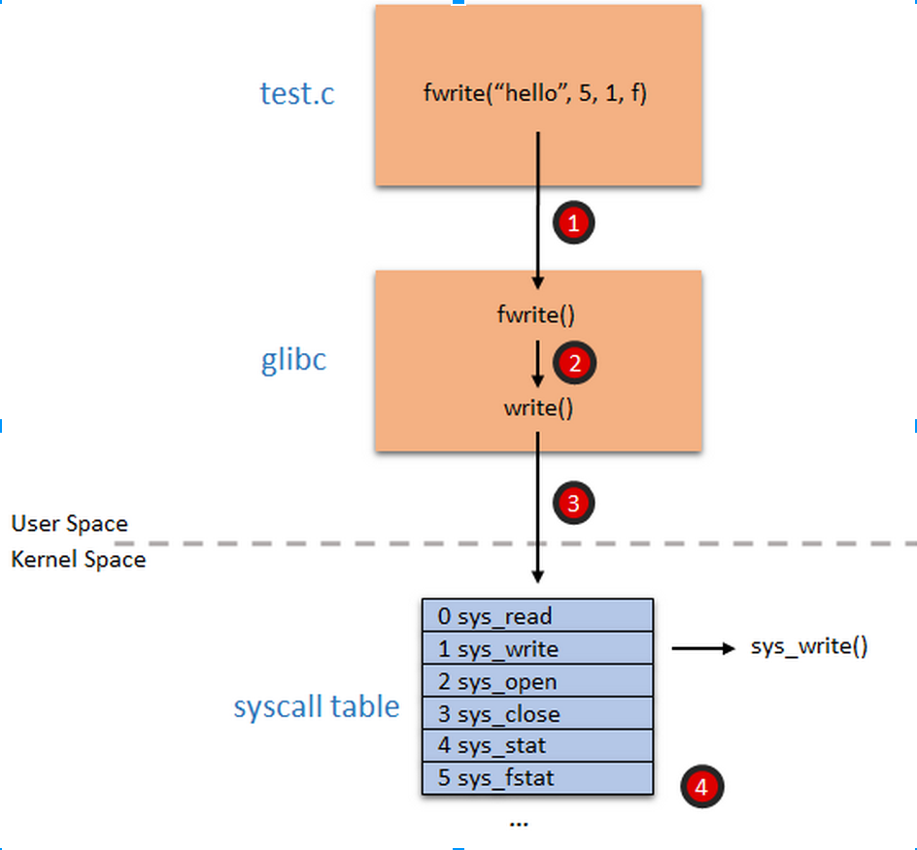
Filesystem
<number> / 65

Slide 54
Filesystem
mmap() !
<number> / 65

Slide 55
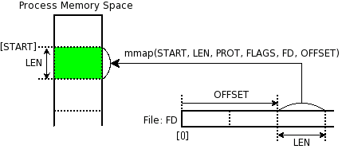
Filesystem
mmap() !
<number> / 65

Slide 56
IPC
IPC == Inter-Process Communication:
  Files
  Signals, Traps
  Sockets
  Message queue
  Pipe
  Shared memory
  Message passing
  ...
<number> / 65

Slide 57
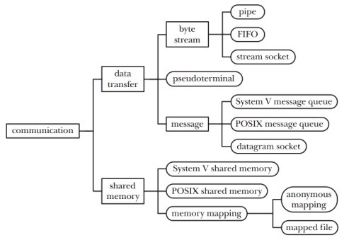
IPC
IPC == Inter-Process Communication:
  Files
  Signals, Traps
  Sockets
  Message queue
  Pipe
  Shared memory
  Message passing
  ...
<number> / 65

Slide 58
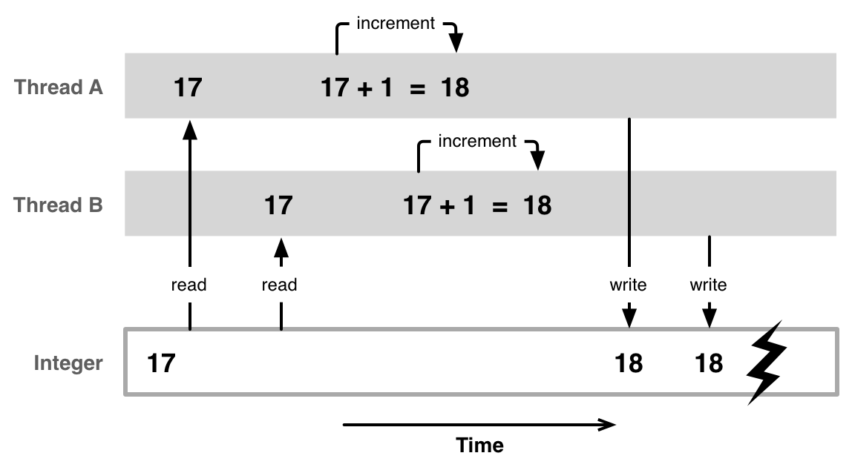
IPC: race condition
<number> / 65

Slide 59
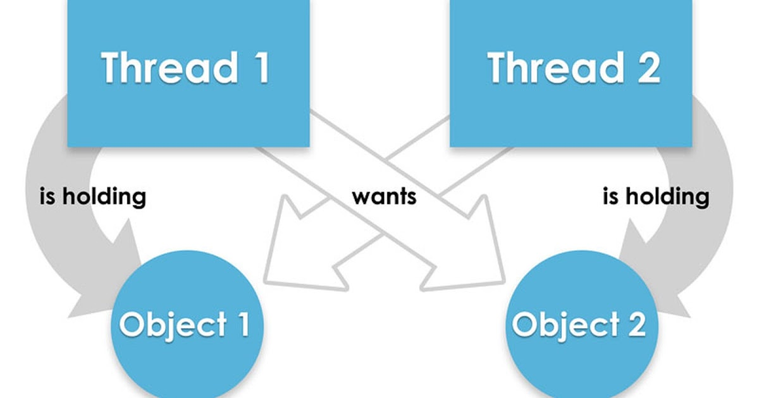
IPC: deadlock
<number> / 65

Slide 60
IPC: synchronization
Technique | Description | Scope
Per-CPU variables | Duplicate a data structure among CPUs | All CPUs
Atomic operation | Atomic read-modify-write instruction | All
Memory barrier | Avoid instruction re-ordering | Local CPU
Spin lock | Lock with busy wait | All
Semaphore | Lock with blocking wait (sleep) | All
Seqlocks | Lock based on access counter | All
Local interrupt disabling | Forbid interrupt on a single CPU | Local
Local softirq disabling | Forbid deferrable function on a single CPU | Local
Read-copy-update (RCU) | Lock-free access to shared data through pointers | All
<number> / 65

Slide 61
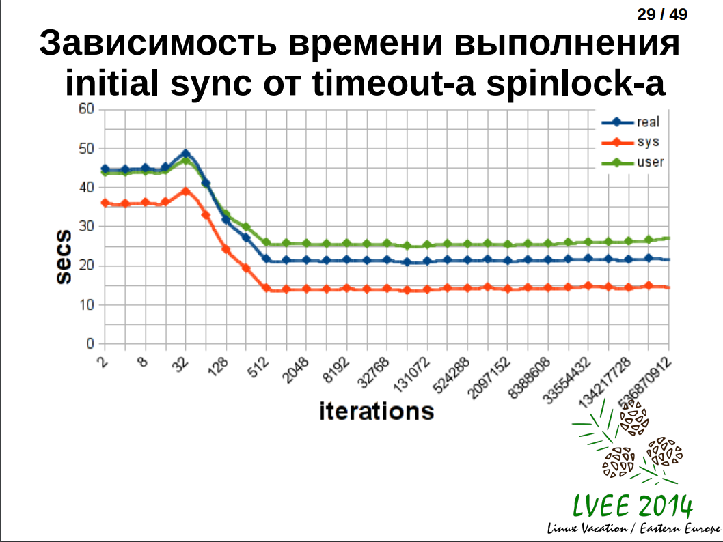
IPC: synchronization
<number> / 65

Slide 62
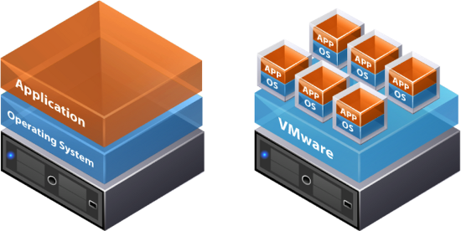
For dessert: virtualization, containers
vmx:
<number> / 65

Slide 63
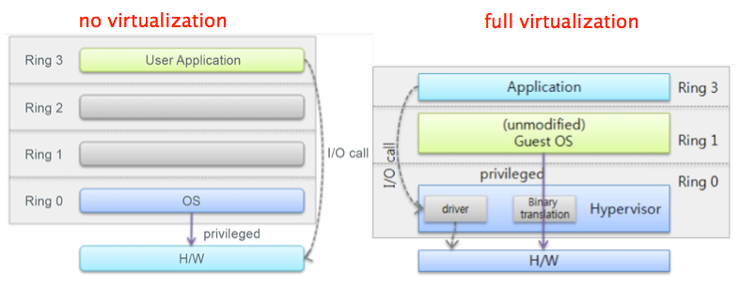
Virtualization
<number> / 65

Slide 64
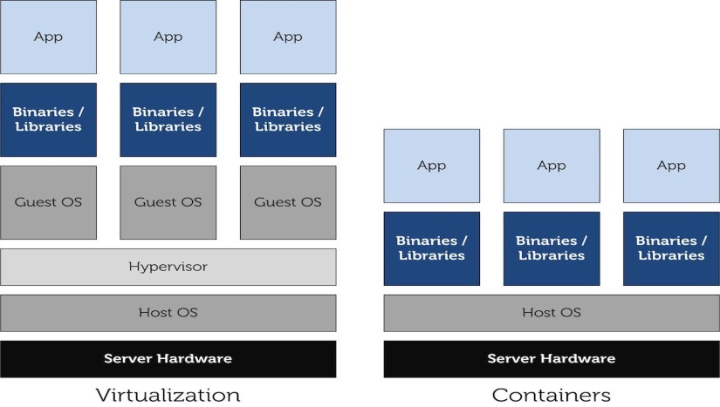
Containers
<number> / 65

Slide 65
Q&A
<number> / 65

