Slide 1
Bliss to Text Translation using Deep Learning
B.Tech Project
- Piyush Kumar, 19IE10022
Supervisor – Manjira Sinha
Project Link - https://github.com/mepiyush2000/BTP_bliss_symbol_project

Slide 2







Introduction
Blissymbolics were developed by Charles K. Bliss (1897-1985).
Blissymbolics is a semantic graphical language that is currently composed of more than 5000 authorized symbols - Bliss-characters and Bliss-words. It is a generative language that allows its users to create new Bliss-words as needed.
It is used by individuals with severe speech and physical impairments around the world, but also by others for language learning and support.
2000 +
The symbols can be formed into sentences and their order is based on English word order
basic symbols which can be combined together to create a huge variety of new symbols.
Notes:
constructed – consciously devised instead of naturally evolved ideographic – graphic symbols that represent an idea or concept, without phonology generative – able to create an infinite number of concepts from an initial finite set.

Slide 3
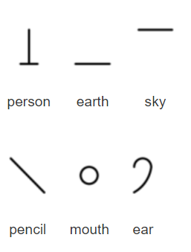
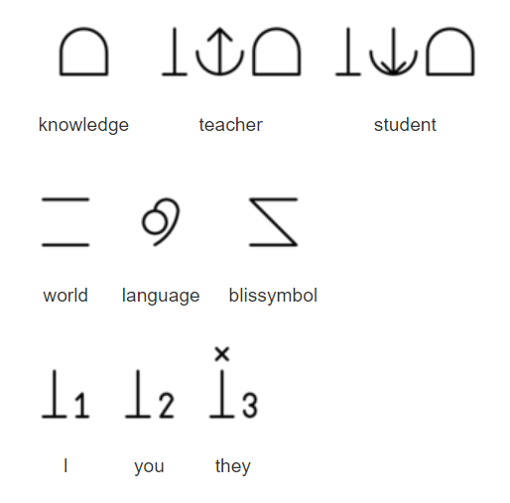
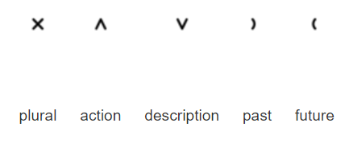
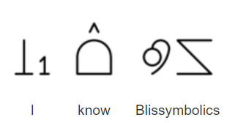
How Bliss Works ?
Bliss-character:
An individual graphic symbol (ideograph)
Bliss-word:
Represents a meaning and is spelled using a sequence of one or more bliss-characters
Indicators:
Characters used to show the part of speech of a symbol
Example:
Notes:
Blissymbolics makes use of core symbols (Bliss-characters), They can be arranged to produce Bliss-words that can represent complex and abstract, yet easy-to-understand meanings.
Nouns can be changed into verbs or adjectives with the addition of an indicator, and there are also simple past and future tenses.
Bliss has simple, elegant, logically based rules, that make it ideal as a non-phonetically based language.

Slide 4
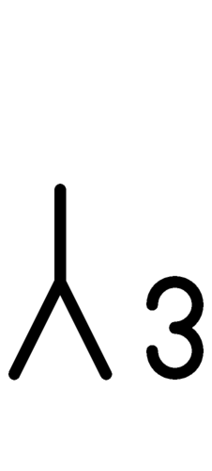




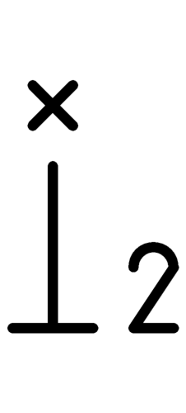
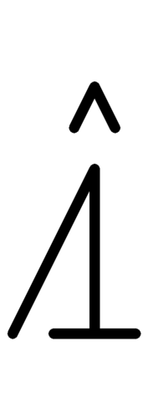

Problem Statement
45182
17321
77523
98651
He is playing football.
he, him, himself
be, am, are, is
to_play
football
34573
12573
76511
12986
Can you help me ?
can, be_able_to
you, yourselves
help, assist, aid
I, me, myself
Given a sequence of bliss symbol, the goal is to translate the sequence into grammatically correct statement in English language.

Slide 5
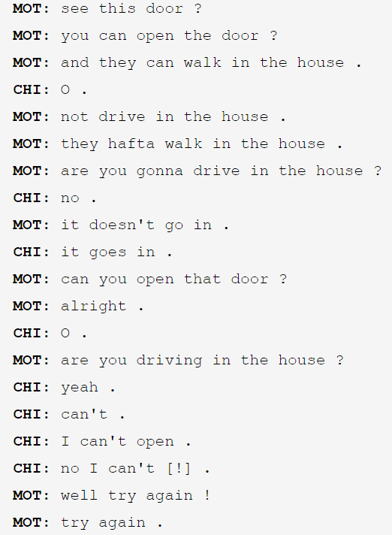
Data Insights
We have used CHILDES dataset which is the collection and annotation of speech to and by children.
CHILDES (talkbank.org)
The dataset contains the transcript of communication done with children of different age group from different countries in the world. In this project dataset of North American English of age group 6-16 is used
CHILDES
DAT
ASET
Notes:
The childes dataset contains daily used dialogues of English language which is normally used in homes to communicate between people and friends. We thought this as a good dataset for us because our bliss dataset had only in effective 2000 very common words and the childes dataset which we have used contains all the daily used common word which is enough to communicate between two people. It is easier for us to ap all that word which are present in bliss dictionary to this dataset. Using this childes dialogue dataset made it easy to implement

Slide 6
Methodology

Slide 7
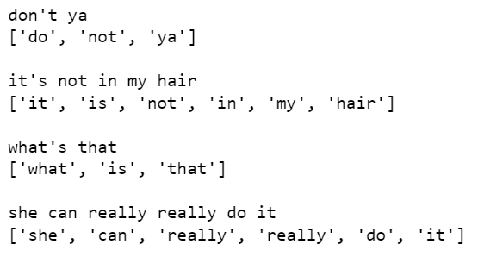
Data Creation
(English Corpus)
“CHILDES” Text Corpus
*Manual Cleaning*
Lemmatization using Spacy
Tokenization
playing/plays/played – play
cars, car’s, cars’ – car
is/are/am – be
Removed junk words like – “um, hm, uh, oh, yea, huh and quotes”
Replaced apostrophe with their meaningful alternate words: he’s – he is, we’re – we are, don’t – do not, she’ll – she will,
Removed chatting abbreviations like: ty(thank you), asap, ttyl
Cleaned “CHILDES” Data

Slide 8
Data Creation
(Bliss Corpus)
The official Blissymbolics dictionary contains a unique 4-5 digit code associated with each Bliss character or Bliss word
BCI reference number | character
12321 | a
12321 | an
12321 | any
18228 | what
16200 | to play
12408 | to approve
12342 | adult
12342 | mature
18245 | who
18245 | whom
18245 | that
BCI reference number | character
12321 | a,an,any
18228 | what
16200 | play-(to)
12408 | approve-(to)
12342 | adult,mature
18245 | who,whom,that
Notes:
961778 rows × 2 columns

Slide 9
Data Creation
(Parallel Dataset)
For processed (after lemmatization and cleaning) of English words, we have mapped each of the words with their corresponding Bliss words code and formed a parallel data corpus for translation.
english | bliss
look at this | 16747 12591 17720
there's a little boy | 24017 12639 8521 14171 12888
shall we go eat | 24261 18212 14449 13906
let's go eat | 24732 12639 14449 13906
dog's gonna eat first | 12380 12639 14449 17739 13906 14187
here comes the little girl | 14708 13383 17700 14171 14439
what's in there | 18231 12639 14932 24017
Notes:
961778 rows × 2 columns

Slide 10
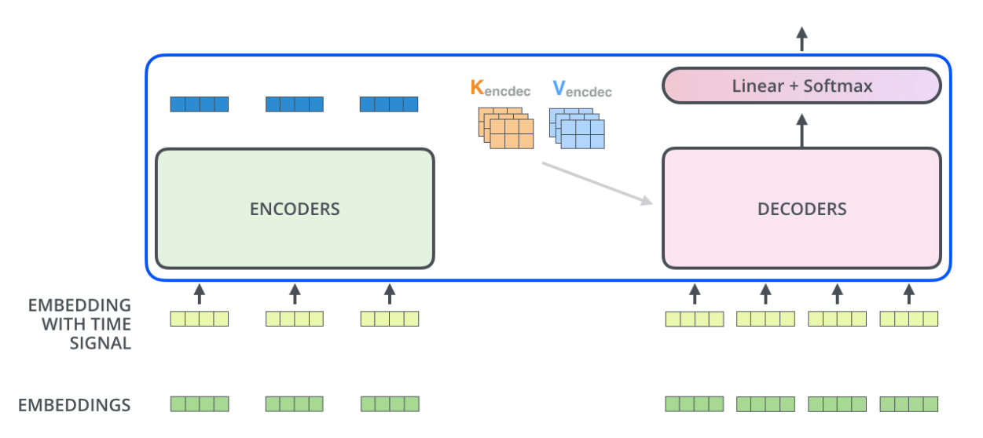
Modeling
Output Sequence
Transformer
Input Sequence

Slide 11
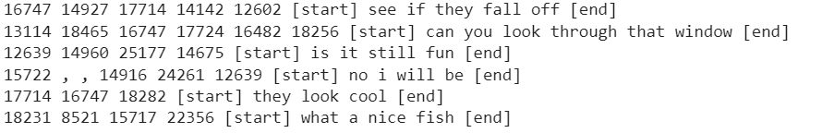
Results
Train Accuracy
Validation Accuracy
English to Bliss translation | 96.81 | 97.35
Bliss to English Translation | 88.74 | 89.27
Predictions

Slide 12
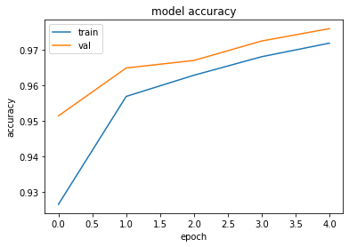
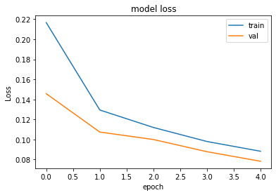
Results
(English to Bliss Translation)

Slide 13
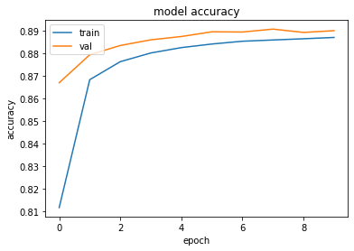
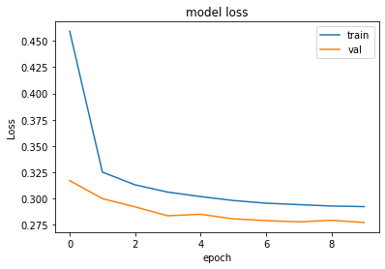
Results
(Bliss to English Translation)
Mean Meteor Score: 0.6504

Slide 14
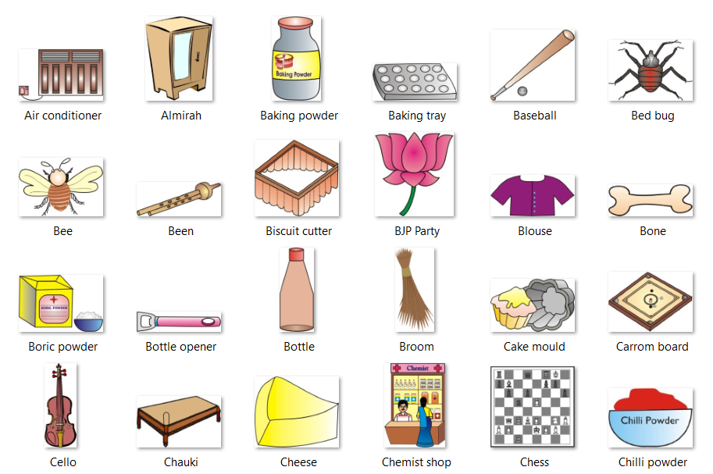
Experiments
(Pictograms Addition)

Slide 15
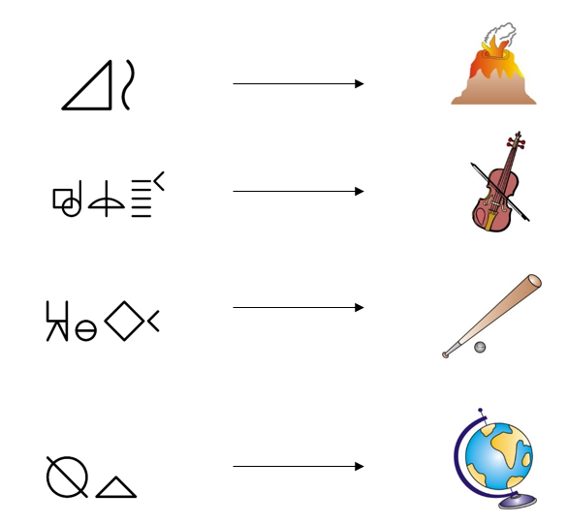
Experiments
(Pictograms Addition)
Volcano
Violin
Baseball
Globe

Slide 16
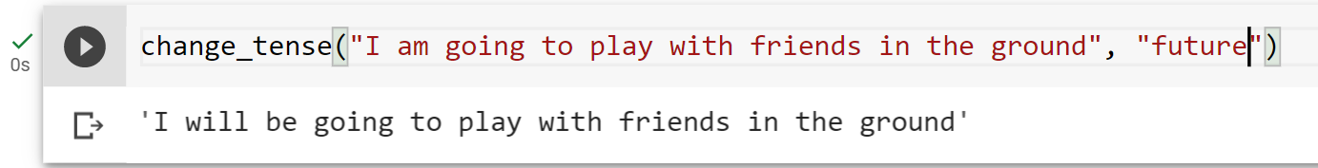
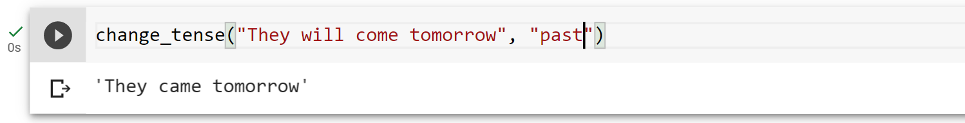
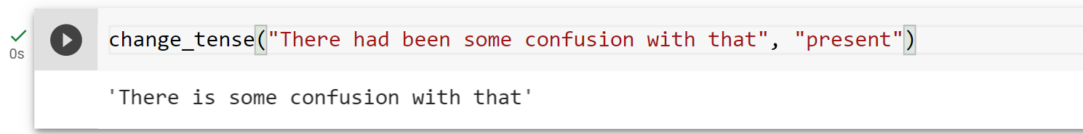
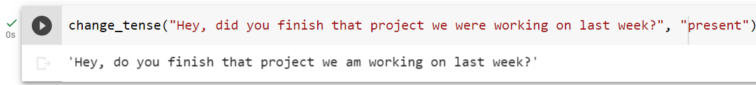
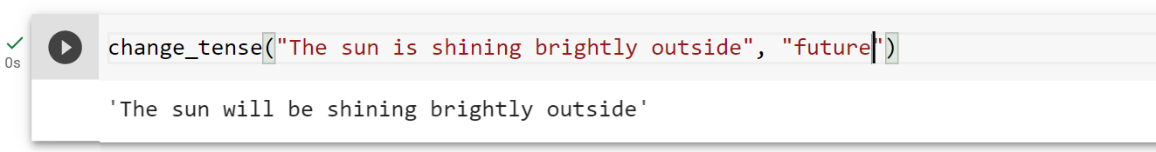
Experiments
(Changing Tenses)

Slide 17
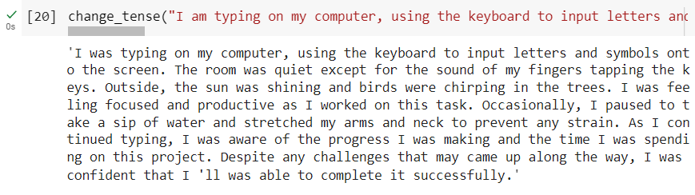
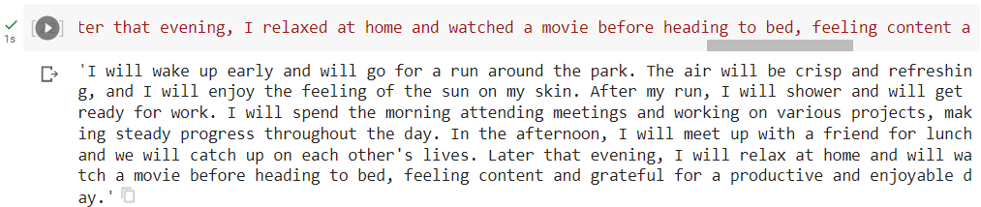
Experiments
(Changing Tenses)

Slide 18
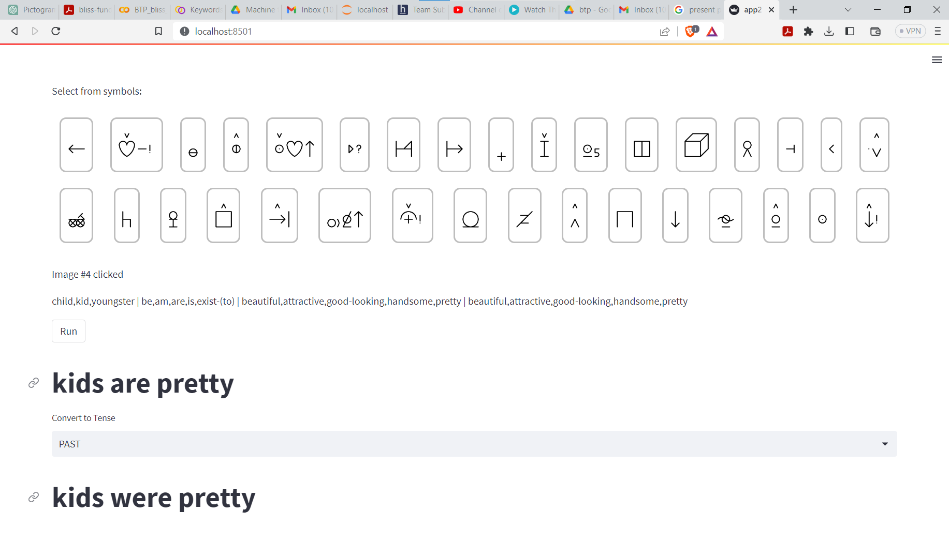
Experiments
(Web Service)

Slide 19
Conclusion
The aim of our work was to create a computer-based tool for educational and communicational purposes for people with severe speech impairments.
The machine learning method using transformer performed well on both side translation that is bliss-to-English and English-to-bliss
Project Link - https://github.com/mepiyush2000/BTP_bliss_symbol_project
Future work will look into generation-heavy and transfer approaches for Bliss-to-Text translation considering blissymbolics as bag of words
Add more number of pictograms for training and language model text generation using bliss symbols
Improve website UI and make it more easy to use by dividing the symbols intp section and sub sections.
Notes:
In the generation-heavy approach, the words conveyed by the input blissymbolics will be considered as a bag of words. All their possible permutations will be evaluated against a language model

Slide 20
References
Electronic usage of BLISS symbols https://www.researchgate.net/publication/238474375_Electronic_usage_of_BLISS_symbols
Application of Blissymbolics to the non-vocal communicatively handicapped https://scholarworks.umt.edu/cgi/viewcontent.cgi?article=2595&context=etd
Web-service for translation of pictogram messages into Russian coherent text https://ieeexplore.ieee.org/stamp/stamp.jsp?tp=&arnumber=8633677
Natural Language Generation from Pictographs https://aclanthology.org/W15-4711.pdf
From Bliss Symbols to Grammatically Correct Voice Output: A Communication Tool for People with Disabilities https://link.springer.com/content/pdf/10.1023/A:1013682632553.pdf
A Neural Machine Translation Approach to Translate Text to Pictographs in a Medical Speech Translation Syst https://aclanthology.org/2022.amta-research.19.pdf
Blissymbolics Communication International https://www.blissymbolics.org/
CHILDES Dataset https://psyling.talkbank.org/years/1985/jcl-childes.pdf

Slide 21
Thank You

