Slide 1

PML -Cricket Object Detection Project –Group 27
Group Members Yugal Sahu Pravin Patil Yogesh Gupte Ratish Nair Gaurav Patil

Slide 2
Objective: Develop a machine learning model to detect cricket objects (bat, ball, stumps, or no object)
in images using classical ML techniques and manual feature engineering. Scope & Approach: • Created dataset of cricket images (balanced across object classes) • Preprocessed images to 800×600 resolution and divided into 8×8 grid cells • Annotated each cell with object labels (0: no object, 1: ball, 2: bat, 3: stump) • Extracted handcrafted features (HOG, grayscale) for classification • Trained and evaluated Random Forest and KNN models Key Deliverables: • Source code • Predictions CSV • Performance metrics & visualizations • Presentation & video Evaluation Criteria: • Problem detailing & solution approach • Model performance on train/test • Quality of documentation and presentation

Slide 3
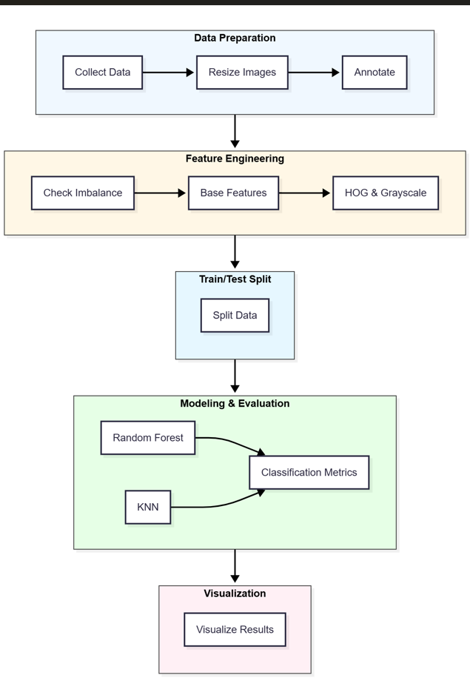
Step-by-Step Workflow

Slide 4
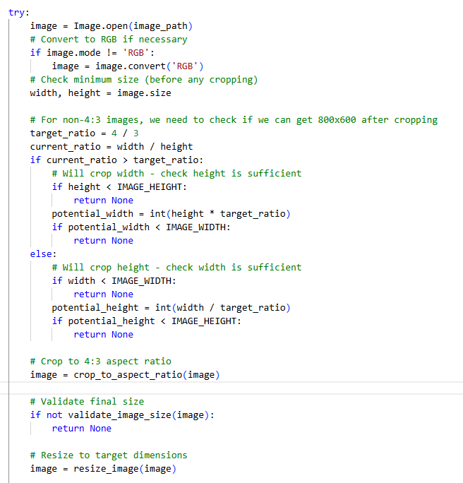
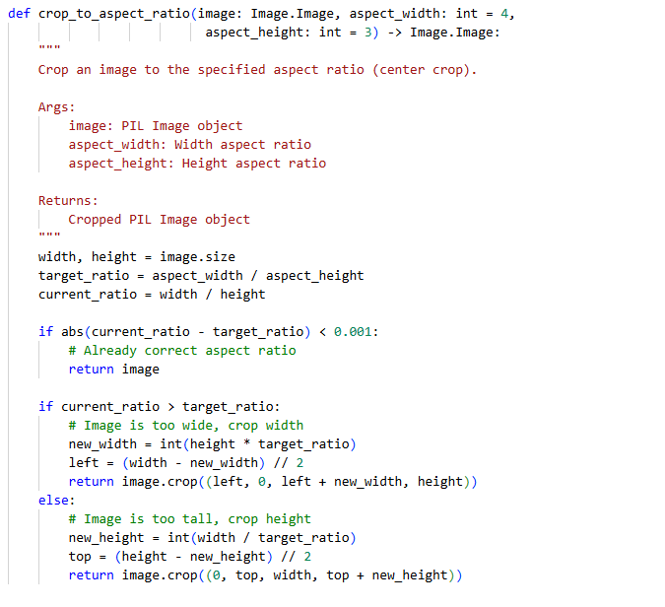
Data Collection & Pre Processing
Gathered various types of cricket images, balanced across object classes.
All images resized to 800×600 and partitioned into an 8×8 grid.
Used python script to resize and reshape all images

Slide 5
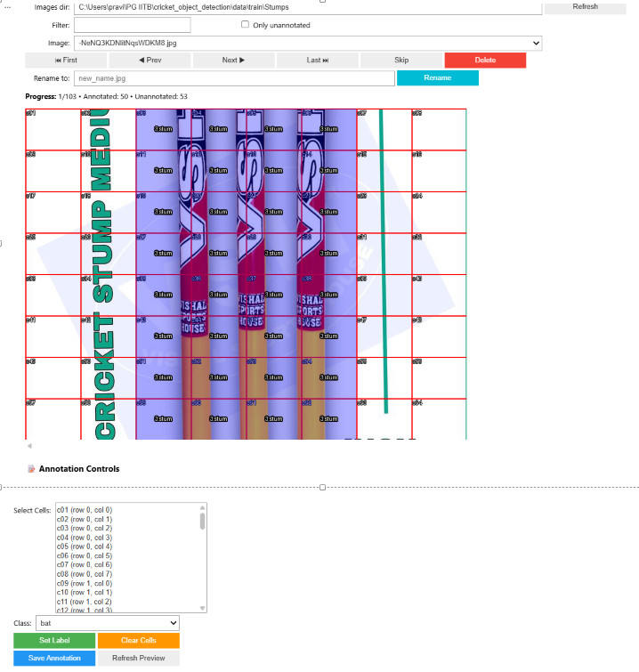
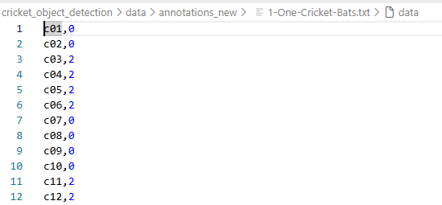
Annotation
Explored tools (LabelImg, Copilot-assisted tools) but they were not adequate for our grid‑cell tagging needs.
Reused existing utility which was created by our peers and extended it as custom annotation utility to perform manual per‑cell tagging.
Utility produces one annotation text file per image (compatible with our use case).
Annotation Utility
Annotation Output

Slide 6
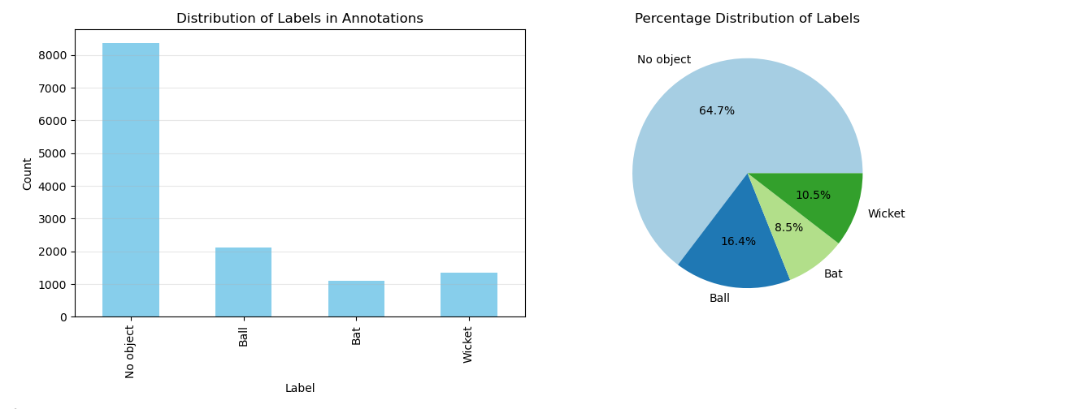
Checking Data Imbalance on Labels We Checked Data imbalances post adding labels to each cells
Notes:
The workflow begins with data collection, where images are gathered and organized by class. Preprocessing follows, involving resizing and cropping images to a standard resolution of 800x600 pixels and saving them into training and testing folders. Annotation is a critical step, where each image is divided into an 8x8 grid, and cells are labeled as 0 (no_object), 1 (ball), 2 (bat), or 3 (stump). Manual annotation is performed using a GUI tool or script for interactive tagging. Feature extraction is then applied to each cell, using techniques like HOG and grayscale transformations to capture essential visual patterns. These features, along with their corresponding labels, are stored in a CSV file for training. Model training involves applying Random Forest and KNN classifiers to the extracted features. Evaluation metrics such as accuracy, precision, recall, and F1-score are computed to compare model performance. Visualization is integrated throughout the process, including overlaying predicted labels on images and generating comparative charts for metrics. Finally, predictions on new images are visualized with color-coded grids, providing an intuitive understanding of model behavior. This structured workflow ensures systematic progress from raw data to actionable insights.

Slide 7
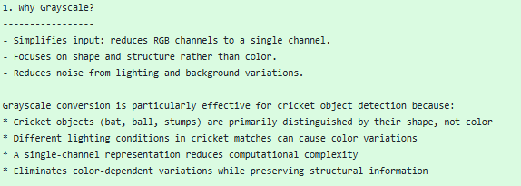
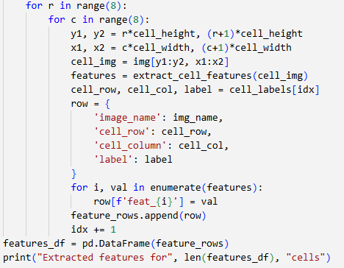
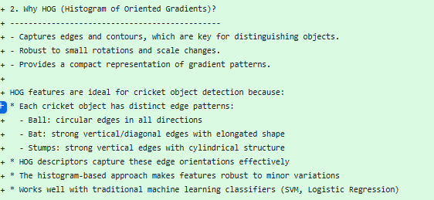
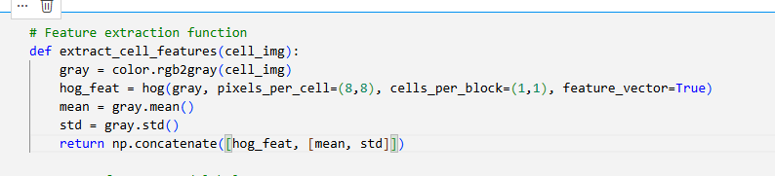
Feature Engineering
Handcrafted features extracted per grid cell:
HOG (Histogram of Oriented Gradients) for shape/edge cues
Grayscale intensity & summary statistics for appearance

Slide 8
Model Training and Evaluation – Random Forest And KNN
Class | RF Precision | KNN Precision | RF Recall | KNN Recall | RF F1-Score | KNN F1-Score
no_object | 0.80 | 0.81 | 0.96 | 0.92 | 0.87 | 0.86
ball | 0.85 | 0.86 | 0.80 | 0.70 | 0.83 | 0.77
bat | 0.92 | 0.53 | 0.14 | 0.37 | 0.25 | 0.43
stump | 0.73 | 0.64 | 0.40 | 0.44 | 0.51 | 0.52
Notes:
Two classical machine learning models were employed: Random Forest and K-Nearest Neighbors (KNN). Both models were trained on cell-level features extracted from annotated images.
Random Forest, an ensemble method, offers robustness and handles feature interactions effectively, while KNN provides simplicity and interpretability. Evaluation was conducted using standard metrics such as accuracy, precision, recall, and F1-score, which were visualized through bar charts for easy comparison.
Random Forest generally outperformed KNN in terms of accuracy and precision, though KNN demonstrated faster training times. Visualizations of predictions were generated for multiple images per model, overlaying grid cells with color-coded labels to illustrate classification performance.
These evaluations highlight the trade-offs between model complexity, accuracy, and computational efficiency, providing valuable insights for selecting appropriate algorithms in similar tasks.

Slide 9
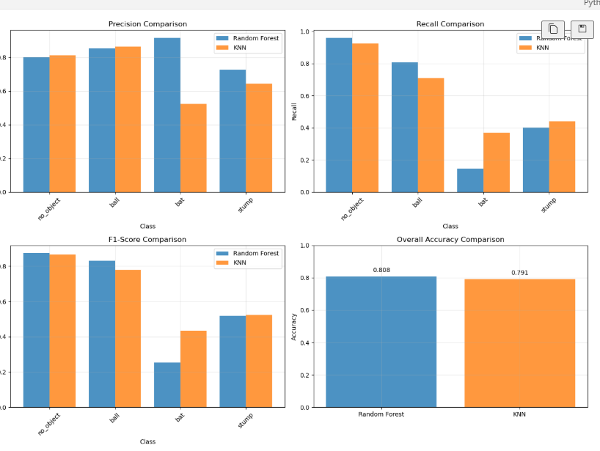
Model Compare Metrics – Random Forest Vs KNN

Slide 10
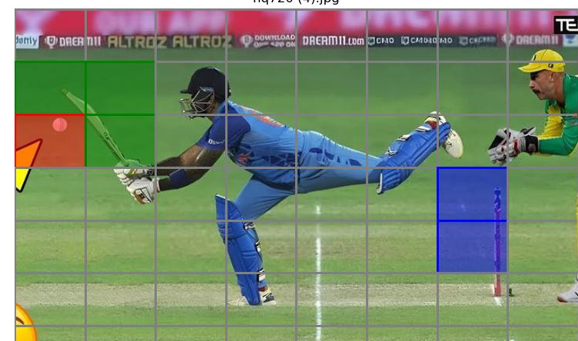
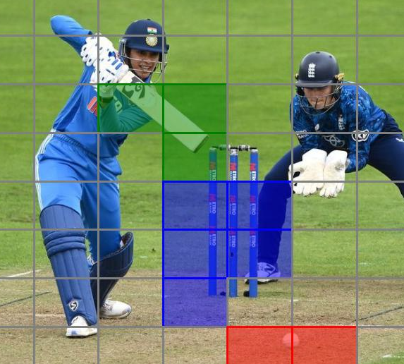
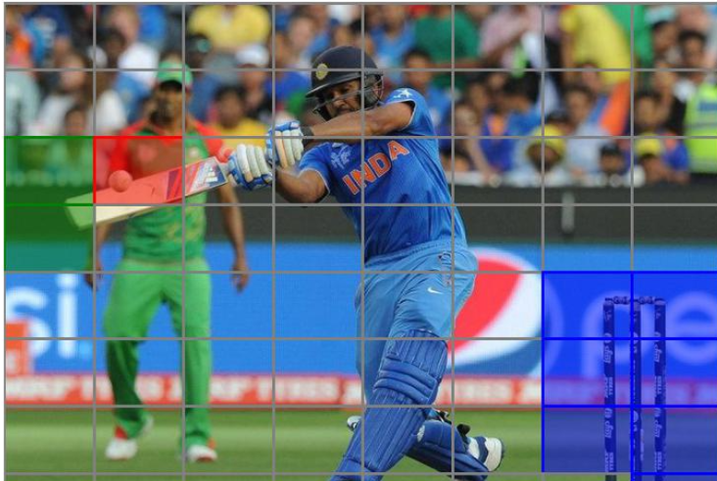
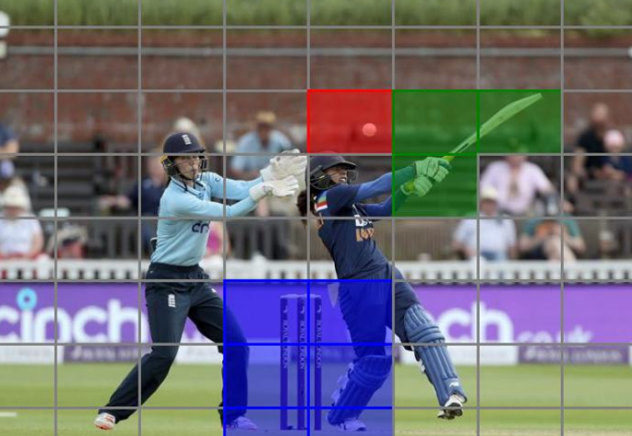
Visualizations
Predicted cell labels are displayed with colored rectangles representing different objects for
clear model interpretation.
Notes:
Visualization is a cornerstone of this project, enabling intuitive interpretation of model predictions and performance. Predicted cell labels were overlaid on images using colored rectangles: gray for no_object, red for ball, green for bat, and blue for stump. These overlays provide a clear visual representation of how well the models identify objects within grid cells. Comparative visualizations were created for three images per model, allowing side-by-side analysis of Random Forest and KNN outputs. Additionally, bar charts summarizing evaluation metrics such as precision, recall, F1-score, and accuracy were included to complement qualitative assessments with quantitative data. These visual tools not only aid in debugging and refining models but also enhance communication of results to stakeholders, making complex data more accessible and actionable.

Slide 11
Learnings and Challenges
Importance of Annotation and Preprocessing
Consistent annotation and preprocessing are critical to achieving reliable model performance and avoiding accuracy drops.
Effective Feature Engineering
Techniques like HOG and grayscale features improve classical machine learning model accuracy through thoughtful selection.
Model Comparison and Trade-offs
Comparing Random Forest and KNN reveals trade-offs between accuracy and computational speed for model selection.
Visualization and Challenges
Visualization aids debugging and understanding, while annotation complexity and scalability remain key challenges.
Notes:
Several key learnings emerged from this project. First, consistent annotation and preprocessing are critical for achieving reliable model performance; inconsistencies can lead to significant drops in accuracy.
Second, feature engineering using techniques like HOG and grayscale proved highly effective for classical machine learning models, underscoring the importance of thoughtful feature selection.
Third, while aggregated features can support image-level tasks, cell-level features are essential for fine-grained classification. The comparison between Random Forest and KNN highlighted trade-offs between accuracy and computational speed, informing decisions about model selection based on project constraints.
Finally, visualization was invaluable for debugging and understanding model behavior, reinforcing its role as a best practice in machine learning workflows.
Challenges included managing annotation complexity and ensuring scalability for larger datasets, which could be addressed through automation and optimized pipelines in future iterations.

