Slide 1
EDA on Netflix Movies and TV Shows Dataset
Uncovering content trends in Movies and TV Shows

Slide 2
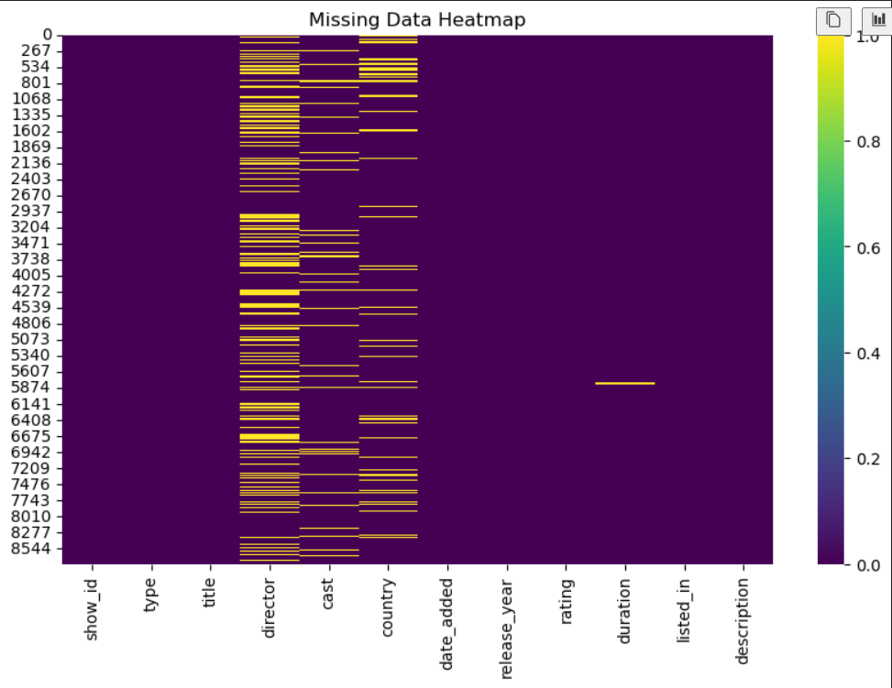
Missing Data Heatmap
This slide visualizes missing data in the Netflix dataset using a heatmap. Space below for plot and corresponding code.
[Space for Plot]
[Space for Corresponding Code]
Code:
plt.figure(figsize=(10,6))
sns.heatmap(df.isnull(),cmap='viridis')
plt.title('Missing Data Heatmap')
plt.show()

Slide 3
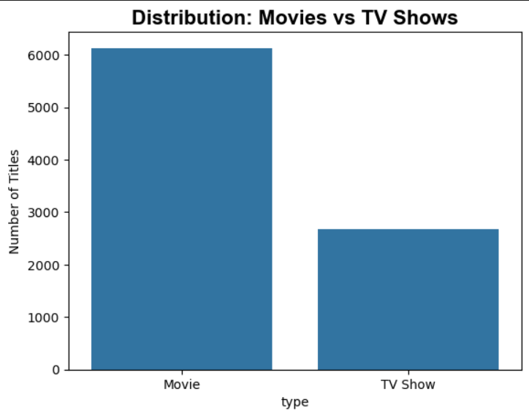
Movies vs TV Shows Distribution
This slide shows the count of total movies and TV shows on Netflix. Space below for plot and corresponding code.
[Space for Plot]
[Space for Corresponding Code]
Key insight:
Movies dominate over TV Shows on Netflix.

Slide 4
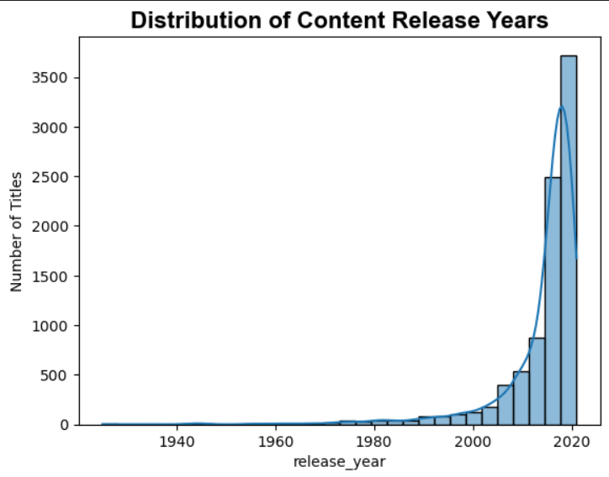
Content Release Years Distribution
This slide displays the distribution of content release years. Space below for plot and corresponding code.
[Space for Plot]
[Space for Corresponding Code]
Key insight:
Content additions increased sharply after 2015.

Slide 5
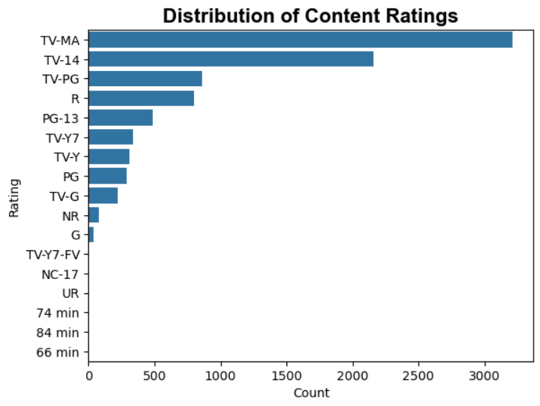
Content Ratings Distribution
This slide visualizes the distribution of ratings. Space below for plot and corresponding code.
[Space for Plot]
[Space for Corresponding Code]
Key insight:
Most content is rated for mature or teen audiences (TV-MA, TV-14).

Slide 6
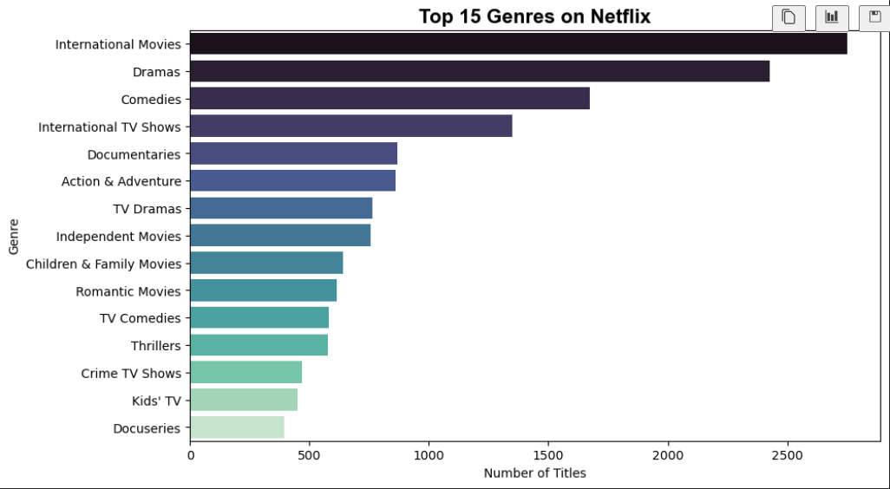
Top 15 Genres on Netflix
This slide shows the top 15 genres available on Netflix. Space below for plot and corresponding code.
[Space for Plot]
[Space for Corresponding Code]
Key insight:
Drama, Comedy, and Documentaries are the most popular genres.

Slide 7
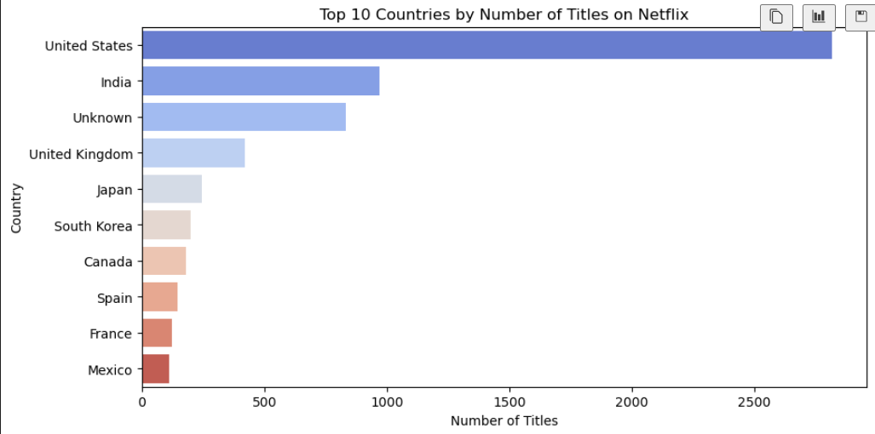
Top 10 Countries by Number of Titles
This slide presents the top 10 countries contributing titles on Netflix. Space below for plot and corresponding code.
[Space for Plot]
[Space for Corresponding Code]
Key insight:
The United States and India are top contributors to Netflix content.

Slide 8
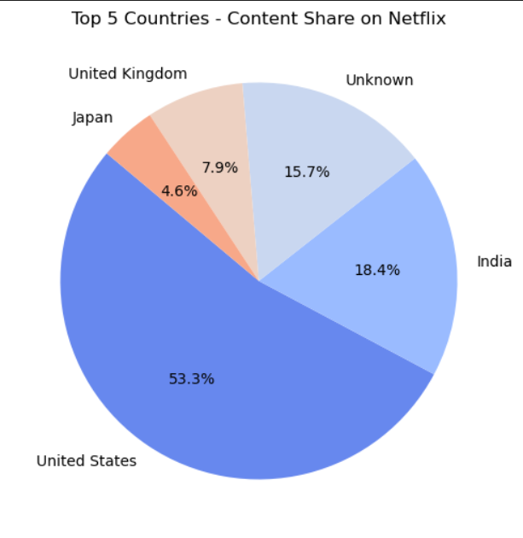
Top 5 Countries Content Share
This slide shows the top 5 countries’ share of Netflix content using a pie chart. Space below for plot and corresponding code.
[Space for Plot]
[Space for Corresponding Code]
Key insight:
The USA has the top-most content share on Netflix, while India follows USA as having the second-most content share on Netflix.

