Slide 1

Student Performance Prediction Through Multiple Linear Regression

Slide 2
PROJECT MENTOR Abdullah Al Kafi LECTURE DEPT. OF CSE DAFFODIL INTERNATIONAL UNIVERSITY
TEAM MEMBERS
Maisha Alam_221-15-5668
Abdullah Al Mamun Sheikh_221-15-5530
Md. Merajul Alam Meraj_221-15-5632
Md. Likhon Bhuiyan_ 221-15-5966

Slide 3
Table of contents
01
02
03
04
Introduction
Methodology
Visualizations
Experimental Results
05
Discussion
06
Conclusion

Slide 4
01
4
Introduction
This study focuses on predicting student performance to help improve teaching and learning. It uses Multiple Linear Regression (MLR) to find the most important factors, like study hours, sleep, extracurricular activities and previous marks. By analyzing data from the model identifies which factors affect performance the most, helping institutions take better measures to support students.

Slide 5
02
Dataset & Features
5
Dataset:
The dataset used for this project contains information from 10,000 students
Features:
Hours Studied
Previous Scores
Sleep Hours
Performance Index
Extracurricular Activities

Slide 6
02
Methodology
6
Model
The equation for Multiple Linear Regression is:
Y = 𝜷₀ + 𝜷₁X₁ + 𝜷₂X₂ +......+ 𝜷pXp + Ɛ
Where,
Y is the output variable, also called response and dependent variable.
Xi (i = 1, 2, 3…p) is the independent variable.
𝜷₀ is the value of Y when independent variable are 0.
𝜷ⱼ (j = 1, 2, 3…p) are the regression coefficients.
Ɛ is a random error in the mode.

Slide 7
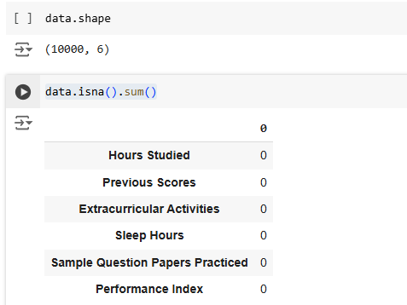
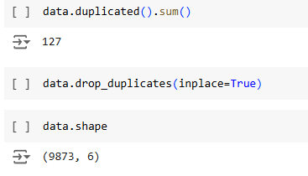
02
Methodology Cont.
7
Null Value Checked
Duplicate Value Removed

Slide 8
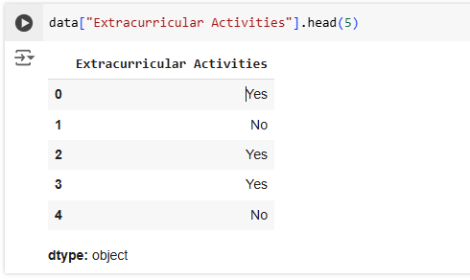
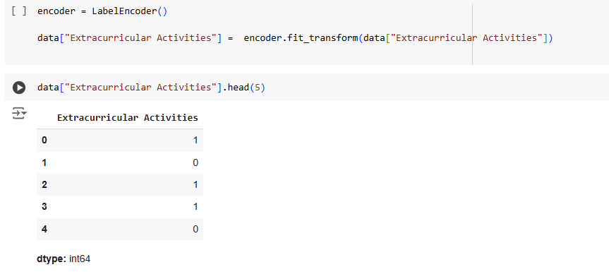
02
Methodology Cont.
8
Label Encoding
The column "Extracurricular Activities" has categorical values like "Yes" and "No".
Label Encoding assigns a unique numerical code to each category.
Here, "Yes" becomes 1 and "No" becomes 0.

Slide 9
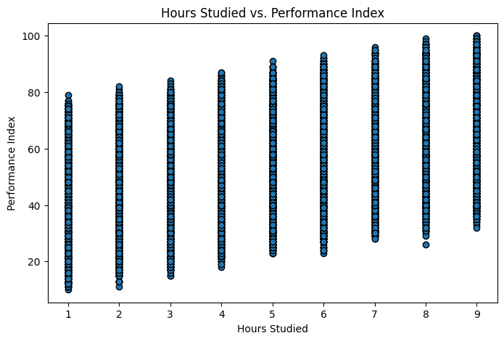
03
Visualizations
9
This scatter plot shows the connection between hours studied and performance.
X-axis: Hours studied (1 to 9).
Y-axis: Performance index (0 to 100).
Suggests that studying more hours generally provides more value to the performance index but the difference between the study hours is very little.

Slide 10
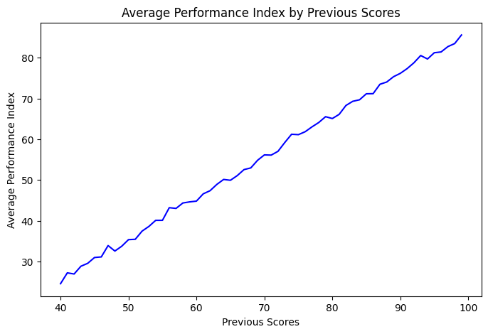
03
Visualizations Cont.
10
This line graph shows the relationship between Previous Scores (x-axis) and Average Performance Index (y-axis).
Demonstrates a clear positive trend.
As Previous Scores increase, the Performance Index also rises steadily.
Suggests that past academic performance is a significant factor in predicting future performance.

Slide 11
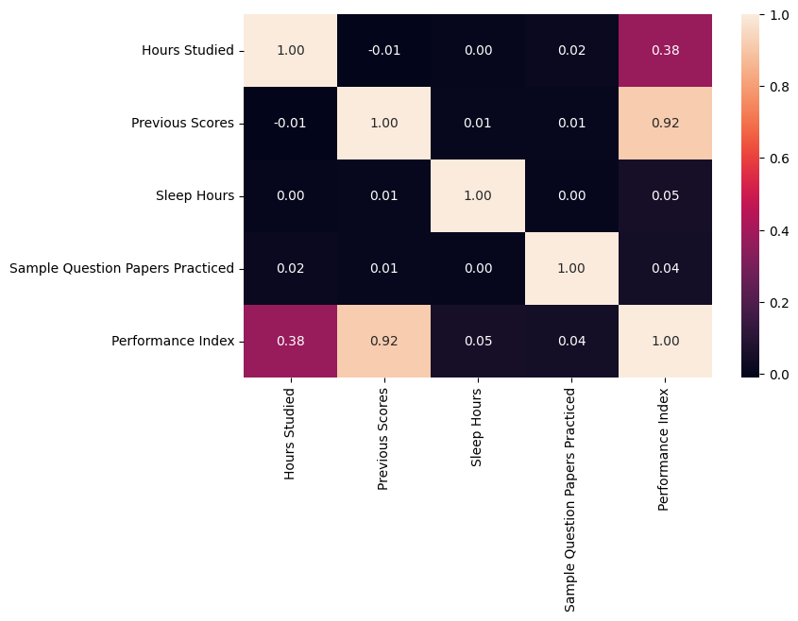
03
Visualizations Cont.
11
This Correlation Matrix is a visual representation of the correlations between every variables.
Highest correlation: Previous Score and Performance Index (0.92), showing that higher past scores strongly boost performance.
Moderate correlation: Hours Studied and Performance Index (0.38).
Weak correlations: Sleep Hours (0.05). Sample Questions Practiced (0.04).

Slide 12
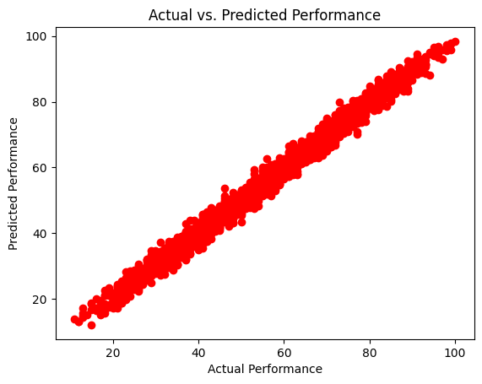
04
Experimental Results
12
The Scatter Plot compares actual and predicted values of the regression model.
The scatter plot compares actual (x-axis) and predicted performance (y-axis).
The plot shows a strong positive correlation, meaning the predictions closely match the actual values.
As the actual performance increases, the predicted performance also tends to increase.

Slide 13
04
Experimental Results Cont.
13
Model Evaluation
Mean Absolute Error (MAE): 1.6469 which means the average absolute difference between the actual and predicted value is 1.6469.
R-squared (R²): 0.9884 which indicates the model explains 98.84% of the variation in the target variable based on the input features.
Intercept: -33.9813. If all input features are zero, the predicted performance would be -33.9813.

Slide 14
05
Discussion
14
Good Fit (High R-squared and Low MAE): The model works well because it explains most of the data (high R-squared) and the predictions are almost accurate (low MAE).
Feature Importance (Coefficients): The coefficients show which features are most important in making predictions. Larger values mean those features have a bigger impact.
Accuracy: The scatter plot shows that the predicted values are close to the actual ones, which means the model is accurate.

Slide 15
06
Conclusion
15
Key features:
Most significant: Previous Scores and Study Hours.
Least significant: Sleep Hours and Sample Papers.
Future Work:
Explore additional datasets with different features.
Compare MLR with other models like Decision Trees, Neural Networks.

Slide 16
Thank You!
Any questions?

