Slide 1

Project Management 101: GitHub
By: Stephanie Honore`
MS Computer Science Candidate
November 1, 2016

Slide 2
What the Heck is GitHub Anyways?

Slide 3
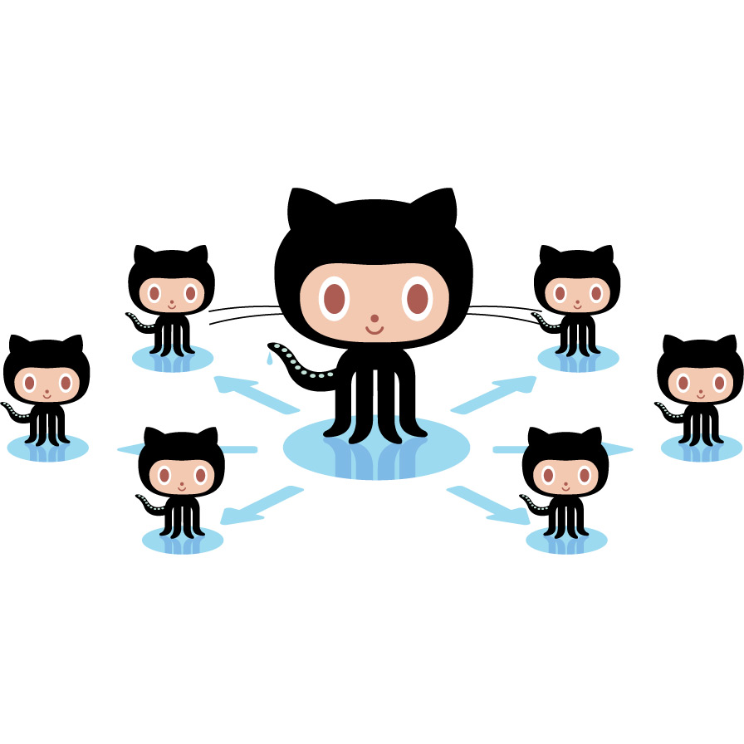
How Does it Work?
Master Branch
Child Branches

Slide 4
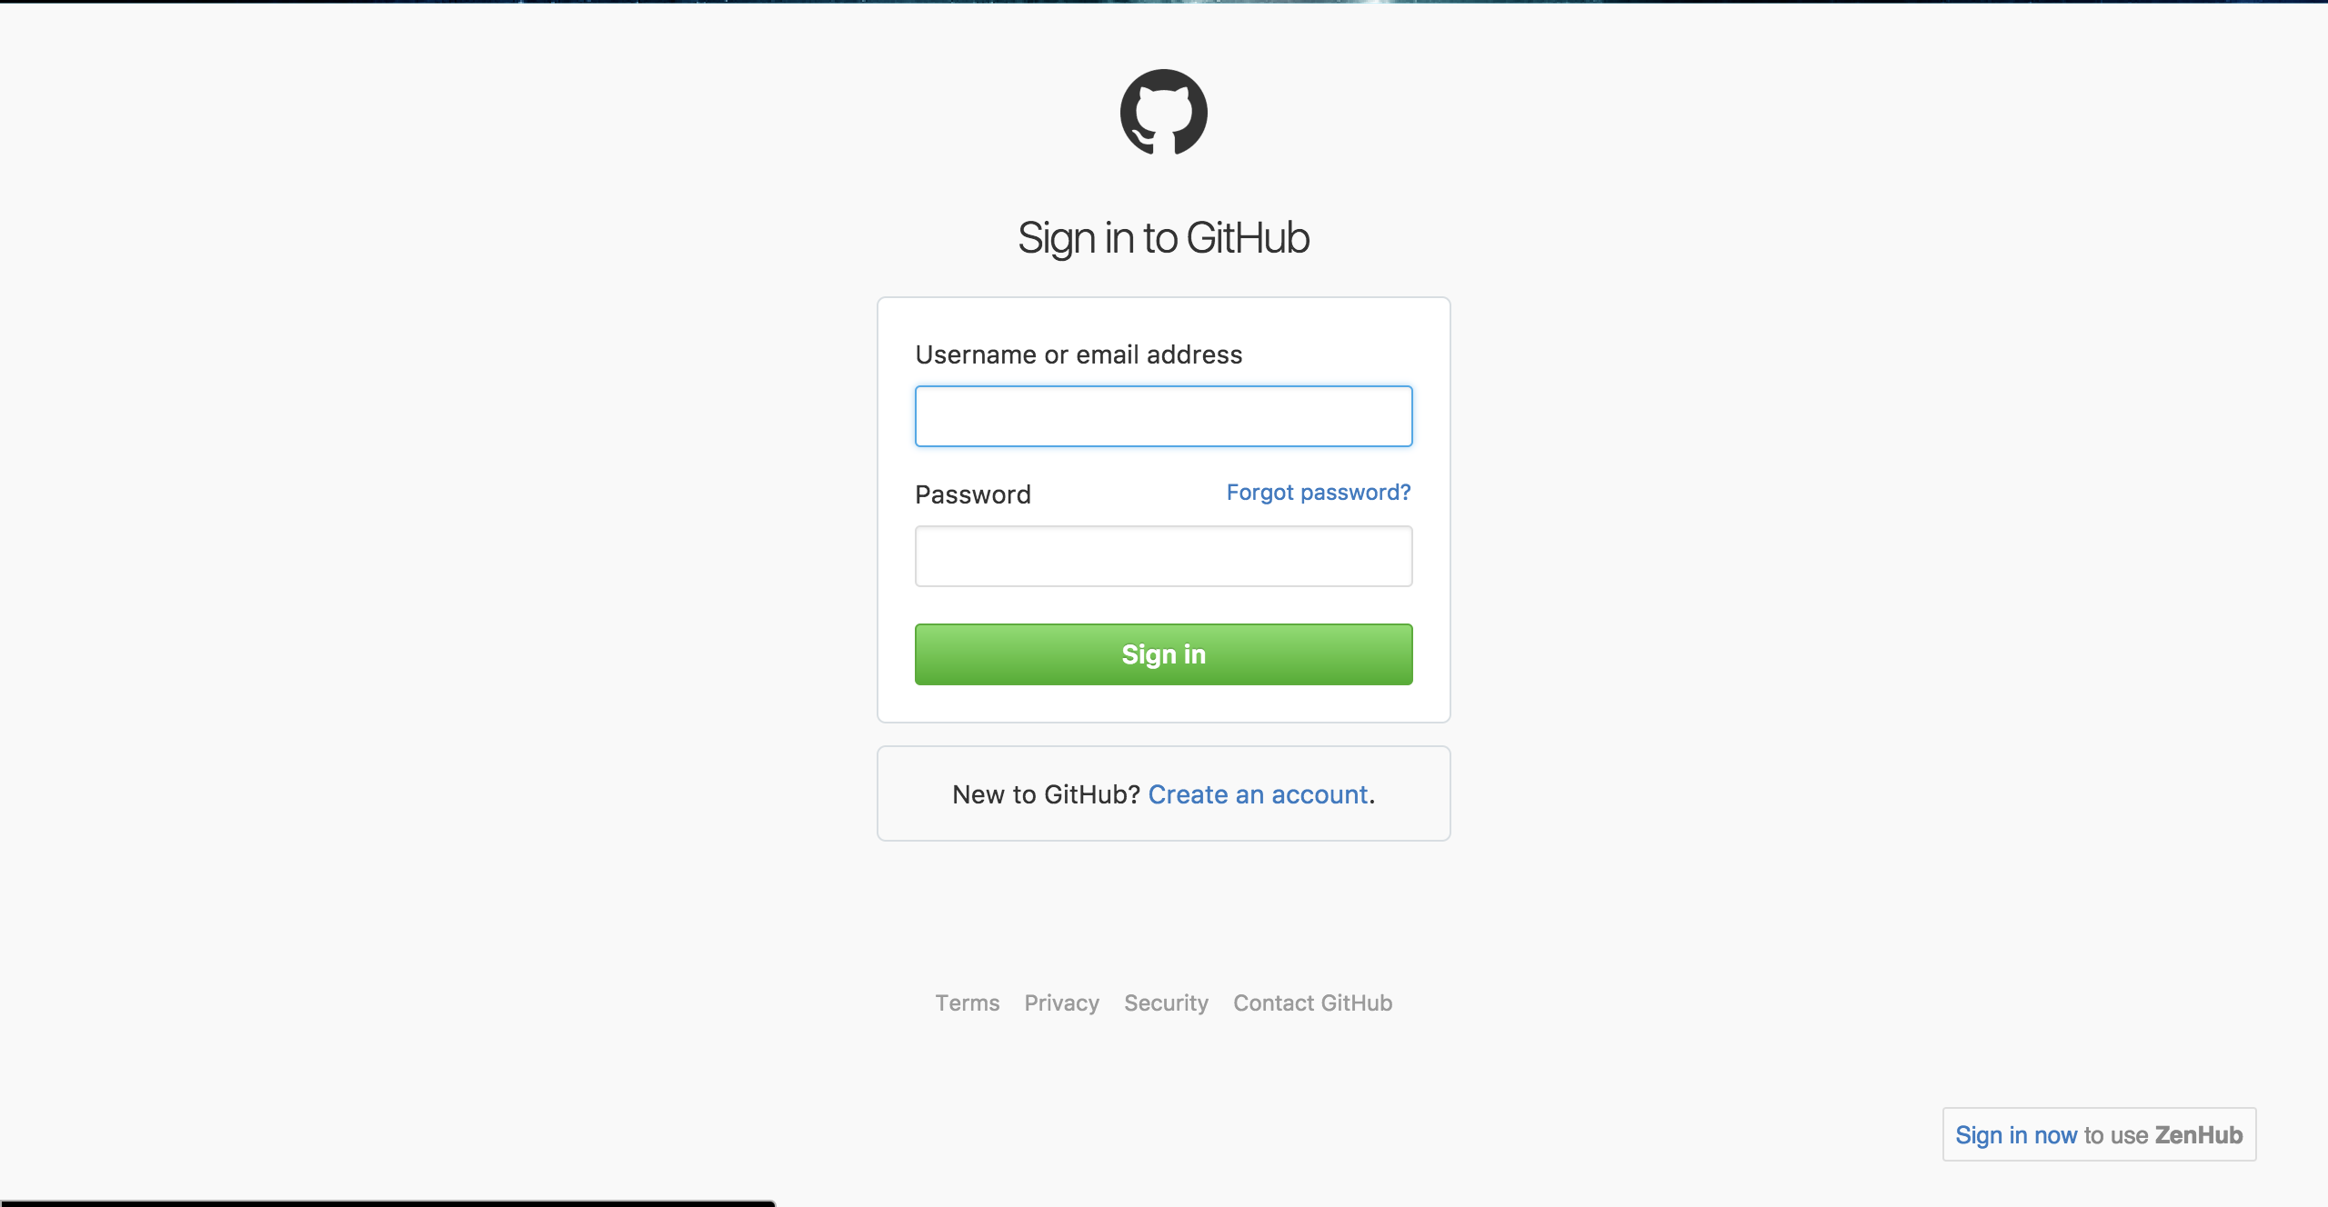
Getting Started
Go to GitHub’s website: https://github.com/
Create a GitHub account (if you don't already have one) and login.

Slide 5
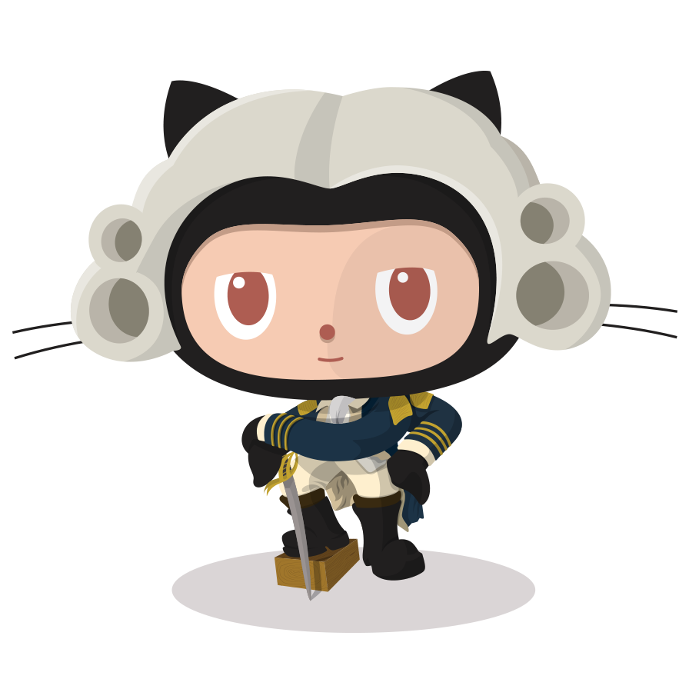
Using the Terminal
You enter git commands through the terminal and that updates your project files on the GitHub website:
Open the terminal
Enter the path of your project folder
Use the “git clone” command to clone the repository from the website to your local machine

Slide 6
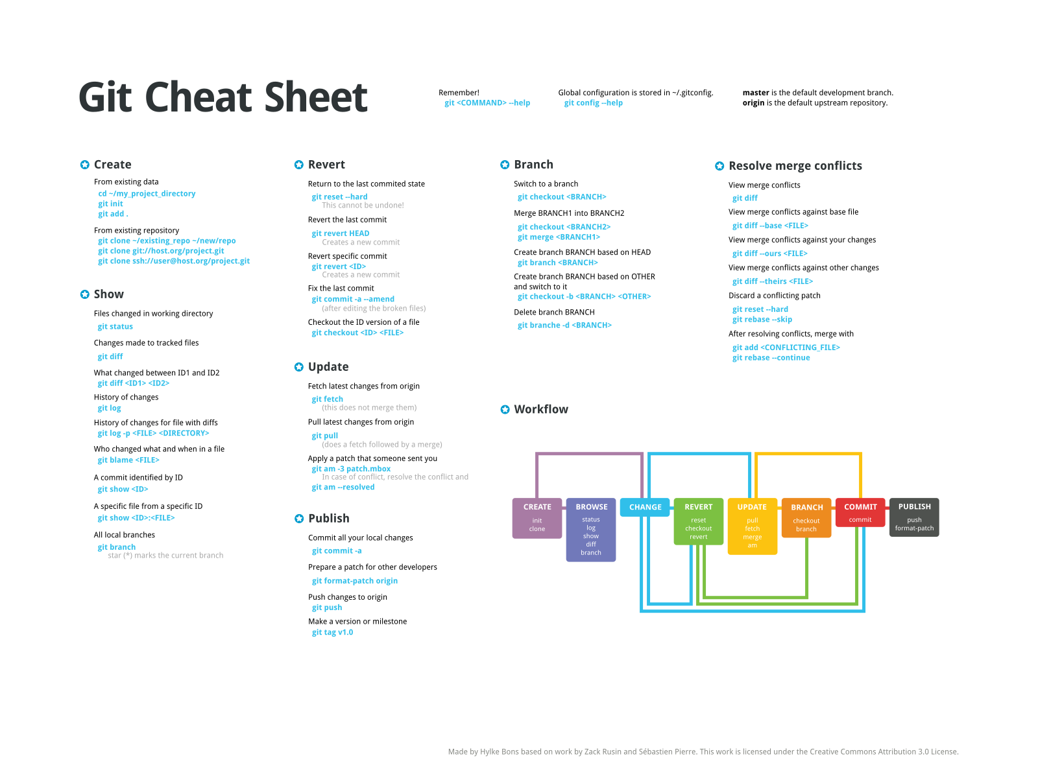

Slide 7
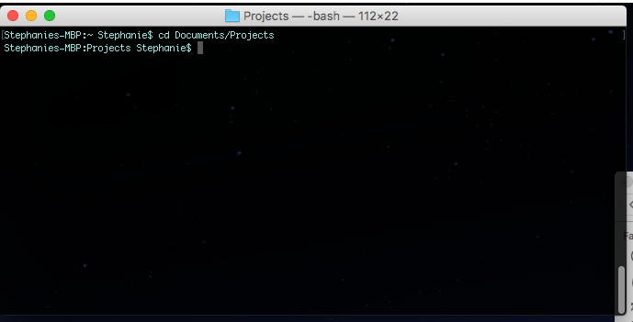
Navigate to Project Folder

Slide 8
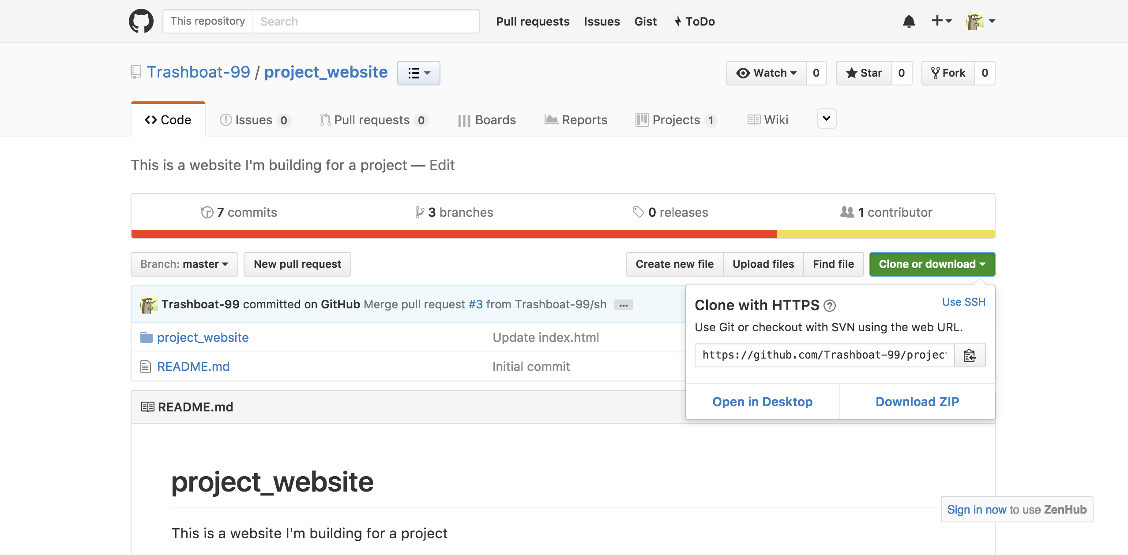
Clone the Repository (with HTTPS) to Your Project Folder

Slide 9

Or Clone with SSH

Slide 10
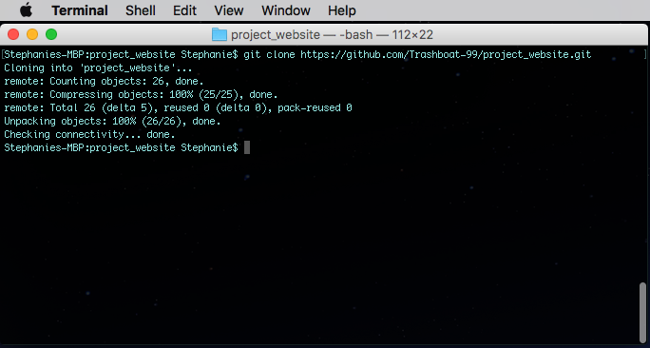
Enter “git clone” in Terminal Window

Slide 11
Changing to Your Branch
When collaborating with others, it is essential that you switch to your branch before you make any changes!
This is to ensure that you do not compromise the contents of the repository with erroneous changes.

Slide 12
Branching Steps
Create a new branch with the command, “git checkout -b”
Enter the command, “git branch” to view your current branch.

Slide 13
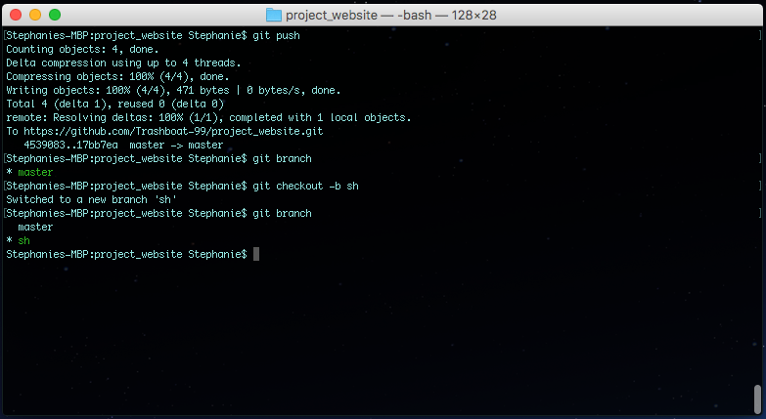

Slide 14
Committing Changes
When you change a file on your local machine you have to do 3 main things in order to update the repository.
Change file in text editor
Stage the changes files with “git add” command
Commit the files with the “git commit” command
Push the changes to the repository to be reviewed with the “git push” command.
Review “Pull Request” on GitHub site
Commit changes to the master branch

Slide 15
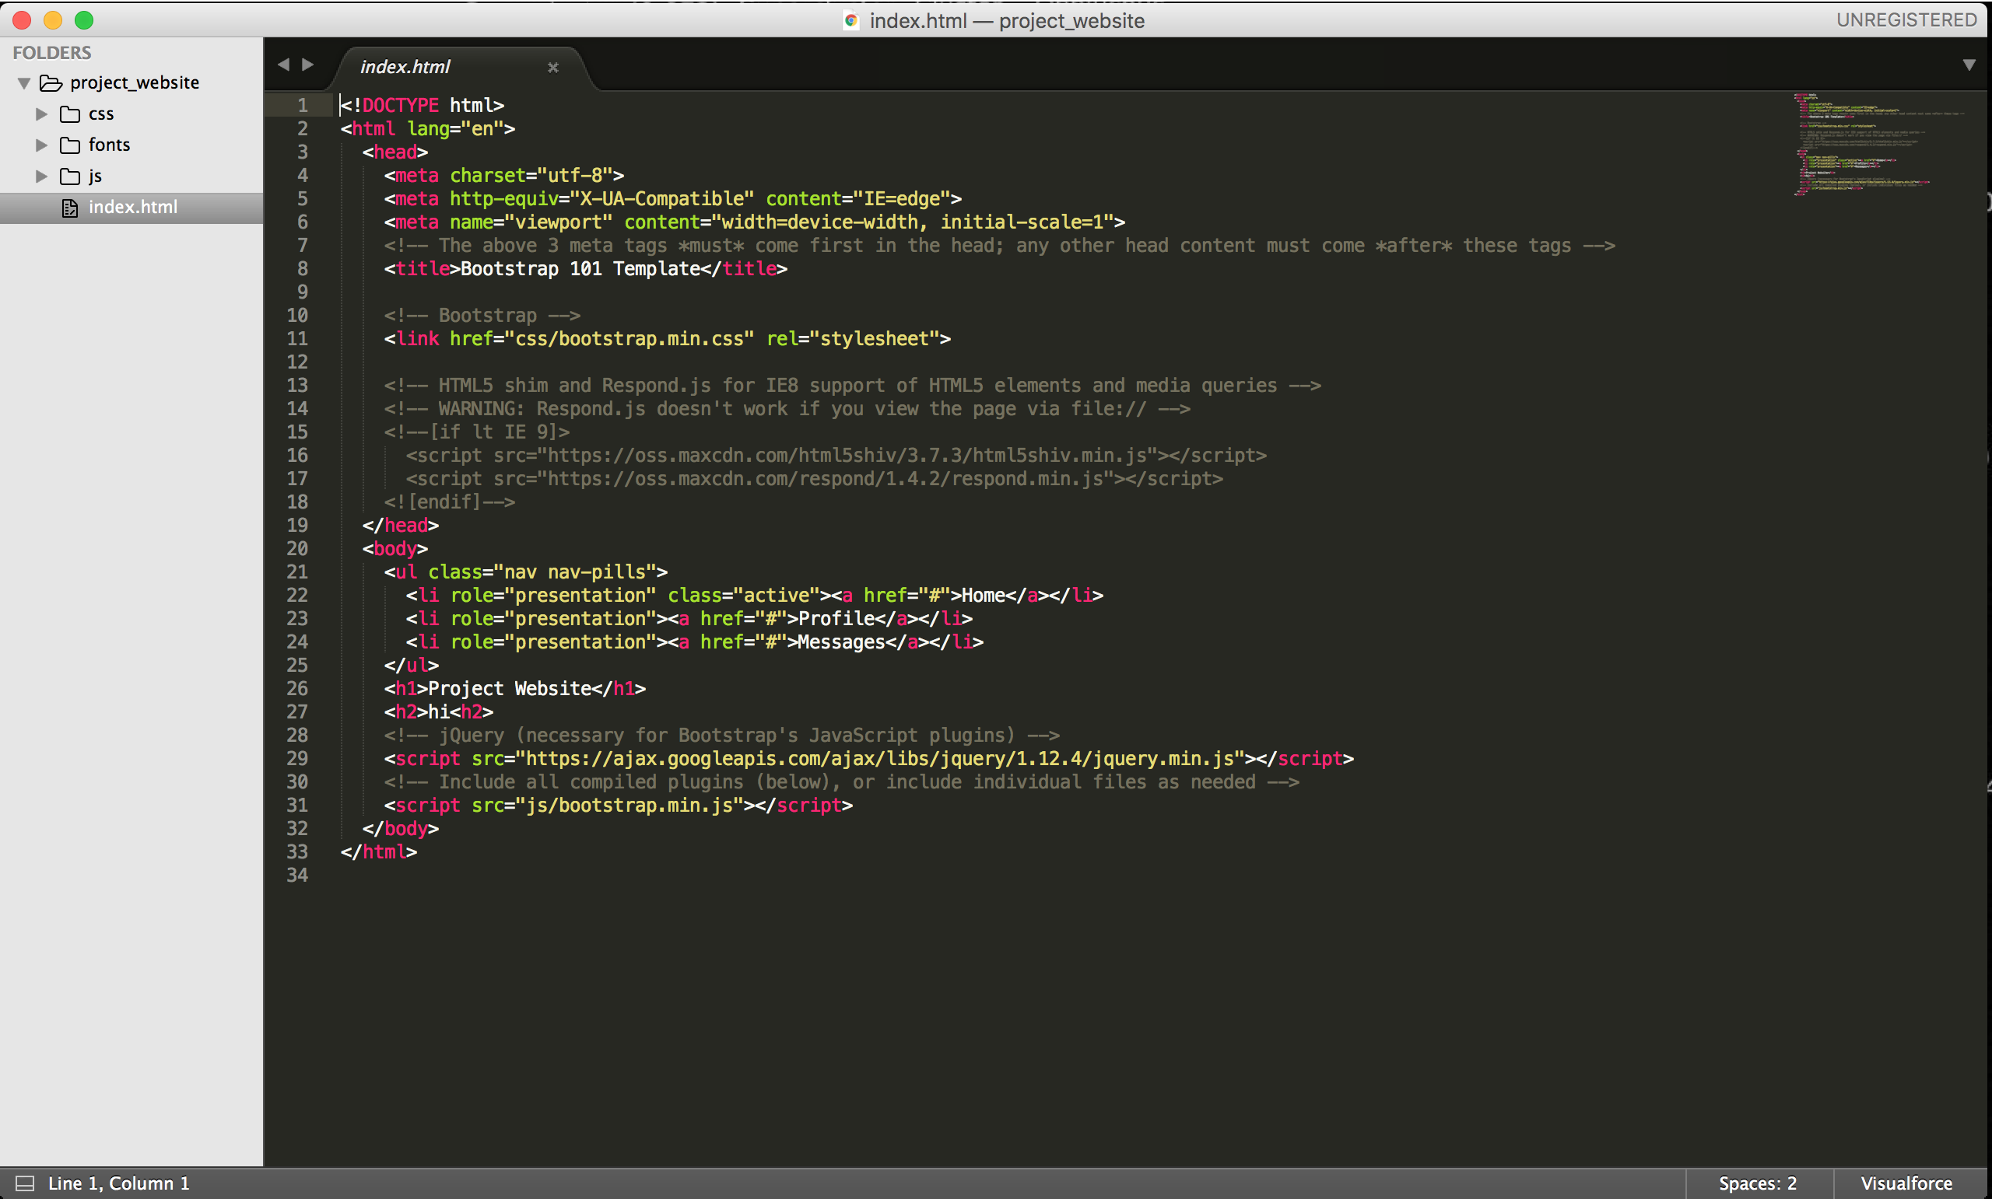
Change File in Text Editor

Slide 16
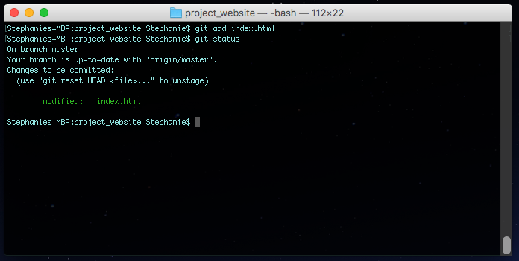
Staging Files

Slide 17
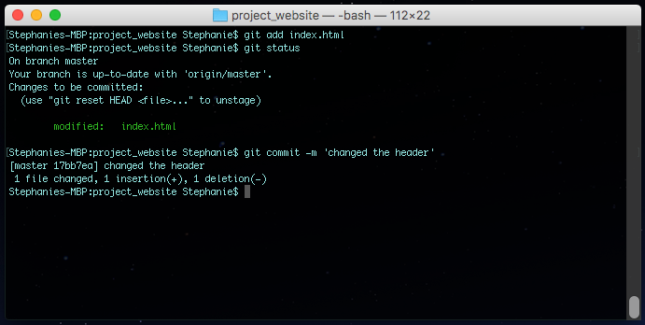
Committing Files

Slide 18
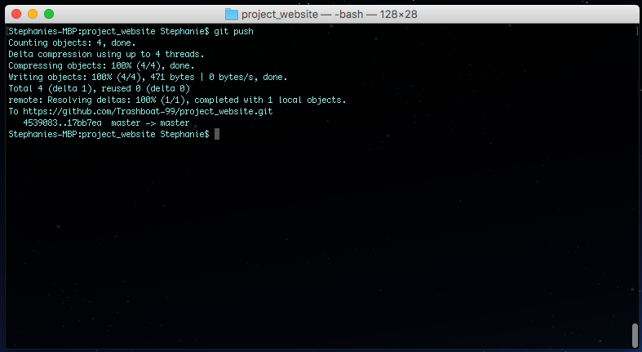
Pushing to Repository

Slide 19
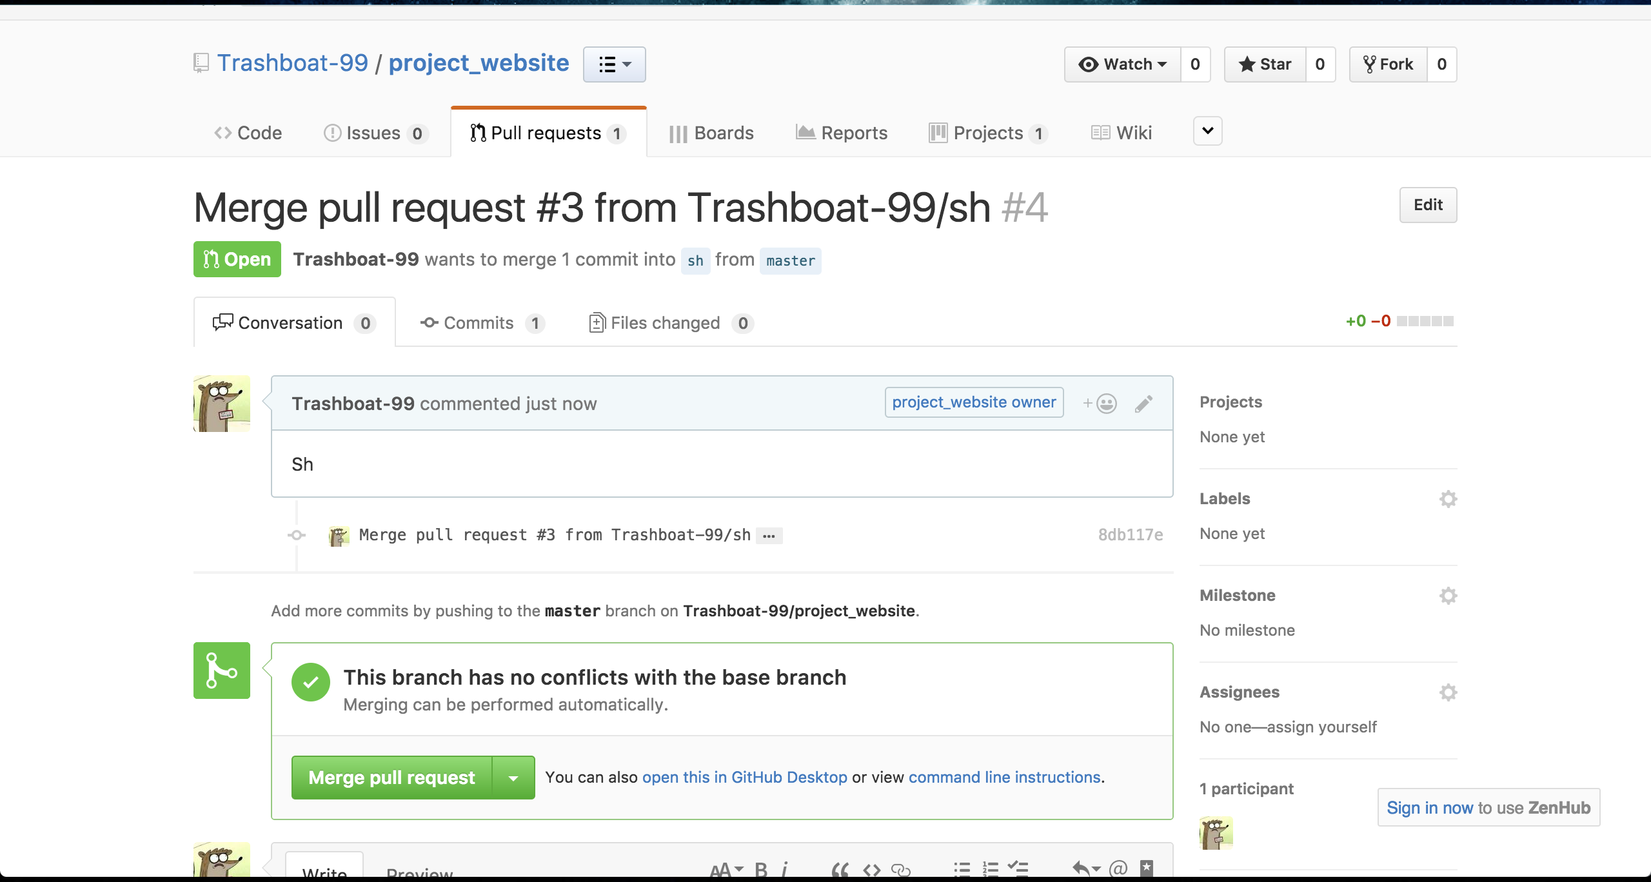
Review Pull Request

Slide 20
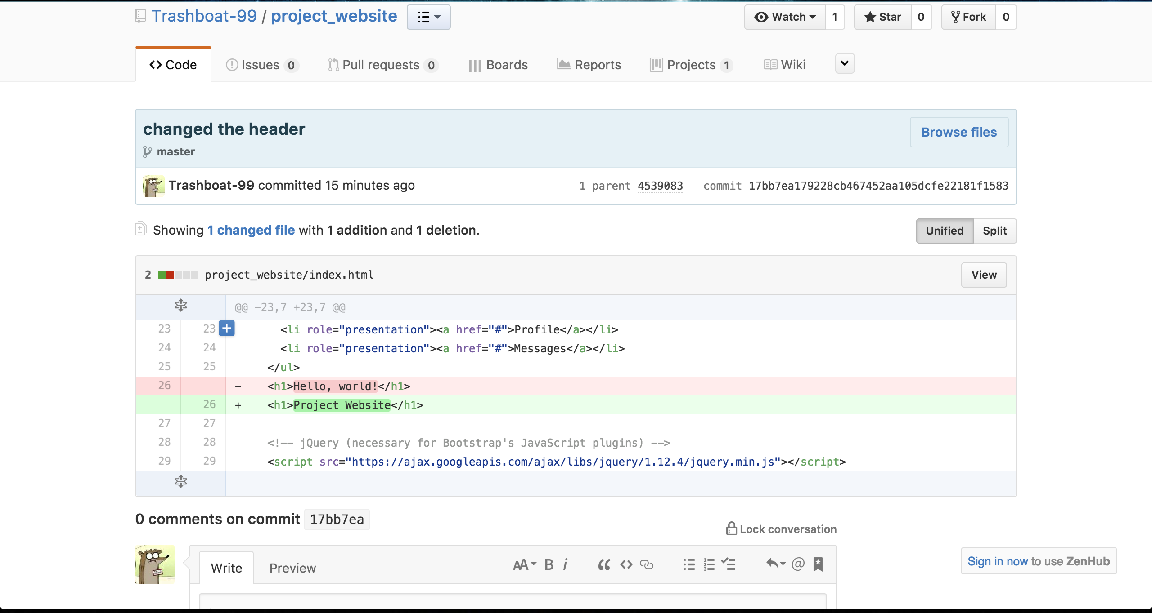

Slide 21
Using the Desktop App
There also exists a GitHub Desktop app that you can download from the App Store.You can sign in to GitHub from here and use this instead of the terminal

Slide 22
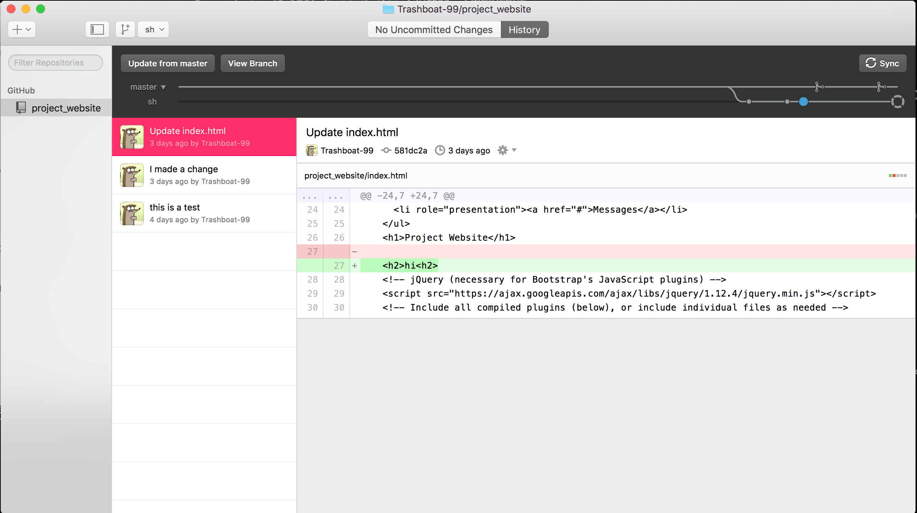

Slide 23
Using Agile for Project Management
In project management you use a technique called Agile.
This process is iterative, where you are doing just enough Planning, Building, and, Testing, to bring the project up for review and possible deployment. This is called a Sprint.
At the end of the Sprint you release the partially complete project and then start another iteration to continue making updates to that project over time.

Slide 24
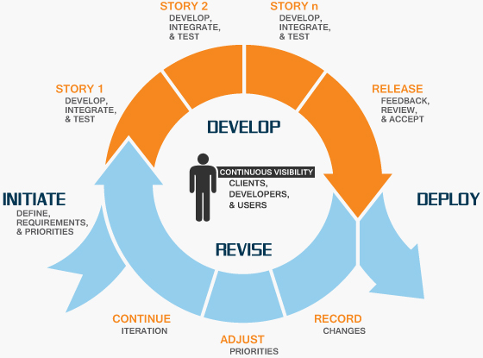
The Agile Method. Everyone is Doing It

Slide 25

A Little Something Called Zenhub
There and a GitHub extension called Zenhub that can be used to organize and manage tasks for a project.
You create issues and assign them to a collaborator on a project. You can then track the progress of your project on the Kanban Board.

Slide 26
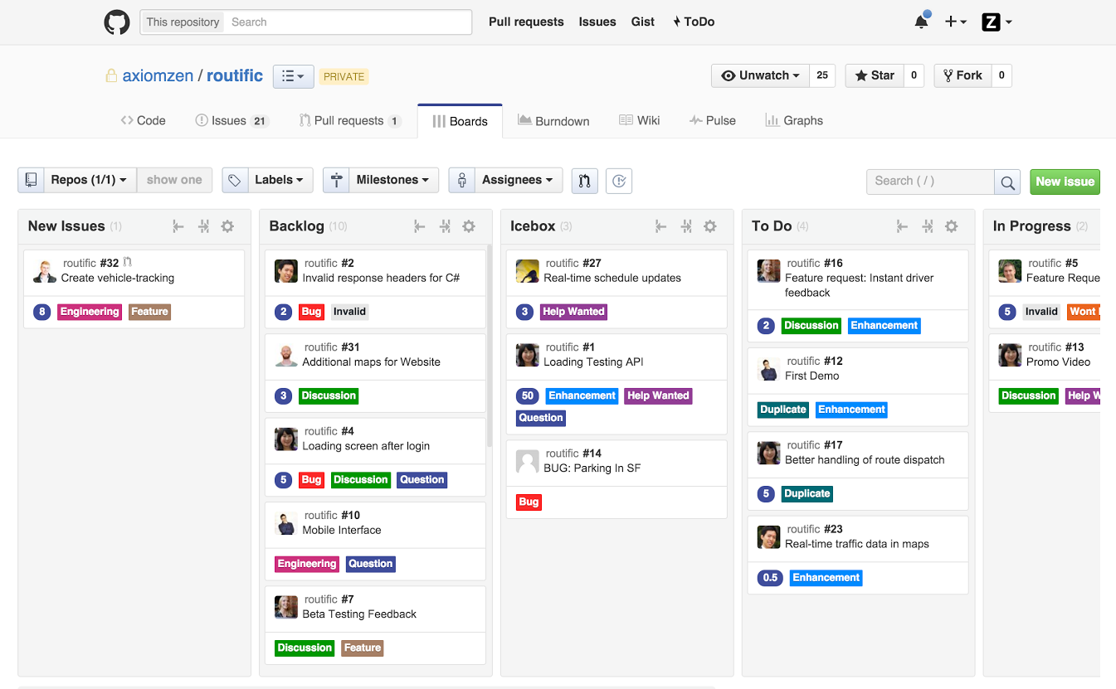

Slide 27
Questions?

Slide 28
Resources
Things you need:
https://github.com/
https://www.zenhub.com/
GitHub tutorial:
https://try.github.io/levels/1/challenges/1
Agile Tutorial:
https://www.youtube.com/watch?v=9TycLR0TqFA

