Slide 1
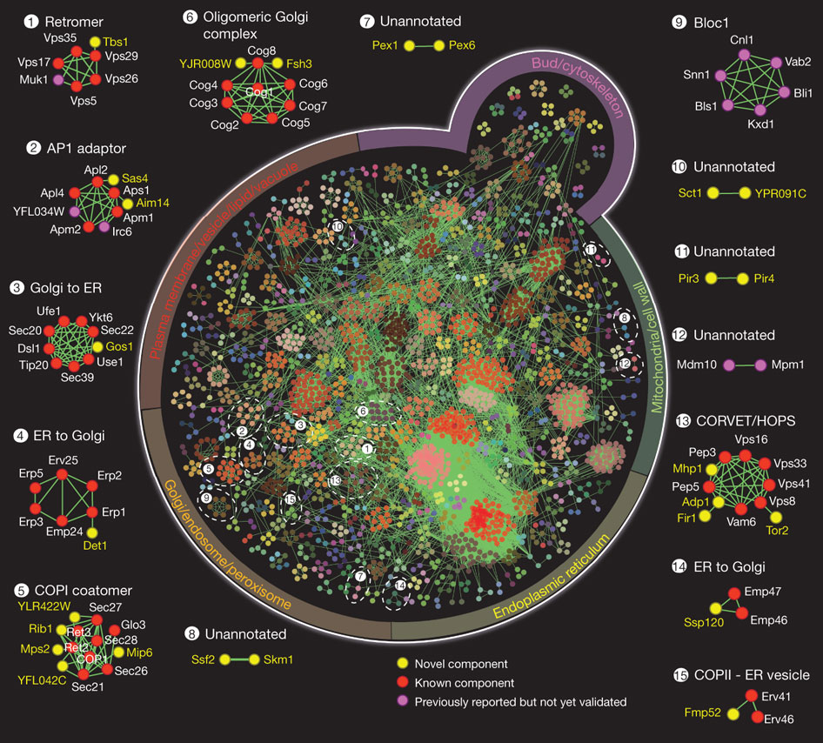

Global organization of yeast MP complexes.
Mohan Babu et al. Nature 000, 1-5 (2012) doi:10.1038/nature11354

