Slide 1
Course 1 Introduction to Formal Languages and Automata Theory (part 1)
The structure and the content of the lecture is based on http://www.eecs.wsu.edu/~ananth/CptS317/Lectures/index.htm

Slide 2
What is Automata Theory?
Study of abstract computing devices, or “machines”
Automaton = an abstract computing device
Note: A “device” need not even be a physical hardware!
A fundamental question in computer science:
Find out what different models of machines can do and cannot do
The theory of computation
Computability vs. Complexity

Slide 3
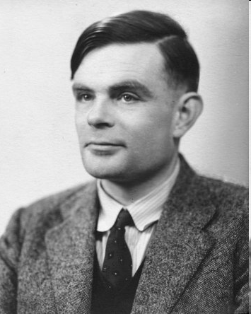
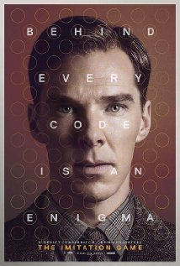
Alan Turing (1912-1954)
(A pioneer of automata theory)
Father of Modern Computer Science
English mathematician
Studied abstract machines called Turing machines even before computers existed
Heard of the Turing test?

Slide 4
Theory of Computation: A Historical Perspective
1930s
Alan Turing studies Turing machines
Decidability
Halting problem
1940-1950s
“Finite automata” machines studied
Noam Chomsky proposes the “Chomsky Hierarchy” for formal languages
1969
Cook introduces “intractable” problems or “NP-Hard” problems
1970-
Modern computer science: compilers, computational & complexity theory evolve

Slide 5
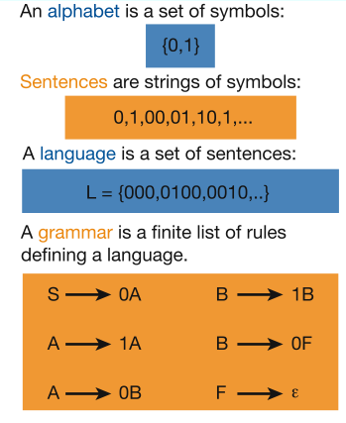
Languages & Grammars
Languages: “A language is a collection of sentences of finite length all constructed from a finite alphabet of symbols”
Grammars: “A grammar can be regarded as a device that enumerates the sentences of a language” - nothing more, nothing less
N. Chomsky, Information and Control, Vol 2, 1959
Or “words”
|00| = 2, l(1)=1
Image source: Nowak et al. Nature, vol 417, 2002

Slide 6
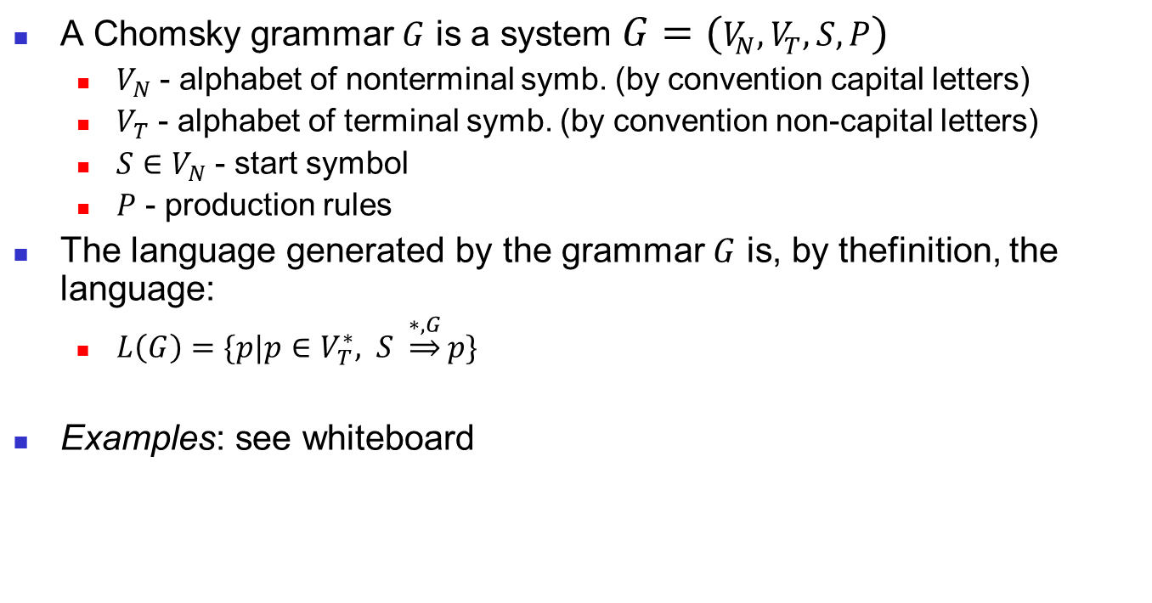
Grammars and languages
A Chomsky grammar $G$ is a system $G=(V_{N},V_{T},S,P)$
$V_{N}$ - alphabet of nonterminal symb. (by convention capital letters)
$V_{T}$ - alphabet of terminal symb. (by convention non-capital letters)
$S∈V_{N}$ - start symbol
$P$ - production rules
The language generated by the grammar $G$ is, by thefinition, the language:
$L\left(G\right)=\{p|p∈V_{T}^{∗}, S \underset{⇒}{∗,G}p\}$
Examples: see whiteboard

